Slide 1

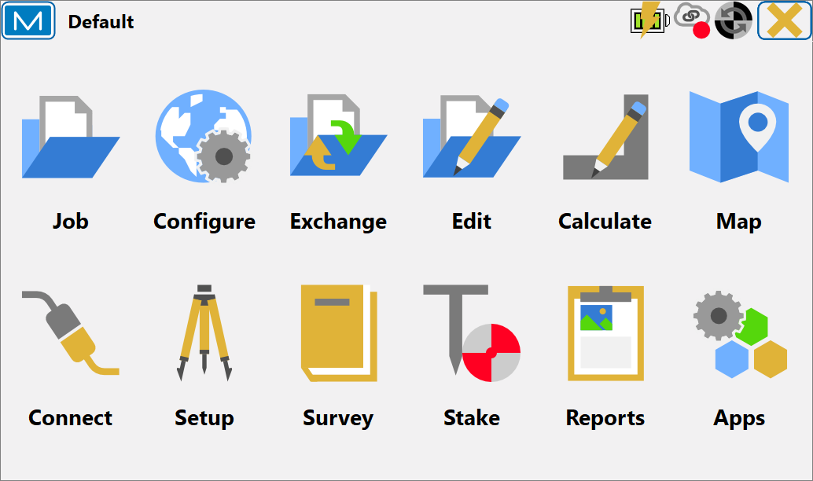

Topcon Magnet Field
March 2024

Slide 2
Topcon Magnet Field
Job
Configure
Exchange
Edit
Calculate
Map
Connect
Setup
Survey
Stake
Reports
Apps

Slide 3

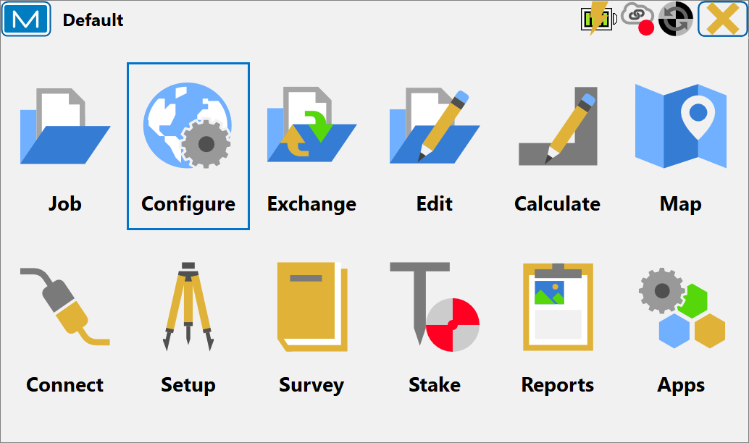
Topcon Magnet Field
Configure
Survey
Coord Sys
Global
Backup
Units
Display
Alarms
Stake Reports
Enterprise

Slide 4

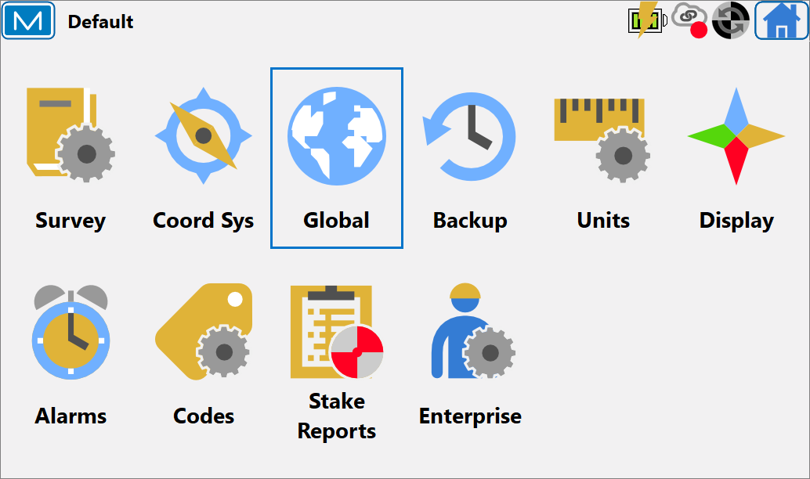
Topcon Magnet Field
Global
MAGNET Field software interface parameters and options applied through all the jobs.
Main Tab
Theme Tab
Job Tab
Shared Data Tab
Keyboard Tab

Slide 5
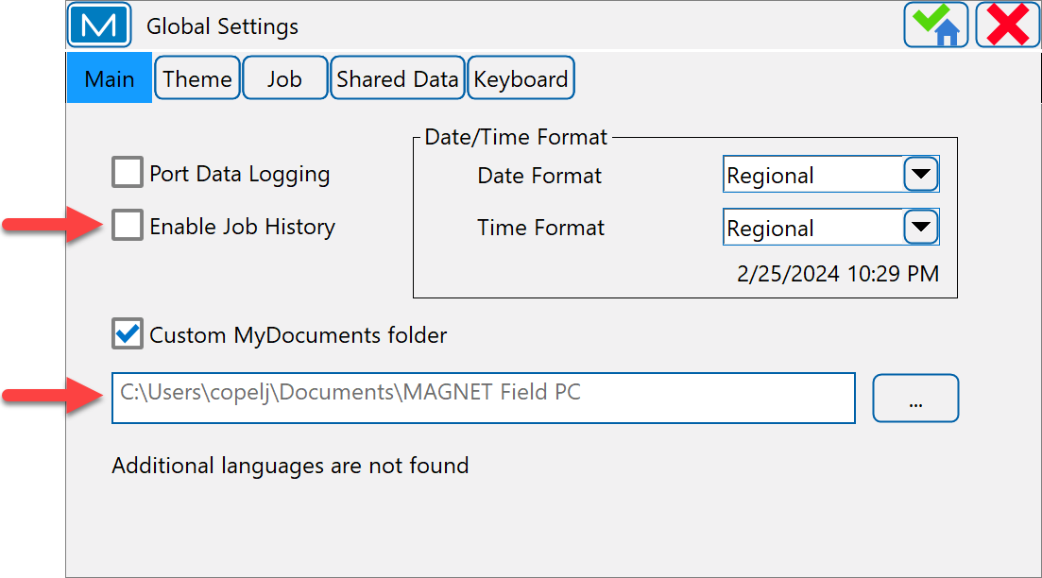
Topcon Magnet Field
Global Settings (Main)
Enable Job History
stores the field measurements on the job to the jobhistory.xml file.
Custom MyDocuments folder
defines the location of custom folder for data storage

Slide 6
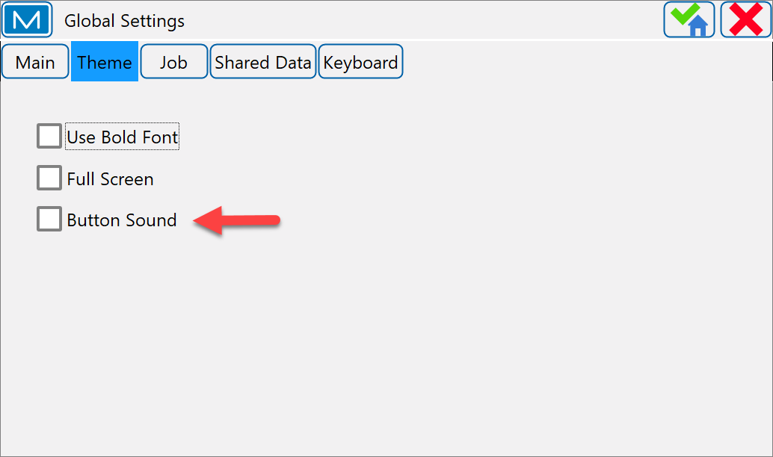
Topcon Magnet Field
Global Settings (Theme)
Use Bold Font check box to display the text in bold font style
Full Screen check box to switch in full screen mode.
Button Sound check box to enable sound effects when you click any functional button. (Deselecting “Button Sound” recommended)

Slide 7
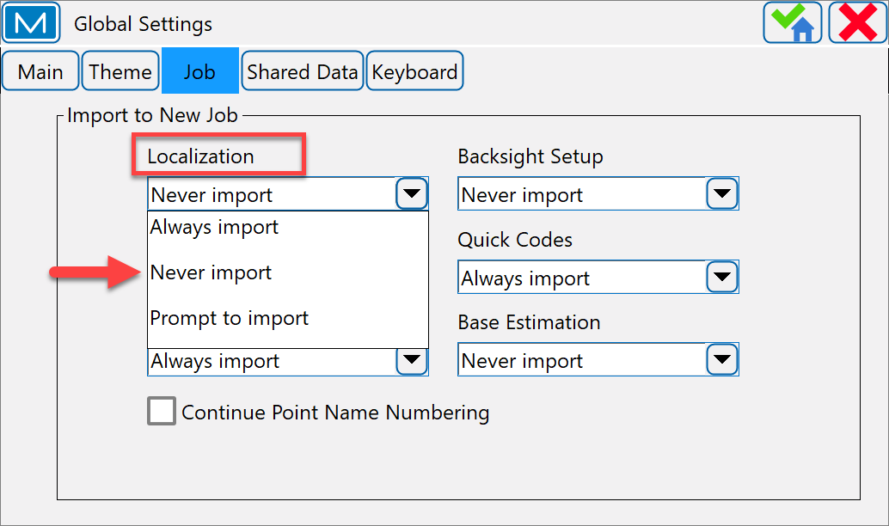
Topcon Magnet Field
Global Settings (Job)
Localization:
Select Never import to create new jobs without importing localization.
Select Always import to automatically import localization.
Select Prompt to import to choose every time if you want to import localization.

Slide 8
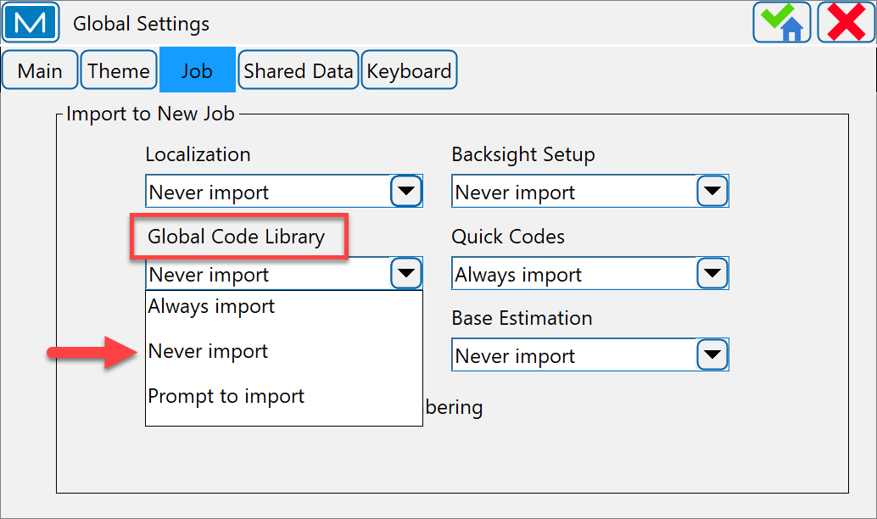
Topcon Magnet Field
Global Settings (Job)
Global Code Library:
Select Never import to create new jobs without importing global codes.
Select Always import to automatically import global codes.
Select Prompt to import to choose every time if you want to import global codes.

Slide 9
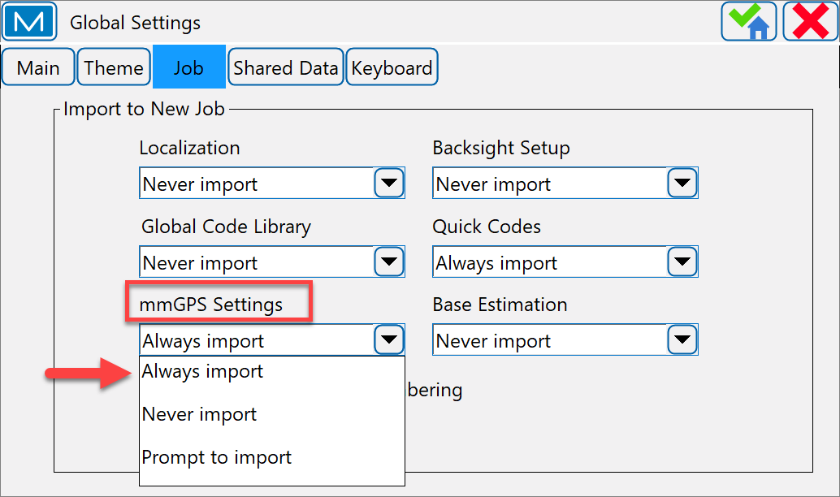
Topcon Magnet Field
Global Settings (Job)
mmGPS Settings:
Select Never import to create new jobs without importing mmGPS settings.
Select Always import to automatically import mmGPS settings.
Select Prompt to import to choose every time if you want to import mmGPS settings.

Slide 10
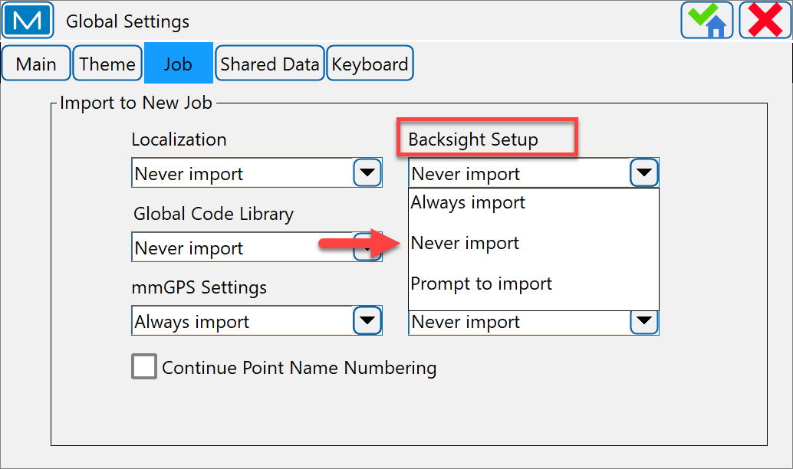
Topcon Magnet Field
Global Settings (Job)
Backsight Setup:
Select Never import to create new jobs without importing backsight setup settings.
Select Always import to automatically import backsight setup settings.
Select Prompt to import to choose every time if you want to import backsight setup settings.

Slide 11
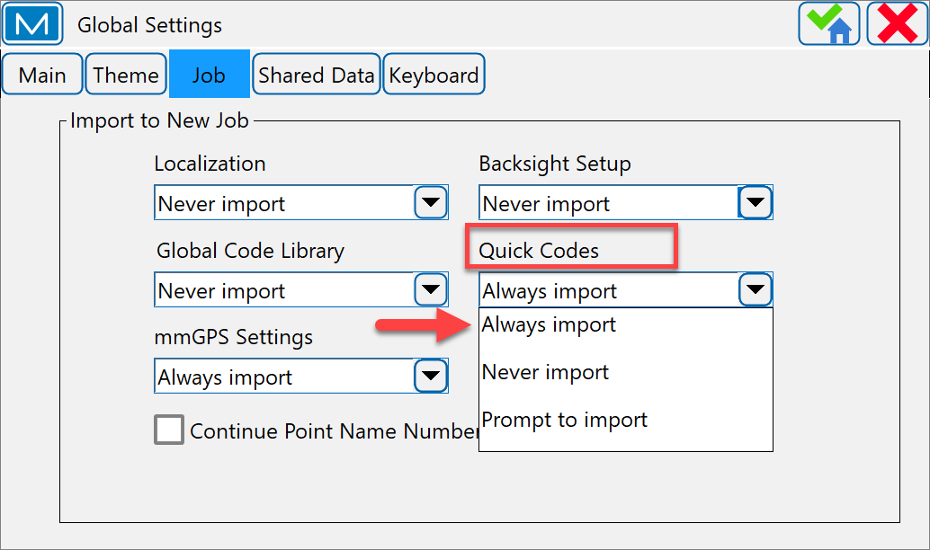
Topcon Magnet Field
Global Settings (Job)
Quick Codes:
Select Never import to create new jobs without importing quick codes.
Select Always import to automatically import quick codes.
Select Prompt to import to choose every time if you want to import quick codes.

Slide 12
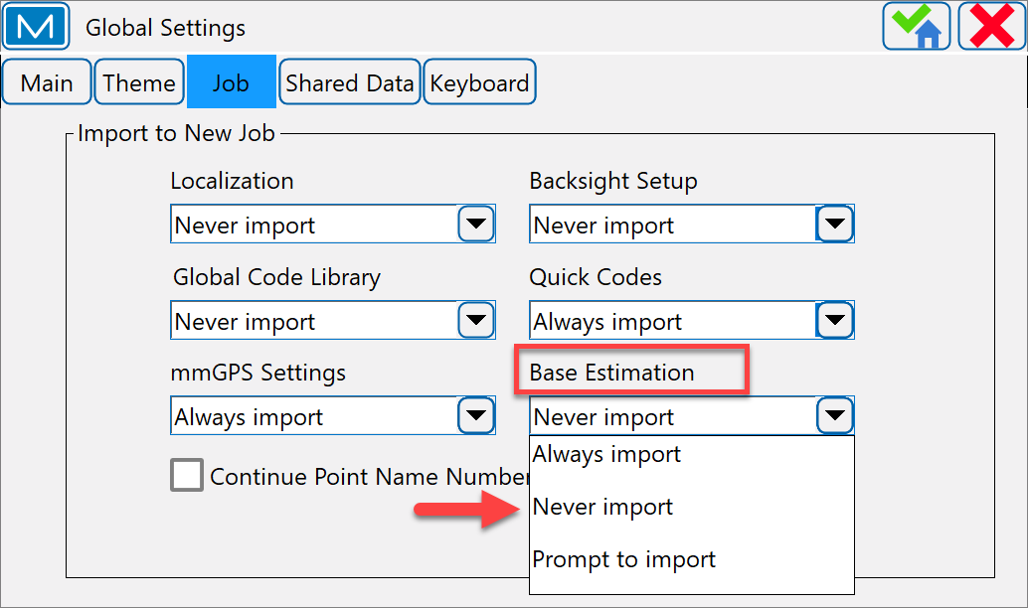
Topcon Magnet Field
Global Settings - Job
Base Estimation:
Select Never import to create new jobs without importing base estimation data.
Select Always import to automatically import base estimation data.
Select Prompt to import to choose every time if you want to import base estimation data.

Slide 13
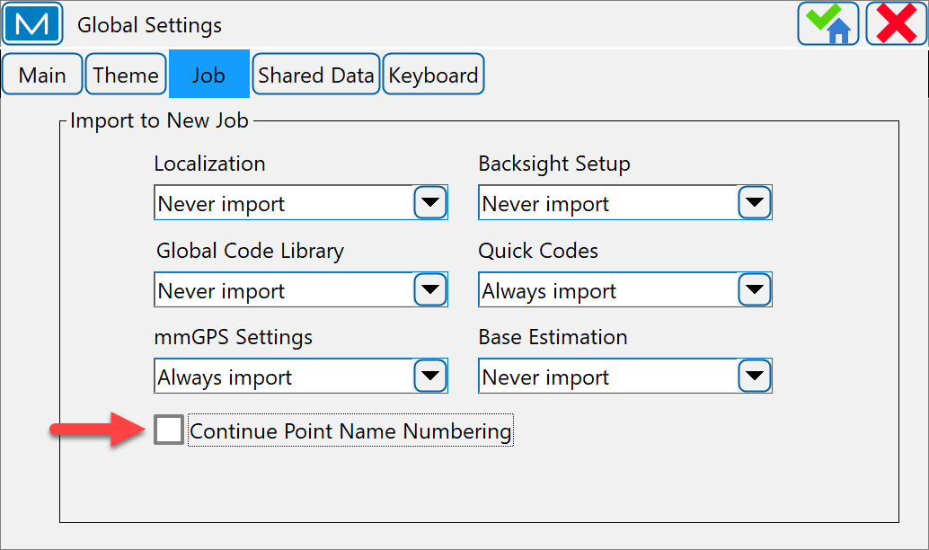
Topcon Magnet Field
Global Settings - Job
Continue Point Name Numbering
check box affects an automatically suggested name of the first point added to a new job. If the check box is selected, the point naming will continue from the last open job.
Example: the name of the final point in previous job is "84"; the increment value is "9"; the name of the new job’s start point will be "93".

Slide 14
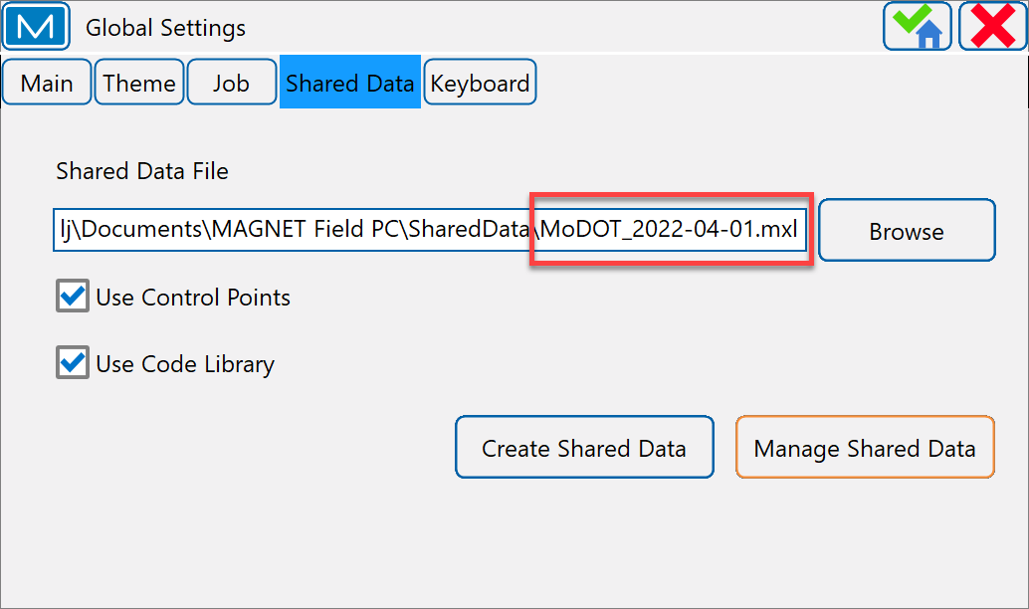
Topcon Magnet Field
Global Settings - Shared Data
The Shared Data File field displays the current file (*.mxl / *.mxlzip / *.xml / *.gc3) used to provide shared data to the current job.
FC5000/6000 Shared Data File path...C:\Users\MODOT\ Documents\MAGNET Field PC

Slide 15
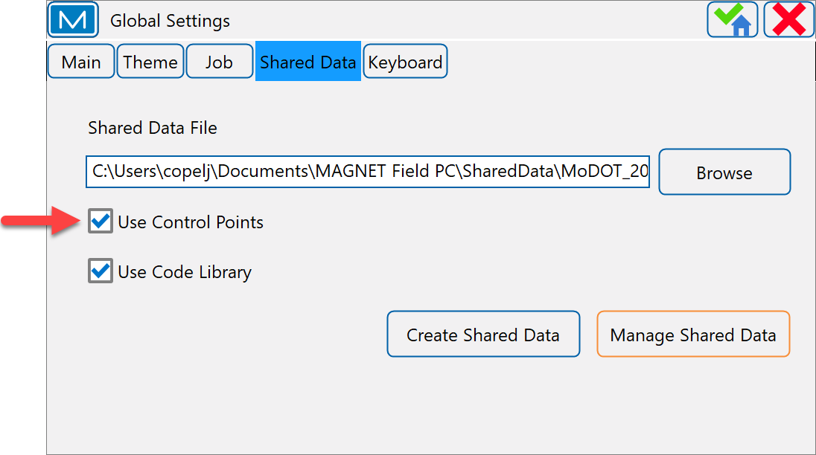
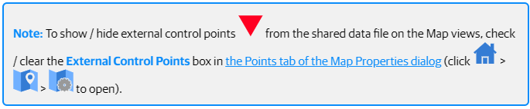
Topcon Magnet Field
Global Settings - Shared Data
Check the Use Control Points box to use points in the shared data file as external control points in the current job without importing them.

Slide 16
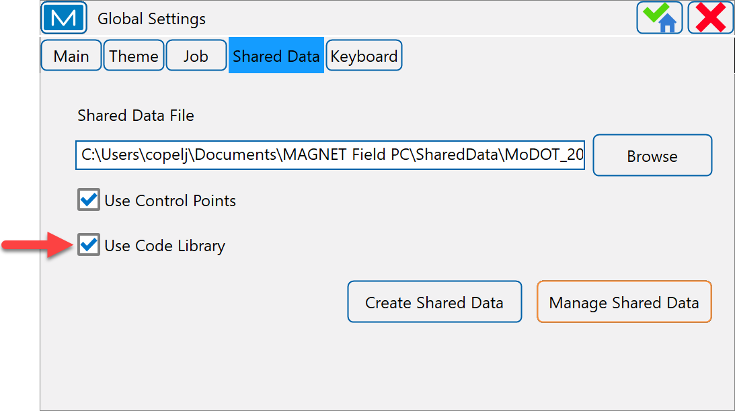
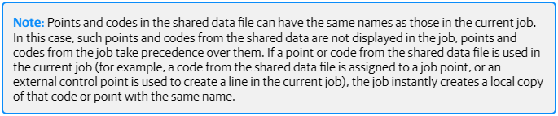
Topcon Magnet Field
Global Settings - Shared Data
Check the Use Code Library box to use codes from the shared data file in the current job.

Slide 17
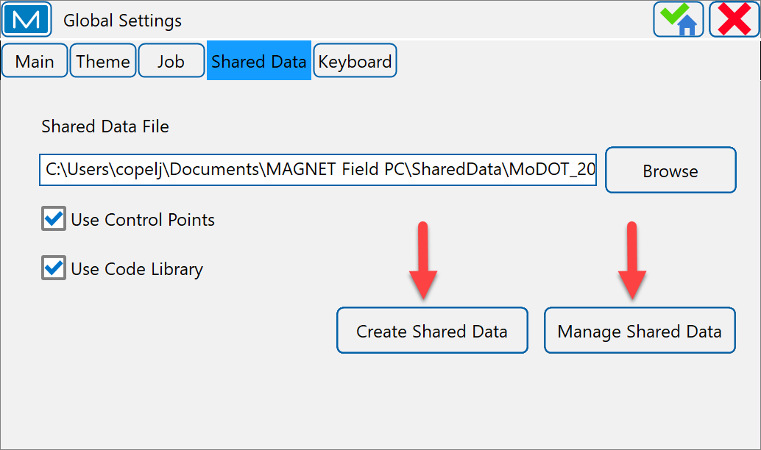
Topcon Magnet Field
Global Settings (Shared Data)
Manage Shared Data button adds data from the current job to the currently selected shared data file or delete data from the currently selected shared data file. Points and codes are supported.
Create Shared Data button creates a new shared data file (supported formats: *.mxl / *.mxlzip).

Slide 18
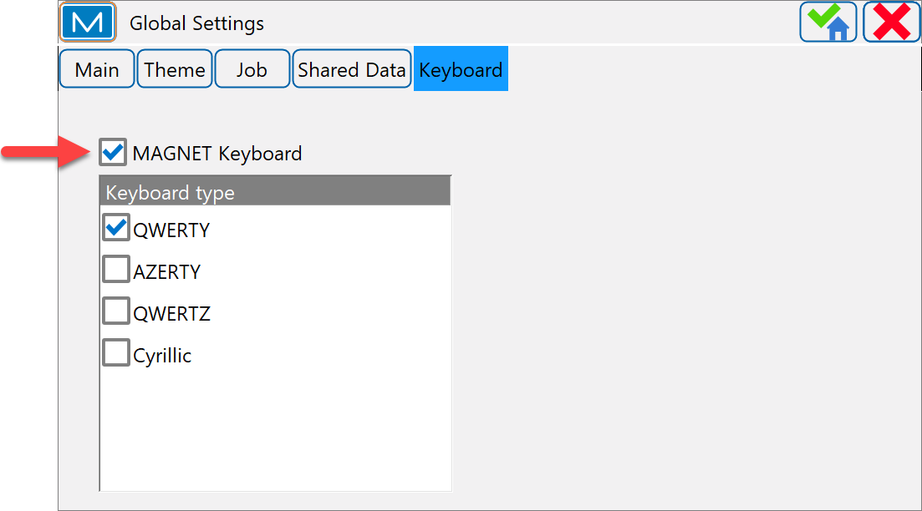
Topcon Magnet Field
Global Settings (Keyboard)
MAGNET Keyboard check box to enable typing with the on-screen keyboard. It displays automatically when editing values.

Slide 19
Topcon Magnet Field
Live Demonstration

Slide 20
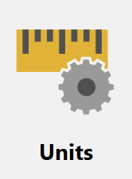
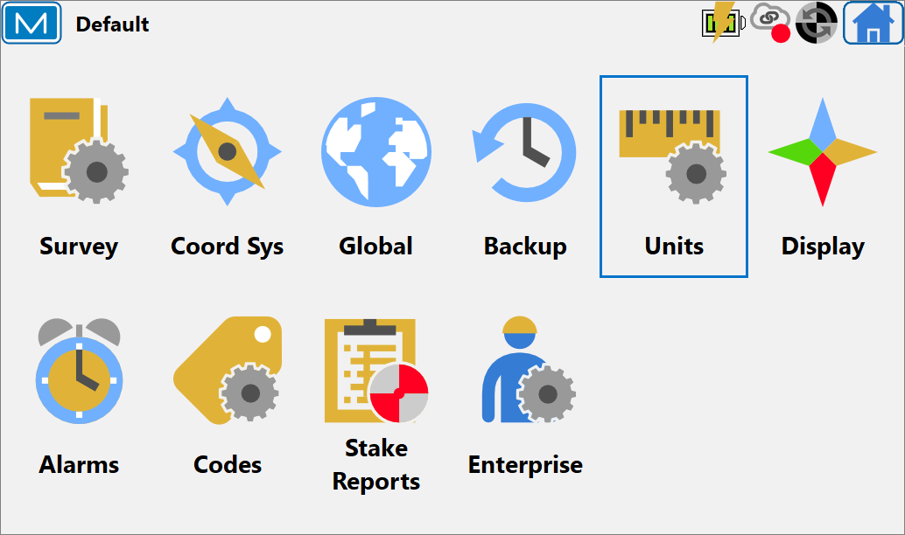
Topcon Magnet Field
Units
Setting different units and precisions for how MAGNET Files will display various numerical values in dialogs.
Distance
Angle
Coordinate
Other

Slide 21

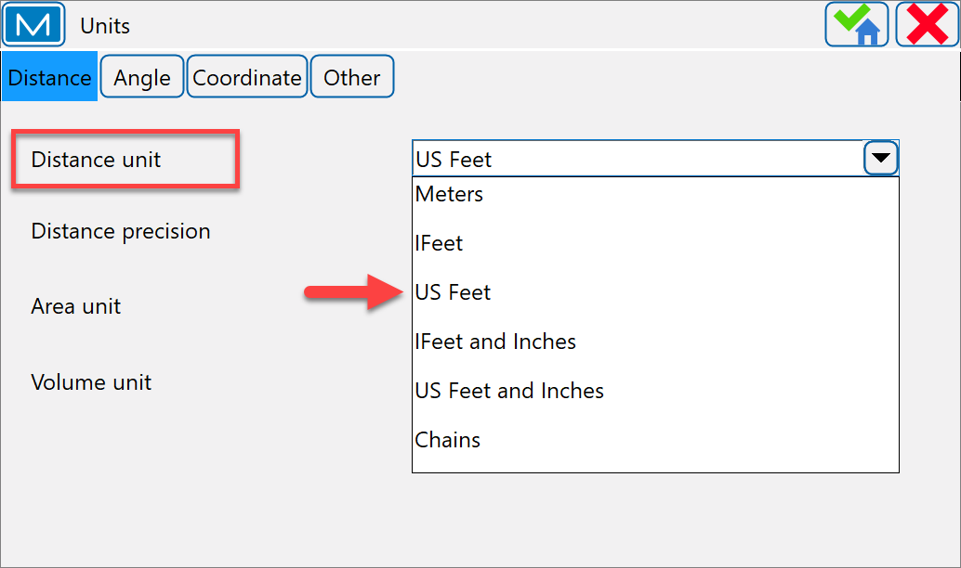
Topcon Magnet Field
Units (Distance)
Distance Unit for any length values. This can be…
US Feet
Meters
IFeet (International Feet)
Currently using…US Feet
If the units are US Feet, linear values can be entered as meters or international feet by appending “m” or “if” to the entered value.

Slide 22
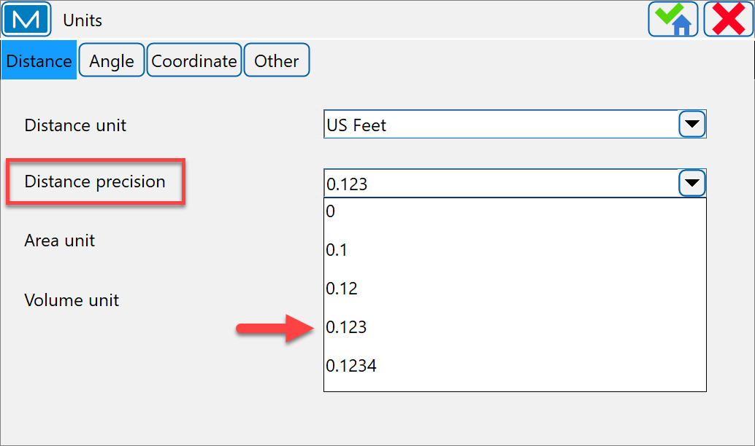
Topcon Magnet Field
Units (Distance)
Distance Precision for the number of decimal places in length values.
Rover poles are typically graduated to the nearest centimeter, so we recommend setting distance precision to….0.123

Slide 23
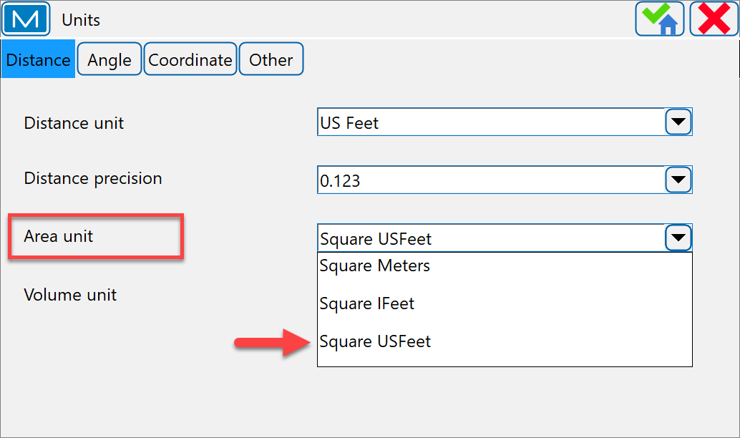
Topcon Magnet Field
Units (Distance)
Area Unit for area values. This can be…
Sq. Meters
Sq. Ifeet
Sq. USFeet
Typically, we use…Square US Feet

Slide 24
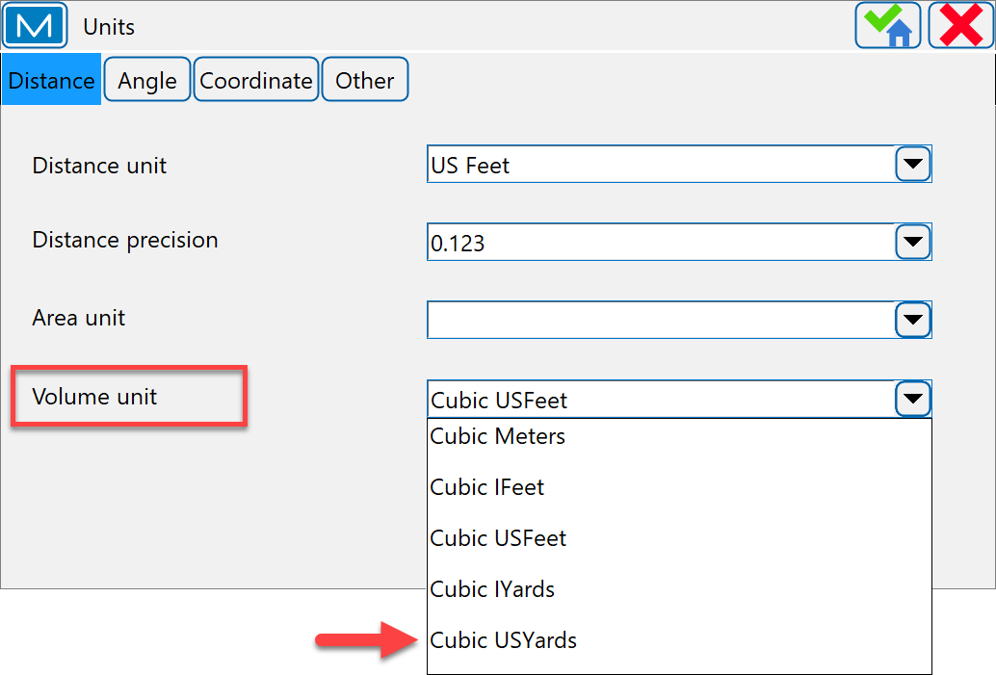
Topcon Magnet Field
Units (Distance)
Volume Unit for volume values. This can be…
Cubic Meters
Cubic IFeet
Cubic US Feet
Cubic IYards
Cubic USYards
Typically, we use…Cubic USYards

Slide 25

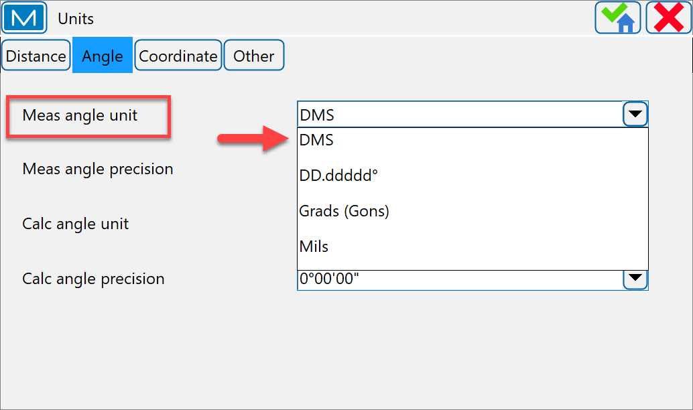
Topcon Magnet Field
Units (Angle)
Meas Angle Unit for values of the measured values. This can be…
DMS – degrees minutes seconds
DD.ddddd - decimal degrees
Grads (Gons) – gradians
Typically, we use…DMS

Slide 26
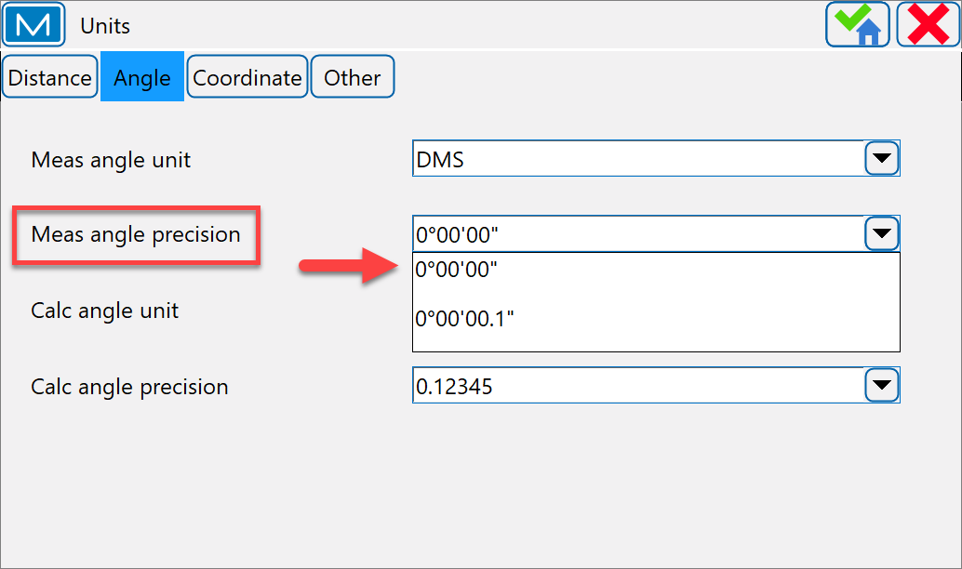
Topcon Magnet Field
Units (Angle)
Meas Angle Precision for the number of decimal places in angular values.
Typically, we use…0°00’00”

Slide 27
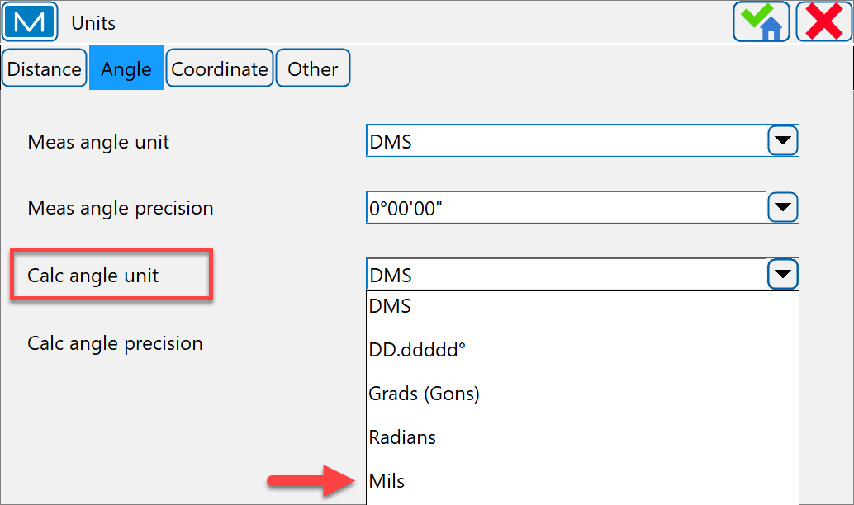
Topcon Magnet Field
Units (Angle)
Calc Angle Unit for angular values in Calculation tasks. In addition to Angular Unit settings, that also can be…
Radians
(full circle = 2*PI radians)
Mils
(1 Mil = 1 Milliradians = 1/1000 of a Radian)

Slide 28
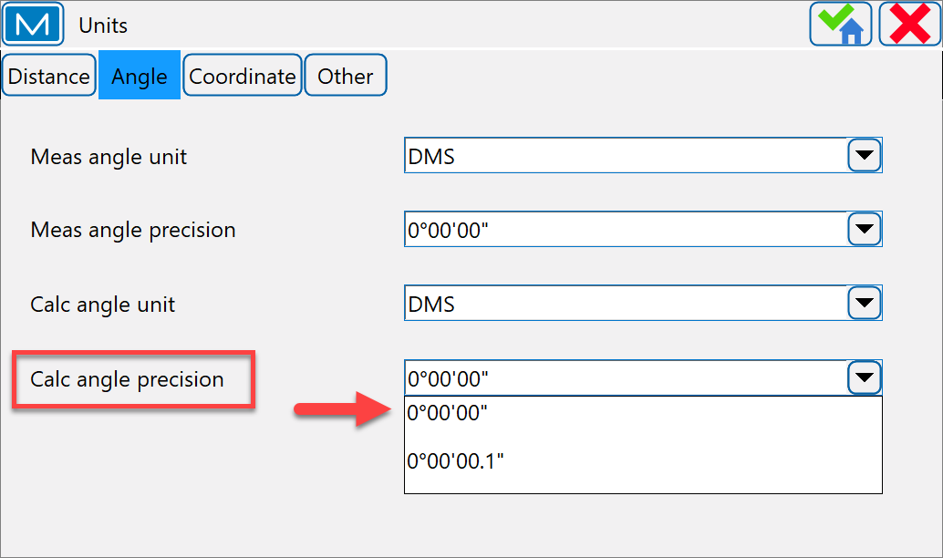
Topcon Magnet Field
Units (Angle)
Calc Angle Precision for the number of decimal places in angular values in Calculation tasks.
Typically, we use…0°00’00”

Slide 29
Topcon Magnet Field
Units (Coordinate)
Northing/Easting Precision for the number decimal places in Northing/Easting Coordinates.
Recommend 0.123 or 0.1234

Slide 30
Topcon Magnet Field
Units (Coordinate)
Lat/Lon Units for the specifying of Latitude and Longitude format.
Always…DD°MM’SS.s

Slide 31
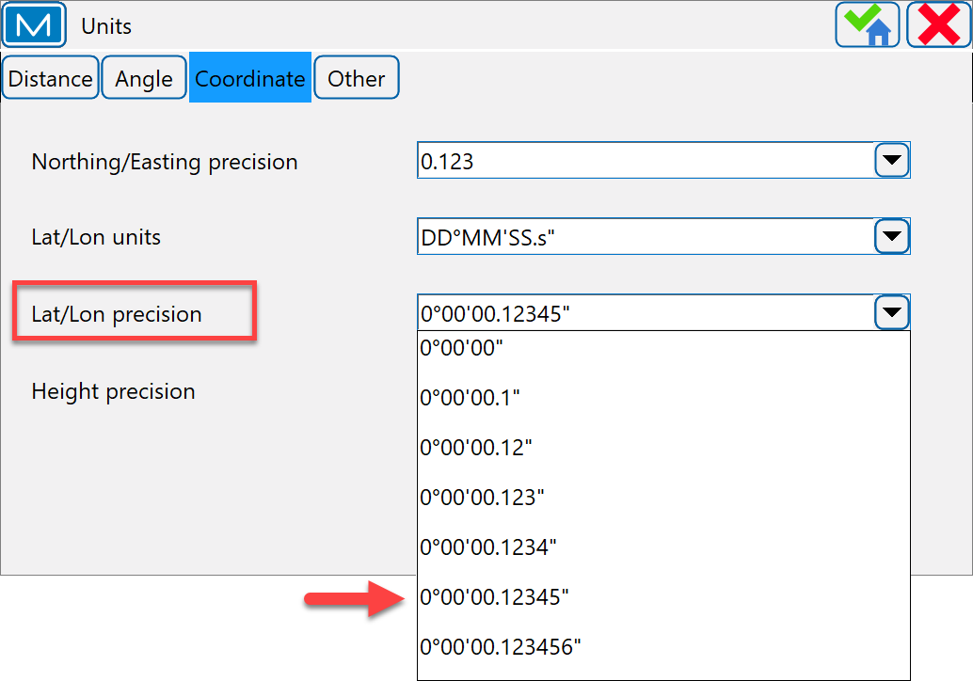
Topcon Magnet Field
Units (Coordinate)
Lat/Lon Units for the number of decimal places in latitude/longitude seconds.
Always…0°00’00.12345

Slide 32
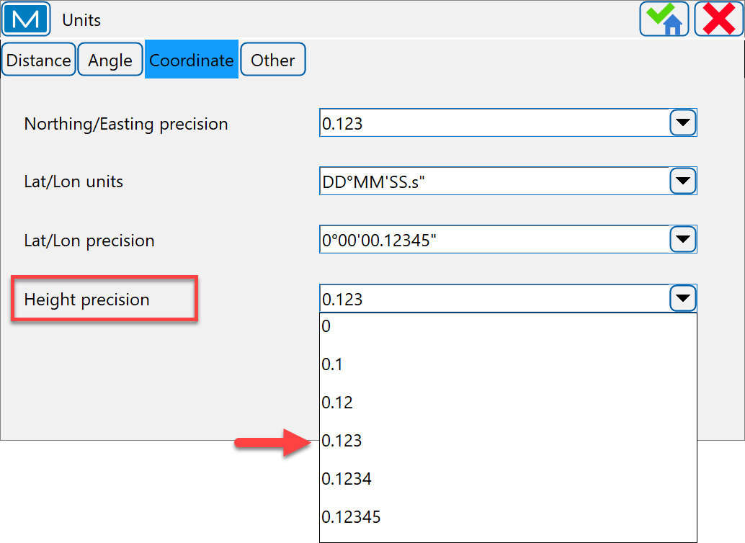
Topcon Magnet Field
Units (Coordinate)
Height Precision for the number of decimal places in ellipsoid height and elevations.
Always…0.123

Slide 33
Topcon Magnet Field
Units (Other)
Temperature Unit only used for raw measurements.
Celsius (°C)
Fahrenheit (°F)

Slide 34
Topcon Magnet Field
Units (Other)
Pressure Unit only used for raw measurements.
mmHg…(millimeters of Mercury)
inHg…(inches of Mercury) 1 inHg = 33.8639 mbar
hPa…(hectoPascals)
mbar…(millibar) 1 mbar = 0.02953 inHg
1 bar = 1000 millibar

Slide 35
Topcon Magnet Field
Live Demonstration

Slide 36

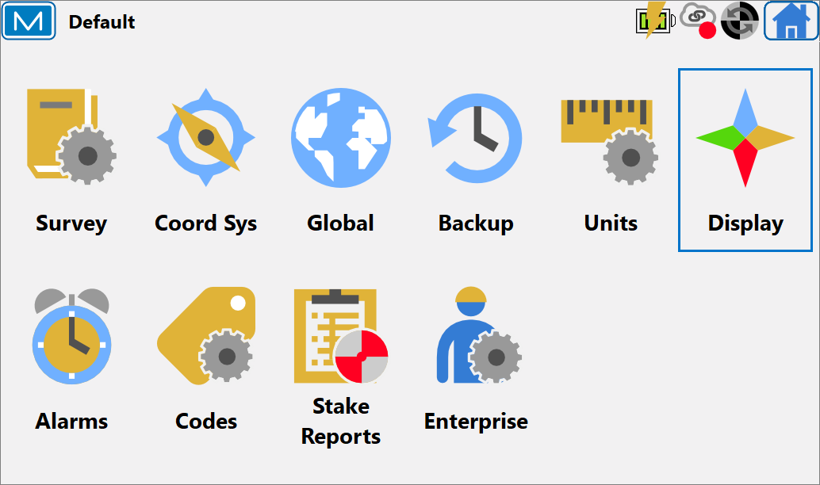
Topcon Magnet Field
Display
Use for customizing the displaying of values in the job.
Display Options….
Coordinate Type
Plane Coordinate Order
Geodetic Azimuth Origin
Direction
Display Slope As
Station Prefix
CL Position

Slide 37
Topcon Magnet Field
Display
Coordinate Type displays coordinates for the coordinate system type selected.
Grid…e.g., Missouri State Plane
Datum (Lat/Lon/Ell ht)…e.g. (NAD83 Lat/Lon/Ellipsoid Ht)
Datum (Lat/Lon/Elevation)…e.g. (NAD83 Lat/Lon/Elevation)
WGS84 (Lat/Lon/Ell ht)
WGS84 (Lat/Lon/Elevation)
Datum (Xc/Yc/Zc)
WGS84 (Xc/Yc/Zc)

Slide 38
Topcon Magnet Field
Display
Plane Coordinate Order displays the Cartesian system order representing the position relative to a local origin.
Typically displayed in controller as…North, East, Height

Slide 39
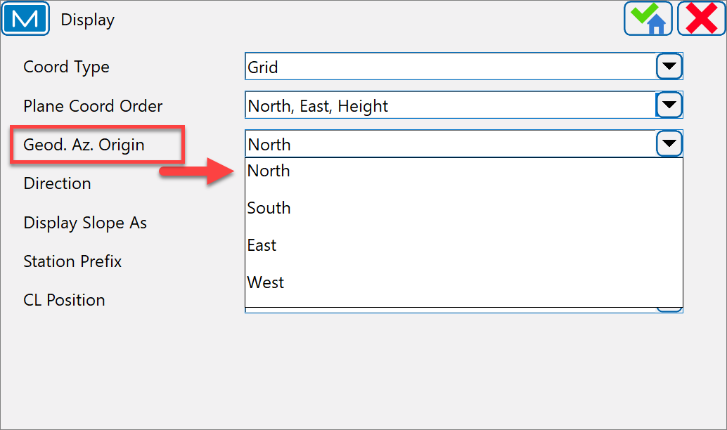
Topcon Magnet Field
Display
Geodetic Azimuth Origin displays the azimuth computed from reference direction.
Always set to…North

Slide 40
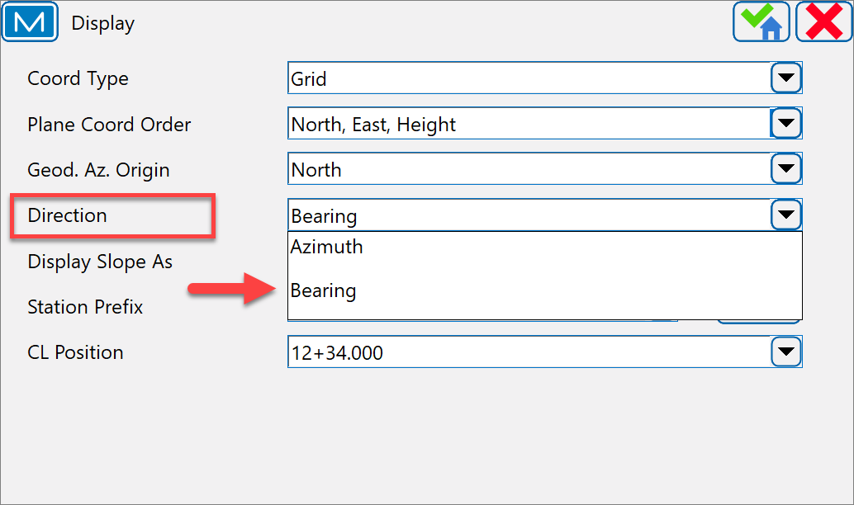
Topcon Magnet Field
Display
Direction displays the directions as bearings or azimuth.
Typically set to…Bearing

Slide 41
Topcon Magnet Field
Display
Display Slope As sets how the slope will be displayed and specified: as gradient.
Typically set to…Bearing

Slide 42
Topcon Magnet Field
Display
Station Prefix selects the desired format for station naming by picking a prefix from the drop-down list.
The button opens the dialog where you can edit existing and create your own prefix for station.
Typically set to…Sta.

Slide 43
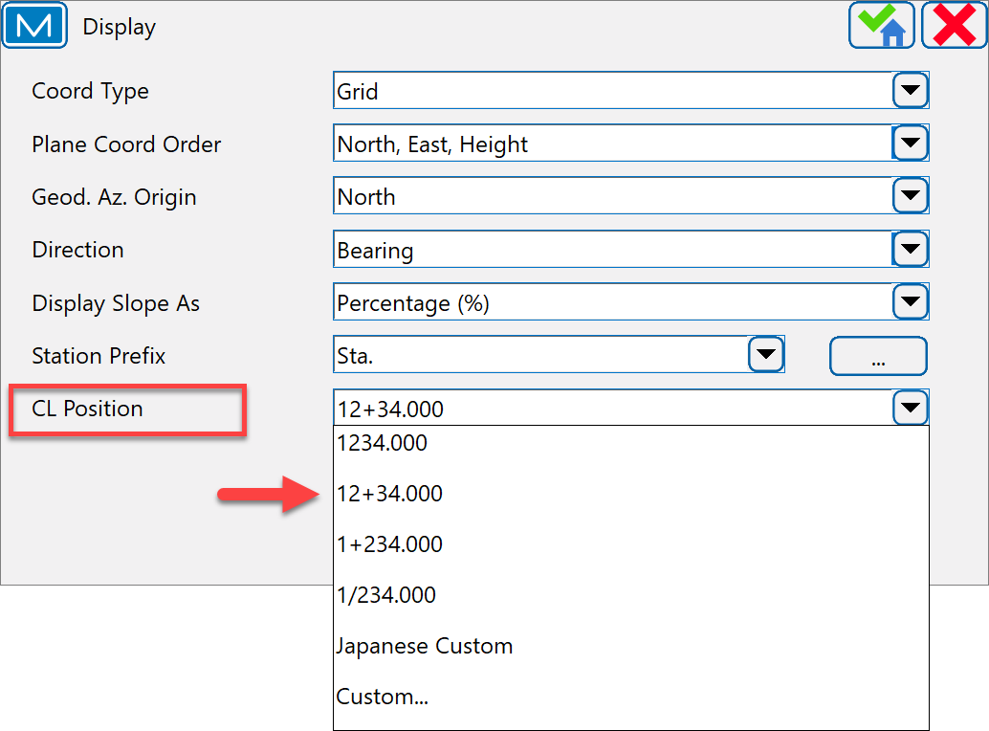
Topcon Magnet Field
Display
CL Position select a desired format to display stationing the centerline.
1234.00…Chainage, the distance to the station along the centerline.
12+34.000…US Station (American format), when using 100 units as a full station plus a remainder.
1+234.000…EU Station (Euro Station) aka “Metric”, when using 1000 units as a full station and a slash before a remainder.
Always set to…12+34.000

Slide 44
Topcon Magnet Field
Live Demonstration

Slide 45

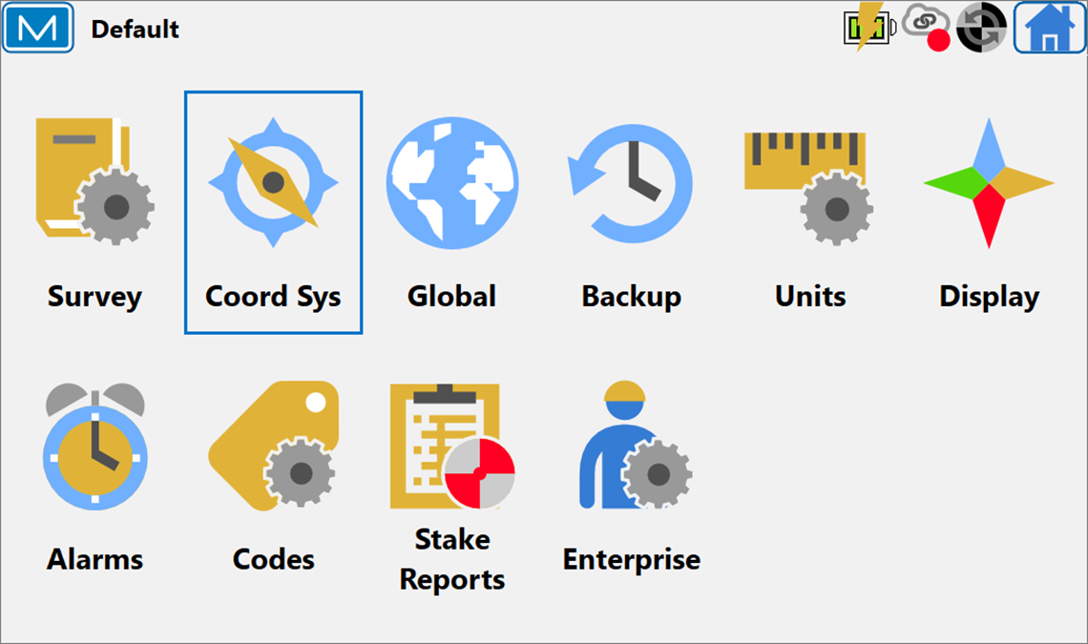
Topcon Magnet Field
Coordinate System
Coordinate System in geometry, is a is a system that uses one or more numbers, or coordinates, to uniquely determine the position.
Projection
Use Grid/Ground
Datum
Geoid Model

Slide 46

Topcon Magnet Field
Coordinate System
Projection in surveying are methods used to transform the spherical surface of the earth into a two-dimensional plane.
next to the Projection dialog, opens the Pre-Defined CS dialog and allow user to add desired projections to the list of projection in the current job.
Select the SPC83 projection/s specific to your district region.

Slide 47
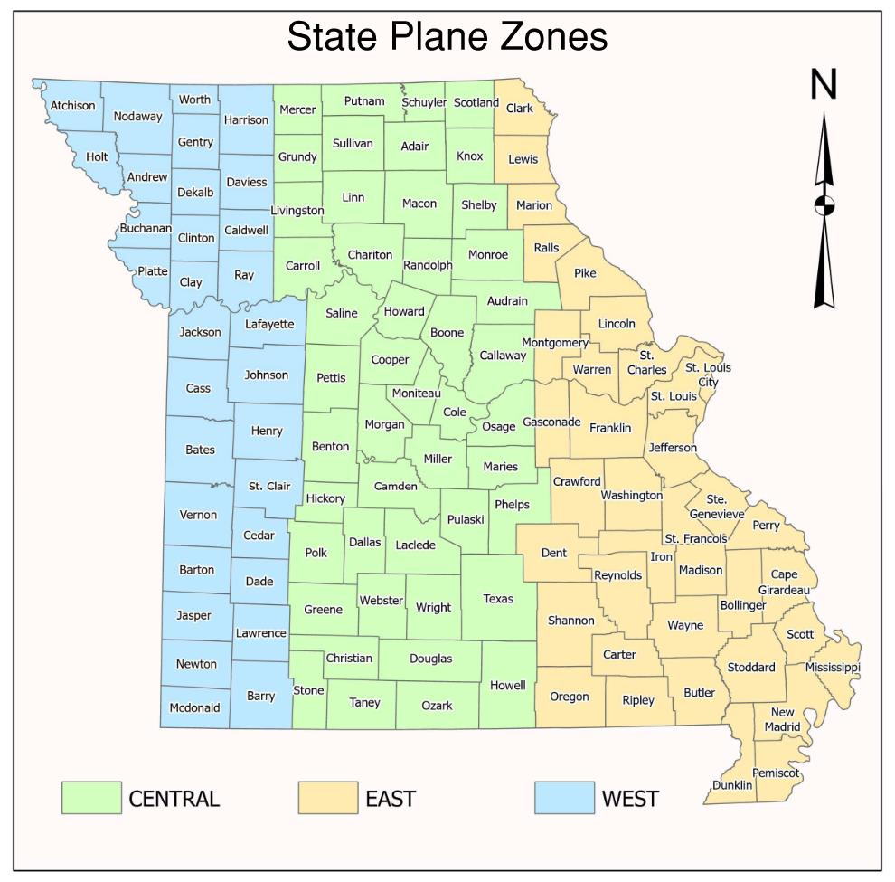
Topcon Magnet Field
Coordinate System
Missouri State Plane Coordinate Zones

Slide 48
Topcon Magnet Field
Coordinate System (Use Grid/Ground)
Use Grid/Ground enables transformation to ground coordinates for surveying. After applying the coordinate system with selected Use Grid/Ground, the coordinates system in the current job will be ground
Grid/Ground Parameters
Configure BEFORE importing data
Parameters – Scale Factor
Combined SF – Projection Factor
Direction – Grid to Ground

Slide 49
Topcon Magnet Field
Coordinate System (Datum)
Datum (horizontal) is a specified coordinate system for a collection of positions on the surface of the earth.
Datum…NAD83_NO_TRANS

Slide 50
Topcon Magnet Field
Coordinate System (Datum)
Geoid Model is the physical reference surface of the earth. Its shape reflects the distribution of mass inside the Earth. Geoid undulations are important for converting GNSS-derived ellipsoidal height differences to orthometric height difference (elevations).
opens the geoid list dialog and allow user to add desired geoid to the list of projection in the current job.
Current Geoid Model…Geoid18

Slide 51
Topcon Magnet Field
Live Demonstration

Slide 52
Topcon Magnet Field
Codes
Used to configure code, quick code and control code settings in the job.

Slide 53


Topcon Magnet Field
Codes Options (Quick Codes)
Allows the user to simplify and speed up adding necessary codes to surveyed points by setting quick code groups.
opens the Quick Codes Group (QCG) dialog, allows user to add desired quick code groups.

Slide 54
Topcon Magnet Field
Codes Options (Quick Codes)
Multiple Code assignment for each Quick Code Group.

Slide 55
Topcon Magnet Field
Codes Options (Quick Codes)
QCG are semi-transparent buttons displayed on a survey map.
Each button has its own set of point codes assigned to it.
Clicking any of these buttons during the survey and it measures a point in Quick mode and automatically applies assigned code(s) to a stored point.

Slide 56

Topcon Magnet Field
Live Demonstration

Slide 57
Topcon Magnet Field
Stake Reports
Report provides detailed information regarding the observation parameters and results of the stake out location compared the to design location.
To create and to manage configurations of stakeout reports.

Slide 58

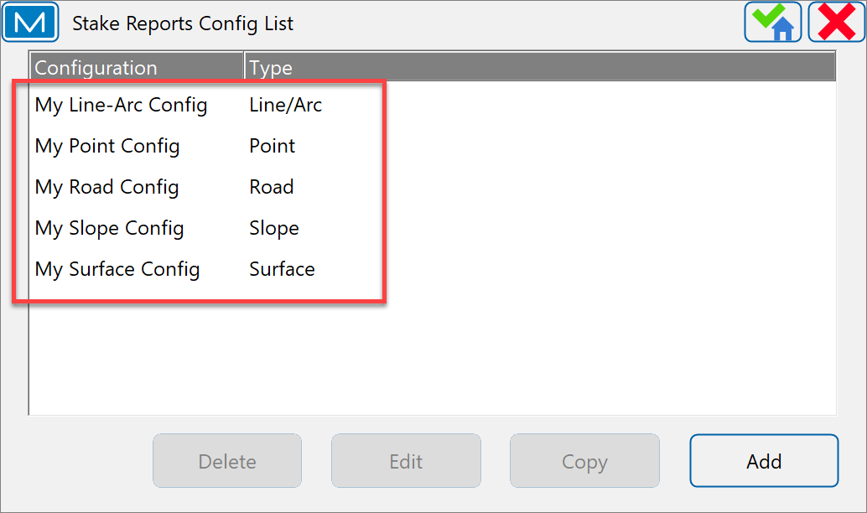
Topcon Magnet Field
Stake Reports (Stake Reports Config List)
MAGNET Field supports five predefined types of stake reports and offers default configurations for each of them.
Line/Arc
Point
Road
Slope
Surface

Slide 59
Topcon Magnet Field
Stake Reports (Report Config)
User can create new configurations or copy, edit, or delete existing configurations for any type of stake reports. Each type of stake reports supports multiple configurations for various job tasks.

Slide 60
Topcon Magnet Field
Live Demonstration

Slide 61

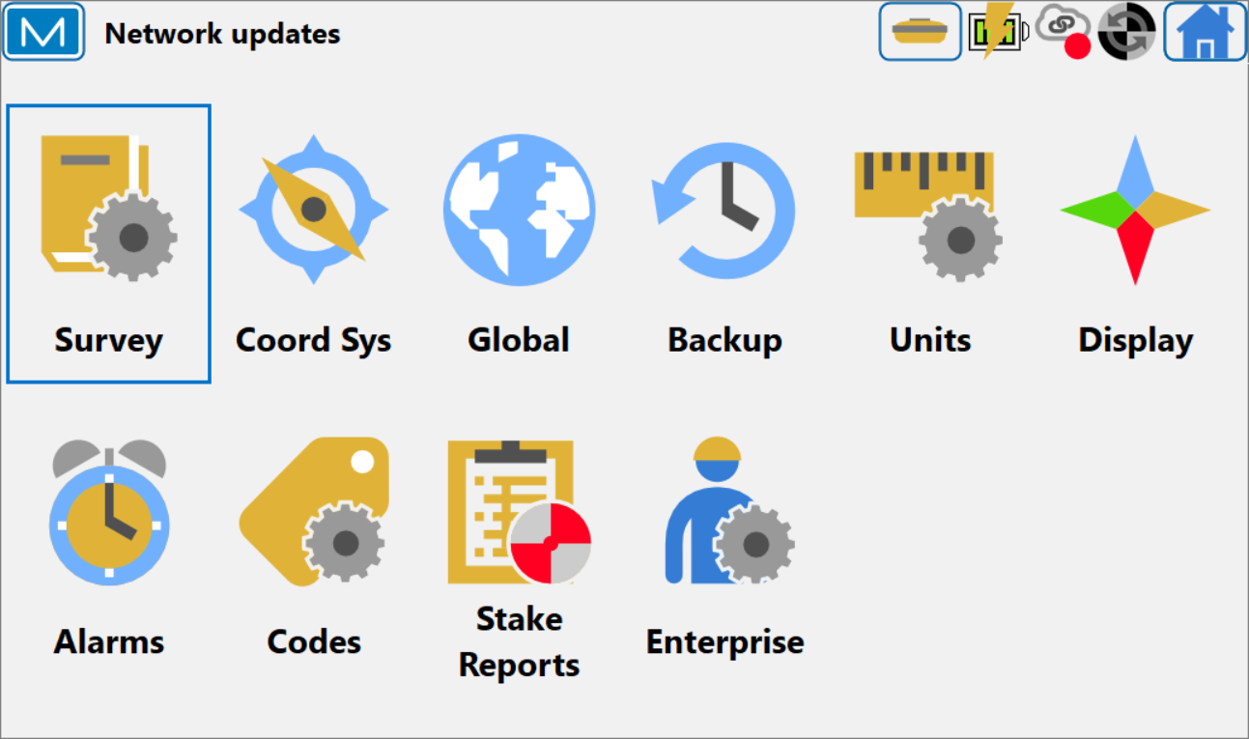
Topcon Magnet Field
Survey
Job Configurations
GNSS Base/Rover
GNSS MoDOT Network
Total Station
Hybrid Integration (GNSS/RTS)

Slide 62
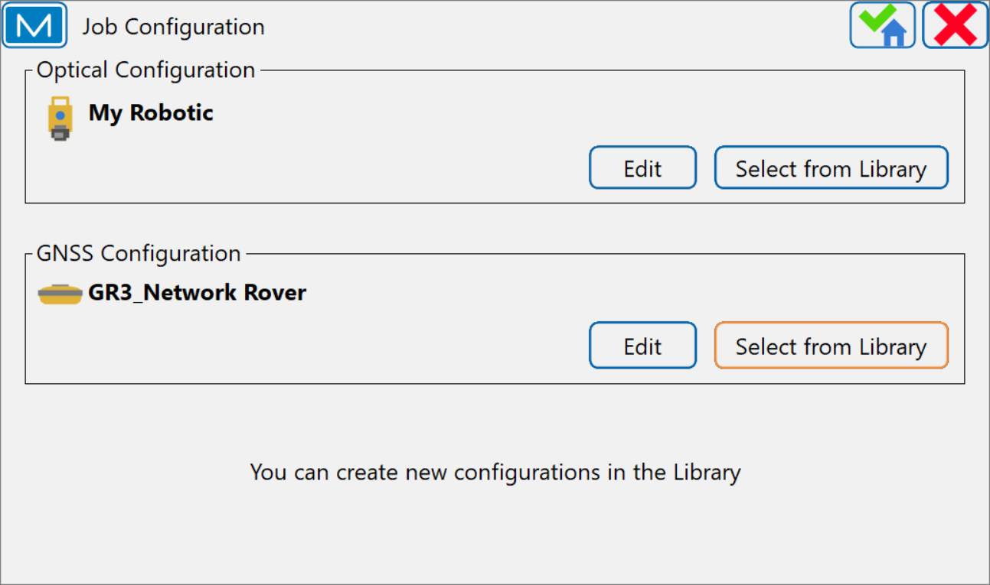
Topcon Magnet Field
Job Configuration
Optical Configuration
Manual Total Station (MTS)
Robotic Total Station (RTS)
GNSS Configuration
GNSS Base/Rover
GNSS MoDOT Network
Hybrid Integration (GNSS/RTS)

Slide 63
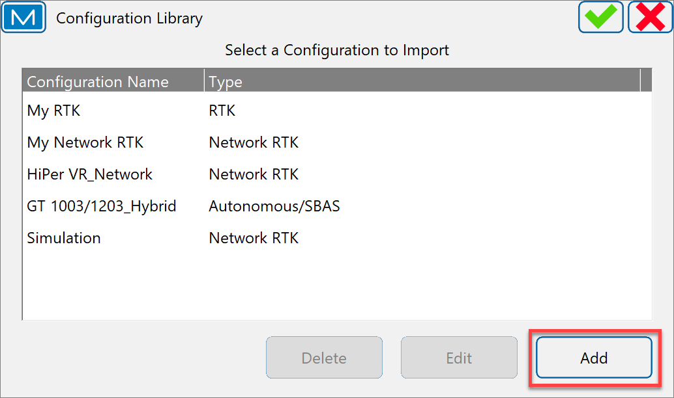
Topcon Magnet Field
Configuration Library (GNSS)
Creating a GNSS Profile
GR-3_Base/Rover
HiPer VR_Base/Rover
HiPer HR_Base/Rover

Slide 64
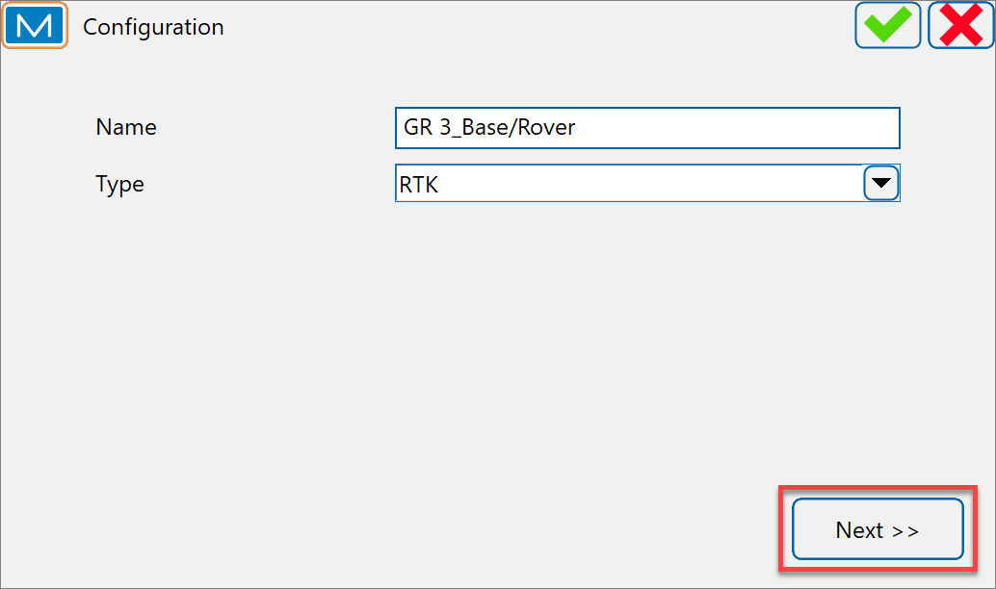
Topcon Magnet Field
Configuration
Name (antenna) Base/Rover
Ex: GR-3_Base/Rover
Ex: HiPer VR_Base/Rover
Type is RTK

Slide 65
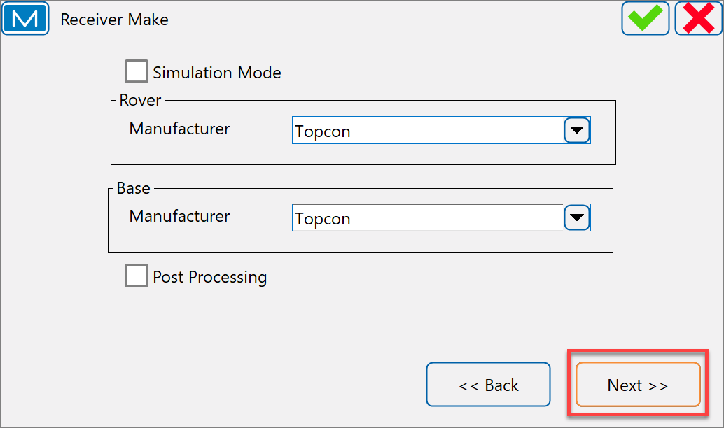
Topcon Magnet Field
Receiver Make
Set both Rover and Base Manufacturer to…Topcon

Slide 66
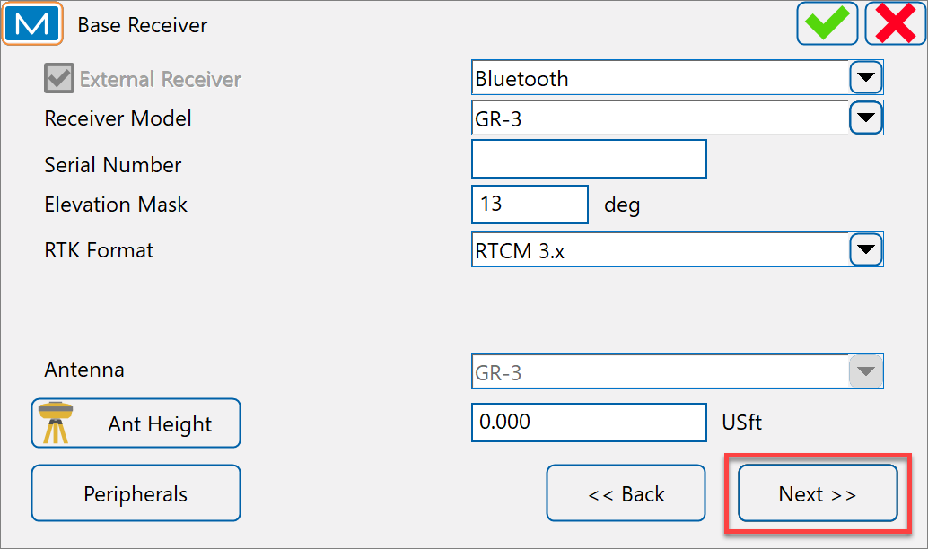
Topcon Magnet Field
Base Receiver
Receiver model…GR-3, HiPer VR
Serial Number…optional
Elevation mask…13 degrees
RTK Format…
GR3…RTCM 3.x
HiPer VR and HR…RTCM 3.x
Antenna Height (ARP Location)
Vertical (2m Fixed tripod)
Slant (standard tripod)

Slide 67
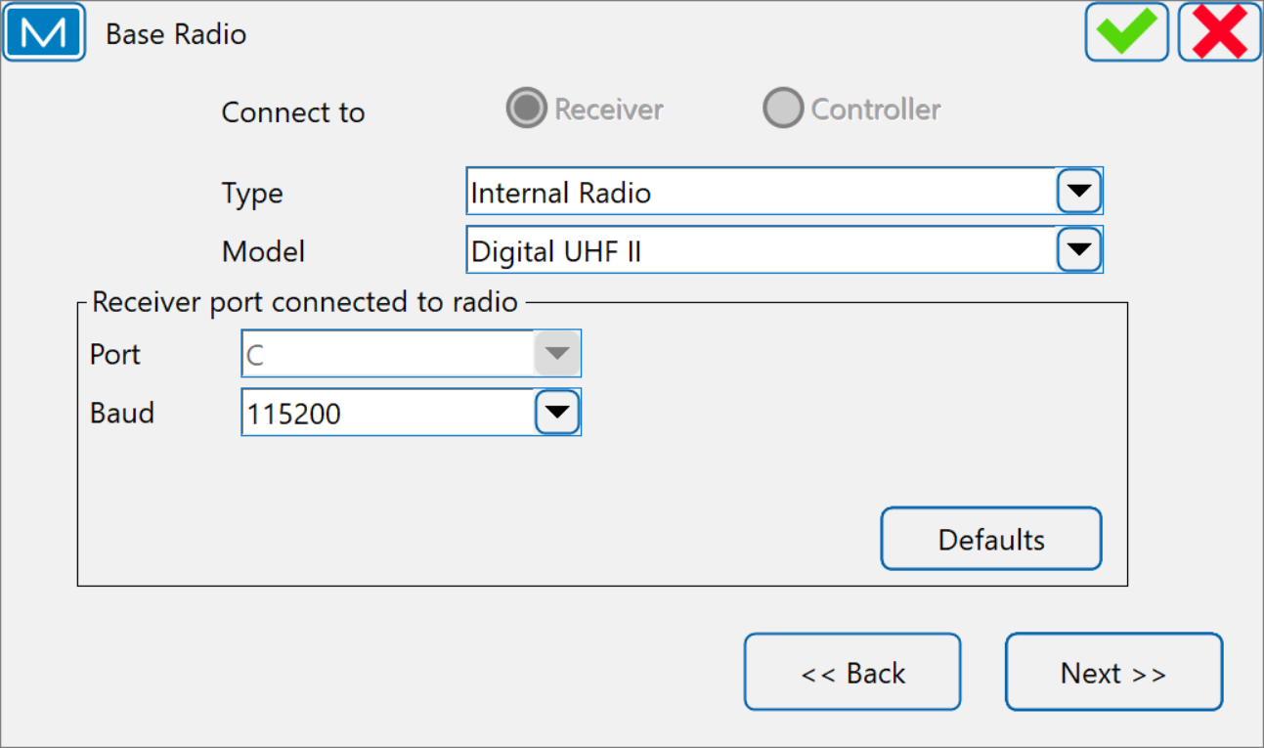
Topcon Magnet Field
Base Radio
Type…Internal Radio
Model
GR-3…Digital UHF or Digital UHF II
HiPer VR and HR…R2 Lite UHF
Port…C
Baud…115200 (standard)

Slide 68
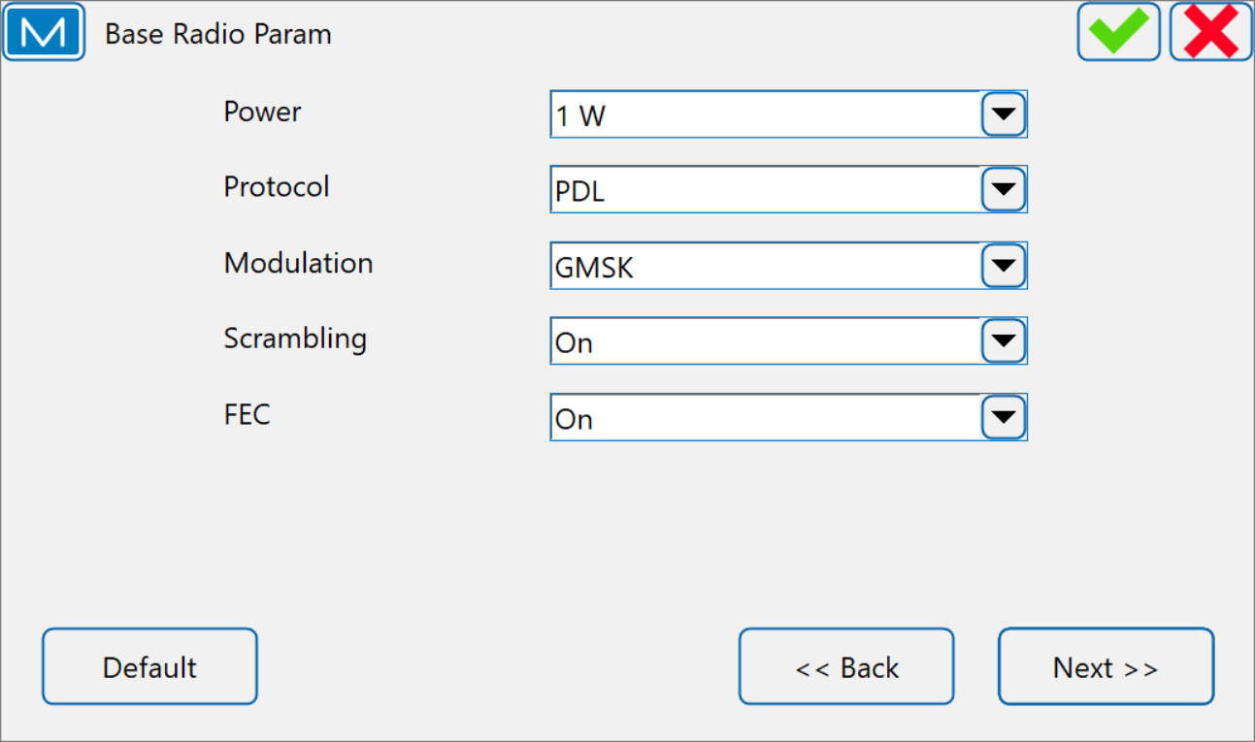
Topcon Magnet Field
Base Radio Parameters
Power…1 W
Protocol…PDL
Modulation
GR-3…GMSK
HiPer V, HR, VR…4SFK
Scrambling…ON
Forward Error Correction (FEC)…ON

Slide 69
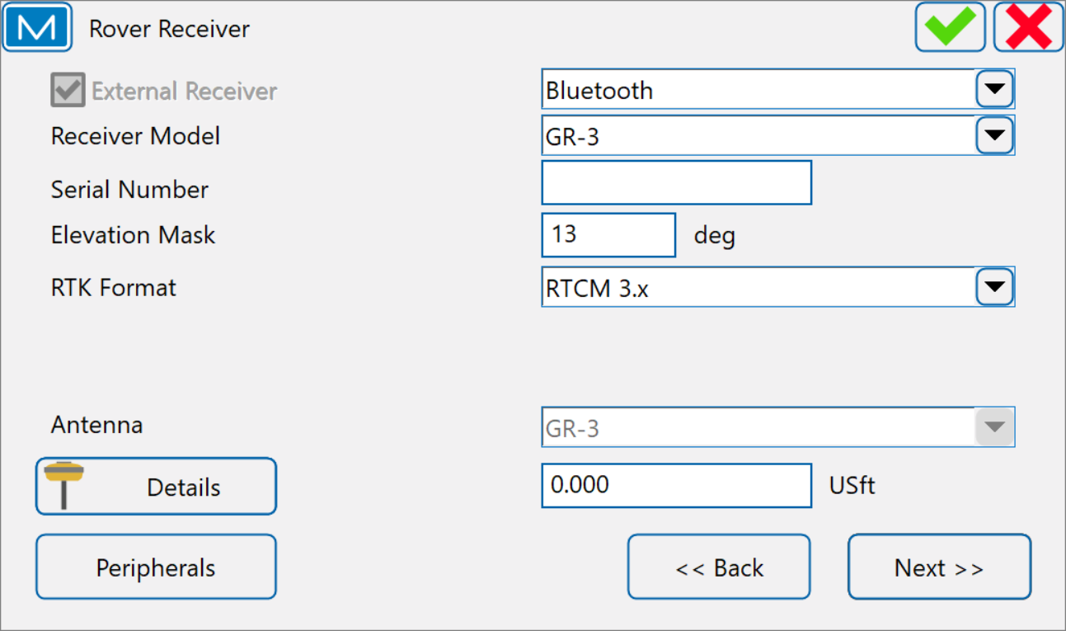
Topcon Magnet Field
Rover Receiver
Receiver model…GR-3, HiPer VR
Serial Number…optional
Elevation mask…13 degrees
RTK Format…
GR3…RTCM 3.x
HiPer VR and HR…RTCM 3.x MSM3
Antenna Height
Vertical (2m Fixed tripod)

Slide 70
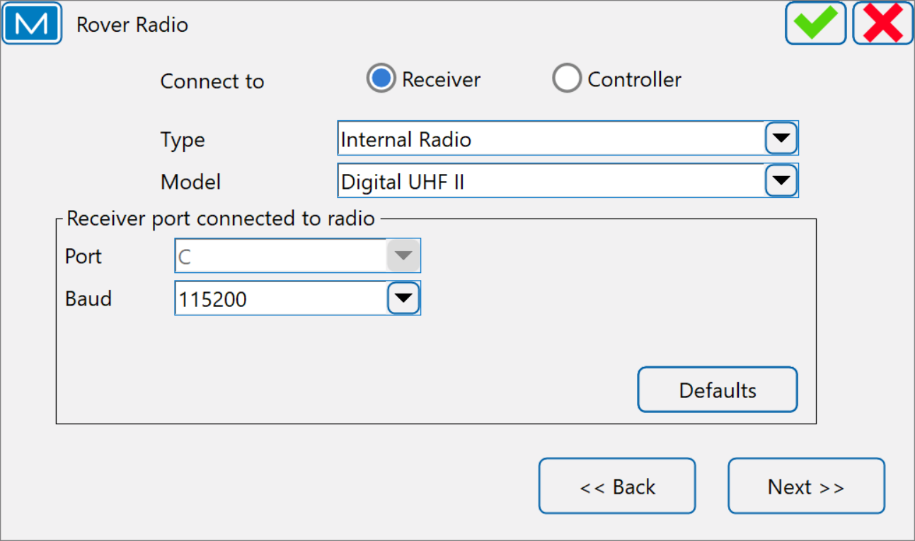
Topcon Magnet Field
Rover Radio
Type…Internal Radio
Model
GR-3…Digital UHF or Digital UHF II
HiPer VR and HR…R2 Lite UHF
Port…C
Baud…115200 (standard)
Note: Base and Rover radio settings must match to communicate between receivers.

Slide 71
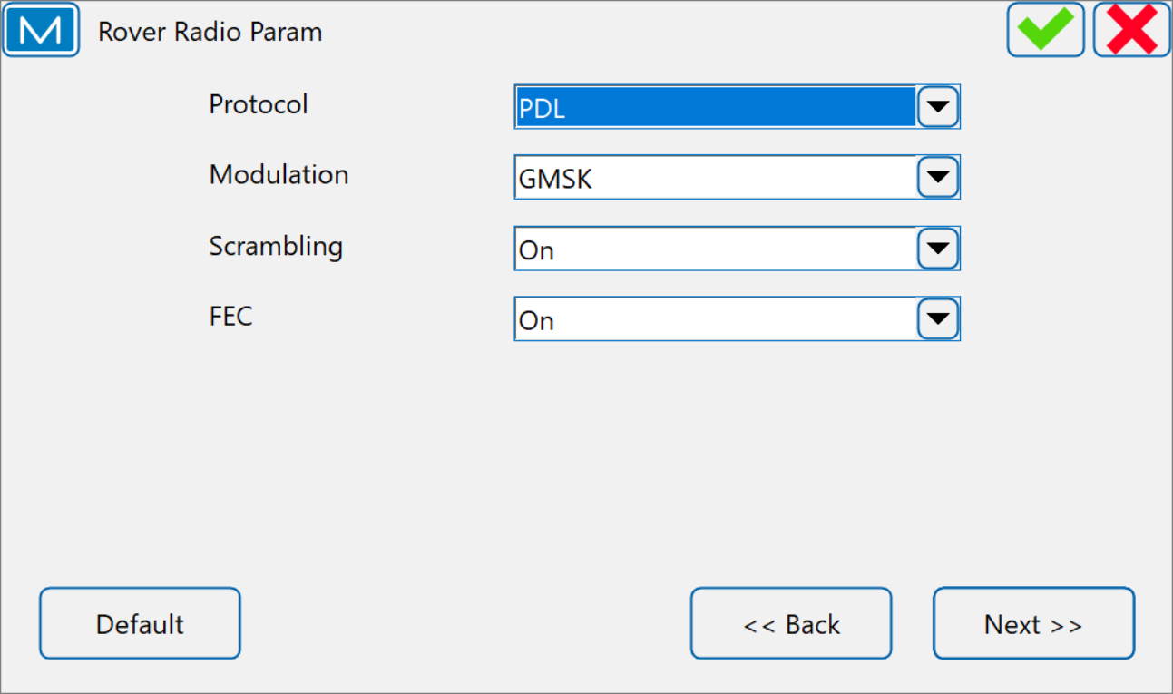
Topcon Magnet Field
Rover Radio Parameters
Protocol…PDL
Modulation
GR-3…GMSK
HiPer V, HR, VR…4SFK
Scrambling…ON
Forward Error Correction (FEC)…ON
Note: Base and Rover radio settings must match to communicate between receivers.

Slide 72
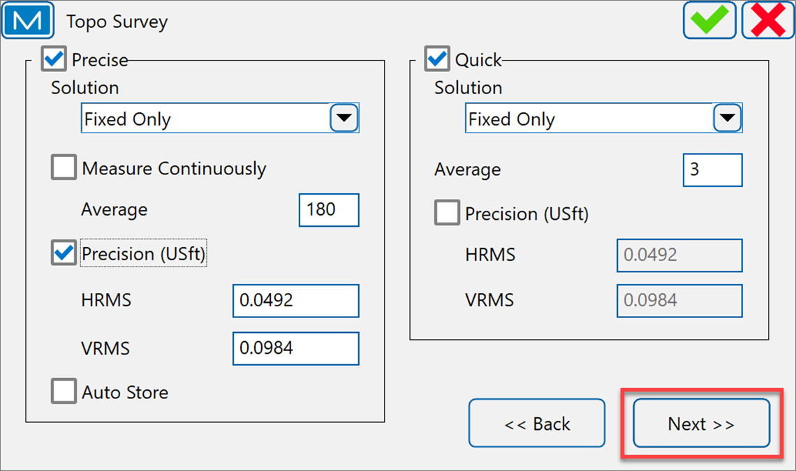
Topcon Magnet Field
Topo Survey
Precise – used for collecting observations on project control
Solution – Fixed Only
Average – establishes the number of epochs collected during an observation… 180 minimum
Precision (USft) – establishes a Horiz. and Vert. precision threshold on measurements
HRMS…0.0492
VRMS…0.0984

Slide 73

Topcon Magnet Field
Topo Survey
Advanced Epoch Filtering –
Precision (USft) – establishes a Horiz. and Vert. precision threshold on measurements
HRMS…XXXX
VRMS…XXXX

Slide 74

Topcon Magnet Field
Topo Survey
SureTopo Settings –
Precision (USft) - establishes a Horiz. and Vert. precision threshold on measurements
Hor. Tolerance…XXXXX
Vert. Tolerance…XXXXX
Num. of Matches…XXXXX
Quick – establishes a Horiz. and Vert. precision threshold on measurements
Hor. Tolerance…XXXXX
Vert. Tolerance…XXXXX
Num. of Matches…XXXXX

Slide 75

Topcon Magnet Field
Topo Survey
Quick – used for collecting observations on planimetric and topographic features, and control check observation
Solution – Fixed Only
Average – establishes the number of epochs collected during an observation…3 or 5 minimum
Precision (USft) – establishes a Horiz. and Vert. precision threshold on measurements…Uncheck

Slide 76

Topcon Magnet Field
Auto Topo Survey
Solution-Fixed Only
Method
By Time
By Horizontal Distance
By Slope Distance
By Elevation
By Stop and Go
Interval

Slide 77

Topcon Magnet Field
Stake Settings
Horizontal Distance Tolerance – determines when close enough to the point for the bull’s eye to appear.
Vertical Distance Tolerance - determines when close enough to the point for the bull’s eye to appear.
Compass Orientation – top of screen is oriented to the North during stakeout session
Display Reference -

Slide 78

Topcon Magnet Field
Stake Settings
Quick – used for collecting observations on planimetric and topographic features, and control check observation
Solution – Fixed Only
Average – establishes the number of epochs collected during an observation…3 or 5 minimum
Precision (USft) – establishes a Horiz. and Vert. precision threshold on measurements…Uncheck

Slide 79

Topcon Magnet Field
Grade Stake Marking
Working stake length– Enter the length of the stake
Top Spacing-Top space reserved for marking
Bottom Spacing-Bottom space reserved for marking
Cut/Fill Interval- Even number that you want the cut/Fill rounded to

Slide 80

Topcon Magnet Field
Stake Point Icon- Define how staked points will be displayed on map
Icon- Select what special icon you want displayed
Use Tolerance Colors- A checked box allows you to choose color based on inside or outside distance tolerance
Color-Allows you to choose color of icon

Slide 81

Topcon Magnet Field
Point Naming
Prefix/Suffix-can be added to point name
Name as-You can use Design point, Next stake point, Design pt. Prefix, Design pt. suffix, Design pt. + Constant, or Range start
Note-You can choose Design Point, Design pt. prefix, Design pt. suffix, Station & Offset, or none

Slide 82

Topcon Magnet Field
Tracking
Current constellations used in US; GPS, Glonass, Beidou, and Galileo
GR 3 – GPS+GLO only
HiPer V – GPS+GLO only
Hyper VR – GPS+GLO+BDS+GAL
Hyper HR - GPS+GLO+BDS+GAL
(Only if receiver has been upgraded)

Slide 83

Topcon Magnet Field
Advanced
RTK Position-Extrapolation or Matched Epoch.
Base Sat Limit-can set number of satellites to transmit from base. Uncheck
Multipath Reduction-helps reduce multipath. Leave checked
Canopy Environment-????

Slide 84

Topcon Magnet Field
RTK Settings

Slide 85

Topcon Magnet Field
RTK Settings
Set Fix Level to Medium

Slide 86

Topcon Magnet Field

Slide 87

Topcon Magnet Field
Miscellaneous
Prompt for antenna height- ask for height before point is stored
Stakeout sound- indicates the point is staked
Beep on storing points- beeps each time a point is stored. On by default

Slide 88

Topcon Magnet Field
Configuration Library (Network RTK)
Create a GR-3 Network Rover

Slide 89

Topcon Magnet Field
Configuration
Name
Type
Corrections
Protocol

Slide 90

Topcon Magnet Field
Rover Receiver
Receiver Model
Elevation Mask
Antenna Details
Slant
Vertical

Slide 91

Topcon Magnet Field
Rover Radio
Controller

Slide 92

Topcon Magnet Field
Internet Address
Setting up a connection to MoDOT Real Time Network

Slide 93

Topcon Magnet Field
Edit Internet Address
Label- just a name
Address- rtk3.modot.mo.gov
Login- insert your username
Password- insert your password

Slide 94

Topcon Magnet Field
Internet Address

Slide 95

Topcon Magnet Field
Position in GGA
Check Automatic Rover Position
Tells RTN where you are so that it can create correction stream

Slide 96

Topcon Magnet Field
Topo Survey
Precise
Average 180
Check on Precision
Quick
Average 3

Slide 97

Topcon Magnet Field
Auto Topo Survey
Solution-Fixed Only
Method
By Time
By Horizontal Distance
By Slope Distance
By Elevation
By Stop and Go
Interval

Slide 98

Topcon Magnet Field
Stake Settings
Horizontal Distance Tolerance
Vertical Distance Tolerance
Compass Orientation
Display Reference

Slide 99

Topcon Magnet Field
Stake Settings
Precise
Quick

Slide 100

Topcon Magnet Field
Grade Stake Settings

Slide 101

Topcon Magnet Field
Staked Point Icon
What your staked point will look like on screen

Slide 102

Topcon Magnet Field
Point Naming
If you store a point when staking

Slide 103

Topcon Magnet Field
Tracking
GR-3-Glonass only
Hyper V- Glonass only
Hyper VR-Glonass, BDS, and Galileo
Hyper HR- Glonass, BDS, and Galileo (As long as it has been upgraded)

Slide 104
Topcon Magnet Field
Advanced
RTK Position
Extrapolation

Slide 105

Topcon Magnet Field
RTK Settings

Slide 106

Topcon Magnet Field
RTK Settings
Set Fix Level to Medium

Slide 107
Topcon Magnet Field

Slide 108
Topcon Magnet Field
Miscellaneous
Personal Preferences

Slide 109
Topcon Magnet Field
Live Demonstration

Slide 110
Topcon Magnet Field
Live Demonstration

Slide 111



Topcon Magnet Field
Job
New Job
Open Job
Delete Job
Job Info
Job Photos
Save Job As
Copy Job
Create Job from File

Slide 112






Topcon Magnet Field
New Job
Name
Created By…(optional)
Recommend entering person creating job file.
Comments…(optional)
Recommend entering description for job file.
Current Date…(system clock)

Slide 113

Topcon Magnet Field
Job Configuration
Optical Configuration
GNSS Configuration

Slide 114

Topcon Magnet Field
Configuration Library
Optical Configuration
Conventional…GTS 4, 500, 600, 700 Series
Robotic…GT 1000 or GT 1200 Series
Motorized…GTS 800 Series

Slide 115

Topcon Magnet Field
Configuration Library
GNSS Configuration
HiPer VR_Base/Rover
HiPer VR_Network
GR 3_Base/Rover
GR 3_Network
GT 1003/1203_Hybrid

Slide 116



Topcon Magnet Field
Coordinate System
Coordinate System
Projection
Datum
Geoid Model
Projection
Zone Selection
Use Grid/Ground

Slide 117




Topcon Magnet Field
Coordinate System
Grid/Ground Parameters
Must be configured BEFORE importing data…control, align
Parameters – Scale Factor
Combined SF – Projection Factor
Direction – Grid to Ground
Datum
NAD83_NO-TRANS
Geoid Model
g2018u7 current Geoid model

Slide 118

Topcon Magnet Field
Shared Data
MoDOT codes
MoDOT_yyyy-mm-dd.mxl

Slide 119





Topcon Magnet Field
Units (Distance)
Distance Unit
US Feet
Distance Precision
0.12 or 0.123
Area Unit
Square US Feet
Volume Unit
Cubic US Feet

Slide 120





Topcon Magnet Field
Units (Angle)
Meas Angle Unit
DMS
Meas Angle Precision
0°00’00”
Calc Angle Unit
DMS
Calc Angle Precision
0°00’00”

Slide 121





Topcon Magnet Field
Units (Coordinate)
Northing/Easting Precision
0.1234
Lat/Lon Units
DD°MM’SS.s”
Lat/Lon Precision
0°00’00.12345”
Height Precision
0.123

Slide 122



Topcon Magnet Field
Units (Other)
Temperature Unit
Fahrenheit (°F)
Pressure Unit
mmHg…(millimeters of Mercury)
inHg…(inches of Mercury) 1 inHg = 33.8639 mbar
hPa…(hectoPascals)
mbar…(millibar) 1 mbar = 0.02953 inHg
1 bar = 1000 millibar

Slide 123
Topcon Magnet Field
Units (Other)
Temperature Unit
Fahrenheit (°F)
Pressure Unit
mmHg…(millimeters of Mercury)
inHg…(inches of Mercury) 1 inHg = 33.8639 mbar
hPa…(hectoPascals)
mbar…(millibar) 1 mbar = 0.02953 inHg
1 bar = 1000 millibar

Slide 124
Topcon Magnet Field
Live Demonstration

Slide 125




Topcon Magnet Field
Open Job
Default Location
Browse
Navigation to alternate location

Slide 126





Topcon Magnet Field
Delete Job
Default Location
Browse
Navigation to alternate location
Warning…Last Chance!

Slide 127
Topcon Magnet Field
Live Demonstration

Slide 128



Topcon Magnet Field
Exchange
To Job
From Job
To File
From File
Enterprise

Slide 129

Topcon Magnet Field
Exchange
To Job
From Job
To File
From File
Enterprise

Slide 130
Topcon Magnet Field
Live Demonstration

Slide 131



Topcon Magnet Field
Edit
Points
Codes
Layers
Linework
Areas
Point Lists
Raw Data
Background
Surfaces
Planes
Roads

Slide 132


Topcon Magnet Field
Edit (Points)
Points

Slide 133

Topcon Magnet Field
Edit (Areas)
Areas

Slide 134







Topcon Magnet Field
Edit (Points Lists)
Point Lists
Add Point List
Name…point list
Add…points
Add
Selection Parameters
Modification
Delete
Edit

Slide 135


Topcon Magnet Field
Edit (Surfaces)
Surfaces

Slide 136


Topcon Magnet Field
Edit (Roads)
Surfaces

Slide 137
Topcon Magnet Field
Live Demonstration

Slide 138


Topcon Magnet Field
Calculate
Inverse
Calculator
Curves
Area
Angles
Offsets
Surfaces

Slide 139

Topcon Magnet Field
Live Demonstration

Slide 140


Topcon Magnet Field
Inverse
Pt to Pt
Calculator
Curves
Area
Angles
Offsets
Surfaces

Slide 141

Topcon Magnet Field
Live Demonstration

Slide 142




Topcon Magnet Field
Map
Map Properties
Calculator
Curves
Area
Angles
Offsets
Surfaces

Slide 143

Topcon Magnet Field
Live Demonstration

Slide 144


Topcon Magnet Field
Connect
XXXXXXX

Slide 145

Topcon Magnet Field
Live Demonstration

Slide 146


Topcon Magnet Field
Setup
Status
Manage Receiver
Localization
Start Base
Simulator

Slide 147
Topcon Magnet Field
Status (Setup)
Status dialog contains information about current survey, connected receiver position and satellite constellations. The status information is presented in the following tabs:
Position Tab
System Tab
Multi Base Status Tab
Scatter Plots Tab
SVs Tab
Log History Tab

Slide 148


Topcon Magnet Field
Position Tab (Status)
Position Tab – displays the data related to a currently occupied position.
icon displays the number of satellites tracked
icon displays the number of satellites used in position determination
Local Time, Solution type, Coordinates
PDOP…Position Dilution of Precision
HRMS and VRMS, the RMS values
Base Distance

Slide 149
Topcon Magnet Field
System Tab (Status)
Position Type…Autonomous, Float, and Fixed
GPS, GLO, SBAS, QZSS, GAL, BDS, and NAVIC constellations
Radio Link…quality of radio link
RTK-Age(sec)…age of last correction message

Slide 150
Topcon Magnet Field
System Tab (Status)
Receiver Storage…available memory in the receiver for storing TPS files
Internal Battery…remaining battery charge of the internal
Removeable Battery…HiPer HR
Ext Battery Pack…GR3/GR5
External Power…12v battery
Controller…Storage and power
Network…Datum and Grid

Slide 151
Topcon Magnet Field
Scatter Plot (Status)
Displays graphically the current receiver position changing in time and showing measurements scatter.

Slide 152
Topcon Magnet Field
Scatter Plot (Status)
Represents graphically the satellites on the sky and their signal-to-noise ratio (SNR).

Slide 153

Topcon Magnet Field
Live Demonstration

Slide 154


Topcon Magnet Field
Manage Receiver (Setup)
Manage GNSS receiver settings, file management and firmware.
DO NOT recommend non-experienced users in these tools
CADD Support or Dealer should assist with updating firmware and receiver configurations within the Manage Receiver Tools.

Slide 155

Topcon Magnet Field
Manage Receiver (Setup)
Info…dialog displays information about the receiver's model, firmware, ID, serial number, and OAF expiration date. In this dialog you can send Clear NVRAM command to the GNSS receiver.
File Manager…dialog displays a list of files stored in internal memory of the GNSS receiver and allows a user to download, upload and remove files in GNSS receiver.

Slide 156
Topcon Magnet Field
Manage Receiver (Setup)
OAF License…dialog displays information about loaded licensed options and allows a user uploading the new OAF.
Update…Allows a user to upload a firmware to the connected receiver.
Recovery…Allows a user to recovery a receiver via a its serial port.
Settings…Allows a user to configure receiver's miscellaneous settings.
WiFi…Allows a user to configure and manage the Wi-Fi module in a receiver that supports this connectivity (NET G5, HiPer HR, etc.).

Slide 157

Topcon Magnet Field
Live Demonstration

Slide 158


Topcon Magnet Field
Survey
Topo
Auto Topo
X-Section
Find Station
Tape Dim.
Surface

Slide 159
Topcon Magnet Field
Topo Survey (GNSS)
To collect points with the GNSS rover receiver by determining coordinates of locations on the survey site and storing points at the user's command

Slide 160

Topcon Magnet Field
Topo Survey (GNSS)
Normal view - displays real-time coordinates for the current position, provides an editable overview of the point being stored, contains point and GNSS raw data saving tools, and shows feedback on GNSS receiver activity.
Map view - shows the surveying process in real time on the map and contains point and GNSS raw data saving tools including buttons with quick codes.

Slide 161


Topcon Magnet Field
Topo Survey (GNSS)
GNSS Precise Mode – click to determine coordinates of the current position in GNSS Precise Mode. Then click to accept determined coordinates and save the point to the job.

Slide 162
Topcon Magnet Field
Topo Survey (GNSS)
GNSS Quick Mode – click to determine coordinates of the current position in GNSS Quick Mode. Command will auto save the point to the job.

Slide 163
Topcon Magnet Field
Topo Survey (GNSS)
Map View– switch to Map View to visually overview the current position and the positions of possible reference objects.

Slide 164



Topcon Magnet Field
Topo Survey (GNSS)
– to access some on-the-fly tools and GNSS status tool
- to access the GNSS solution requirements for saving points can be changed at any time.

Slide 165
Topcon Magnet Field
Auto Topo (GNSS)
Auto Topo survey allows you to collect points automatically.
While the GNSS rover receiver obtains the required GNSS solution, MAGNET Field checks the status of the criterion in real time and saves the obtained coordinates as another auto topo point in the job at the moment the criterion condition is met.

Slide 166
Topcon Magnet Field
Auto Topo Survey (GNSS)
Store Criteria
Solution
Fixed Only
Method
By Time
By Horiz Dist
By Slope Dist
By Elevation
Stop and Go
Interval

Slide 167

Topcon Magnet Field
Live Demonstration

Slide 168
Topcon Magnet Field
Live Demonstration

Slide 169


Topcon Magnet Field
Stake
XXXXXXX

Slide 170


Topcon Magnet Field
Stake Point (Stake)
To stake design points. MAGNET Field supports points stacking in several modes – standard mode, PTL (point to line), and Drape
Typically, we use…Standard Mode

Slide 171




Topcon Magnet Field
Stake Point (Stake)
To stake a point, select either Design Point or the Nearest Point
If the Design Point is selected, entered manually or select from map or from the list of job points.
If the Nearest Point is selected, MAGNET Field will automatically look for a nearest point among existing points in the current job.
Toggle between Design Point and Nearest Point, select the button next to the hand icon

Slide 172

Topcon Magnet Field
Live Demonstration

Slide 173


Topcon Magnet Field
Lines (Stake)
To stake points along the line formed by design points.
If the Design Point is selected, entered manually or select from map or from the list of job points.
If the Nearest Point is selected, MAGNET Field will automatically look for a nearest point among existing points in the current job.
Toggle between Design Point and Nearest Point, select the button next to the hand icon

Slide 174
Topcon Magnet Field
Stake Point (Stake)
To stake a point, select either Design Point or the Nearest Point
If the Design Point is selected, entered manually or select from map or from the list of job points.
If the Nearest Point is selected, MAGNET Field will automatically look for a nearest point among existing points in the current job.
Toggle between Design Point and Nearest Point, select the button next to the hand icon

Slide 175
Topcon Magnet Field
Live Demonstration

Slide 176


Topcon Magnet Field
Reports
Field Reports
Stake Reports
DL Reports
Report Header

Slide 177
Topcon Magnet Field
Live Demonstration

Slide 178


Topcon Magnet Field
Apps
Take Photo
Photo Viewer
Files

Slide 179




Topcon Magnet Field
Take Photo (Apps)
Starts camera application or opens the Capture dialog to take a photo.
Use the buttons to zoom in- , zoom out – , or reset zoom –
To capture the photo, click the button. The Preview dialog opens after capturing to confirm saving to the current job.

Slide 180

Topcon Magnet Field
Photo Viewer (Apps)
Starts pictures and video browser to view pictures attached to the current job.

Slide 181
Topcon Magnet Field
Files (Apps)
Starts file explorer to manage files.

Slide 182
Topcon Magnet Field
Live Demonstration

