Slide 1
Tips and Tricks for Optimizing Corridor Processing Speeds

Slide 2
Optimizing Corridor Processing Speeds
Break Up “Long” Corridors into separate dgn files.
Things to consider are:
The number of intersections, ramps, and entrances.
Urban vs. Rural
Length of Corridor

Slide 3
Optimizing Corridor Processing Speeds
When to Activate the Existing Surface?
End Condition draw to the “active” existing surface which takes a majority of the corridor processing time.
Consider deactivating the Active surface when not working on end conditions.

Slide 4
Optimizing Corridor Processing Speeds
Clipping the Existing Terrain?
Corridor Modeler evaluates the entire active surface’s width .
Clipping the width of the terrain to a reasonable width.

Slide 5
Optimizing Corridor Processing Speeds
Vertical Point Controls and Existing Ground Profiles
Consider using template point constraints instead of profiles attached to alignments

Slide 6
Optimizing Corridor Processing Speeds
What is the “Right” Setting for Template Drop Intervals?
What is the maximum distance along a tangent piece of geometry where there are no changes in horizontal geometry, vertical geometry, superelevation, or external point controls?
This question won’t fit in the dialog prompt.

Slide 7
Optimizing Corridor Processing Speeds
What is a Template Drop Multiplier?
Used by Corridor Design Stages, this “Multiplier” modifies the number of template drops on your corridor.

Slide 8
Optimizing Corridor Processing Speeds
Utilizing Critical Sections Effectively
Critical Section settings are key to controlling:
The speed of processing
The accuracy of the model

Slide 9
Optimizing Corridor Processing Speeds
Use Template Intervals to Your Advantage
On large Corridors with many template drops, consider changing the intervals to large numbers in areas where you are not currently designing.
This will dramatically increase your processing times.

Slide 10
Optimizing Corridor Processing Speeds
Limit Use of Meshes
Terrain models can be built more efficiently using graphical terrain filters.

Slide 11
Optimizing Corridor Processing Speeds
Using the “Final” Design Stage
Generally not necessary when doing normal design work.

Slide 12
Optimizing Corridor Processing Speeds
What are Corridor Rules?
Corridor Rules - aka - “The Padlock” are used to turn on or off the ability of the Corridor to process when changes are made to settings associated with the Corridor(s).

Slide 13
Optimizing Corridor Processing Speeds
Limit Number of Clipping References.
Adding clipping references to corridors is supported but will slow processing times dramatically at this time.

Slide 14
Optimizing Corridor Processing Speeds
Choose Parametric Constraints First.
Use Parametric Constraints where possible to utilize the fastest processing times.

Slide 15
Optimizing Corridor Processing Speeds
Limit the Number of Corridor References.
Corridor references developed from Survey can create a lot of additional processing time
Do not add alignments as references to the Corridor unless you need them

Slide 16
Optimizing Corridor Processing Speeds
Dynamic XS View…Use When Needed.
The Dynamic XS View requires the Corridors to Process
Do not leave Dynamic XS View open, before exiting dgn file, close Dynamic XS View, and save settings

Slide 17
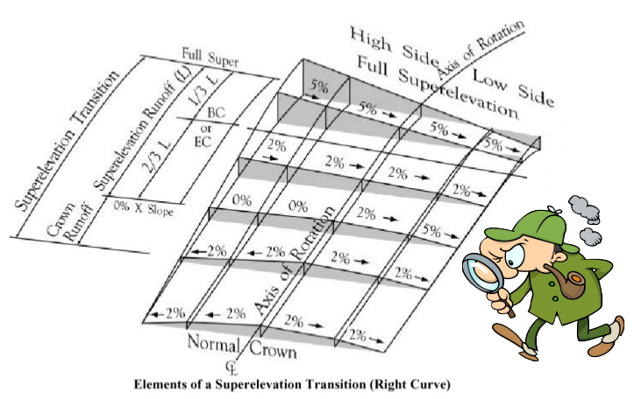
Optimizing Corridor Processing Speeds
Superelevation Lane Objects…Avoid the “Fill”.
Using the fill setting requires a lot of additional processing
Use the boundary setting instead

Slide 18
Optimizing Corridor Processing Speeds
Nesting Depths – Not the kind in a tree branch!.
Avoid using a nested Depth greater than zero unless the program automatically sets it greater.
MoDOT already sets the default Nested Depth setting to Zero in their Workspace.

