Slide 1

I-55 Corridor Improvements Project Noise Wall Public Meeting
July 30, 2024

Slide 2
Outline of Presentation
Noise Study Area
Noise Basics
Sound Wall Basics
Noise Analysis Process
Sound Wall Criteria
What’s Next?

Slide 3
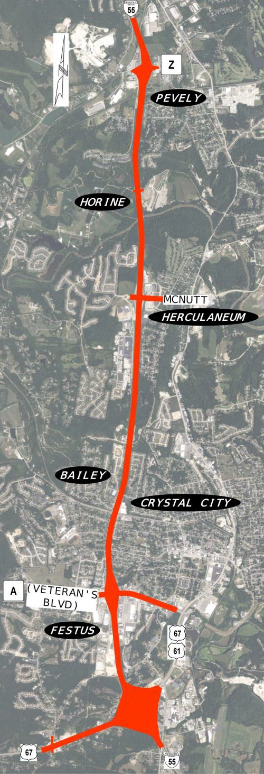



Limits of The Noise Study Area
I-55 from Route Z to US 67
See Boards for
Specific Sound Walls

Slide 4
Noise Basics
Noise is unwanted sound
Sound is a pressure fluctuation caused by vibration (source)
Travels through a medium such as air (path)
Capable of causing response in human ear and brain (received)
Measured in decibels (dBA)

Slide 5
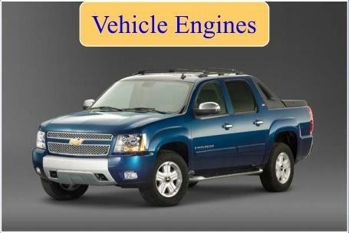
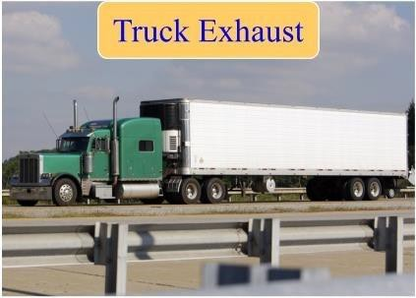
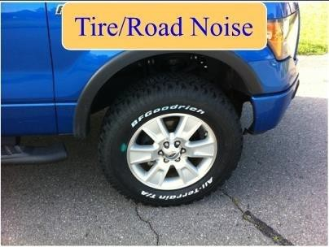
Noise Basics
Main Causes of Noise:

Slide 6
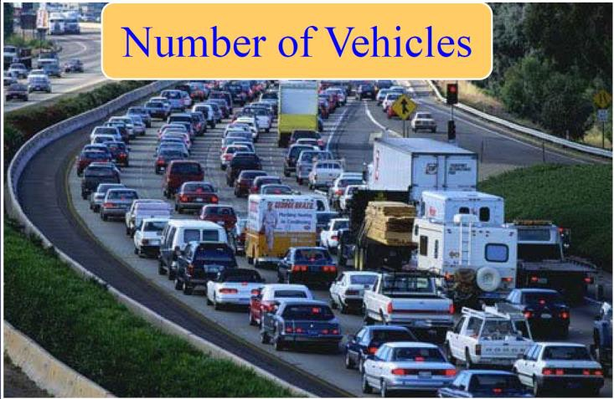
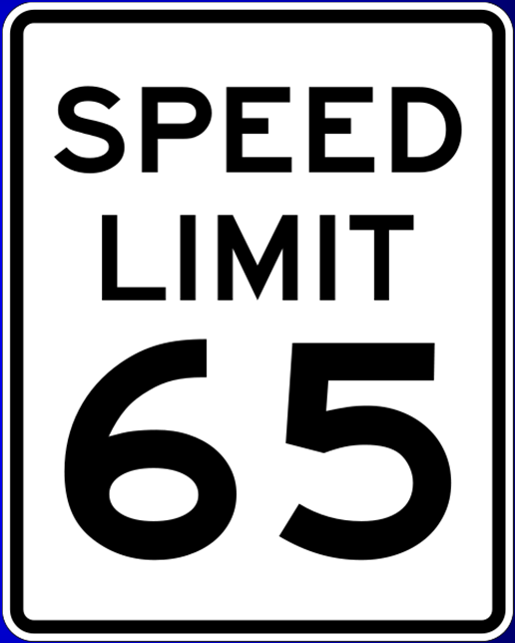
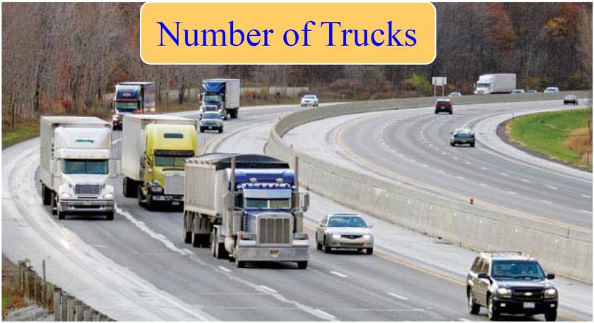
Noise Basics
Main Causes of Noise:
Speed of Traffic

Slide 7
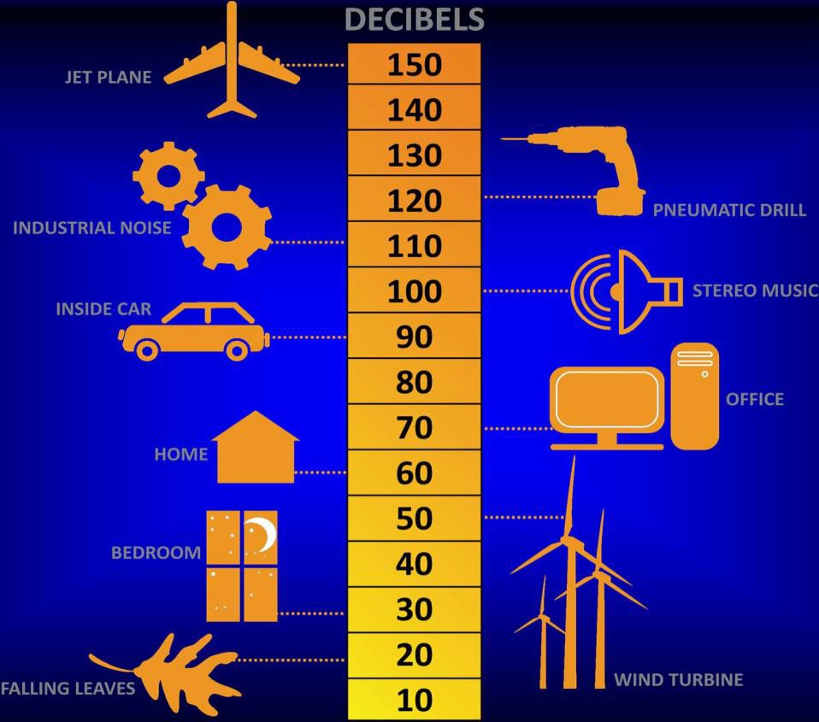
Noise Basics
Noise is measured on a scale known as Decibel (dBA)
66 dBA – Criteria for Sound Wall Feasibility

Slide 8
Noise Basics
Change in Sound Level | Perception
3 dBA | Barely Perceptible
5 dBA | Clearly Perceptible
10 dBA | Twice as Loud

Slide 9
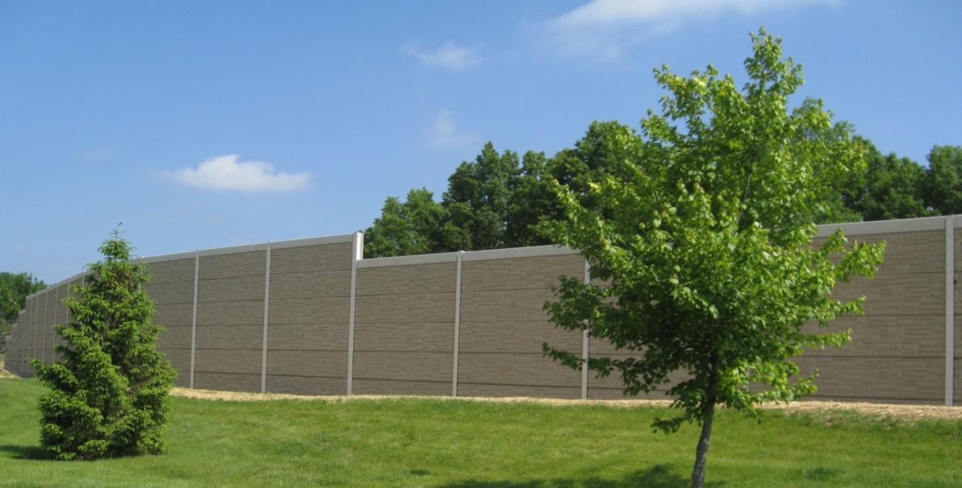
Sound Wall Basics
Typical sound wall has a panel design
Pattern: Ashlar Stone

Slide 10
Noise Analysis Process
Identify areas of frequent outdoor human use
Front or backyards of residences, outdoor seating at
commercial properties
Future noise level prediction based upon year 2044
traffic forecasts
Field measurement of existing noise levels
Determine impacts
FHWA Software: TNM
Evaluate noise walls for benefits

Slide 11
Noise Analysis Process
Feasible
Acoustic Feasibility: 5dBA reduction at a majority of impacted receivers
Engineering Feasibility: Consider environmental, drainage, safety, and other issues to identify best location
Reasonable
Noise Reduction Goal – 7dBA reduction for majority of receivers on property directly adjacent to the roadway
Reasonable size – height and area vs. cost
Property owner support: Simple majority of vote

Slide 12
Sound Wall Criteria
Impacted Receiver / Receptor
Any receptor (property) that is determined to be 66 decibels or greater in an outdoor residential setting.
Benefited Receiver / Receptor
A receptor (property) that receives at least a 7 decibel reduction in noise level with the addition of a sound barrier.

Slide 13
Sound Wall Criteria
Existing noise level must exceed 66 dBA
Sound wall must provide a minimum 7 dBA reduction
Sound wall must be no higher than 20 feet
Sound wall must be built on state property and meet safety and
maintenance needs
Majority of benefited first-row property residents must agree to sound wall
Area per Benefited Receptor (APBR) - Sound wall cannot
exceed 1,300 square feet of wall per benefited receptor

Slide 14
What’s Next?
First row Impacted/benefitted receivers will be allowed
the opportunity to vote
See boards for specific wall locations
All ballots must be returned or postmarked by August 13, 2024
Ballots may be turned in tonight

Slide 15
Thank you for Attending
Slideshow Will Automatically Restart

