Slide 1



Welcome!
Route AC
(New Halls Ferry Road) Improvements
Open House

Slide 2




Crash Data
From Shackelford Rd. to Dunn Rd. (2016-2020)
1800 crashes
5x statewide average
for similar roads
22 crashes
involving pedestrians
3 crashes
involving bicyclists
20 crashes resulting in serious or fatal injuries

Slide 3
New Halls Ferry Improvements

Slide 4
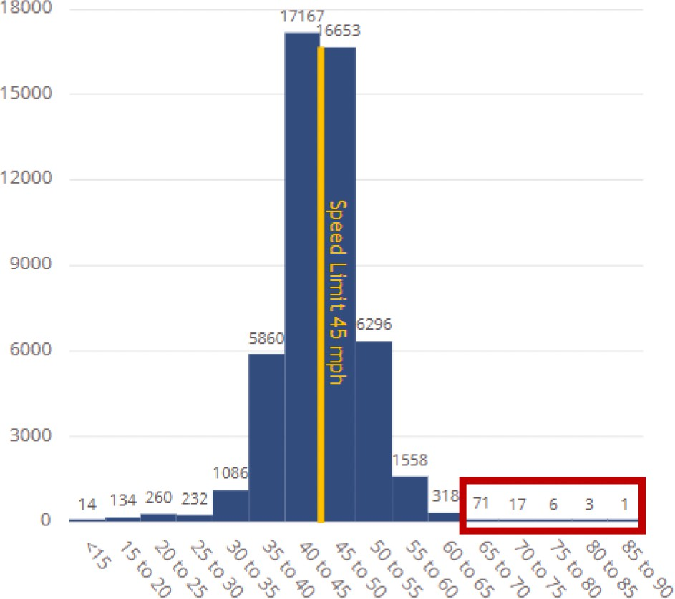
New Halls Ferry Speed Study
Based on speed data collected by MoDOT for 5 days in 2024
Posted Speed Limit: 45 mph Highest recorded speed: 89 mph 50% drive over the speed limit 17% travel 50 mph or more
Number of Drivers
Over 95 drivers go over
65 mph
Drivers Speed

Slide 5
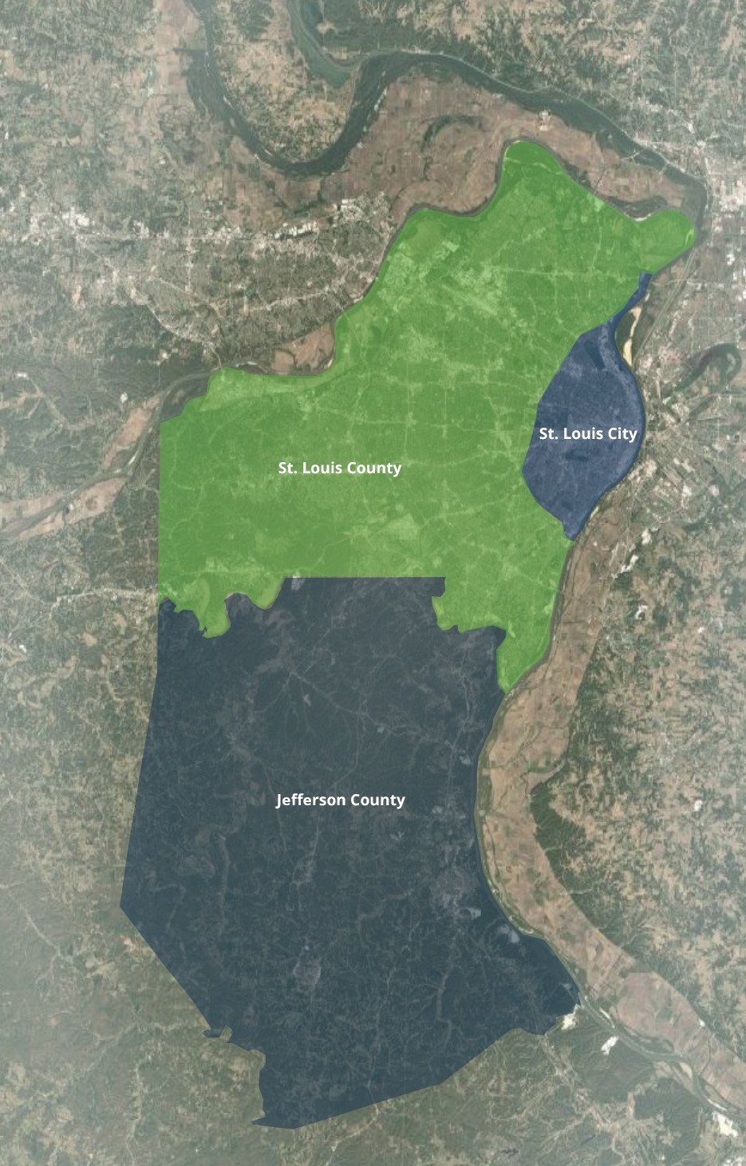
Overall Project Info
5,321 serious or fatal crashes
This project includes over 230 locations in Jefferson County,
St. Louis City, and St. Louis County
32 unique types of safety improvements
430+ installations

Slide 6

Project Budget & Results
$52 Million
MoDOT | $48 million
St. Louis County | $4 million
* St. Louis County project includes work on St. Louis County Roads only. This budget consists of $2 million in Federal Safety Funds and $2 million in St. Louis County funds.
170
Serious and Fatal Injury Crashes Reduced
(Estimated) over ten-year period
$1.2 Billion
In estimated societal savings due to crash reduction
Source: The Highway Safety Manual

Slide 7
Project Goals
Reduce fatal and serious injury crashes within the budget of $52 million.
Maximize safety improvements for pedestrians and roadway users distributed equitably across the project area.
Provide improvements with reasonable maintenance and service life.
Construct improvements with an emphasis on safety for workers and the traveling public.
Deliver the project by June 30, 2026, using a diverse workforce.

Slide 8
Safety Improvements in North
County
Description
Visual
Retroreflective Backplates
Increase visibility of signals by adding retroreflective yellow border
Chevrons and Curve Warning Signs
These signs increase visibility of roadway curves to help drivers navigate the curve safely
Stop Sign with Flashing LEDs
Increase visibility of stop sign by incorporating LED lights
Reduces angle driver must
look over their shoulder to see oncoming traffic
Modified Right Turns
Encourages slower, more attentive driving in right turn lane helping both
vehicles and pedestrians
By shifting left-turn lanes, drivers have a clearer line of sight to choose when to turn left
Offset Left-Turns

Slide 9
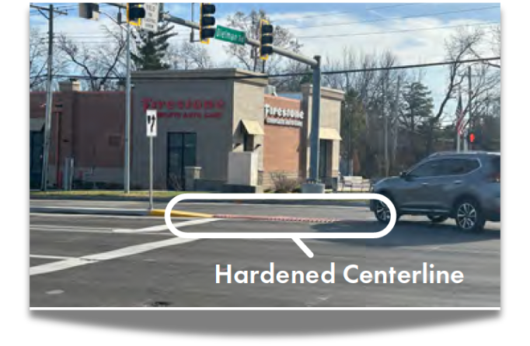
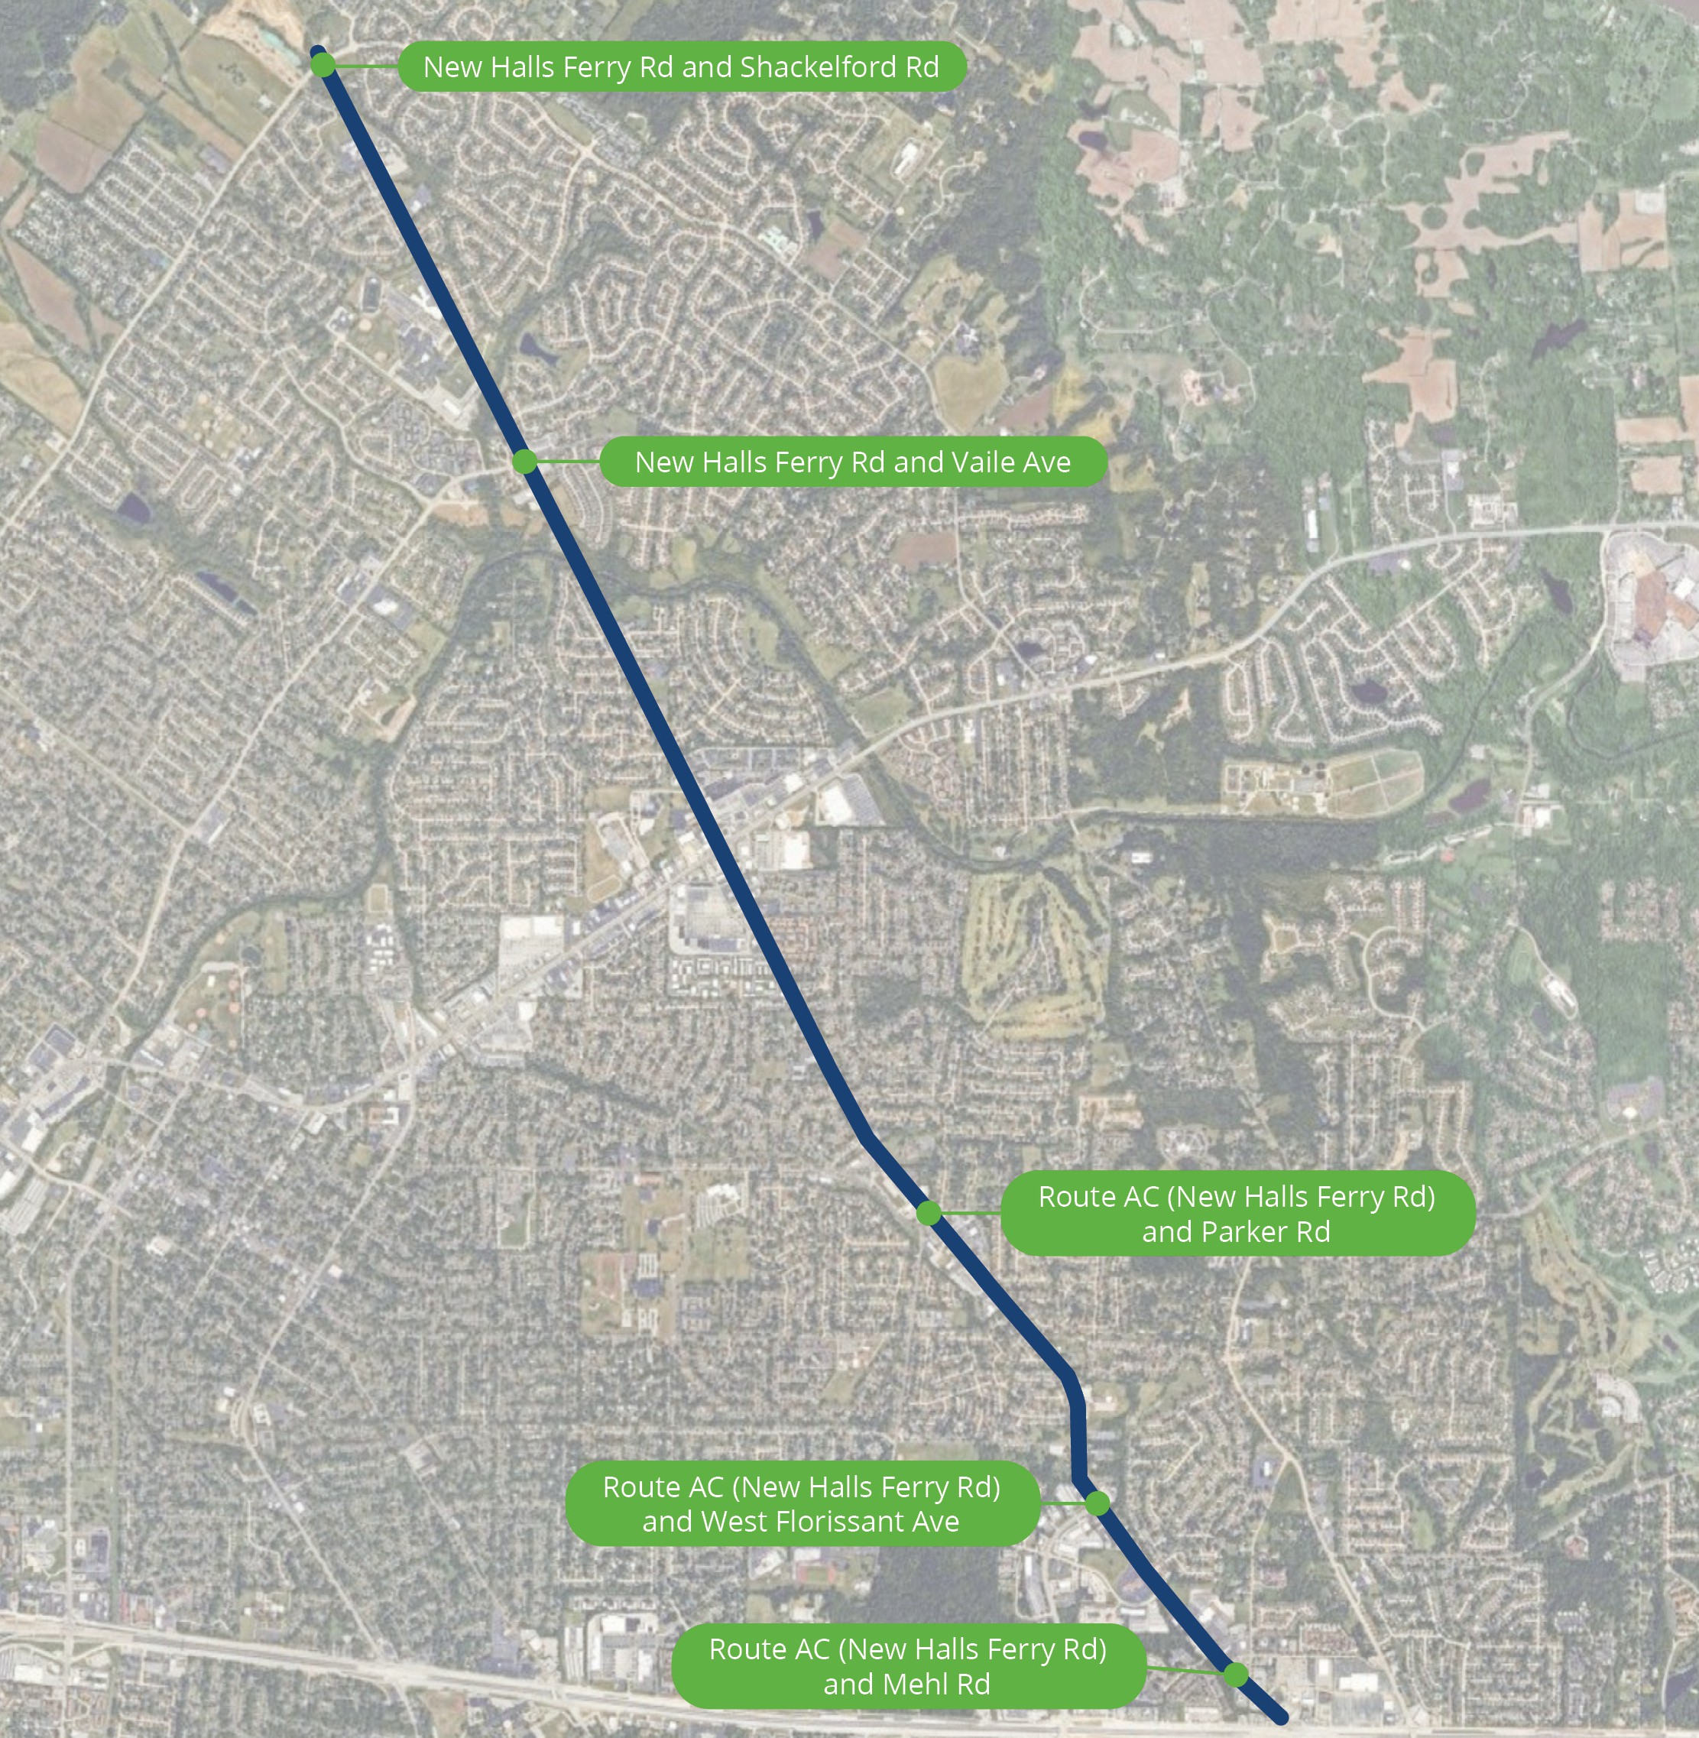
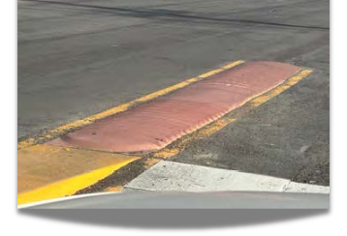

Hardened Centerline Locations
Hardened Centerline: Decreasing left-turn conflicts by extending a low median island with rumble strips into the intersection
See strip maps located on tables for proposed locations of this safety improvement.

Slide 10
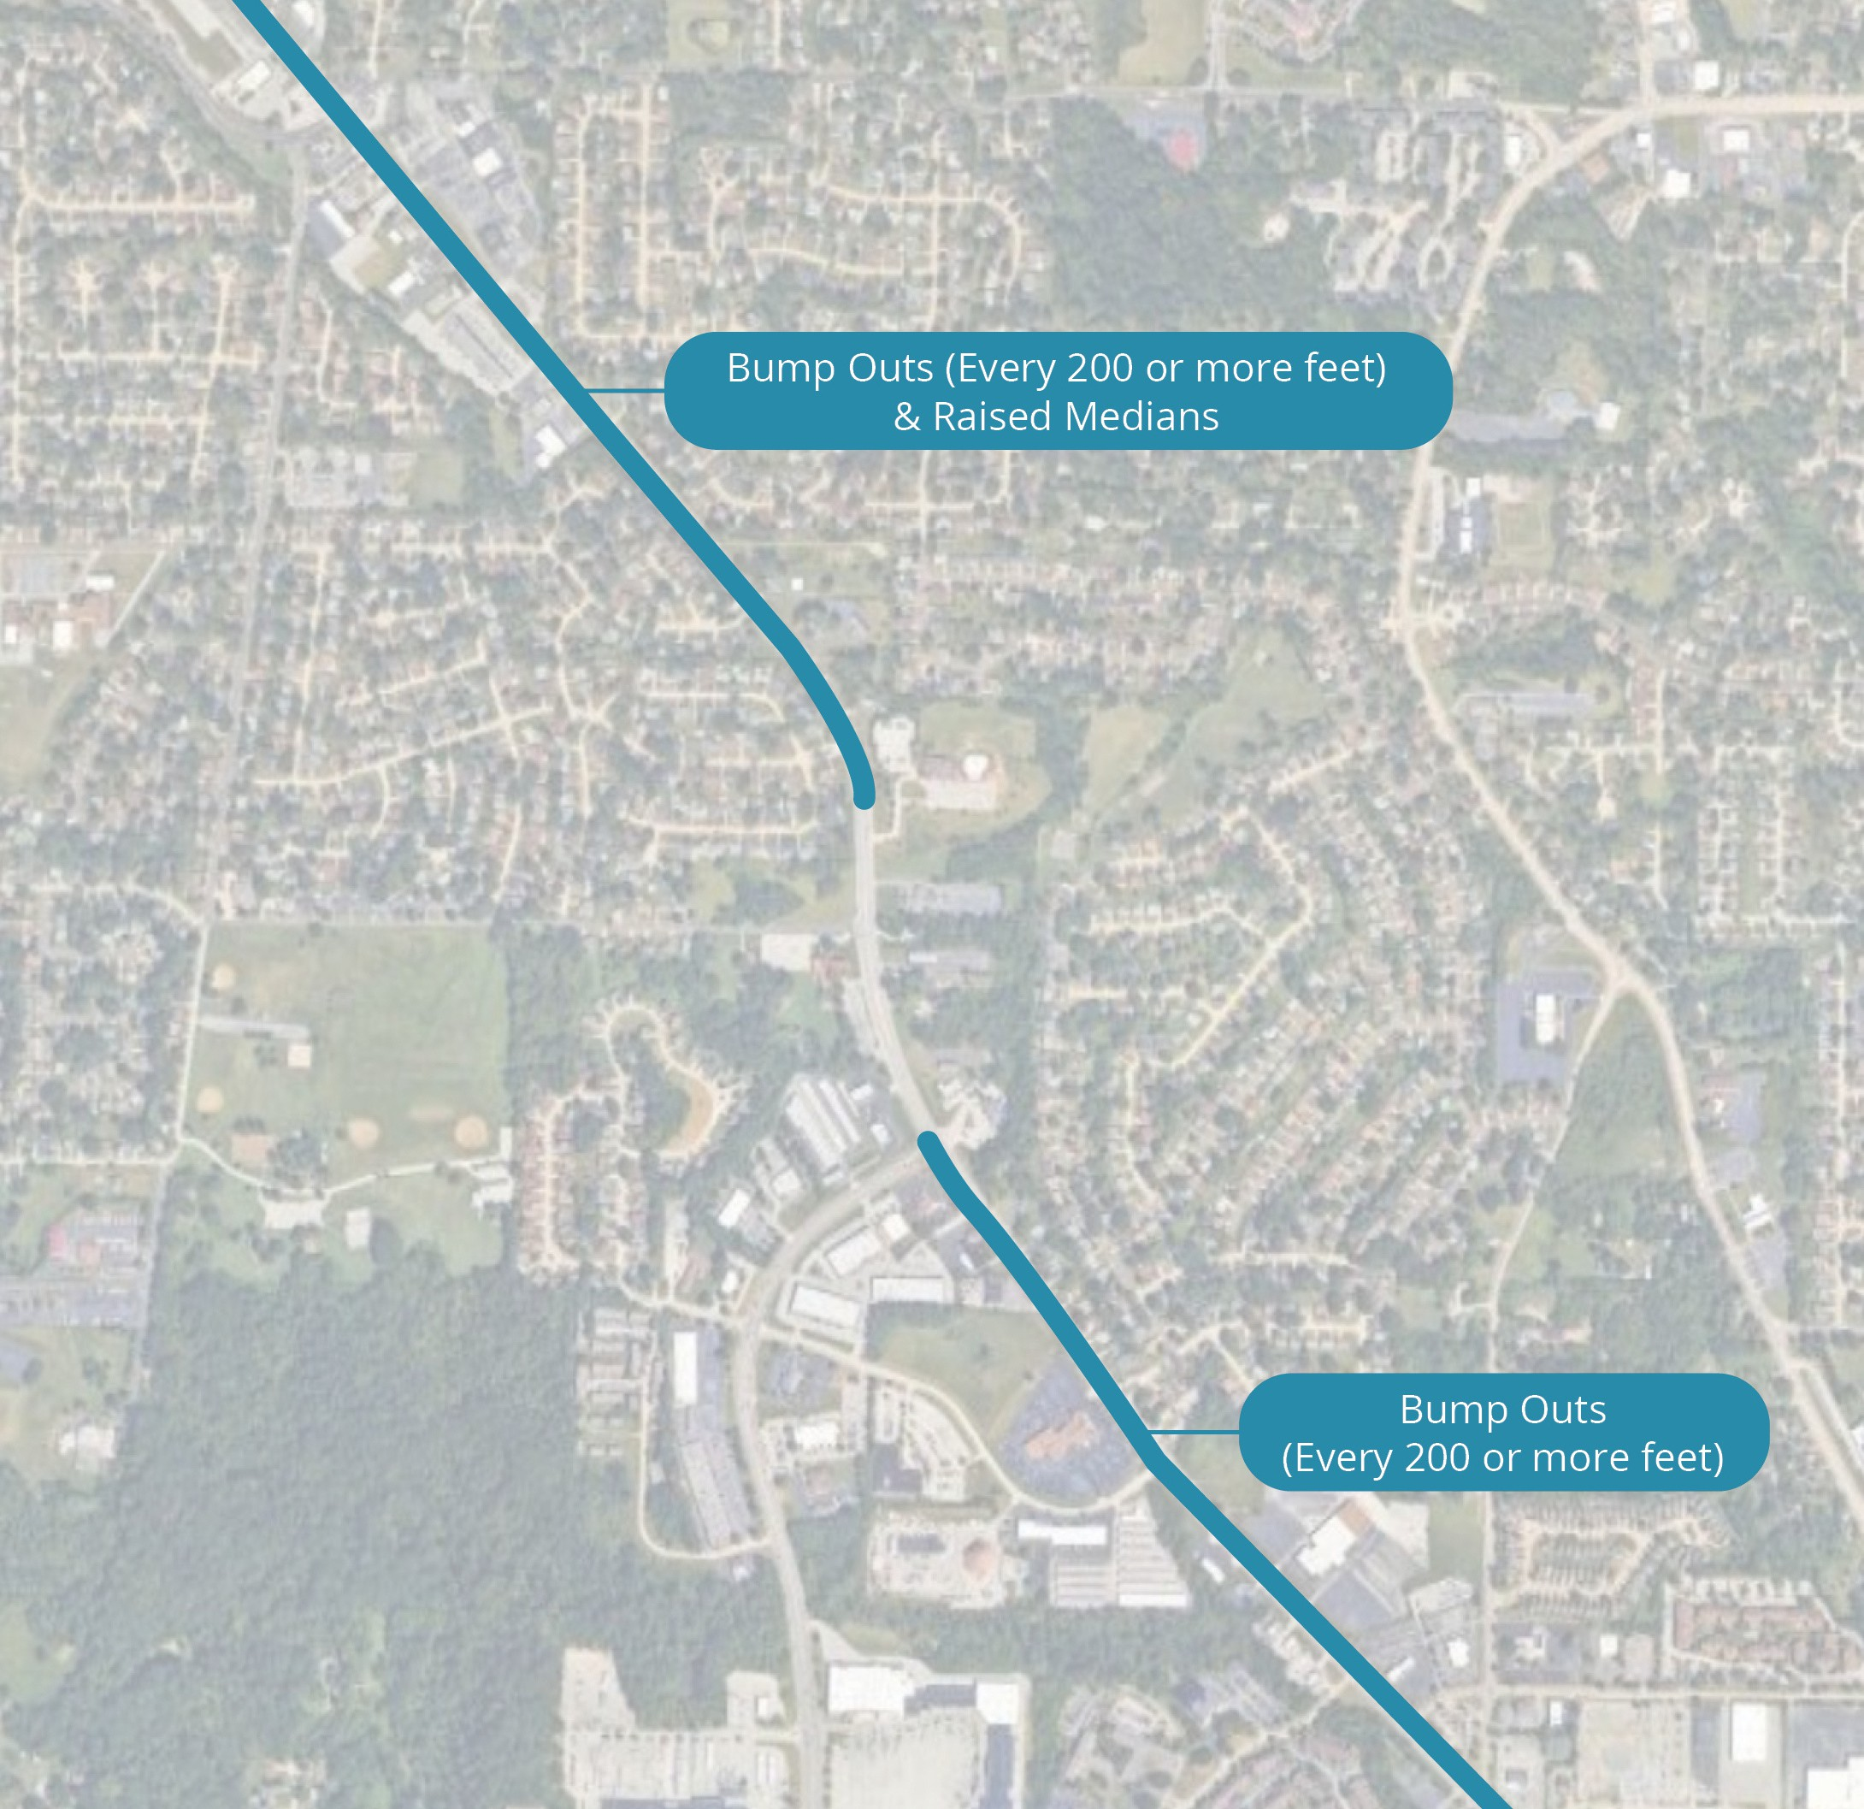
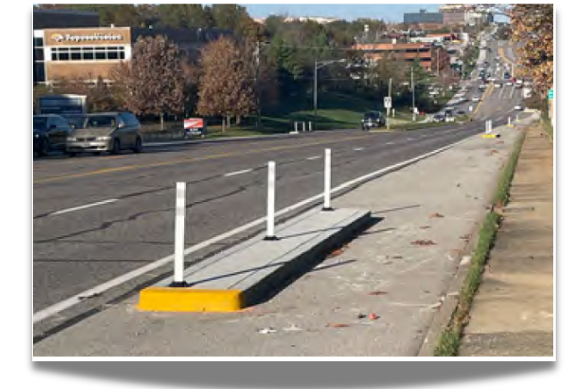
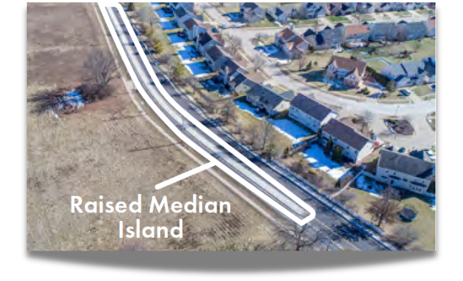

Curb Bump Outs Islands & Raised Median Locations
Curb Bump Out Islands: Islands along the shoulder to provide a visual prompt of a narrower roadway.
Raised Median: New median gives visual prompt of narrower roadway.
See strip maps located on tables for proposed locations of this safety improvement.

Slide 11

Next Steps
Thank you for joining us today at this open house! Before you go:
Complete a comment form!
Paper forms are available in the Comment Area or scan the QR code to complete it online.
We appreciate your feedback!
Stay updated! Sign up for updates on the website: www.MoDOT.org/SLSafetyProject

