Slide 1

TSMO Implementation
October 23, 2019

Slide 2
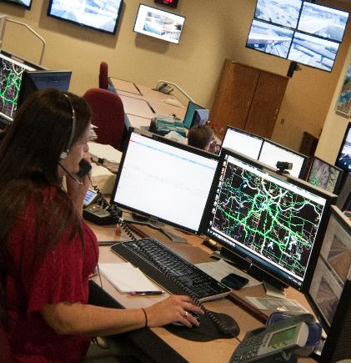
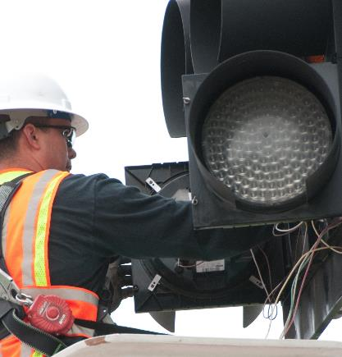

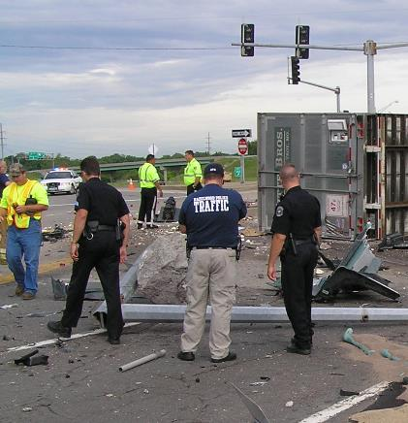
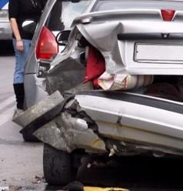
TSMO Implementation Agenda
General
Update
Advancing
TSMO
Work Zone
Management
Traffic Incident Management

Slide 3
Integrated strategies to optimize the performance of existing infrastructure… to preserve capacity and improve safety and reliability of transportation systems.
TSMO MISSION

Slide 4

Purpose of
This Effort
Implement TSMO
Program and Action Plan 2017

Slide 5
Central Office Highway Safety & Traffic Liaison Engineers
FHWA
Advancing TSMO
Work Zone Management
Traffic Incident Management
SMT
Ashley Buechter | Alex Wassman | Katy Harlan
John Miller | Brian Nevins
Randy Johnson | Team Lead
Nicole Hood | SMT Sponsor
10 Additional Team Members
Dan Oesch | Team Lead
Dave Ahlvers| SMT Sponsor
10 Additional Team Members
Owen Hasson | Team Lead
Chris Redline | SMT Sponsor
7 Additional Team Members

Slide 6
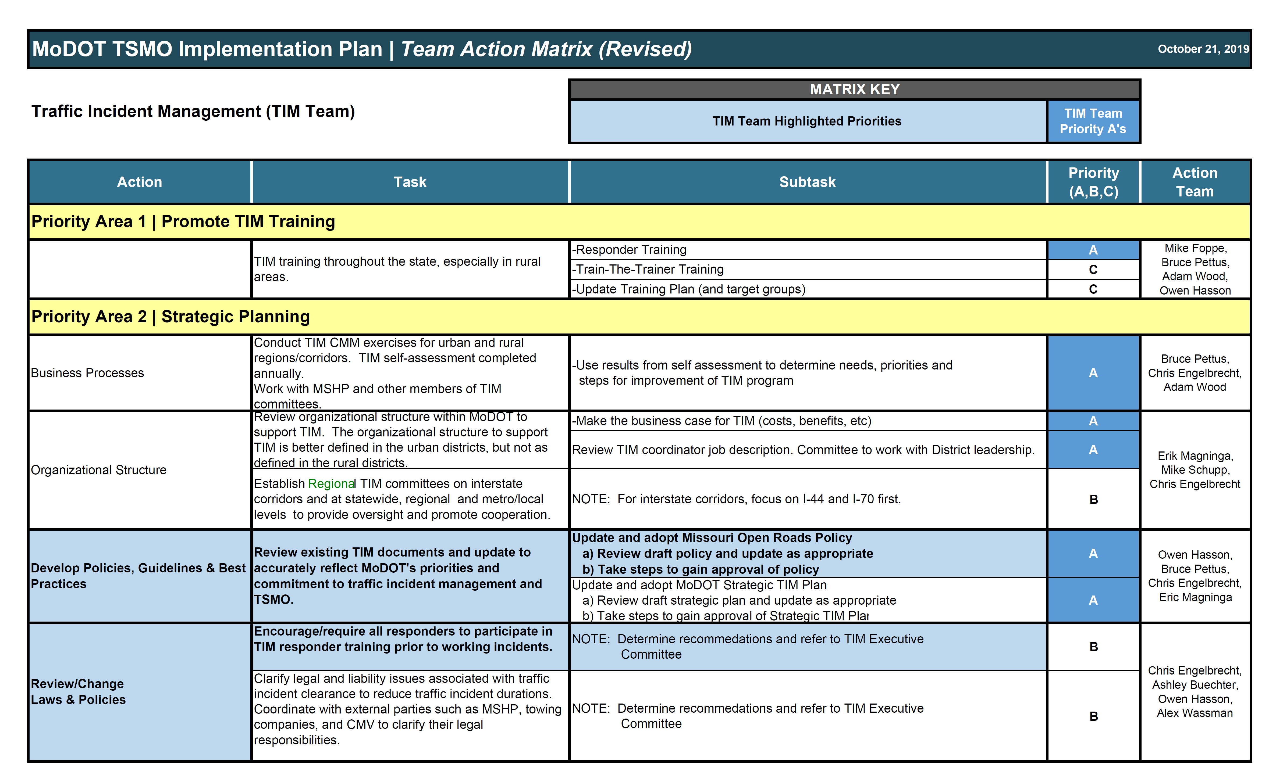
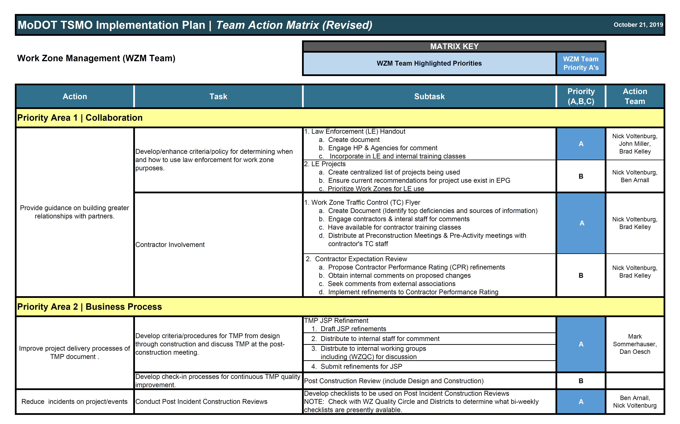
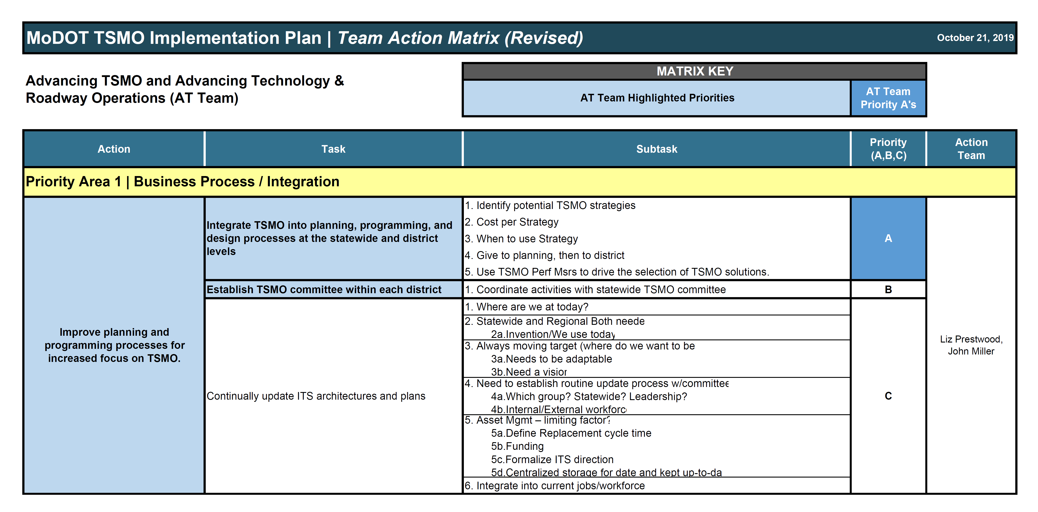
What We’ve Been Doing
Update & Refine Actions
Identify
  Priorities
  Schedules
  Resources
SMT Concurrence

Slide 7
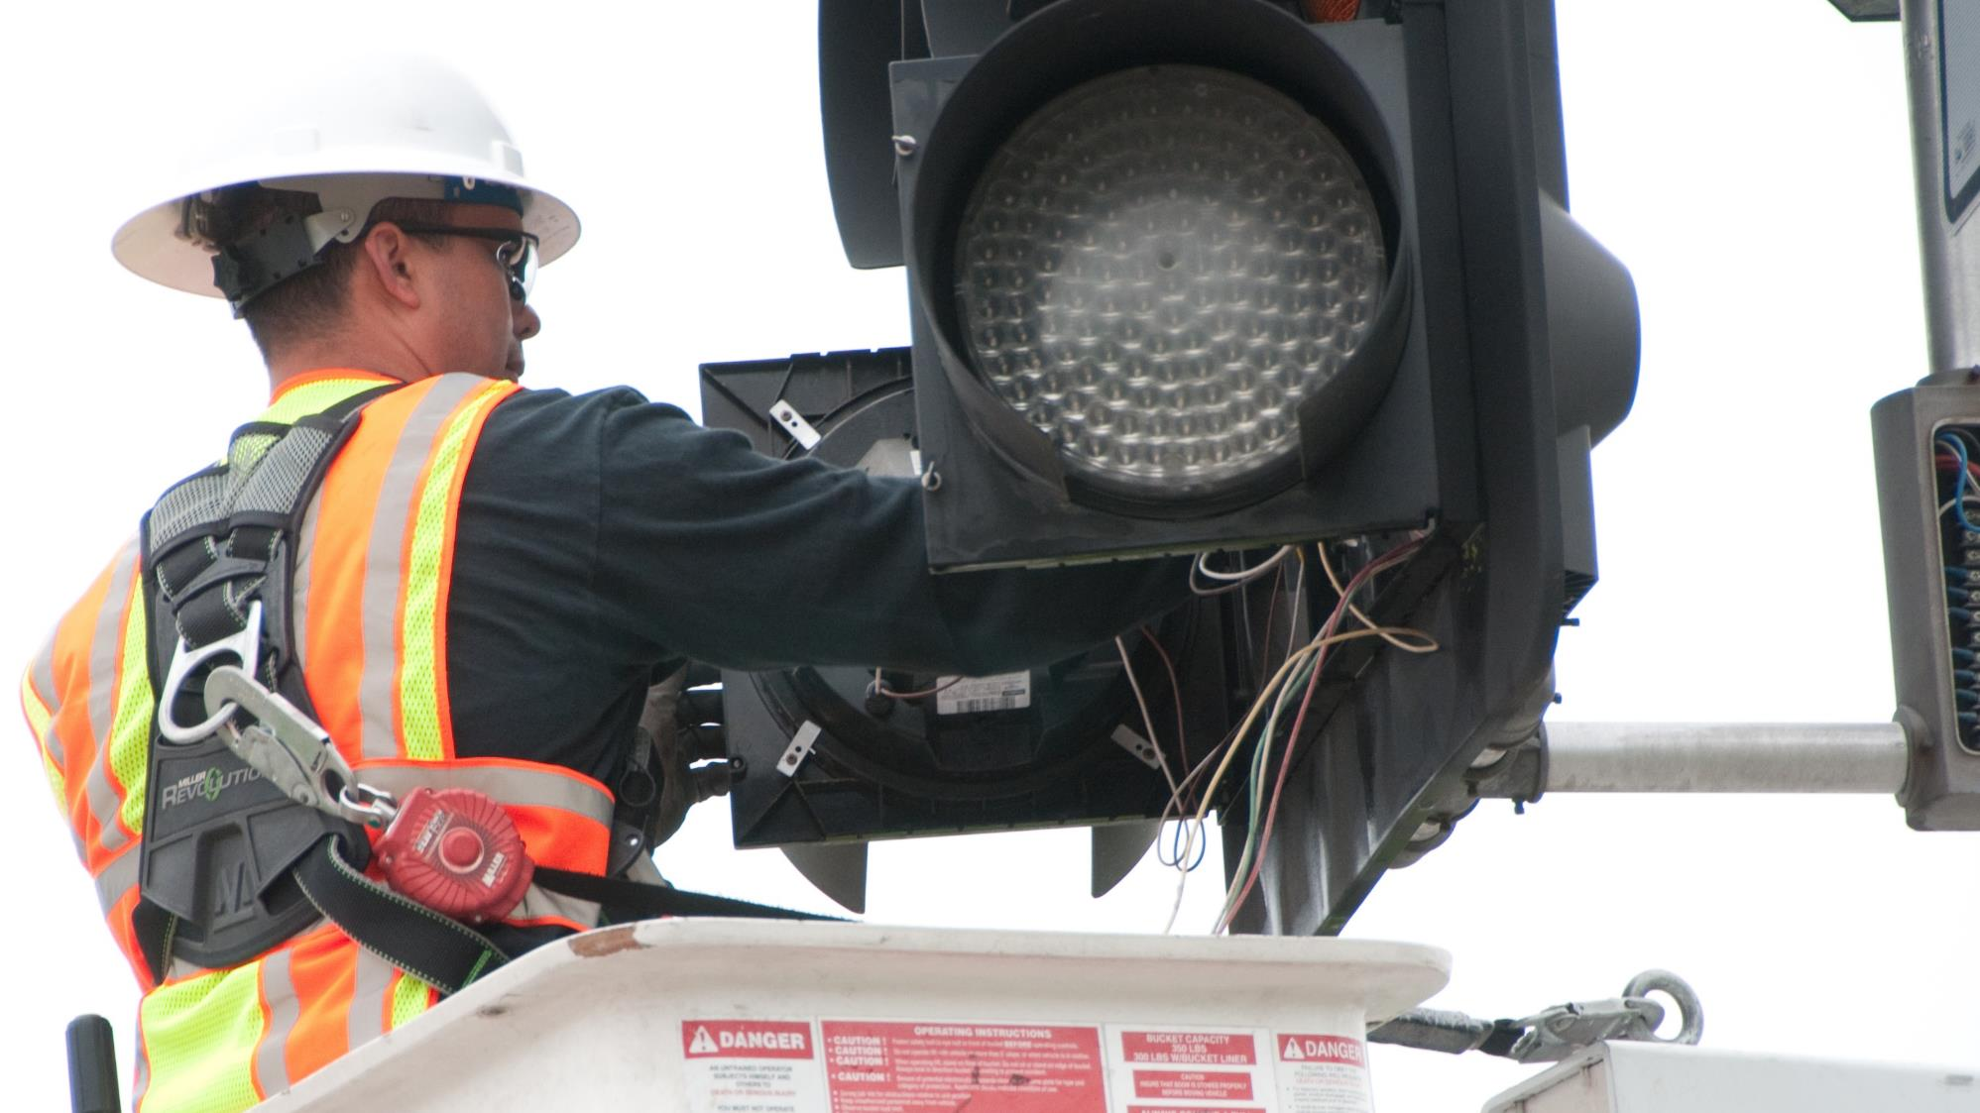
ADVANCING TSMO

Slide 8
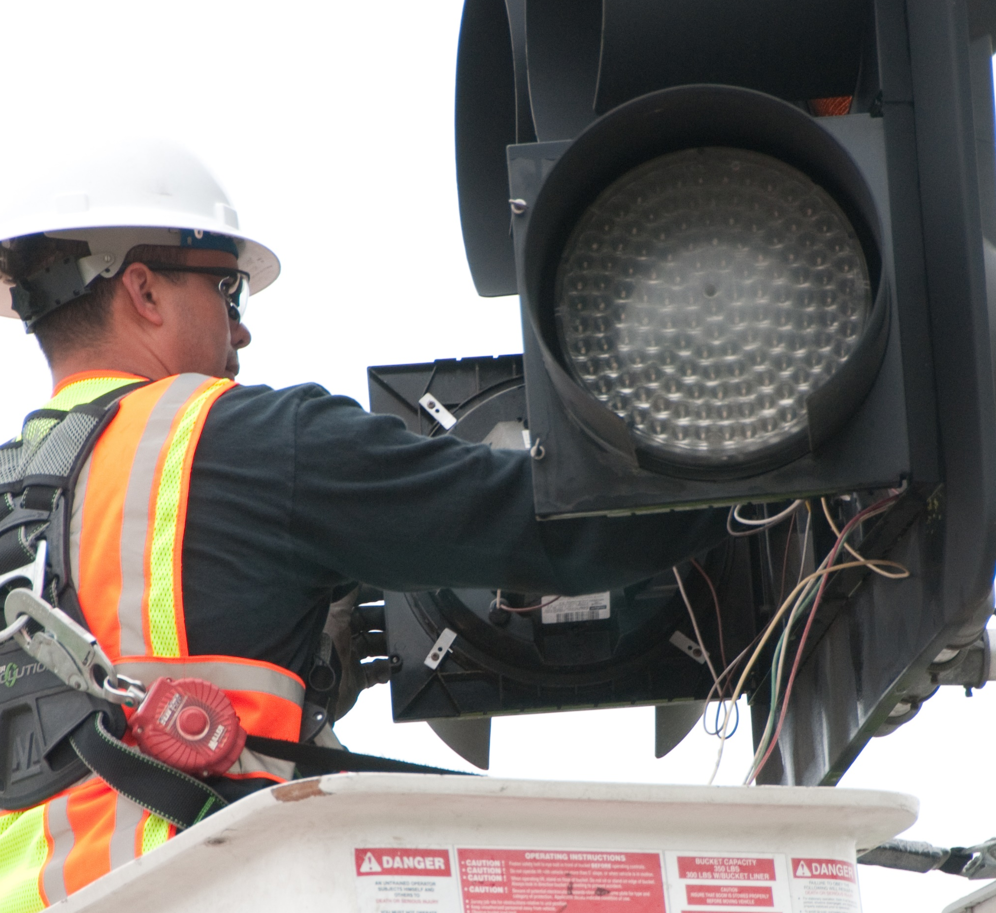
AT TEAM PRIORITIES
Prioritized Areas
Business Process/Integration
Technology/Traffic Management
Funding
Agency Culture
Performance Measures/Data
Educate/Training
Organization/Work Force

Slide 9
AT TEAM MEMBERS
Nicole Hood | Sponsor
CO Highway Safety and Traffic
Susan Barry | Kansas City District
Susan Summers | Central District
Justin Wagner | St. Louis District
Jami Rana | St. Louis District
Marc Lewis | Southwest District
DeAnne Rickabaugh | CO Motor
Carrier Services
Jen Harper | CO Construction and Materials
Ken Warbritton | CO Maintenance
Dave Simmons | CO Design
Liz Prestwood | CO Innovative Partnership/Alternative Funding
Randy Johnson | Team Lead
Kansas City District

Slide 10
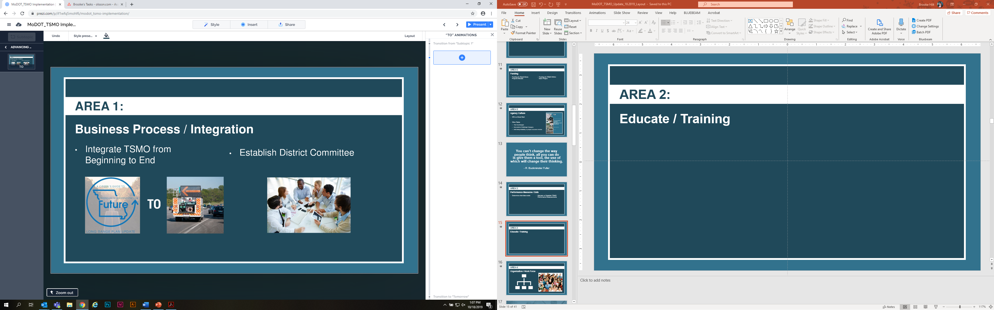
PRIORITY AREA 1:
Business Process / Integration
Integrate TSMO from
Beginning to End
District TSMO Committees

Slide 11
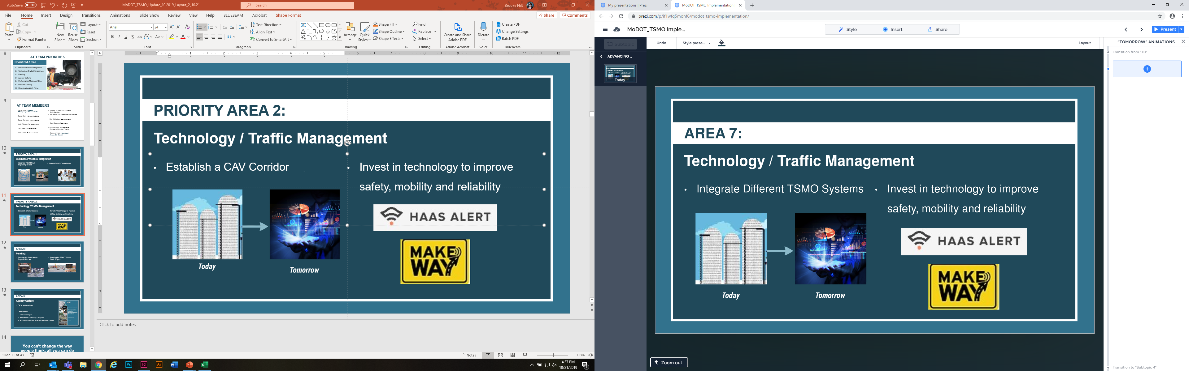
PRIORITY AREA 2:
Technology / Traffic Management
Integrate Different TSMO Systems
Establish a CAV Corridor
Invest in technology to improve safety, mobility and reliability

Slide 12
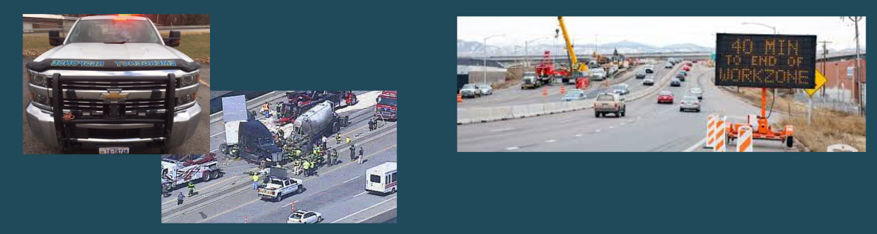
PRIORITY AREA 3:
Funding
Funding for Stand Alone
Projects
Funding for TSMO Within
Each Project

Slide 13
PRIORITY AREA 4:
Agency Culture
Off to a Great Start
Other Tasks
  Peer Exchanges
  Innovations Challenge Category
  Add delay/reliability to project success metrics

Slide 14
You can’t change the way people think, all you can do is give them a tool, the use of which will change their thinking.
- R. Buckminster Fuller

Slide 15
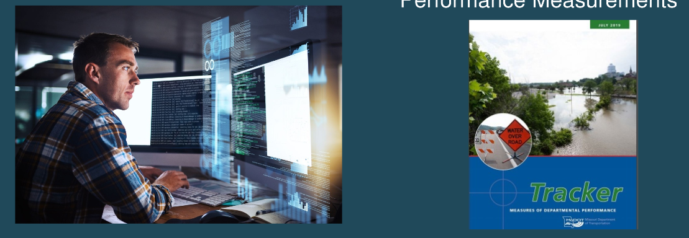
PRIORITY AREA 5:
Performance Measures / Data
Determine what data exists
Maintain or Establish TSMO Performance Measurements

Slide 16
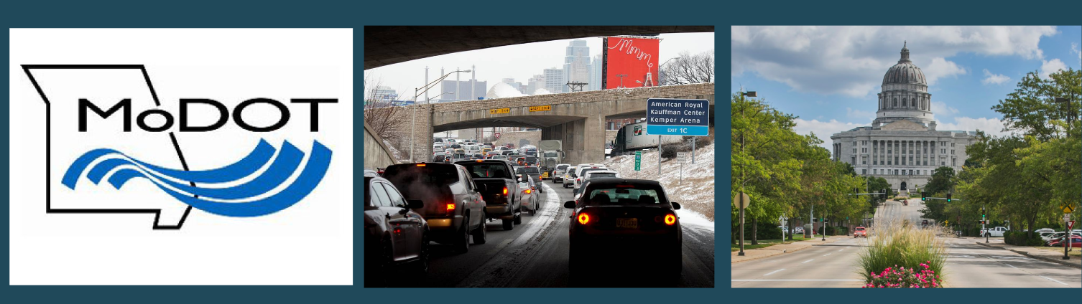
PRIORITY AREA 6:
Educate / Training

Slide 17


PRIORITY AREA 7:
Organization / Work Force

Slide 18
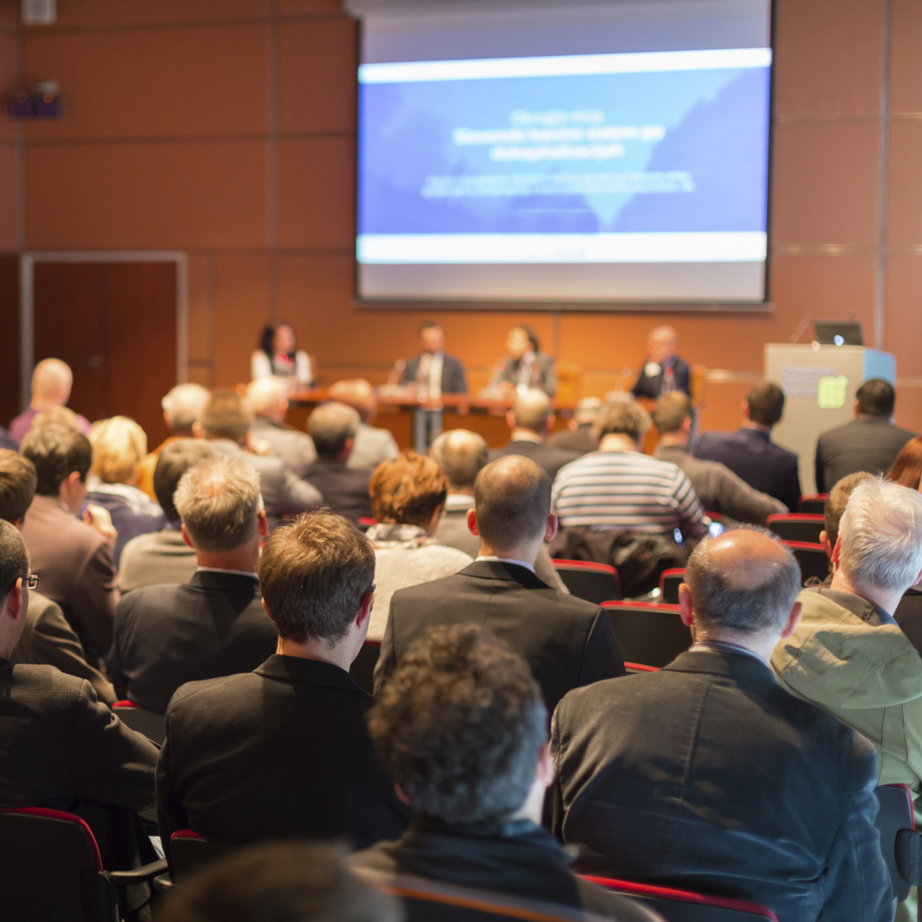
AT TEAM HIGHLIGHTS
Task Highlights
Integrate TSMO into
Program Delivery process
District TSMO Committees
Establish CAV Corridor
Integrated Data Repository
Integrate Crowdsourcing Technologies
Allocate funding for TSMO
Evaluate Statewide/District PM’s (May include Tracker Changes)

Slide 19

WORK ZONE
MANAGEMENT

Slide 20

WZM TEAM PRIORITIES
Prioritized Areas
Collaboration
Business Process
Systems/Technology
Performance Measurement
Organization/Workforce
Agency Culture

Slide 21
MEMBERS
Dave Ahlvers | Sponsor
CO Construction and Materials
Rob Frese | Northeast District
Mark Sommerhauser | Kansas City District
James Connel | St. Louis District
Ben Arnall | Southwest District
Seth Bollinger | Southeast District
Mike Shea | CO Maintenance
Troy Hughes | CO Design
Jay Bestgen | CO Const. & Materials
Nick Voltenburg | CO Safety and Traffic
Brad Kelley | CO Transportation Planning
Dan Oesch | Team Lead
CO Construction and Materials

Slide 22
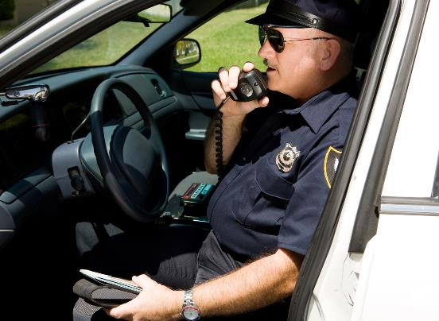

PRIORITY AREA 1:
Collaboration
Develop/enhance criteria/policy for
determining when and how to use
law enforcement for work zone purposes.
Contractor Involvement

Slide 23
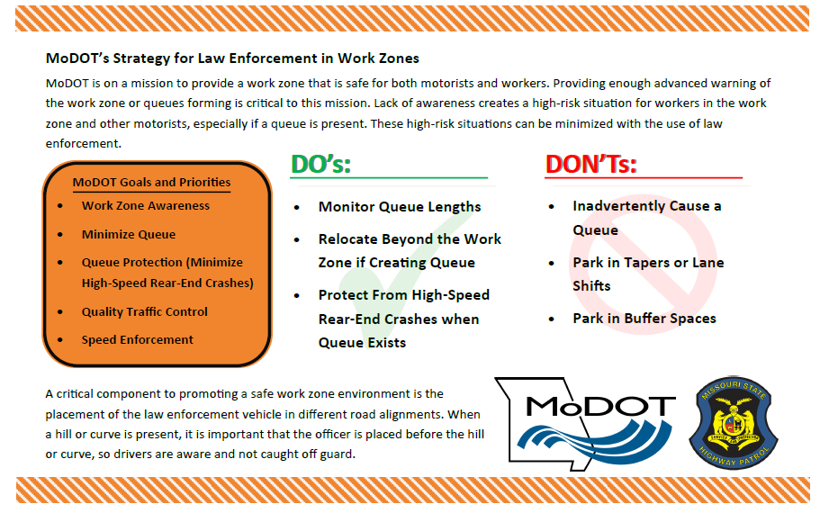
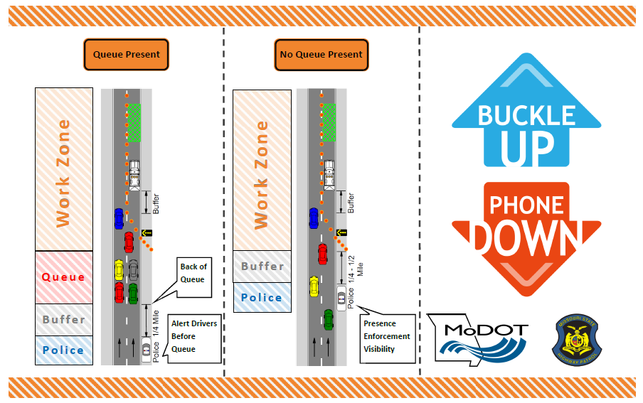
Law Enforcement Handout & Deployment
PRIORITY AREA 1: Collaboration
Nick Voltenburg | Ben Arnall | Brad Kelley

Slide 24
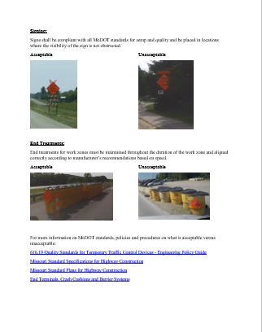
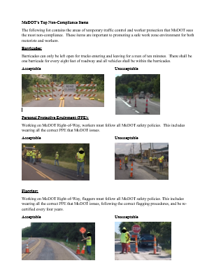
Contractor Involvement
PRIORITY AREA 1: Collaboration
1) Work Zone Traffic Control Flyer
  Critical Information
    Preconstruction Conference
    On-Site Conversation
  Top 10 Deficiencies
2) Contractor Performance Rating – Refinement
  Placing greater emphasis on Safety Aspects
Nick Voltenburg | Jay Bestgen | Brad Kelley

Slide 25
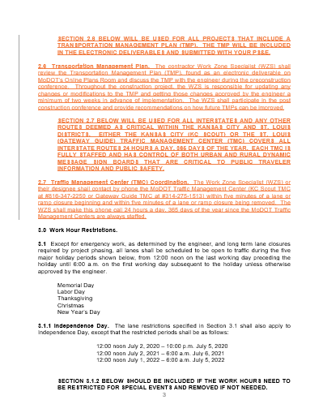
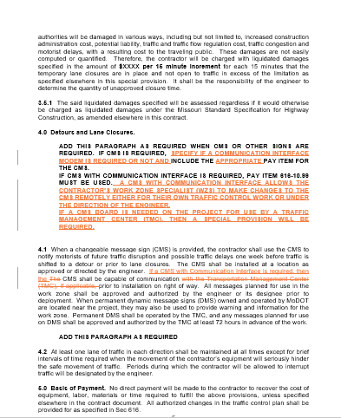
Transportation Management Plan (TMP)
PRIORITY AREA 2: Business Process
Refining JSP to go from design through construction
TMP Check-in Process for
continual improvement
Mark Sommerhauser | Dan Oesch

Slide 26

PRIORITY AREA 2: Business Process
WZ Routine Checklists
    Refinement of Existing Checklists and Process
    Implementation
Ben Arnall | Nick Voltenburg

Slide 27
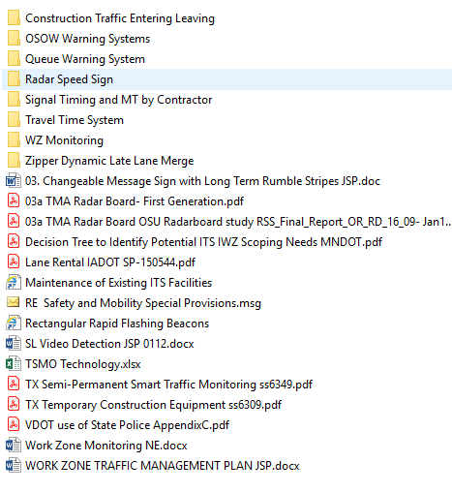
PRIORITY AREA 3: System/Technology
Advance Available Technologies
  WZ JSP Assessment, Refinement,
  Additions Underway
  Application Deployment
  Incorporating guidance into
  Designer Training
Seth Bollinger | Rob Freeze | Troy Hughes

Slide 28
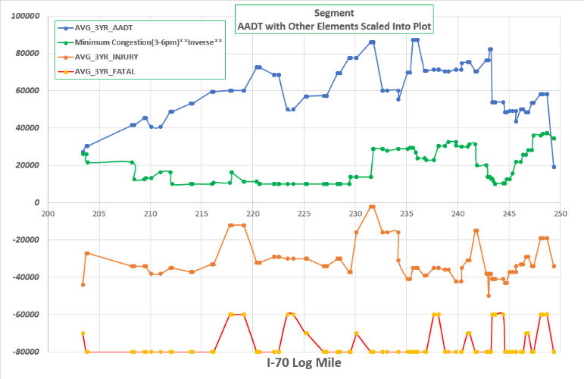
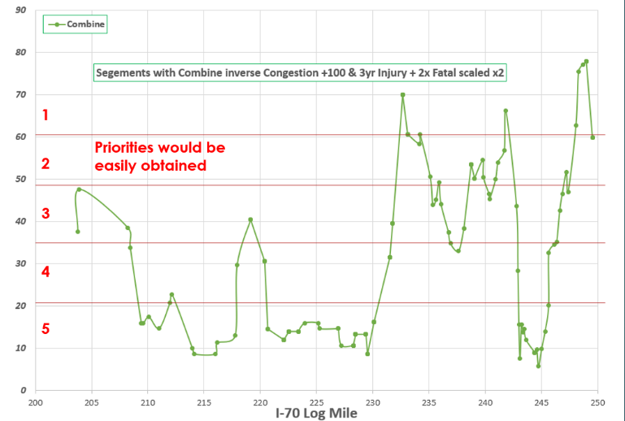
PRIORITY AREA 3: System/Technology
Early Dedicated WZ Funding
Identifying High Priority Areas
Mapping Priority on High Volume System
  Ensure sufficient funding
  considered at Planning Stage
Ensure Delay/Queuing is considered in beginning of the Design Process
Dave Ahlvers | Dan Oesch | Brad Kelley

Slide 29
PRIORITY AREA 3: System/Technology
Production of TSMO Summary Document
    Facilitate Project Development Staff with available
    Work Zone Enhancements
Implementation and review of technology deployments
Nick Voltenburg | Alex Wassman | Mark Sommerhauser

Slide 30
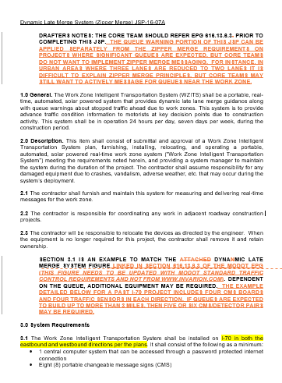
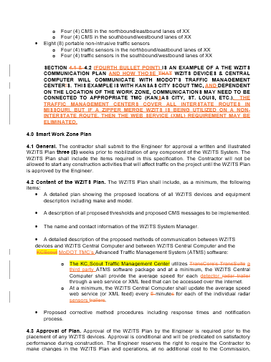
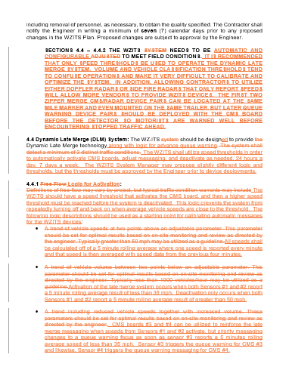
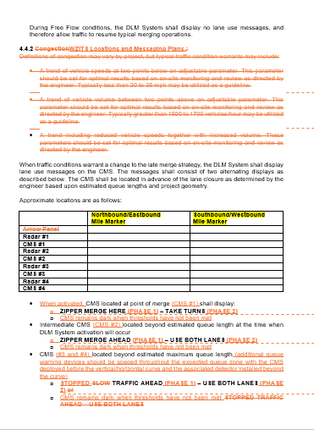
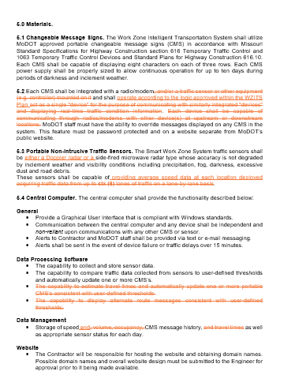
Zipper Merge
PRIORITY AREA 3: System/Technology
Providing recommendation for the Improvement and Deployment of this System and Methodology
Mark Sommerhauser | Dan Oesch

Slide 31
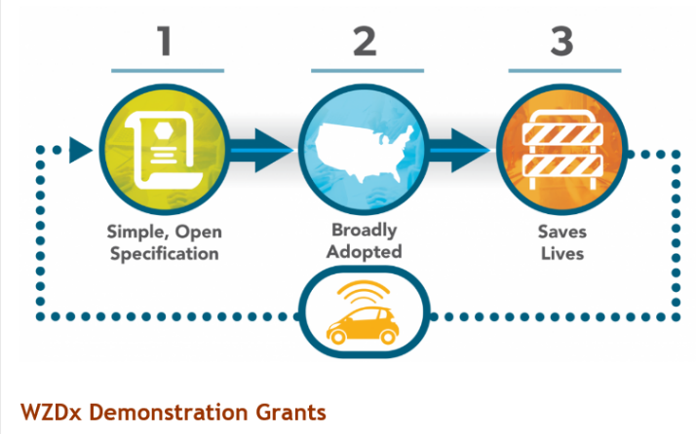
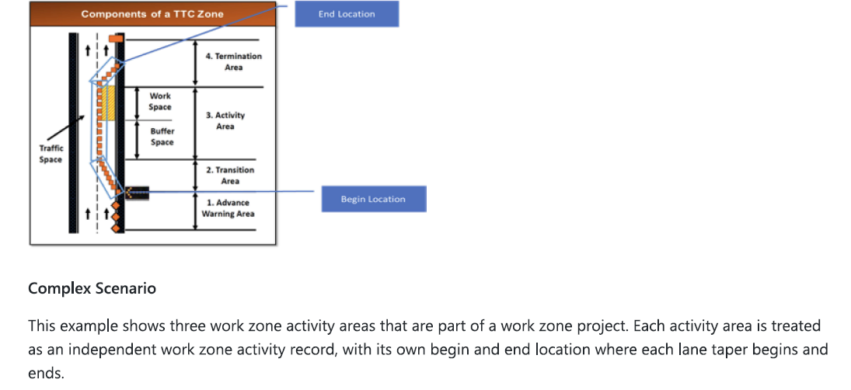
Enhanced Use and Application of Realtime Data
AREA 4: Performance Measurement
Work Zone Data Exchange (WZDx)
Recent Developments
$200K Grant Opportunity
Up to 12 States

Slide 32

WZM TEAM HIGHLIGHTS
Task Highlights
Increase Work Zone ITS
Increase Rumble Strips
By…Pilot WZITS Applications on Existing Projects
Discuss…Doing a lot already

Slide 33
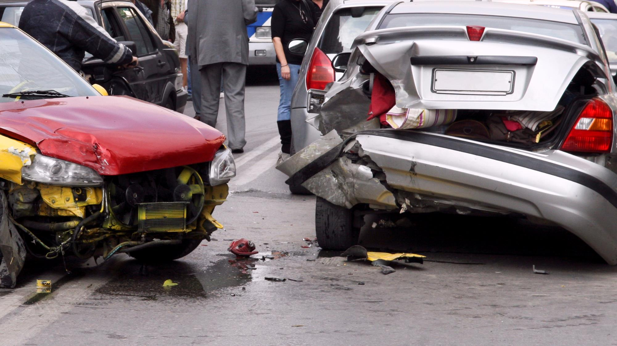
TRAFFIC INCIDENT MANAGEMENT

Slide 34
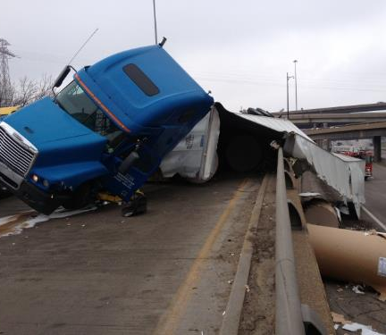
TIM TEAM PRIORITIES
Prioritized Areas
Promote TIM Training
Strategic Planning
Promote TIM Best Practices
Monitor Performance Measures
Corridor TIM Plans

Slide 35
TIM TEAM MEMBERS
Chris Redline | Sponsor
Northwest District
Adam Wood | Northwest District
Erik Maninga| Northeast District
Marcus Slaughter | Kansas City District
Mike Foppe | St. Louis District
Bruce Pettus
Chris Engelbreght | CO
Jake Butler | Southeast District
Owen Hasson | Team Lead
St. Louis District

Slide 36
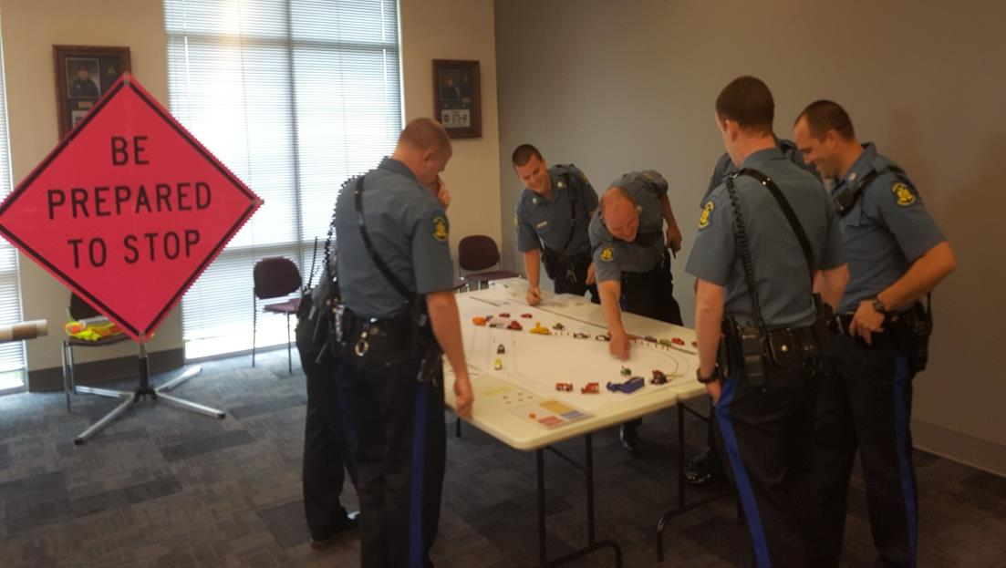
PRIORITY AREA 1:
Promote TIM
Training
TIM training throughout the state, especially in rural areas.

Slide 37
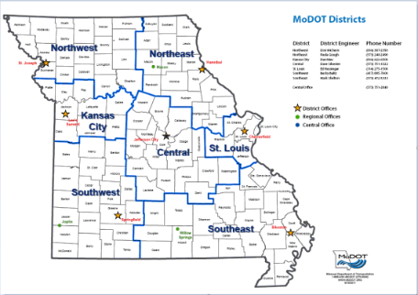
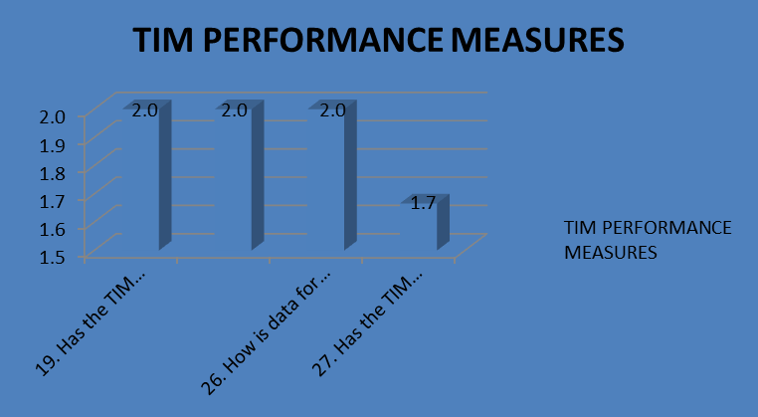

PRIORITY AREA 2:
Strategic Planning
Conduct TIM CMM exercises for urban and rural regions/corridors. TIM self-assessment completed annually.
Work with MSHP and other members of
TIM committees.
Review organizational structure within MoDOT to support TIM. The organizational structure to support TIM is better defined in the urban districts, but not as defined in the rural districts.
Establish Regional TIM committees on interstate corridors and at statewide, regional and metro/local levels to provide oversight and promote cooperation.
Review existing TIM documents and update to accurately reflect MoDOT's priorities and commitment to traffic incident management
and TSMO.
Encourage/require all responders to participate in TIM responder training prior to working incidents.
Clarify legal and liability issues associated with traffic incident clearance to reduce traffic
incident durations.
Coordinate with external parties such as MSHP, towing companies, and CMV to clarify their
legal responsibilities.

Slide 38
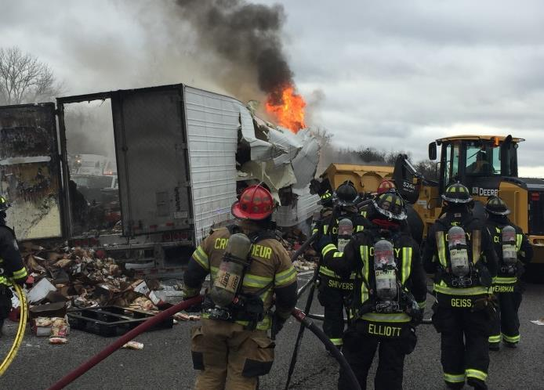
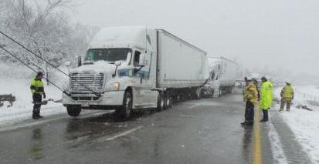
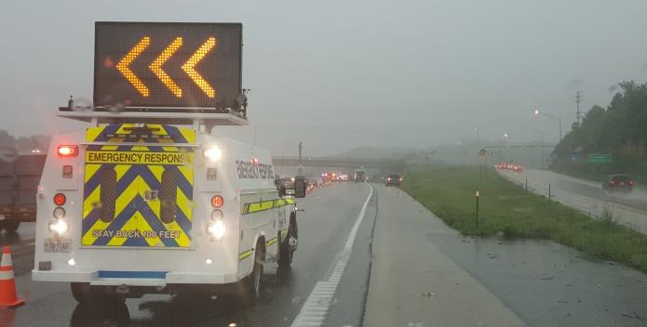
PRIORITY AREA 3:
Promote TIM Best Practices
Develop guidelines and promote best
practices for quick clearance.
Initiate development of standard operating procedures (SOP) between first/emergency responders, MoDOT/TMCs, and Partner Agencies.
Execute MOUs to ensure adoption of
Corridor Response Plans.

Slide 39

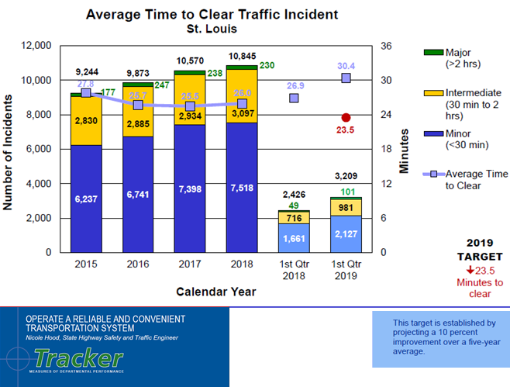
PRIORITY AREA 4:
Establish & Monitor Performance Targets
Update & implement performance goals and measures for TIM in both rural and urban environments.

Slide 40
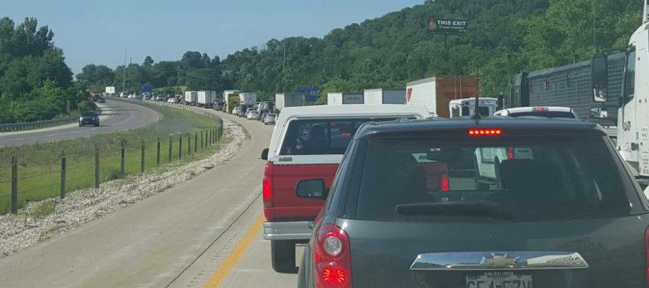
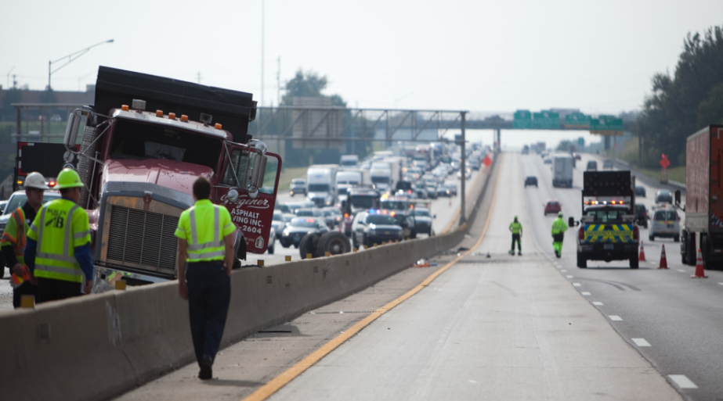
PRIORITY AREA 5:
Corridor TIM Plans
Develop corridor response plans - for interstate highways and metropolitan areas.

Slide 41

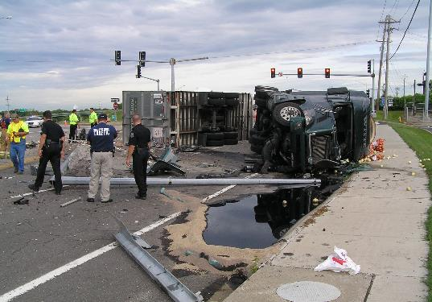
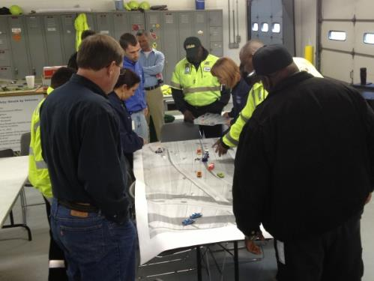
TIM TEAM HIGHLIGHTS
Task Highlights
Open Roads Policy
Require TIM Training
for ALL Responders
(including towers)

Slide 42
Questions?
General
Update
Advancing
TSMO
Work Zone
Management
Traffic Incident Management

