Slide 1
MoDOT
Highway Safety
Child Passenger & Bike/Ped. Resources
Lillian Hinkson
MoDOT, Highway Safety & Traffic
Child Passenger and Non-Motorized Safety Coordinator
Lillian.Hinkson@modot.mo.gov
573-751-5420

Slide 2
Car Seat Safety
Resources for Younger Children
To improve car seat safety in Missouri, we need:
More Instructors
CPSTs in rural areas
CPSTs where children are
CPST certification provided by Safe Kids Worldwide.
Typically a 4-day, in-person class, but hybrid options are becoming available

Slide 3
Smart Riders
Resources for Younger Children
Online learning tool that children can use themselves!
Curriculum is facilitated by the classroom teacher and reinforced by special guests (high schoolers, fire fighters, etc.).
MoDOT has some small prizes available for children after they complete the program and books available for special guests to read to the children.

Slide 4
Booster to Belts
Resources for Younger Children
20-minute presentation that engages students and educates them about the importance of booster seats.
Individual that completes the presentation is eligible for a $150 speaker reimbursement fee.
Developed by DCCCA
Contact
Chase Hobart-boosters@dccca.org

Slide 5
Vulnerable Road Users
To eliminate serious injuries and fatalities of our vulnerable road users, we must change the attitude and culture surrounding roadway use.

Slide 6
Resources for
Vulnerable Road Users
Uses Education, Engineering, Engagement, and Evaluation to normalize courteous behavior and promote pedestrian-friendly communities.
Has been shown to increase drivers yielding at crosswalks by 25%+.
Developed by City of Springfield-Public Works
Contact
Mandy Büttgen-Quinn
mbuettgen@springfieldmo.gov

Slide 7
Robyn Schroeder
MoDOT, Highway Safety & Traffic
Youth Driving Coordinator
Robyn.Schroeder@modot.mo.gov
573-751-2488

Slide 8
Contact
Nick Pitts nick@dwiprevention.org
Patrick DeGrasse Patrick@dwiprevention.org
Impaired Driving
VR driving simulator in a real vehicle
Distracted driving, impaired driving
Participation as the driver
Outside the car are screens for others to see what the driver is seeing
Vehicle simulator and operators that come to school or other event location

Slide 9
B.R.A.K.E.S.
Contact
Robyn Schroeder Robyn.Schroeder@modot.mo.gov https://putonthebrakes.org
Hands-on advanced driver training
Teens and parents
Skid recovery, crash avoidance, off road recovery, panic braking
Vehicles, equipment, and trainers that come to event location
Participants must drive to event location

Slide 10
BUPD Showdown
Contact
Nick Chabarria Chabarria.Nick@aaamissouri.com
Angela Nelson Nelson.Angela@aaamissouri.com
AAA competition between Missouri High Schools
School with the most pledges wins $$$
Community-wide effort led by students
Online sign-up
Materials sent to schools

Slide 11
Contact
Kate Kaslauskas kk3h9@missouri.edu www.mopip.org/CHEERS/
College-focused impaired driving program
CHEERS to the Designated Driver program
University of Missouri Partners In Prevention (PIP)
Program that is available through local businesses

Slide 12
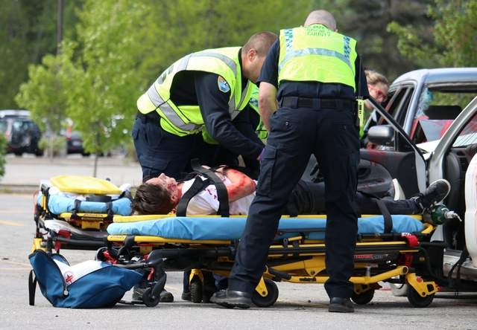
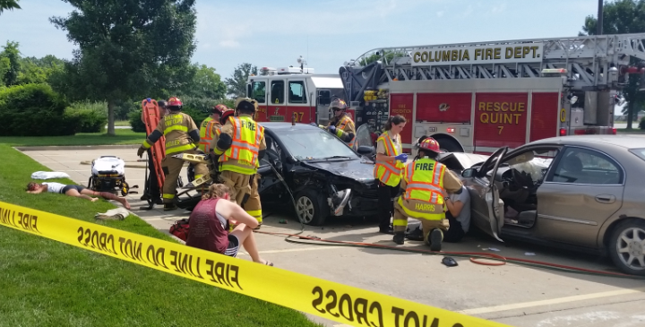
Docudrama (Mock Car Crash)
Contact
Mag Roberts Kirganroberts@hotmail.com
Local Emergency & Enforcement Agencies
Reenactment of car crash
Involves local law enforcement, fire dept., ambulance, coroner, towing
Coordinated and planned locally
Impaired driving, distracted driving, drowsy driving, speed

Slide 13
The Drive to Save Lives
Contact
Robyn Schroeder Robyn.Schroeder@modot.mo.gov
Speed, reckless driving, passenger safety
Cara Filler
~50 Missouri Presentations a year
LIMITED AVAILABILITY
Presentation that will come to school or event location

Slide 14
FCCLA FACTS
Contact
Abigail Lee
alee@fcclainc.org
Families Acting for Community Traffic Safety Program
Student-led projects
Digital materials that are provided to school FCCLA chapters

Slide 15
Contact
Allyn Workman gawcft@health.missouri.edu
Carol Hoormann ceh8zg@health.missouri.edu
Class targeted to parents and teens
Increasing understanding of Missouri’s Graduated Driver License Law
Provides parents with tools to coach and support their new driver
Presenters that come to school or other event location

Slide 16
Is It Worth It?
Contact
Beth Koster kosterb@health.missouri.edu
Distracted driving, impaired driving, seatbelts
60-90 minute interactive classroom presentation
University of Missouri Health Care Injury Prevention and Trauma Outreach Program
Presenters and activities that come to school or other event location

Slide 17
Contact
Chandel Perez Chandel.Perez@embracefamilies.org
Driver’s Education
Creates opportunities and removes barriers to driving
Covers cost of driving lessons for youth in out-of-home care
Applications made online
Lessons coordinated by FLITE

Slide 18
Contact
Christopher Pate – StL Christopher.Pate@madd.org
Evan Lite – KC Evan.Litae@madd.org
Power of You(th)
Interactive presentations on the short- and long-term effects of drinking underage, long-lasting social consequences
Power of Parents
Workshop discussing youth brain development, starting and maintaining conversations about alcohol
Presenters and activities that will come to school or event location

Slide 19
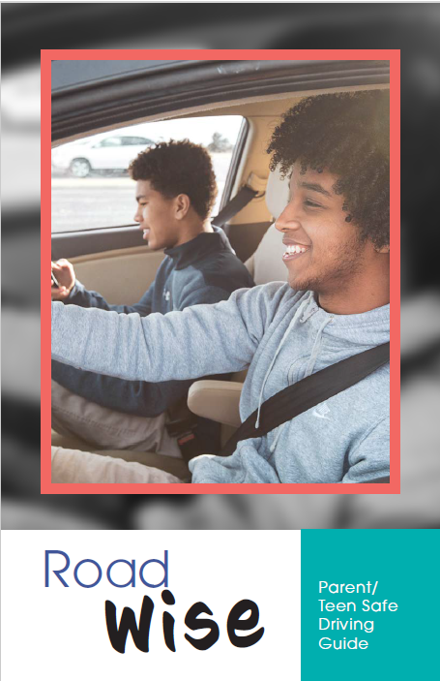
Roadwise
Contact
Robyn Schroeder Robyn.Schroeder@modot.mo.gov
Graduated Driver’s License law
Driving Skills
Road signs
Driving log
Quizzes
Contract
Booklet that is ordered online

Slide 20
SADD
Contact
Alicia Ozenberger aozenberger@actmissouri.org
Chris Dzurick cdzurick@actmissouri.org
Junior High & High School
Distracted driving, impaired driving
PROM – Please Return On Monday
Digital & print materials, educational campaigns
Programs that are made available to school SADD chapters

Slide 21
Contact
Megan Hopper megan@safeandsober.org
Christina Casey christina@safeandsober.org
High school, middle school, and parent programs
Video-based presentations educating on consequences of impaired driving
Criminal
Civil
Personal
Emotional
Educates on how to set limits and prevent underage drinking
Program materials sent to schools or groups

Slide 22
Contact
Kate Kaslauskas kk3h9@missouri.edu www.mopip.org/SMART/
College-focused impaired driving and alcohol server training program
SMART responsible beverage service trainings
University of Missouri Partners In Prevention (PIP)
Online and in-person trainings

Slide 23
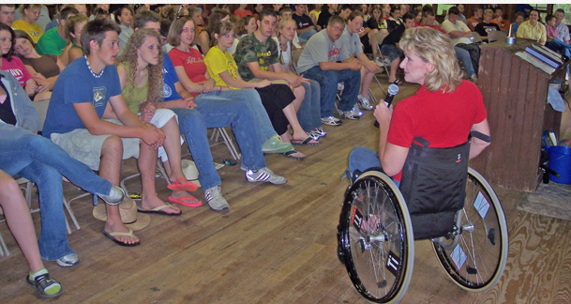
Contact
Nancy Foster (Columbia) nafzgq@health.missouri.edu
Will Nothnagel (Kansas City) will@theresearchfoundationkc.org
Distracted driving, impaired driving, seatbelts, speed
Presentation from survivors of brain and spinal cord injuries
Multiple chapters cover whole state of Missouri
Presenters that come to school or other event location

Slide 24
Contact
Rachel Penny rpenny@cityofcape.org
Peer-to-peer traffic safety leadership training
Empowering youth to become leaders that advocate for safer driving
Schools create an action plan to reduce fatalities within their community
2 Summer Conferences
14 schools
14 students
2 advisors
$15 per person*

Slide 25
TyREDD
Contact
Kerrie Warne Kerrie.Warne@gmail.com
Drowsy Driving
Partnered with Clayton Sleep Institute
Presenters that come to school or other event location

Slide 26
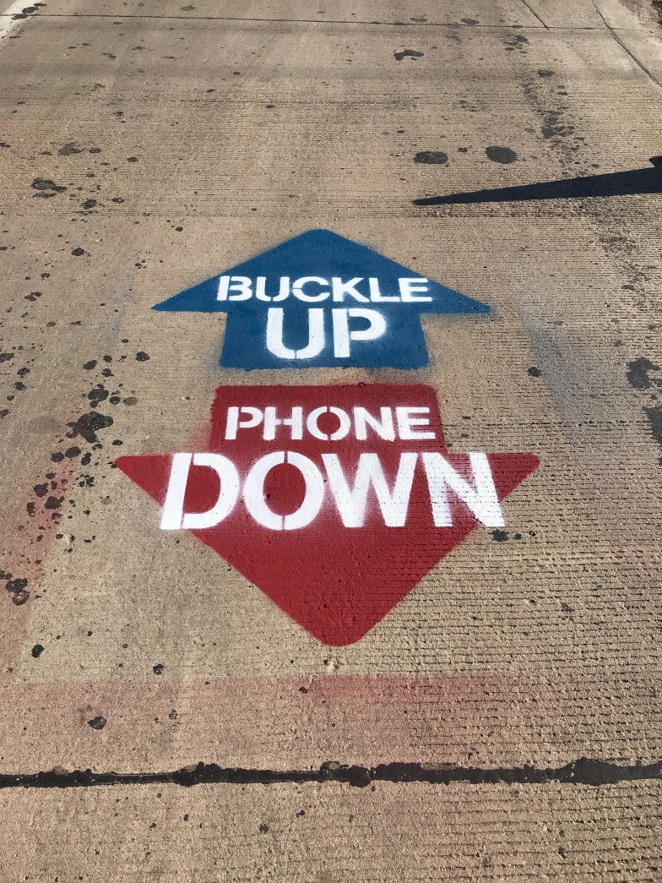
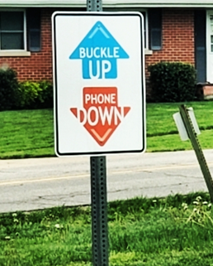
And more!
Contact
Robyn Schroeder Robyn.Schroeder@modot.mo.gov
Posters
Signs
Stencils
Brochures
Don’t forget MSHP
Contact your local troop’s Public Information Officer

Slide 27
Lillian Hinkson
MoDOT, Highway Safety & Traffic
Child Passenger and Non-Motorized Safety Coordinator
Lillian.Hinkson@modot.mo.gov
573-751-5420
Robyn Schroeder
MoDOT, Highway Safety & Traffic
Teen Driving Coordinator
Robyn.Schroeder@modot.mo.gov
573-751-2488

