Slide 1
Intersection Safety Improvements
Marion 61 & F – Palmyra
Safety
Access

Slide 2
Community Advisory Group
Members selected by MoDOT to represent various communities
CAG provided input for MoDOT decision
Goal: Select option for Safety Improvement
Lindell Shumake – State Representative
Lyndon Bode – Presiding Commissioner Marion County
Nathan Miller – City of Palmyra
Rusty Rothweiler – Sydenstricker Farm & Lawn
Bill Goldinger – Farmer – local Agricultural Community
Eddie Bogue – Palmyra Police Chief and Rte F resident
Joella Dryden – BASF Transportation Director
Norm Ellerbock – Resident and Business Owner

Slide 3
Crashes since 1988
Safety
Access

Slide 4
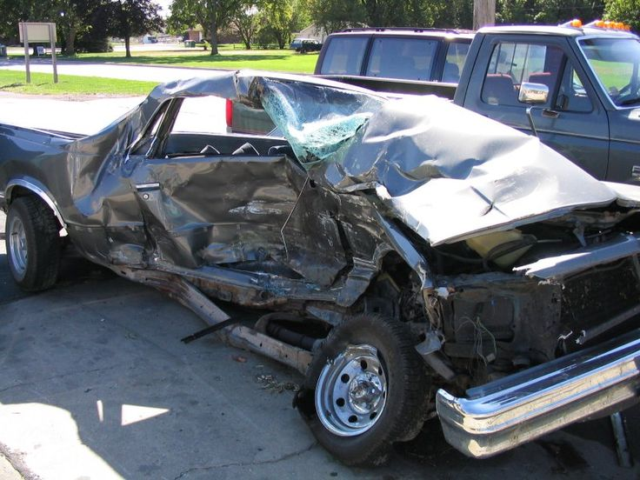

Slide 5
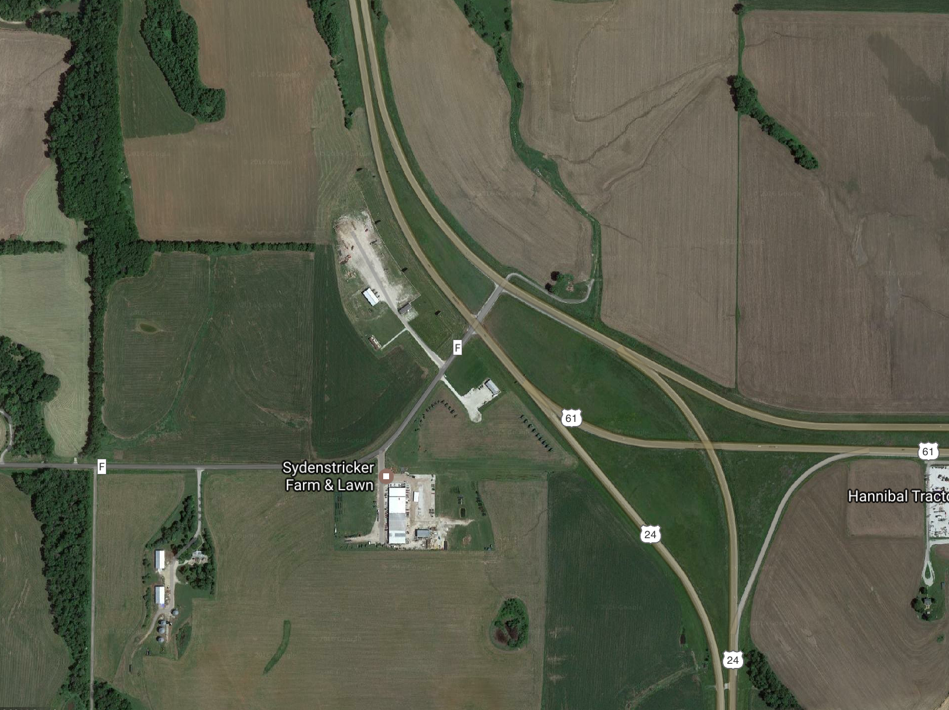
Existing Conditions
Safety
Access

Slide 6
Existing Intersection
US 24/61
US 61
Route F
Safety
Access
US 24

Slide 7
Skewed Intersection
US 24/61
Route F
Safety
Access

Slide 8
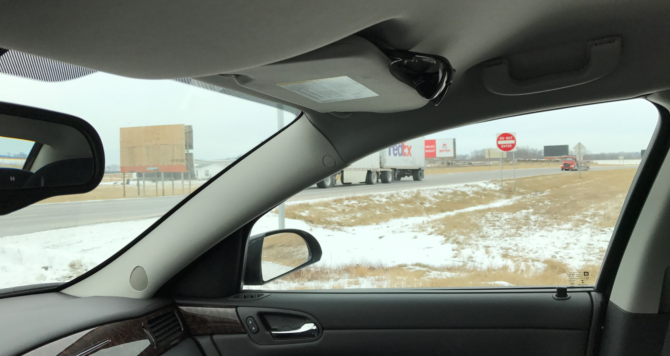
Skewed Intersection
US 24/61
Route F

Slide 9
Primary Conflict Points
US 24/61
US 61
US 24
US 24/61
US 61
Route F

Slide 10
Ideas from CAG Meetings
January 20 and February 3, 2017
Do Nothing
Change Signing (KC/STL) – Overhead Signs
Eliminate Skew in Median Opening
Improve Deceleration Lane SB61/24 to F
Eliminate Median Opening
Median U-Turns

Slide 11
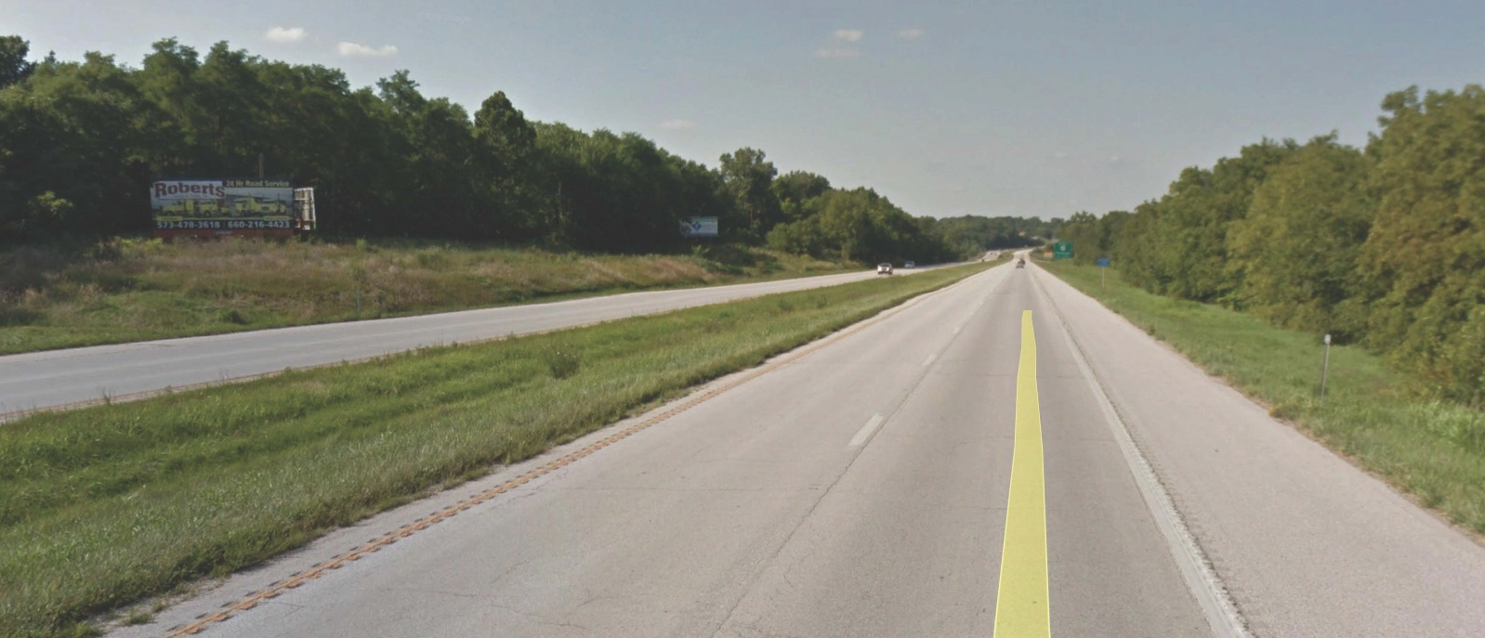
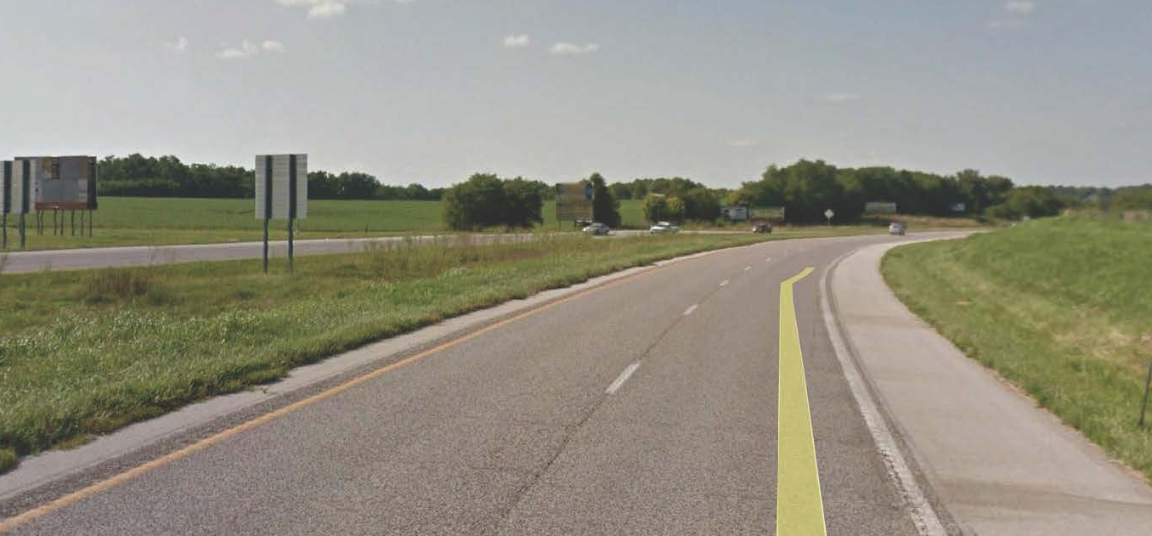
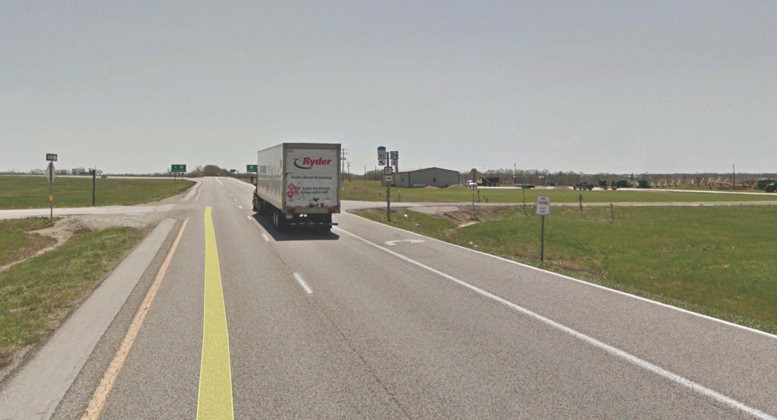
Intersection Safety
Improvements
Marion 24, 61 & F
Existing Conditions
Safety
Access

Slide 12
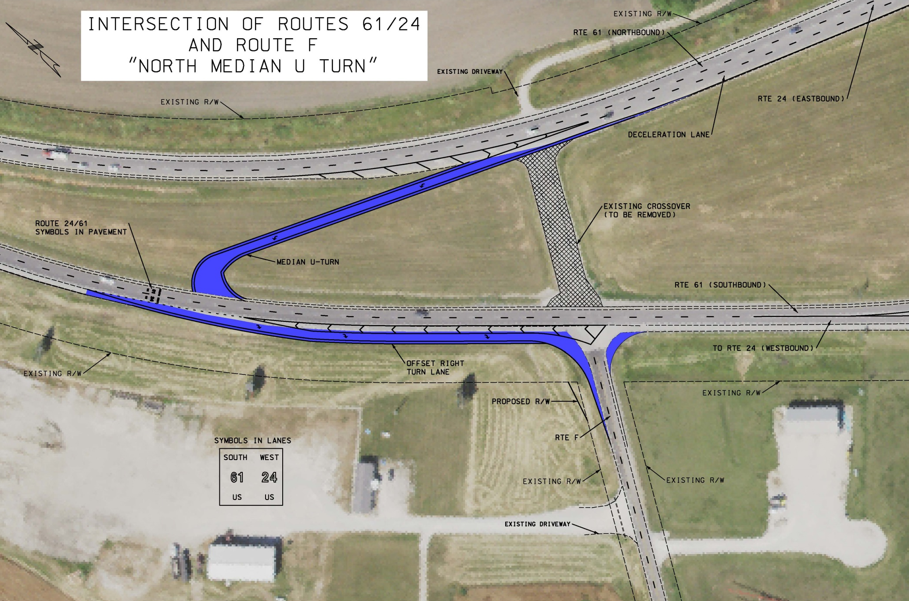

Slide 13
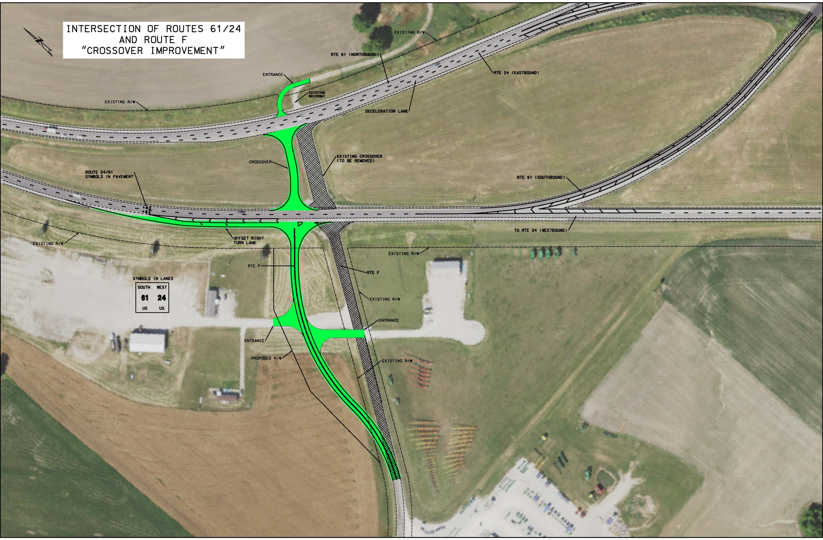

Slide 14
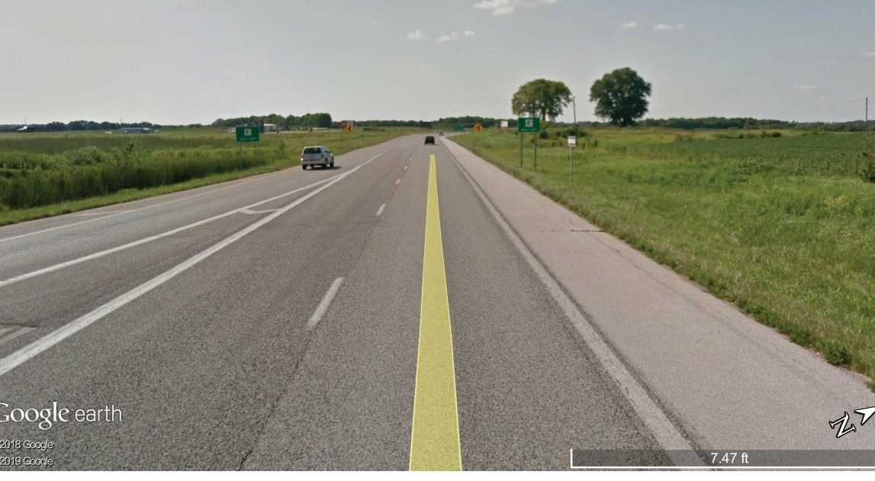
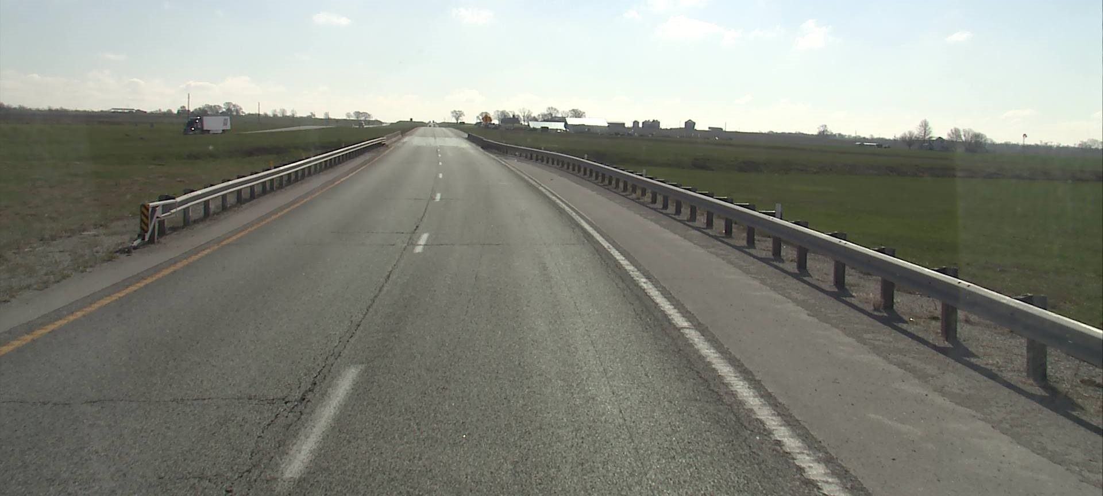
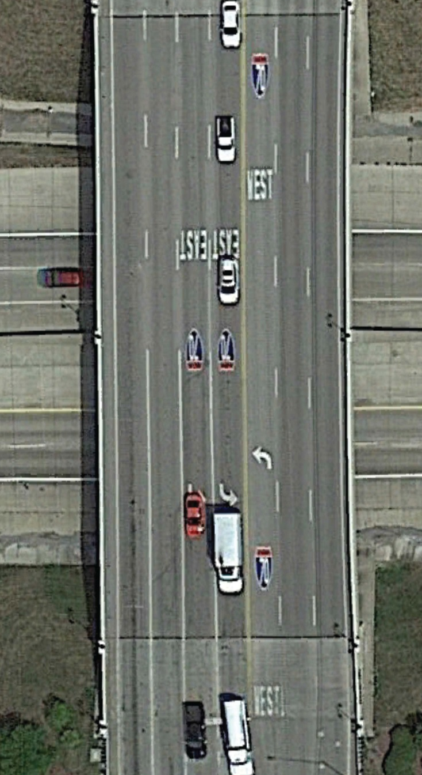
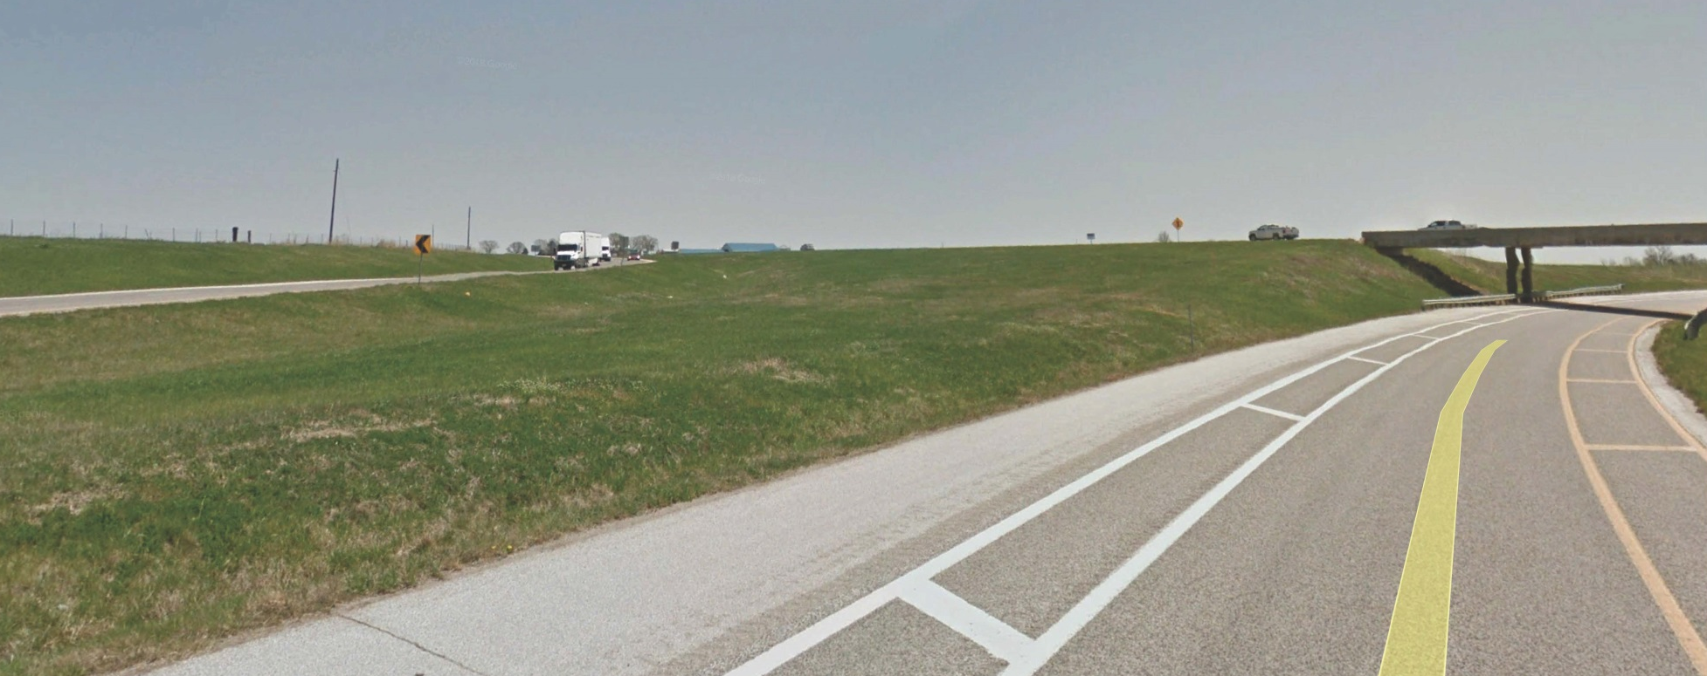
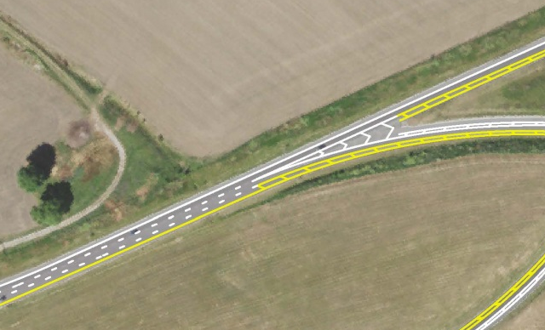
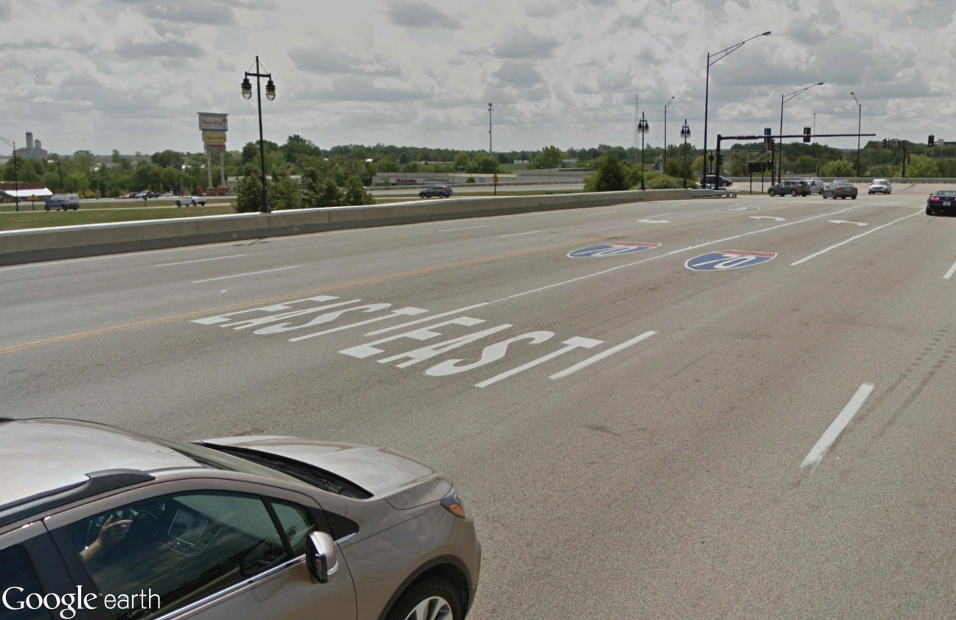
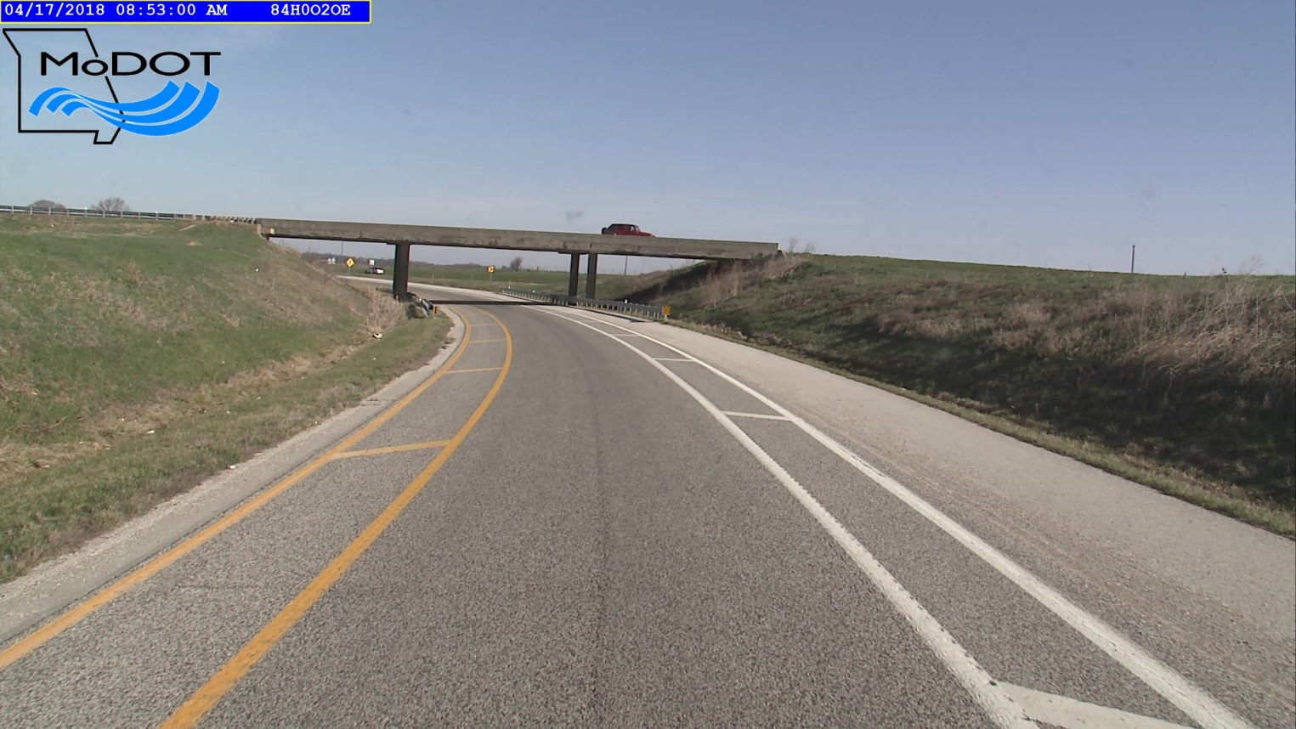
Existing Conditions
Safety
Access

Slide 15
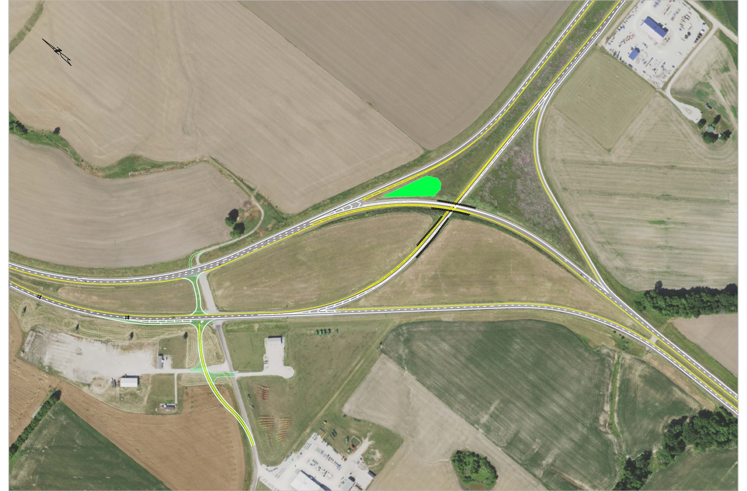
Intersection Safety Improvements
Marion 61, 24 & F

Slide 16
Project Cost and Schedule
$500,000 Estimated cost of Crossover Improvements
Summer 2019 Right of Way Acquisition
Fall/Winter 2019 – Utility Relocation
December 2019 – Bid Opening
Spring/Summer 2020 - Construction

Slide 17
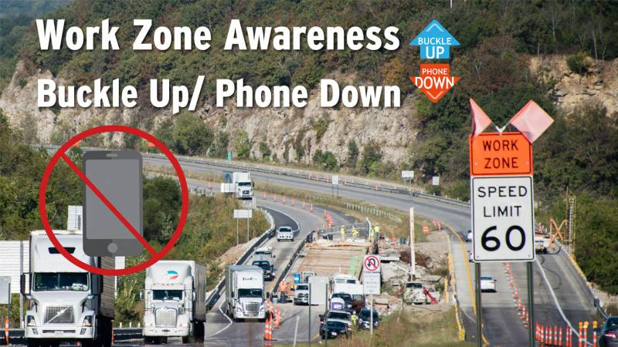
Construction Impacts
Constructed in conjunction with Route 24 and 61 resurfacing projects.
Route F and the crossover will remain open during construction.
Route 61 will be reduced to one-lane traffic conditions.
Notes:
Route 61 resurfacing
NB & SB from Route F to Hannibal
2-3/4” Resurfacing
$3.5 M
Route 24 Resurfacing
Route F to near 36
3-3/4” Resurfacing
$1.9 M
Total of all projects Approx. $6 M

Slide 18
Intersection Safety Improvements
Marion 61, 24 & F

