Slide 1
2 CFR 200
”OMB Super Circular”
Indirect Cost Rate Requirements for Non-Profit & Governmental Organizations
Notes:
Hi, thank you for joining the discussion of 2 CFR 200 or better known as the “OMB Super Circular. We will be discussing the Indirect Cost Rate Requirement for non-profit and governmental organizations.

Slide 2
MoDOT
Audits & Investigations Division
Kelly R. Niekamp – Audit Manager
Christie Martin – Senior Auditor
Sandra Riley - Auditor
Notes:
Meeting with us today is Kelly Niekamp, MoDOT’s Audit Manager, Christie Martin, our Senior Auditor who has several years of experience in governmental and non-profit indirect cost rate reviews and me, Sandra Riley. I am an auditor who works primarily with assisting consulting firms in meeting the requirements of the Federal Acquisition Regulations or “FAR”. This is a requirement firm’s must meet before they can provide professional services to MoDOT or Local Public Agencies. The OMB Super Circular is similar in the indirect cost rate requirements.

Slide 3
Objective:
Provide outreach to Governmental Organizations and Non-Profit Organizations in understanding and meeting the criteria necessary for Federal award.
OMB Super Circular:
The reform of Office of Management and Budget (OMB) guidance will reduce administrative burden for non-federal entities receiving Federal awards while reducing the risk of waste, fraud, and abuse.
Supersedes OMB Circulars A-21, A-87, A-110, A-122, A-89, A-102, A-133, Circular A-50
Effective Date: December 26, 2013
Notes:
MoDOT’s objective is to help you become familiar with the requirements necessary to charge indirect cost rates for reimbursements of Federal award. The OMB Super Circular will reduce administrative burden for non-federal entities receiving Federal awards while reducing the risk of waste, fraud and abuse. Through a streamlining of several OMB requirements and became effective December 26, 2013

Slide 4
2 Code of Federal Regulations (CFR) 200 Chapter 1 & 2
    Streamlining existing OMB guidance will increase the efficiency and effectiveness of Federal awards to ensure best use of the more than $500 billion dollars expended annually.
    Entity’s must develop and implement systems to ensure proper stewardship of funds
      Financial management systems
      Procurement systems
      Time and effort reporting systems
      Monitoring activities
      Adherence to terms and conditions of award
Notes:
The streamline the OMB circulars will increase the efficiency and effectiveness of Federal awards to ensure best use of the more than $500 BILLION Dollars expended annually on Federal awards.
Entities must develop and implement systems to ensure proper stewardship of funds.
This includes Financial Management Systems
Procurement Systems
Time and Effort Reporting Systems
Monitoring Activities
And Adherence to the terms and conditions of the award

Slide 5
MoDOT Requires the following documents prior to Indirect Cost Rate Approval
Item A Cost Allocation Plan
Item B Organization Chart
Item C Employee Time Sheet Sample
    Allocation of Direct & Indirect Labor Hours
Item D Audited Schedules of Indirect Costs
& Fringe Benefits
Item E Audited, Reviewed or Compiled Financial Statements
Item F Certification of Indirect Costs
Item G Listing of Grants/Contracts with MoDOT
Notes:
And as the Federal Highway Administration had delegated the administration of federal funds to MoDOT – MoDOT must then ensure compliance with the federal regulations
To determine compliance MoDOT requires the review and accept of the
Cost Allocation Plan
review the entities org chart and sample timesheet, which must have the ability to report direct and indirect labor hours,
review and accept the Audited Indirect Cost Rate – commonly referred to as an Overhead Rate,
Review and accept the Financial Statements,
Accept the Certification of Indirect Costs
and finally the listing of Grants and Contracts with MoDOT.
The review and acceptance of the information is required to be complete before your entity receives a Federal award

Slide 6
Requirements for Compliance
2 CFR 200
Item A - Cost Allocation Plan
  Written methodology describing the process, policies and procedures used to segregate direct and indirect costs, as well as, identify unallowable costs.
    It is essential that each item of costs incurred for the same purpose be treated consistently in like circumstances either as a direct or an indirect cost in order to avoid possible double-charging of Federal awards.
  Ensures the entity has establish and maintains effective internal controls over the Federal award that provides reasonable assurance the entity is managing the Federal award in compliance with Federal statues, regulations, and the Federal award.
Notes:
Cost Allocation Plan is the methodology used by your entity to ensure compliance with the federal regulation. The Cost Allocation Plan is a written description of how your entity consistently reports direct and indirect costs, as well as, how unallowable costs are identified and reported. You entity should have processes, policies and procedures in place documenting the steps taken to accurately report federal expenditure.
This brings us back to the objectives of the OMB Super Circular. By consolidating each OMB Circular into one Super Circular :
You increase the efficiency and effectiveness of Federal awards to ensure best use of the more than $500 billion dollars annually expended.
AND
Provides the Pass-Through agency reasonable assurance the entity is managing the Federal award in compliance the federal regulations.

Slide 7
Requirements for Compliance
2 CFR 200
Required for state, local gov. & Indian Tribes - excludes non-profit org.
CERTIFICATE OF COST ALLOCATION PLAN
This is to certify that I have reviewed the cost allocation plan submitted herewith and to the best of my knowledge and belief:
(1) All costs included in this proposal [identify date] to establish cost allocations or billings for [identify period covered by plan] are allowable in accordance with the requirements of this Part and the Federal award(s) to which they apply. Unallowable costs have been adjusted for in allocating costs as indicated in the cost allocation plan.
(2) All costs included in this proposal are properly allocable to Federal awards on the basis of a beneficial or causal relationship between the expenses incurred and the Federal awards to which they are allocated in accordance with applicable requirements. Further, the same costs that have been treated as indirect costs have not been claimed as direct costs. Similar types of costs have been accounted for consistently.
I declare that the foregoing is true and correct.
Governmental Unit:
Signature:
Name of Official: Title:
Date of Execution:
Notes:
The Signed Cost Allocation Plan Certification is required for state, local governments and Indian Tribes. However, this form is not a requirement for Non-Profit Organizations.
The certification provides assurance that your entity understand the importance of segregating direct and indirect cost, as well as, identifying unallowable costs, which provides reasonable assurance the indirect cost rate was prepared in accordance to the federal regulations
Accuracy in recording transaction is important to properly develop the indirect cost rate compliant with the federal regulations.
Before the transaction is recorded you should ask yourself:
Is this an direct or indirect costs Is this an allowable or unallowable costs Is cost reasonable? Dollar amount or purpose?

Slide 8

Requirements for Compliance
2 CFR 200
Item B - Organizational Chart
  Functional statement(s) noting the duties and/or responsibilities of all units that comprise the agency.
  Once this is submitted, only revisions need be submitted with subsequent proposals.
Notes:
Organizational Chart should list duties and responsibilities
Submit annually with any changes noted

Slide 9
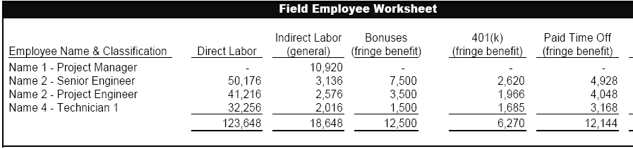
Requirement for Compliance
2 CFR 200
Item C - Sample Employee Time Sheet
    Establish timekeeping policies, processes or procedures to adequately track project (direct) and non-project (indirect) related labor and overtime.
      Consistently track all billable and non-billable labor hours
      Consistently track unallowable labor costs activities
Notes:
The sample timesheets must have the ability to report hours worked on a federal award, as well as, time worked on duties that cannot be defined to a specific project.
This includes the fringe benefits paid
Hours worked on a Federal award are Direct Costs
Hours work on duties that cannot be defined to a specific project or administrative duties are Indirect Costs

Slide 10
Requirement for Compliance
2 CFR 200
Item D & E
D - Audited Schedule of Indirect Cost to include Fringe Benefits- submitted annually within six months of entities fiscal year end.
  E - Audited Financial Statements - submitted annually within six months of entities fiscal year end.
    Performed in accordance to Generally Accepted Government Auditing Standards (GAGAS)
    Include a Federal Acquisition Regulations (FAR) Part 31 references to identify unallowable costs
Notes:
You must obtain an audited schedule of indirect costs. This schedule should agree to your audited, reviewed or compiled financial statements.
The audits must follow Generally Accepted Government Auditing Standard “GAGAS” and must indicate the audit was performed in accordance with applicable OMB Requirement. The Audited Indirect Cost Rate Schedule must include FAR references to define the unallowable costs
Check with your CPA/Accounting firm to determine if they are familiar with GAGAS and FAR Requirements.

Slide 11
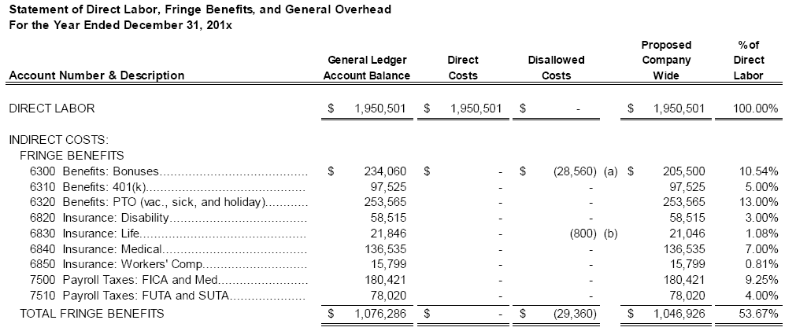
Requirements for Compliance
2 CFR 200
Required Schedule of Indirect Cost Rate (Overhead) Format
Direct Costs: Typical costs charged directly to a Federal award are the compensation of employees who work on that award and their related fringe benefits.
Notes:
The schedule of indirect costs rate must follow this 4 part format
First is the direct labor costs which should be obtained through accurate timekeeping procedures
The Second component is the listing of Fringe Benefits

Slide 12

Requirement for Compliance
2 CFR 200
Know your Federal award if you provided for it as a deliverable in a workplan, estimate, grant application or contract, it is probably a direct costs
Notes:
Know your Federal award if you provided for it as a deliverable in a workplan, estimate, grant application or contract, it is probably a direct costs

Slide 13
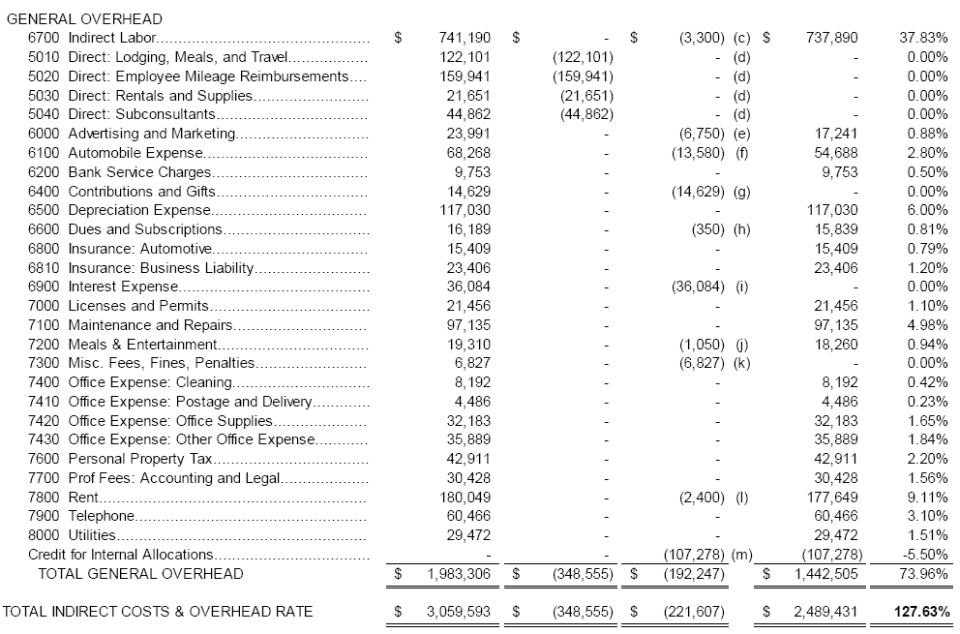
Requirements for Compliance
2 CFR 200
Indirect Costs:
Typical examples of indirect cost include depreciation on buildings and equipment, the costs of operating and maintaining facilities, and general administration and general expense, such as the salaries and expense of executive officers, personnel administration and accounting
Cost must be reasonable and actual
Notes:
The third part of the overhead is the indirect costs. These costs are generally the cost of doing business that cannot be identified to a specific grant or contract deliverable. These types of costs would include, but not limited to depreciation, cost of operating and maintenance expense, general administrative costs and office supplies.
The costs must be considered reasonable

Slide 14


Reasonableness of Cost?
Ask yourself these questions when determining reasonableness of costs
Would your mission benefit from the expense
Can you defend the purpose?
First Class Airfare vs Coach
Or
Mercedes vs Metro Geo
VS
Notes:
What is REASONABLE???
Would the objectives of the Federal award benefit from the expense
Can you defend the expense
EXAMPLE 1st Class Airfare verses Coach
Renting/leasing a Mercedes verses a Geo Metro???????

Slide 15
Overhead rate calculation
Indirect Cost Pool
Direct Cost Base
Indirect Cost Rate
Notes:
The components and resulting formula for calculating an indirect costs rate is:
The Total Proposed Fringe Benefits plus General Overhead divided by the Direct Labor Costs = Your indirect Cost Rate
FYI – Your CPA/Accounting firm should know this formula
AGAIN
It is important to know the terms and conditions of the Federal award
Because that will determine how you manage the direct and indirect cost
Consistency through the cost allocation plan

Slide 16
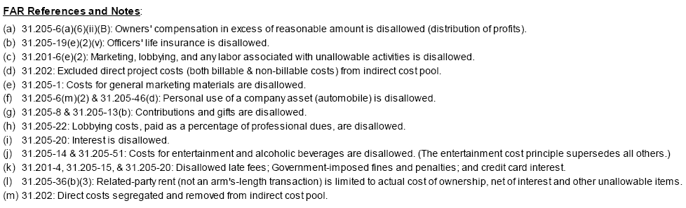
Requirements for Compliance
2 CFR 200
FAR References
Must include FAR References to identify unallowable costs
Notes:
The fourth part of an indirect cost rate is the identification of unallowable costs.
An unallowable costs could be labor hours used for marketing or lobbying activities
Unallowable indirect costs would be alcohol, personal use of vehicles, any costs that is specific to a Federal award.
The AASHTO Uniform Audit and Accounting Guide is a great reference to determining the allowability of costs. A link to that resource is found on the MoDOT Website under Consultant Services.

Slide 17
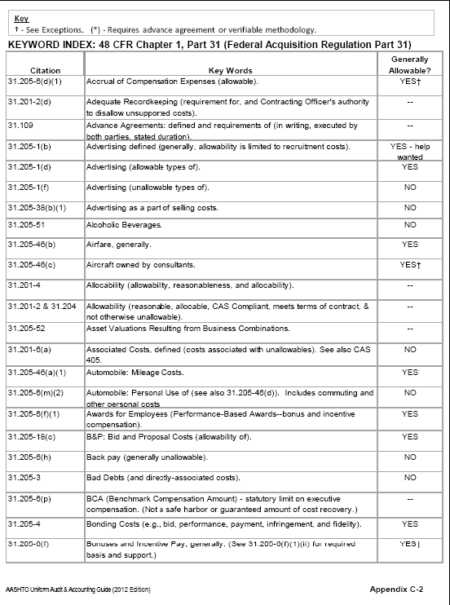
Requirements for Compliance
2 CFR 200
Unallowable Costs
Reference: Subpart E
Cost Principles of Part 200
Review Federal award
Additional determination of unallowable costs with FAR references can be found on Appendix C in the AASHTO Uniform Audit and Accounting Guide.
Notes:
The AASHTO Uniform Audit and Accounting Guide includes a section titled, “Appendix C”. This is a quick reference tool listing the FAR Reference number, a description of the cost and the allowability of the costs.
You may find this resource helpful in developing you Cost Allocation Plan, identification of direct and indirect cost, as well as, samples of indirect cost rates and internal control structures which will provide reasonable assurance of compliance with the OMB Super Circular.

Slide 18
Requirements for Compliance
2 CFR 200
Item F - Certification of Indirect Costs – Gov. Org.
Certification of Indirect Costs
This is to certify that I have reviewed the indirect cost rate proposal submitted herewith and to the best of my knowledge and belief:
(1) All costs included in this proposal [identify date] to establish billing or final indirect costs rates for [identify period covered by rate] are allowable in accordance with the requirements of the Federal award(s) to which they apply and the provisions of this Part. Unallowable costs have been adjusted for in allocating costs as indicated in the indirect cost proposal
(2) All costs included in this proposal are properly allocable to Federal awards on the basis of a beneficial or causal relationship between the expenses incurred and the agreements to which they are allocated in accordance with applicable requirements. Further, the same costs that have been treated as indirect costs have not been claimed as direct costs. Similar types of costs have been accounted for consistently and the Federal government will be notified of any accounting changes that would affect the predetermined rate.
I declare that the foregoing is true and correct.
Governmental Unit:
Signature:
Name of Official: Title:
Date of Execution:
Notes:
Once you have the Cost Allocation Plan, Org Chart, Sample Timesheet, Audited Indirect Cost Rate, Financial Statements you will need to certify that the indirect cost rate was developed in compliance of the federal regulations
If you are a Governmental Unit you will you this certification

Slide 19
Requirements for Compliance
2 CFR 200
Item F - Certification of Indirect Costs-NonProfit Org.
Certification of Indirect Costs
This is to certify that I have reviewed the indirect cost rate proposal submitted herewith and to the best of my knowledge and belief:
(1) I have reviewed the indirect cost proposal submitted herewith;
(2) All costs included in this proposal [identify date] to establish billing or final indirect costs rate for [identify period covered by rate] are allowable in accordance with the requirements of the Federal awards to which they apply and with Subpart E-Cost Principles of Part 200.
(3) This proposal does not include any costs which are unallowable under Subpart E-Cost Principles of Part 200 such as (without limitation): public relations costs, contributions and donations, entertainment costs, fines and penalties, lobbying costs, and defense of fraud proceedings; and
(4) All costs included in this proposal are properly allocable to Federal awards on the basis of a beneficial or causal relationship between the expense incurred and the Federal awards to which they are allocated in accordance with applicable requirements
I declare that the foregoing is true and correct.
Nonprofit Organization:
Signature:
Name of Official: Title:
Date of Execution:
Notes:
Non Profit organizations will use this certification

Slide 20
Requirements for Compliance
2 CFR 200
Item G: Listing of Grants and Contracts with MoDOT
Federal Award Identification Number
Sub recipient name
Federal Award Date
Period of Performance Start and End Date
Total Amount of the Federal Award
Project description
This information assists Pass-Through agencies, like MoDOT, to reconcile your entities Federal award expenditures with reimbursement paid to your entity.
Notes:
Finally a list of Grants and Contract with MoDOT. The list should include the
Federal Award Identification Number
Sub recipient name
Federal Award Date
Period of Performance Start and End date
Total Amount of the Federal Award
And
Project description
This information assists Pass-Through agencies, like MoDOT, to reconcile your entities Federal award expenditures with reimbursement paid to your entity by MoDOT.

Slide 21
Requirements for Compliance
2 CFR 200
References:
2 CFR Chapter 1, Chapter II, Part 200
Certification of Cost Allocation Plan
Certification of Indirect Cost – Gov. Org.
Certification of Indirect Cost – Non Profit
Notes:
You may find the attached links beneficial as you develop the processes discussed here today. The presentation can be found on the MoDOT website
From the MoDOT homepage navigate to the Consultant Services link (bottom of page under More Links)
From the Consultant Services webpage navigate to the Fourth Tab - Consultant Prequalification Requirements and
Select
The link to Non-Profit/Governmental Organization Compliance Tools

Slide 22
Single Audit Requirements
A non-Federal entity that expends $750,000 or more during the non-federal entity’s fiscal year in Federal awards must have a single or program specific audit conducted for that year in accordance with the provisions of 200.501 of the Super Circular
Notes:
You thought it was time for lunch – WRONG - ONE MORE THING
A non-Federal entity that expends $750,000 or more during the non-federal entity’s fiscal year in Federal awards must have a single or program specific audit conducted for that year in accordance with the provisions of 200.501 of the Super Circular

Slide 23


Slide 24

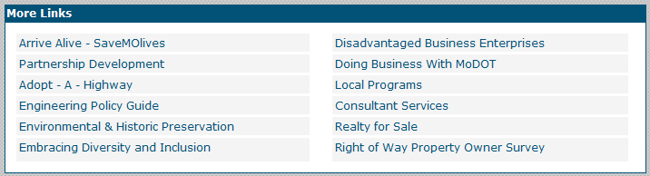
How do I navigate to the Consultant Prequalification webpage
located near the bottom of the page under the “More Links” section on the MoDOT website.

Slide 25
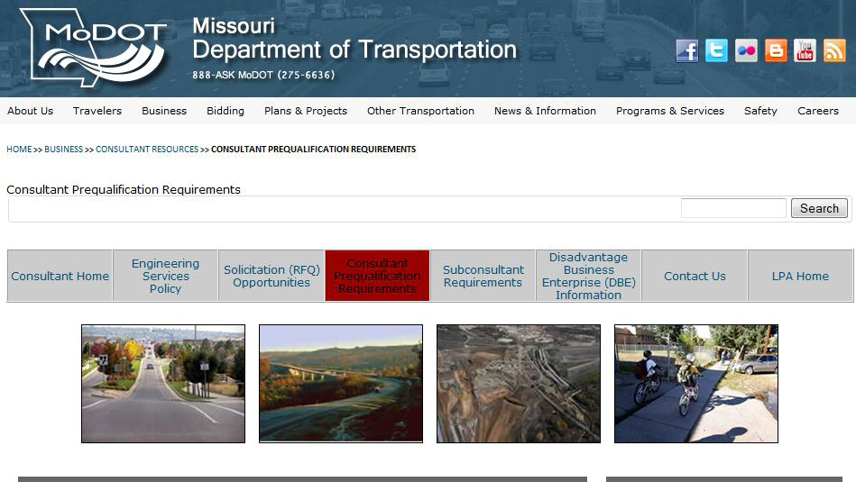
Select the fourth tab titled, “Consultant Prequalification Requirements”
Consultant Prequalification webpageSelect Consultant Prequalification Requirements
Select the fourth tab titled, “Consultant Prequalification Requirements

Slide 26
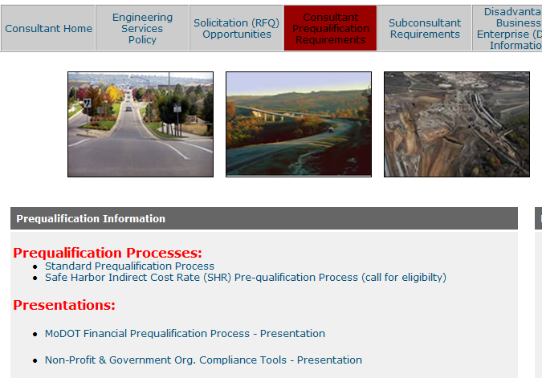

Slide 27
Requirements for Compliance
2 CFR 200
  Questions
You may call MoDOT’s Audits and Investigations Division at 573-751-7446 for additional assistance or questions regarding the information presented today

