Slide 1


Flagger Training
with 3-2-1 Cone Procedures
Course Code: 92021
Notes:
Safety is the top priority in a work zone. Flagging is one of the most hazardous work zone activities, making it imperative to have the proper training before performing this operation.

Slide 2
Course Objectives
Understand importance of proper flagger operations
Learn the capabilities of a good flagger
Apply standard flagger control references
Identify proper flagging signals and procedures
Learn flagger practices for various typical situations
Notes:
After completing this course, you should understand the importance of proper flagger operations – their primary purpose, proper procedures, and capabilities of a good flagger. It is important to understand some employees may not meet the minimum qualifications.

Slide 3
Discussion Topics
Chapter 6E of the MUTCD
Qualifications of a flagger
Flagger Guidelines
High-visibility safety apparel
Hand signaling devices
Flagger stations
Flagger procedures
Advanced warning placement
Traffic control devices
Additional Traffic control devices to consider
Notes:
During this course, we will primarily discuss Chapter 6E of the Manual on Uniform Traffic Control Devices or MUTCD, which includes information related to qualifications and guidelines of flagger operations, the required high-visibility safety apparel, hand signaling devices, and related traffic control devices and set up.

Slide 4
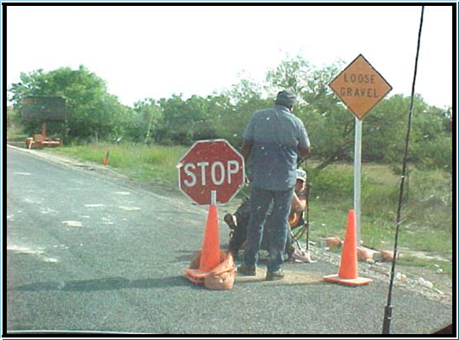
I’m Safe???
Flaggers shall not sit in a chair
Flagger should be alone without distractions of other employees
Flag paddle shall not be unattended
Stop/slow paddle must remain visible to all traffic
Co-worker is not wearing high-vis apparel
Flagger shall remain off roadway until traffic is stopped
Your job is the most important
one on the crew!
Notes:
What doesn’t look right with this picture? Flaggers are important because they control the flow of traffic, alert the crew when vehicles fail to stop, or are going too fast as they approach the work area. They should be visible and mobile so they can get away from errant vehicles if needed. Sitting in a chair is not allowed while flagging. The employee standing with his back to traffic is blocking the flagger’s view and is not wearing high-visibility apparel. Additionally, the flagger should have direct control of the STOP/SLOW paddle at all times and should not leave the device unattended on a cart or in a channelizer. The STOP/SLOW paddle must remain visible by all approaching traffic. In this case, it would be blocked by the first stopped vehicle.

Slide 5
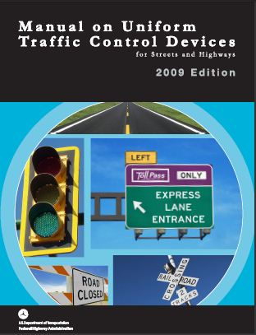
Traffic Control Standards
Manual on Uniform Traffic Control Devices
(MUTCD)
Chapter 6E
https://mutcd.fhwa.dot.gov/pdfs/2009r1r2/pdf_index.htm
Notes:
The Manual on Uniform Traffic Control Devices, Chapter 6E, talks about minimum requirements for flaggers across the country and this is where we derive our information. The MUTCD contains federal requirements and our baseline guidance from the national standards governing all traffic control devices. All public agencies and owners of private roads open to public travel across the nation rely on the MUTCD to bring uniformity to the roadway. The MUTCD plays a vital role in improving safety and mobility of all road users. Traffic control devices are critical for safe and efficient transportation. By setting minimum standards and providing guidance, the MUTCD ensures uniformity of traffic control devices across the nation. The use of uniform traffic control helps reduce crashes and congestion, and improves the efficiency of the surface transportation system. To find the current version of the MUTCD, visit the link provided on the screen.

Slide 6
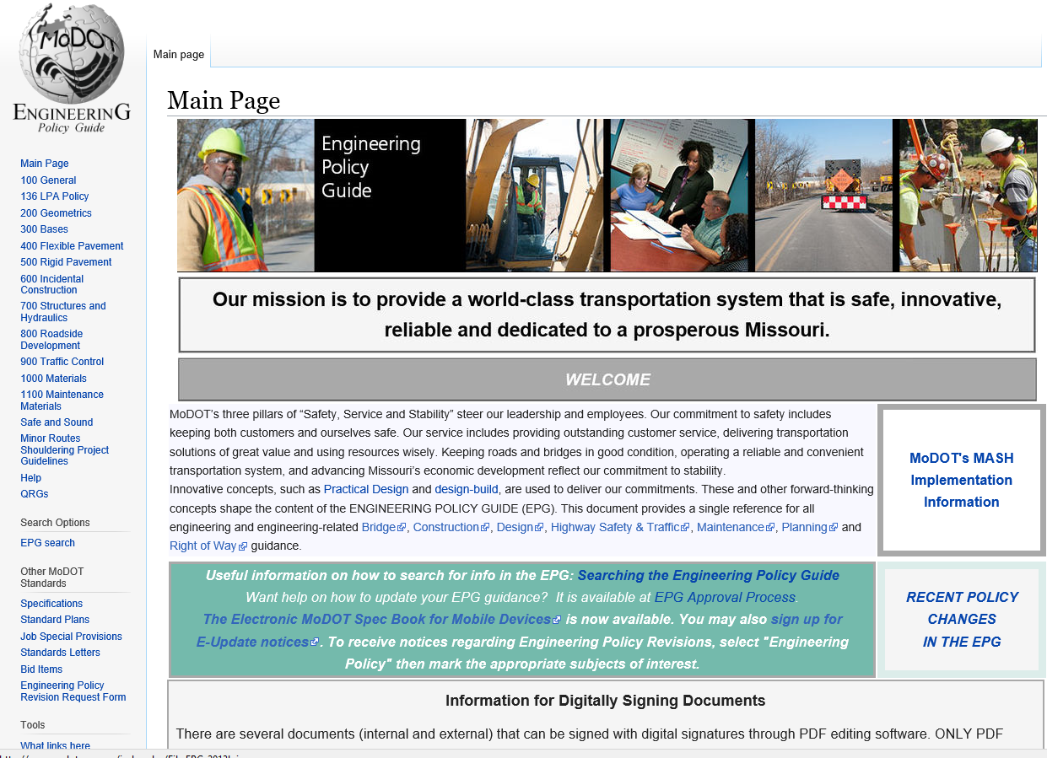
Engineering Policy Guidelines
Standards for MoDOT Work Zones
  Reference Guide to MoDOT Operations
  Reference for Temporary Traffic Control
  Article 600
    616 Temporary Traffic Control
Temporary Traffic Control for Field Operations (TCFO)
  Article 616.23
Found at the quick links
  MoDOT SharePoint Home Page
http://EPG.modot.org
Notes:
The Engineering Policy Guidelines or EPG, is a complete manual that covers all MoDOT operations from Right of Way, Design, Bridge, Construction, Traffic, and Maintenance. It can help research and find answers from common everyday scenarios to complex situations. In many cases, the EPG surpasses federal guidelines. Article 616 covers Temporary Traffic Control. Sub-article 616.23 is the Traffic Control for Field Operations document which provides temporary traffic control guidance, products, and links to other areas of the overall article 616. The typical applications also known as TAs, or traffic control plans, can be found in the Traffic Control for Field Operations document. You will see a few examples of these a little later, along with more detail. You can access the EPG by visiting http://EPG.modot.org or clicking on the EPG button on the MoDOT SharePoint homepage. TAs can also be found in the Maintenance Management System after assigning work.

Slide 7
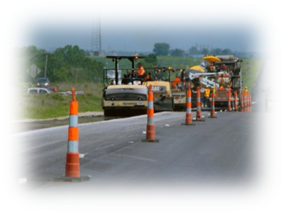
Training
MUTCD
Each person whose actions affect temporary traffic control work zone safety, from upper level management through field workers, should receive training appropriate to the job decisions each individual is required to make.
Notes:
Each person whose actions affect temporary traffic control work zone safety, from upper level management to field workers, should receive training appropriate to the job decisions the individual is required to make. For example, if you are a new employee who has never flagged before, MoDOT needs to provide flagger training and on the job training to ensure you understand proper procedures related to flagging. If you are responsible for setting up a work zone or placing advanced warning signs, you will need additional training related to work zone set up which may be found in Gear Up or Advanced Work Zone training. There are 3 levels of work zone training – flagger, Gear Up (which replaced the technician level training), and Advanced Work Zone (which is specialist level training).

Slide 8
MISSOURI STANDARD SPECIFICATIONS
FOR HIGHWAY CONSTRUCTION
Specification 616.4.3
Each flagger, automated flagger assistance devices (AFAD) operator, portable signal flagging device (PSFD) operator and pilot vehicle operator shall maintain a valid flagger certification card that certifies the individual has been trained by a qualified person as defined by the Occupational Safety & Health Administration, in the principles and procedures of flagging in accordance with Chapter 6 of the MUTCD.
    4 yr. expiration
Notes:
Section 616.4.3 of the Missouri Standard Specifications for Highway Construction states that each flagger, automated flagger assistance device or AFAD operator, portable signal flagging device operator, and pilot vehicle operator shall maintain a valid flagger certification card that certifies the individual has been trained by a qualified person as defined by OSHA, the Occupational Safety and Health Administration, in the principles and procedures of flagging in accordance with Chapter 6 of the MUTCD. Flagger re-certification shall be required a minimum of every four years. This also applies to our advanced work zone (specialist) training.

Slide 9
First quiz
What chapter in the MUTCD talks about the minimum requirements for flaggers across the country?
6E b. 2C c. 6D d. 1B
EPG stands for what?
Easy Plan Guides b. Early Planning Guidelines
Engineering Policy Guidelines d. Engineers Planning Guide
What can be found in the EPG?
Standards for MoDOT work zones b. Reference guide to MoDOT operations
Reference for temporary traffic control d. temporary traffic control for field operations e. all of the above
How many years is a flagger certification card valid for?
a. 2 b. 4 c. 6 d. 5

Slide 10
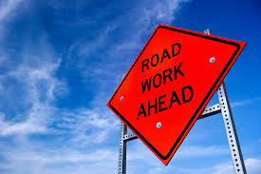
Flagger Guidelines, Responsibilities & Qualifications
Notes:
Next, let’s talk about flagger guidelines, responsibilities, and qualifications.

Slide 11
Flagger Guidelines
Before any flagging begins you should:
Select a qualified flagger that has been properly trained
Have proper safety attire and equipment
Select flagging method and location
Have all advance warning signs in place
Flagger station must be visible to motorists
  If possible the crew and other flaggers
Notes:
Before flagging begins, you need to select qualified flaggers. Employees should know what job they will be doing for the day before ever leaving the building. Flaggers need to make sure they have the correct equipment and PPE, and should check the quality of the flag paddles before leaving to a job site. Pre-planning is essential. Advance warning signs are important and should be in place prior to flaggers being placed on the road and work beginning, to let motorists know what to expect. It is important to give as much advanced warning as possible. Selecting a flagging location and method is important, and is a good idea to plan out the day before – where you are going to perform flagging operations and where will signs be placed. Be aware of items which may obstruct the vision of flaggers and drivers. The flagger station needs to be visible to motorists. During day time hours, there should be at least 500 foot of visibility to the flagger station; at night, we double this to 1,000 feet of visibility. When signs are too far from the flagger or work area, motorists may not be prepared when they approach a flagging station, which could create a hazardous situation we want to avoid.

Slide 12

Flagger Responsibilities
A flaggers protects:
  Themselves
  Crew
  Road Users
  Pedestrians
  Equipment
Your job is the most important
one on the crew!
Notes:
What are a flagger’s responsibilities? First and foremost, protect themselves, they are the first line of defense for themselves and the crew. They should be positioned in a location that provides an escape route to prevent them from being struck. A flagger sometimes must alert the crew if something is occurring that puts the crew in danger; they should be aware of how to get their attention. Flaggers are also responsible for protecting motorists. We see a lot of crashes at flagger stations each year where the first vehicle is stopped and the second vehicle runs into the back of it, sometimes pushing that first vehicle into the flagger if stationed too close to stopped traffic. Always have an escape route and be positioned with enough distance that if something does go wrong, you have the ability to get away. In urban areas, we must keep it safe for pedestrians as well. It may be a requirement to flag at intersections. Last but not least, protect the equipment. When a motorist strikes equipment, it can lead to severe injuries. Employees are at risk while in equipment; it should be protected with a secondary protective vehicle when available. We will discuss ways to avoid equipment or employees from being struck a little later. Again, a flagger’s job is the most important one on the crew.

Slide 13
Qualifications of a Flagger
Ability to receive and communicate specific instructions clearly, firmly, and courteously
Ability to move and maneuver quickly in order to avoid danger from errant vehicles
Ability to control signaling devices (such as paddles & flags) in order to provide clear and positive guidance to drivers approaching a TTC zone in frequently changing situations
Ability to understand and apply safe traffic control practices, sometimes in stressful or emergency situations
Ability to recognize dangerous traffic situations and warn workers in sufficient time to avoid injury
EPG 616.5.1 Qualifications for Flaggers (MUTCD 6E.01)
Notes:
Flaggers should be able to receive and communicate specific instructions clearly, firmly, and courteously. The more confidence you display, the more trust you will gain from the public. You should remain calm and try to get traffic through as quickly and safely as possible. Flaggers need the ability to move and maneuver quickly away from errant vehicles. This is NOT a job for modified duty work. Employees need to stay mobile, be able to get away, and control the flag and paddle devices. Flaggers shall be able to understand and apply safe traffic control practices in stressful or emergency situations, including a police pursuit or an emergency vehicle coming through to a call. We cannot allow them to move through the work zone until traffic is flushed and it is safe to proceed. You also must be able to recognize dangerous situations and warn the workers in sufficient time to avoid injury. Flaggers should be looking down the road to see what is approaching, looking for vehicles who don’t appear aware of the flagger station coming up that might not stop. You need to be ready to warn the crew with a plan in place.

Slide 14

Flaggers Must Be
Mentally alert
Not under influence of alcohol or drugs
Beware of the effects of:
  Prescription medication
  Over-the-Counter
Well rested, not drowsy
I – Illness
M – Medications
S – Stress
A – Attitude
F – Fatigue
E - Education
Notes:
Flaggers should always be mentally alert. You shall not be under the influence of alcohol or drugs. Some prescription and over the counter medications can have the same side effects as illegal drugs, especially if it is new and you are not yet aware of how it will affect your body or mentality. You should tell your supervisor if you are on a new prescription that may affect your work performance that day. There are modified duties you can perform until you are aware of the effects a medication will have on you. If the bottle says, may cause drowsiness, this is not something you should be taking while performing flagging operations. These can include simple things like allergy medications or Benadryl. Flaggers should be well rested and not drowsy. If you don’t get a good night’s sleep, how well will you perform the next day? Follow the I’m Safe model above. Supervisors and crew leaders should be able to recognize these signs and symptoms to make safe decisions.

Slide 15
Flaggers must be
In good physical condition
Good sight
Good hearing
Ability to move quickly
This is NOT an assignment for modified duty /injured workers
Notes:
Flaggers must be in good physical condition – have good sight and hearing and the ability to move quickly. Flaggers should be able to see approaching vehicles from 1,000 foot down the road. If you forgot your glasses or contacts, flagging is probably not a good operation for you to perform that day. Flaggers need to be able to hear from a distance. This may mean separating flaggers from the work area if it is noisy, to reduce the level of exposure. Again, this is not an assignment for modified duty and flaggers need to be in good physical and mental condition.

Slide 16
Flaggers must be
Professional, Authoritative & Courteous
Dress appropriately
Clean and Neat appearance
  Clean PPE
Polite when providing firm directions to the traveling public
  You must remain calm with irate motorists
Confident and competent
Notes:
You should be professional, authoritative, and courteous while performing flagger operations. Dress appropriately and have a clean, neat appearance. Employees shall not wear inappropriate or politically promoting attire while at work. PPE shall always be clean and in good condition to be as visible as possible. Be polite and firm; the public expects you to know what you are doing and keep them safe. If you have an irate driver, the best thing to do is separate yourself from them and remain calm. We should not be flagging right next to the driver side window of a vehicle that is stopped. Flaggers should be confident and competent; this comes with being well trained and knowing your job. Training should be taken seriously. Employees shall not flag for more than 2 hours at a time. After a 15-30 minute break to refresh, they can resume the duties again. Crew leaders should have a good practice of rotating flaggers to keep them fresh and alert. If you do not have enough employees on a crew to rotate every 2 hours, plan ahead and ask for help from nearby sheds. If this cannot be done, the work should not be performed that day. Productivity is not more important than safety.

Slide 17
Second quiz
When should you select your flagging station location?
When you get to the job site b. Before you leave the shed for the day
The day before d. a week in advance
Who does a flagger protect?
Themselves b. The crew c. Road users/pedestrians d. Equipment
e. All of the above
What are the qualifications of a flagger? (select all that apply)
Ability to receive and communicate specific instructions clearly, firmly, and courteously
Ability to sit for long periods of time
Ability to sufficiently operate a computer
Ability to move and maneuver quickly in order to avoid danger from errant vehicles
Ability to recognize dangerous traffic situations and warn workers in sufficient time to avoid injury
Flaggers must (select all that apply) this one is meant to throw them off and make them think by having all correct answers
▪ Not be under the influence of drugs or alcohol ▪ Have good sight & hearing
▪ Be mentally alert ▪ Dress appropriately
▪ Have the ability to move quickly ▪ Be confident

Slide 18
High-Visibility Safety Apparel
Notes:
Now on to high-visibility safety apparel

Slide 19
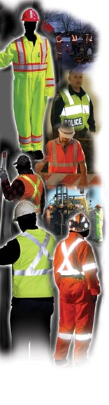
High-Visibility Safety Apparel
EPG 616.5.2 & MUTCD 6E.02
Flaggers shall wear high-visibility safety apparel that meets the Performance Class 2 or 3 requirements of the ANSI/ISEA 107–2004 publication entitled “American National Standard for High-Visibility Apparel and Headwear” and labeled as meeting the ANSI 107-2004 standard performance for Class 2 or 3 risk exposure.
The retro-reflective safety apparel shall be designed to clearly identify the wearer as a person.
616.5.2 High-Visibility Safety Apparel (MUTCD 6E.02)
Notes:
The EPG and MUTCD both say basically the same thing, but MoDOT has some additional standards for our internal employees. Flaggers shall wear high-visibility safety apparel that meets the Class 2 or 3 requirements of the ANSI 107-2004. ANSI is the American National Standards Institute. 107 deals with high visibility apparel and 2004 is the version of the plan we currently follow. There are more recent versions, but MoDOT follows the 2004 minimums. The apparel’s tag will specify the year rating; MoDOT employees can utilize anything 2004 or newer. Supervisors have the right to require additional PPE above the minimum requirements if they deem necessary.

Slide 20
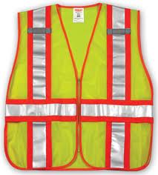
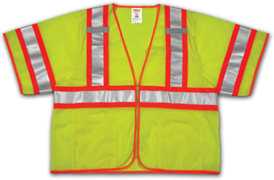
High Visibility Safety Apparel
ANSI/ISEA 107 Class 2
ANSI/ISEA 107 Class 3
Notes:
What is the difference between a class 2 and class 3? Class 2 is the typical standard issued vest and has at least 775 inches of background and 201 square inches of reflectivity material required, but does not have sleeves. Class 3 has at least 1,240 inches of background material and 310 square inches of reflectivity material - including on the sleeves, to have a full silhouette outline and identify the wearer as a person through movement of the arms. For night time work, employees are required to have at least an equivalent of class 3 for workers and flaggers are required to have a little more beyond that.

Slide 21
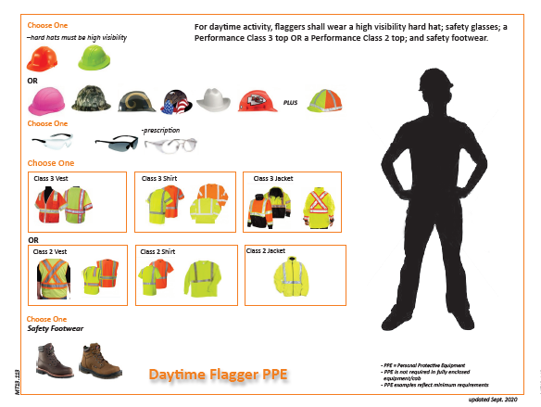
Notes:
For daytime flaggers, we require a high-visibility hard hat, which does not have to be reflective. Eye wear is also required - prescription if necessary, and they can be shaded or clear. You have a choice of class 2 or class 3 vest or shirt during daytime hours. MoDOT also requires safety footwear.

Slide 22
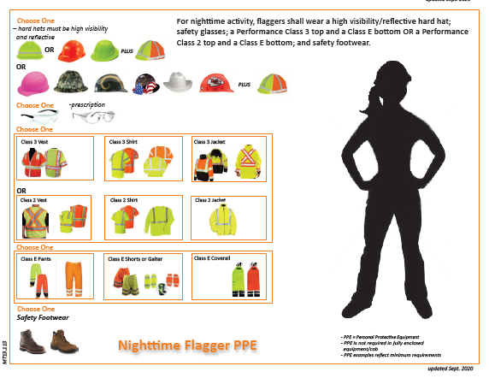
Notes:
Remember to refer to your posters when looking for the minimum requirements for nighttime worker operations. For nighttime, we step it up just a little more and require a high-visibility color plus reflective material on the hard hat. ANSI recommends a minimum of 10 square inches. Eye wear and safety footwear are still required at night. You can choose between a class 2 or class 3 vest, but we require class E pants, leggings, or gators in addition. According to ANSI standards, class 2 plus class E is equivalent to class 3, but MoDOT still requires the class E gators or pants at night.

Slide 23
Third quiz
What version of ANSI standards does MoDOT currently follow?
2015 b. 2004 c. 1999 d. 2020
On the class 3 vest, the reflectivity on the sleeves helps identify the wearer as a _________ through movement of the _________.
Person, arms b. worker, body c. flagger, head
Does a daytime flagger high visibility hard hat have to be reflective?
Yes b. No
ANSI recommends a minimum of ____ sq. inches of reflective material on a night time flagger high visibility hard hat.
8 b. 24 c. 10 d. 15
For night time flagging operations, flaggers are required to wear class ____ pants, leggings or gators in addition to their class 2 or class 3 top.
a. C b. 3 c. A d. E

Slide 24
Hand Signaling Devices
Notes:
Hand Signaling Devices

Slide 25
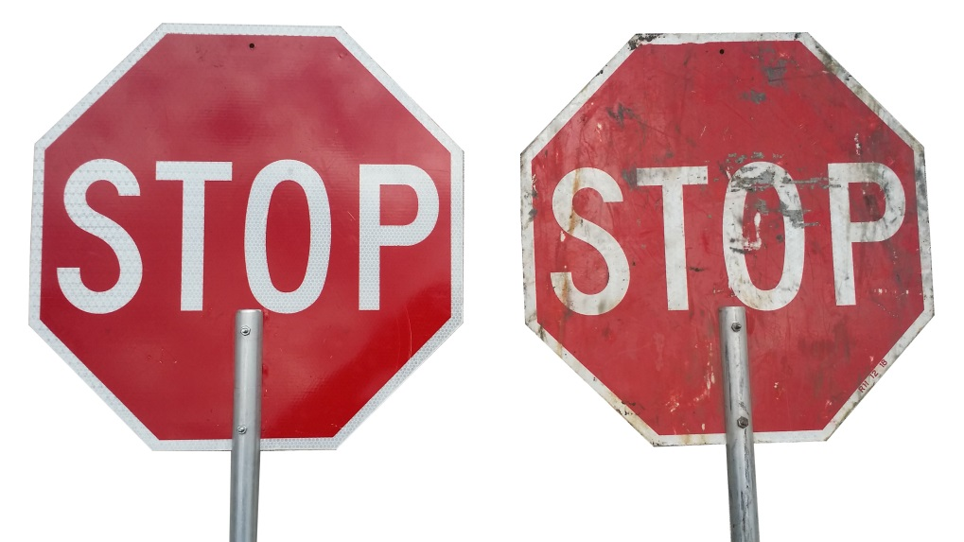
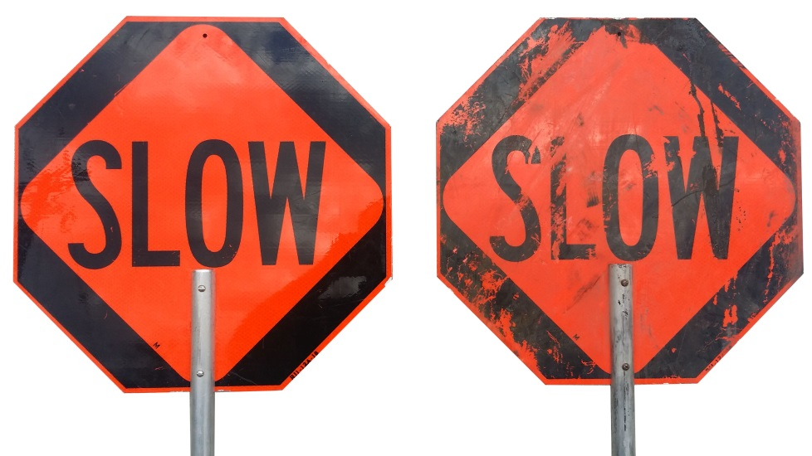
Stop/Slow Paddle
Shall be retro-reflective
Shall be octagon shape on a rigid handle
  Preferred height of 5-7ft.
Shall be 18 inches with 6 inch letters
Shall be in quality condition
Use of flags should be limited to emergency situations only
Notes:
Flaggers shall use a STOP/SLOW paddle, a flag, or AFAD. The use of hand movements alone shall be prohibited except for law enforcement personnel or emergency responders at incident scenes. A STOP/SLOW paddle is the typical device used. All devices shall be retro-reflective, or reflective from any direction and octagon shaped with a rigid handle. Paddles should be at least 18 inches with 6 inch letters. This ensures the drivers can see what is coming up. Signs should not be laid on top of each other or other objects; this will smash the prismatic material that makes them retro-reflective. All devices should be in good quality condition and easily read. It is the flagger’s job to ensure condition of the STOP/SLOW paddle before leaving for the job site that morning.

Slide 26
Flagger Stations
Notes:
Let’s talk about flagger station requirements

Slide 27
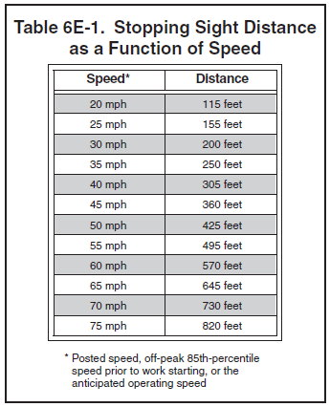
Flagger Station
Flagger stations shall be located such that approaching road users will have sufficient distance to stop at an intended stopping point
Notes:
The table shows how far away flaggers should be stationed from the crew, so approaching road users have sufficient distance to stop. Motorists need to have enough time to perceive, think about it and react before the intended stopping point. Something to keep in mind is the anticipated or off peak speeds; this is the speed motorists are actually travelling compared to the posted speed limit. For example, on a 55 mph posted roadway, travelers are actually going 70 mph, incorporate that when planning the distance of the flagger station from the crew.

Slide 28
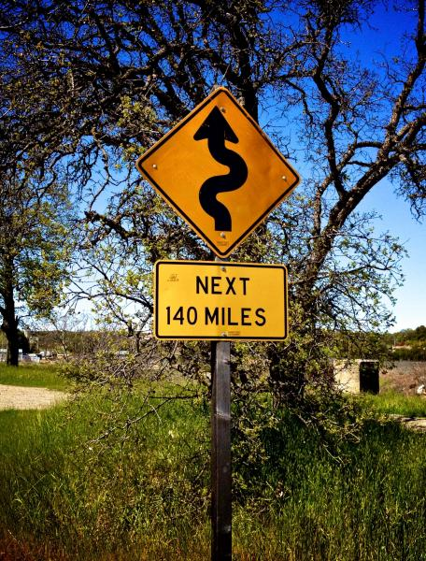
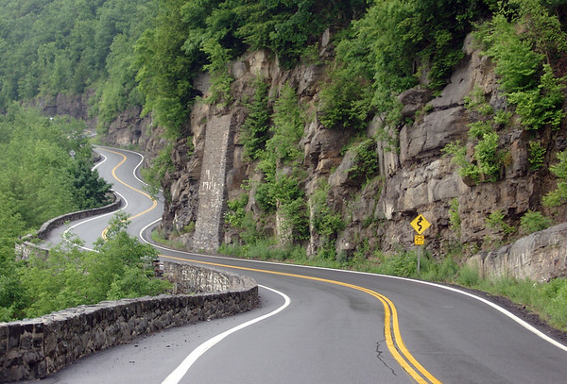
Factors that Affect Sight Distance
Hills
Curves
Obstructions
Shade – hard to see people in shaded area
Glare – lighting devices or angle of sun
Color contrast – wearing an orange vest and standing next to a similarly colored truck
Bad weather
Darkness
Notes:
What are some things that affect sight distance? Hills, curves, obstructions and bad weather can all affect your sight distance. Shade is another one - it is hard to see a flagger on a bright sunny day if they are standing in the shade. It’s the same with glare – the angle of the sun can make it hard to see as well. Watch the angle of the sun especially at sunrise and sunset. Color contrast – wearing a yellow shirt next to a piece of yellow equipment does not allow the flagger to stand out – this is why we recommend to stay 100 feet away from equipment, other objects, or people.

Slide 29
Flagger Station
Flaggers should be clearly visible to the first approaching road user at all times
  500 ft. daytime/1,000 ft. nighttime
Flaggers should face oncoming traffic
Flaggers should also make themselves visible to other road users after first vehicle stops
Notes:
As previously mentioned, flaggers should be clearly visible to approaching motorists, at least 500 feet during the day and at least 1,000 feet during nighttime. To increase visibility - do not stand like a statue. Move/raise/lower the STOP/SLOW paddle and move your body with small side to side movements. Flaggers should always face oncoming traffic. After you stop the first vehicle, watch the second and third stop, and are comfortable that everyone is going to stay, proceed toward the center of the road to make yourself visible to other road users. Do not cross the center line or go into the other lane, but make sure to be visible to the queue.

Slide 30
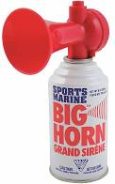
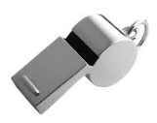
Flagger Station
Flaggers should be stationed sufficiently in advance of the workers to warn them of approaching danger by out-of-control vehicles
Flagger stations should be located such that an errant vehicle has additional space to stop without entering the work space
The flagger should identify an escape route that can be used to avoid being struck by an errant vehicle
Consider audible warning devices:
Horns
Whistles
Notes:
Ensure flaggers are stationed sufficiently in advance of the work area so if drivers do come through, they can be stopped before they get to the crew. The use of channelizers helps draw attention to drivers and helps them get stopped. Make sure the flagger station is in a location that allows you to get away from errant vehicles. Flaggers should pre-identify an escape route in both directions where possible, to avoid being struck in the event of an errant vehicle. Consider the use of audible warning devices such as horns or whistles to alert the crew of an errant motorist.

Slide 31
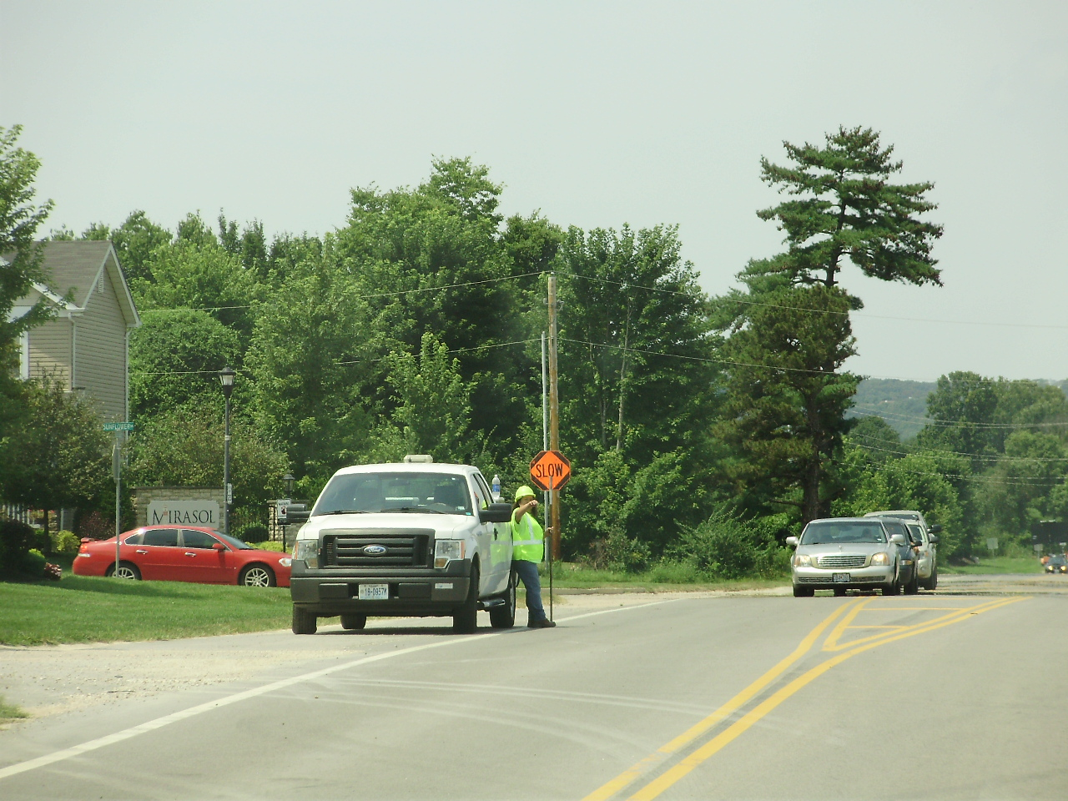

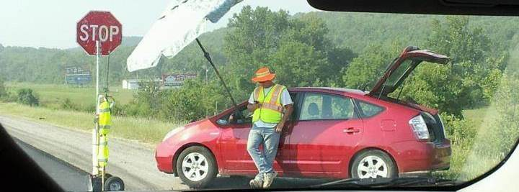
The flagger should stand alone, at least 100 ft. from:
Other workers
Work vehicles
Equipment
Flagger Station
Flagger must identify an escape route
Notes:
Flagger stations should be located away from other workers, vehicles, or equipment. The flagger in the top picture does not have a place to escape to. The bottom picture displays everything you could do wrong while flagging. It is really hard to pick people out when they are standing next to equipment or other objects. You must stand far enough away to be identified, so motorists know you are not part of the crew working and they cannot go around you.

Slide 32

Flagger Station
Flagger cannot be more than 1 mile away from the flagger symbol sign
Only 1 Flagger symbol sign may be posted, per travel direction
Notes:
Flaggers cannot be more than 1 mile away from their flagger symbol sign. Most people do not remember the sign seconds after seeing it, especially if they are distracted. Therefore, we recommend keeping the shortest distance from the flagger sign that gives motorists adequate stopping distance. If you expect drivers to be going faster than the posted speed limit routinely, you can expand the sign distance in accordance with the table we saw earlier. Make sure to have an engineering reason behind the change. Ensure drivers can see the signs. Only one flagger symbol sign can be posted per travel direction. Any sign that does not apply to the current condition, should be taken down. You can cover, fold down, or turn the sign away from traffic so it cannot be read, to ensure motorists are not getting false information about the upcoming situation.

Slide 33

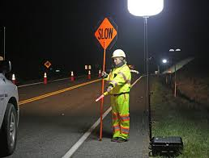
Nighttime Flagging
Nighttime hours:
Begin one-half hour before sunset
End one-half hour after sunrise
Notes:
Nighttime flagging starts one-half hour before sunset and ends one-half hour after sunrise. This requires lighted flagger stations for planned operations. The preferred method of lighting the stations is using a glow bug type light, which is multi direction and does not cause a glare to motorists. It lights up a large work area and does not blind the flagger. If using a light tower, which is directional; you must be careful not to point it so it blinds drivers or the flagger. The lighting station needs to be projecting onto the flagger, and must be in front of the flagger and high enough to not be glaring in their face. If you place the lighting behind the flagger, it creates a shadow and does not highlight them, making them unseen.

Slide 34
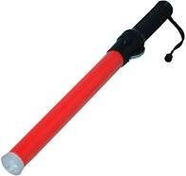
Nighttime Flagging
Flaggers shall be visible at a minimum distance of 1,000 feet
All signs shall be retro-reflective and channelizing devices shall have two retro-reflective bands
Glow wands or handheld lights are recommended
Notes:
As previously mentioned, flaggers shall be visible at least 1,000 feet away during nighttime so motorists pick up on their reflectivity a long distance away and identify them as a person. All signs, channelizers, and cones require retro-reflective material with at least 2 bands. Another recommendation for nighttime use is a light saber or glow wand. The glow wand helps enhance hand movements giving direction during nighttime flagging operations. Use good sweeping motions when directing traffic.

Slide 35

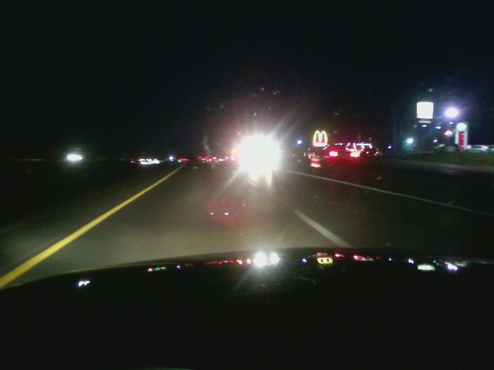
Glare
Lighting shall not produce a disabling glare to:
Traveling Public
  Traveling in either direction
Flaggers
Crew Workers
Factors impacting glare are:
Lighting unit set-up location
Height of light unit
Direction the light units are aimed
Notes:
Can you see the flagger in the bottom picture? No! The light station is placed behind them, creating a shadow and blinding oncoming traffic, making the flagger undetectable. The glow bug is the best option to be used and is required for planned operations. Plan ahead for emergencies and have glow bugs available at the minimum for major, high-speed and high-volume routes, if not in all locations. Lighting stations should not cause problems for anyone, including the traveling public, the flagger, or the crew workers. Factors to consider when setting up a light station include – location, height of unit and the direction aimed.

Slide 36
Fourth quiz
What shape is the STOP/SLOW paddle required to be?
Circle b. Octagon c. Square d. Diamond
All stop slow paddles shall be at least ____ inches with ___ inch letters.
18, 6 b. 24, 12 c. 18, 9 d. 24, 10
Flaggers should be visible at least ____ feet away during the day time and at least _____ feet at night time.
495, 1,000 b. 500, 1,200 c. 500, 1,000 d. 550, 1,200
Flaggers should never face oncoming traffic?
true false
Who is in charge of inspecting equipment and identifying an escape route before the day’s work begins?
a. Crew leader b. supervisor c. crew members d. flagger

Slide 37
Fourth quiz cont.
Flaggers cannot be stationed more than ______ away from the flagger symbol sign.
1 mile b. 500 feet c. 775 feet d. ¾ of a mile
What does MoDOT consider as night time hours?
Begins one-half hour before sunset & ends one-half hour after sunrise
Begins one-half hour after sunset & ends one-half hour before sunrise
How many bands of retro-reflective material are required on channelizing devices?
3 b. 1 c. 2 d. 4
What factors impact the glare from a lighting station? (select all that apply)
Lighting Unit Set-Up Location
Color of lights
Height of Light Unit
Direction the Light Units are aimed
Number of vehicles in the queue

Slide 38
Flagger Procedures
Notes:
Flagger Procedures

Slide 39
Flagger Duration
Flaggers should not flag for more than two hours at one time
  Unless it is an emergency situation
Supervisors shall provide flaggers with a 15-minute break from flagging in non-emergency situations
Even in emergency situations, the supervisor should make every effort to rotate or relieve the flaggers with another qualified flagger every two hours
Notes:
Flaggers should not flag for more than 2 hours at one time without a break. Operations should be planned to have enough crew members to swap duties. Supervisors shall provide flaggers with a 15 minute break every 2 hours. An automated flagger is another great tool that can be used.

Slide 40
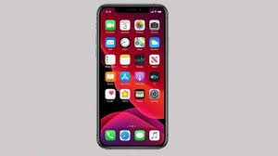
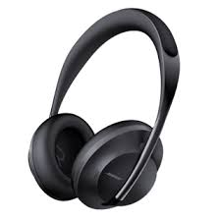
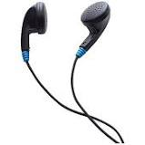
Flaggers Cannot Be Distracted:
Do NOT Use:
Cell Phones
Ear buds or headphones
Notes:
Flaggers shall not use cellphones, ear buds, or headphones while flagging. The ONLY time it would be okay to have your cell phone out is in the event of an accident and you need to call 911. Flaggers should not be distracted and on the phone. Listening to music is also not acceptable while performing flagging operations. Flaggers need to be alert and aware of what is going on around them. If you are listening to music or on a phone call, you cannot hear what is happening around you and be fully aware.

Slide 41
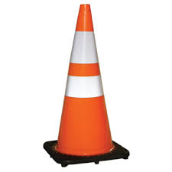
Flagging Hand Signals
&
3-2-1 Cone Procedure
Notes:
There are only 3 hand signals for flagging

Slide 42
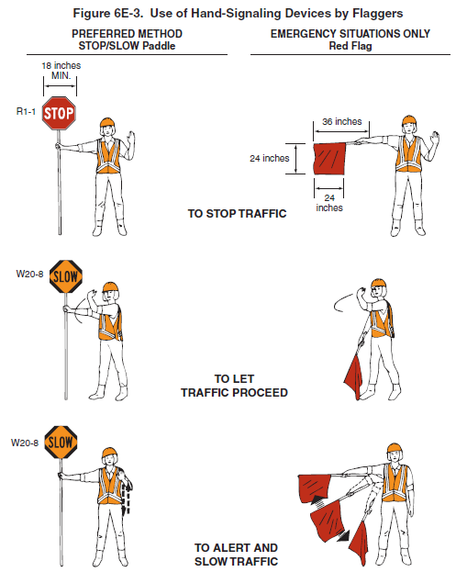
Use of Hand Signaling Devices by Flaggers (MUTCD 6E-3)
Notes:
Stopping traffic, which is the arm fully extended and the other hand straight up in the air. Releasing traffic, turn the paddle to the SLOW side and give motorists an assertive sweeping motion in the direction you want them to go. Slowing traffic, a simple up and down motion is used.

Slide 43
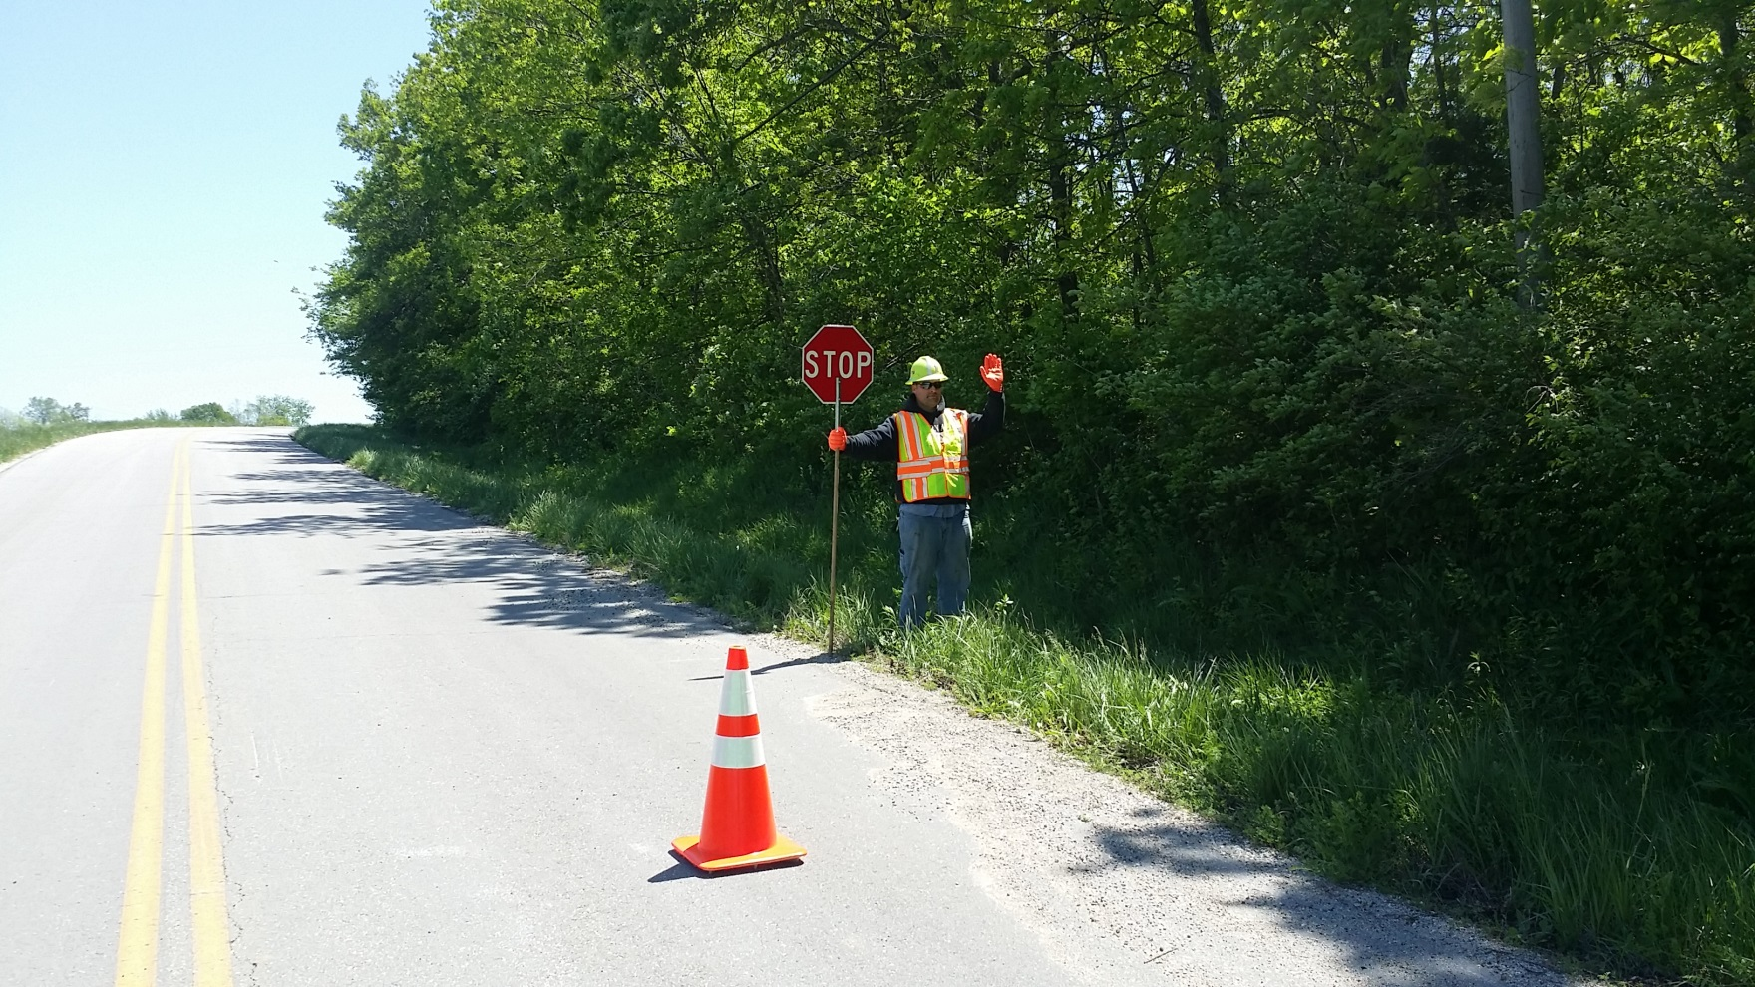
Step 1: Stopping Traffic
Stop/Slow Paddle is fully extended from the body
Left hand is up with open palm, in STOP position
Face Traffic, from the edge line/edge of pavement
  Ensure STOP sign is facing oncoming traffic
The following photos represents open lane of work zone. Flagger at opposite end controlling traffic of the closed lane (the lane work is actually taking place in) would not move the cone(s). Instead, you would motion traffic to drive around the cone(s).
Notes:
For stopping traffic, understand that a flagger must be on the shoulder of a roadway and not IN the roadway. You need to be visible. Think about the alignment - try to avoid curves and find a location where you will be easily seen by oncoming traffic. You must hold the flagger paddle in the right hand closest to traffic, with your arm fully extended displaying the STOP side. Your left hand should be straight up. Stop the first vehicle, make eye contact with the driver, and ensure the second vehicle is stopping.

Slide 44
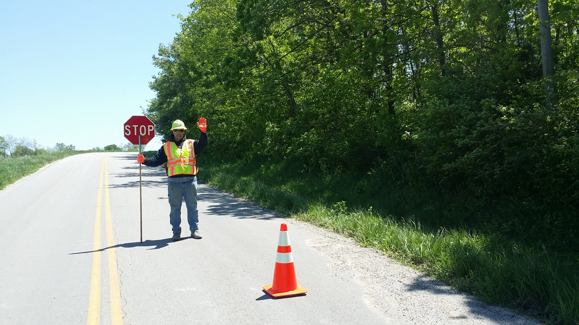
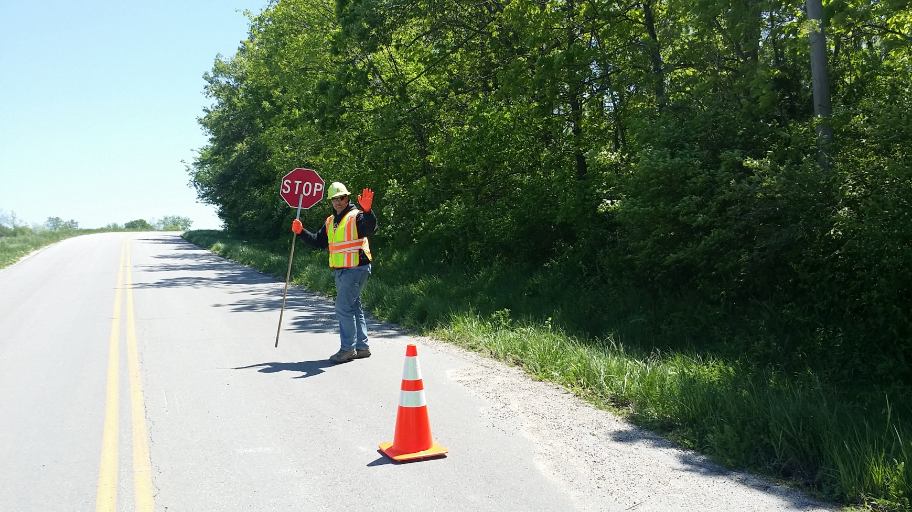
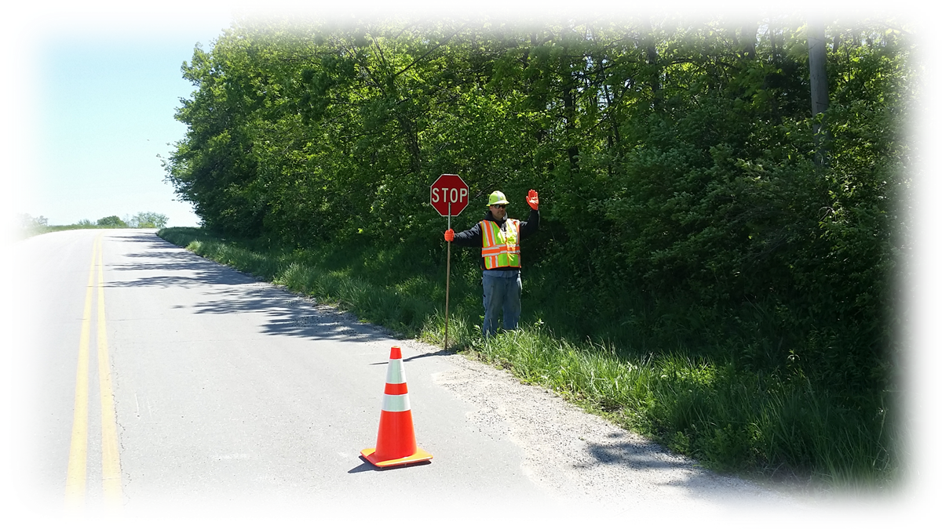
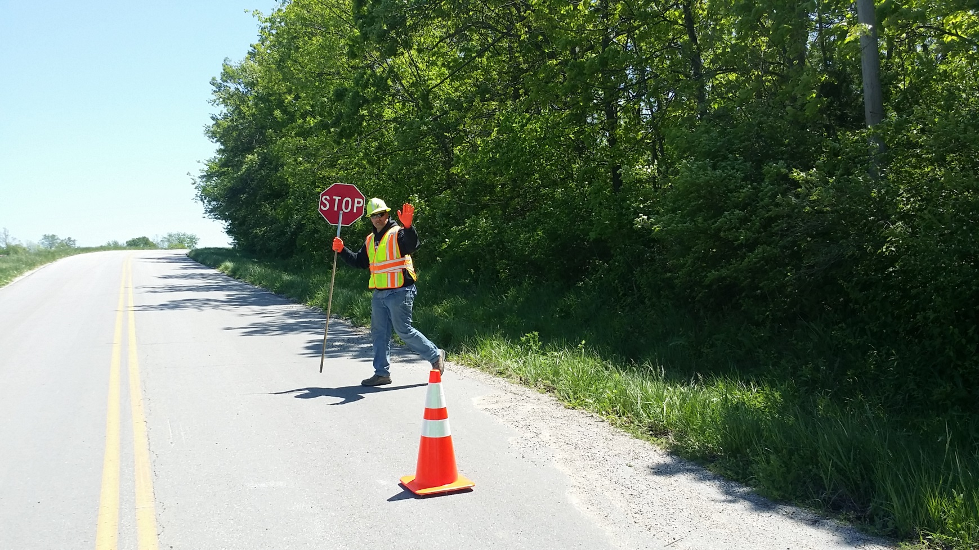
Step 2: Traffic is Stopped
Once traffic has stopped, move out towards the center of the lane
Keep the Stop/Slow Paddle in your right hand and position it out towards the center line, be sure not to cross the line with the Stop/Slow Paddle
Keep visual contact with drivers of stopped vehicles
Keep left hand raised with palm facing driver, signaling to stop, until traffic has stopped
Notes:
After the second vehicle has stopped, you can start proceeding out towards the center of the roadway. Do not cross the center line. Stay in your lane and place the flagger paddle close to the center line to make it visible. Always keep the paddle in your right hand.

Slide 45
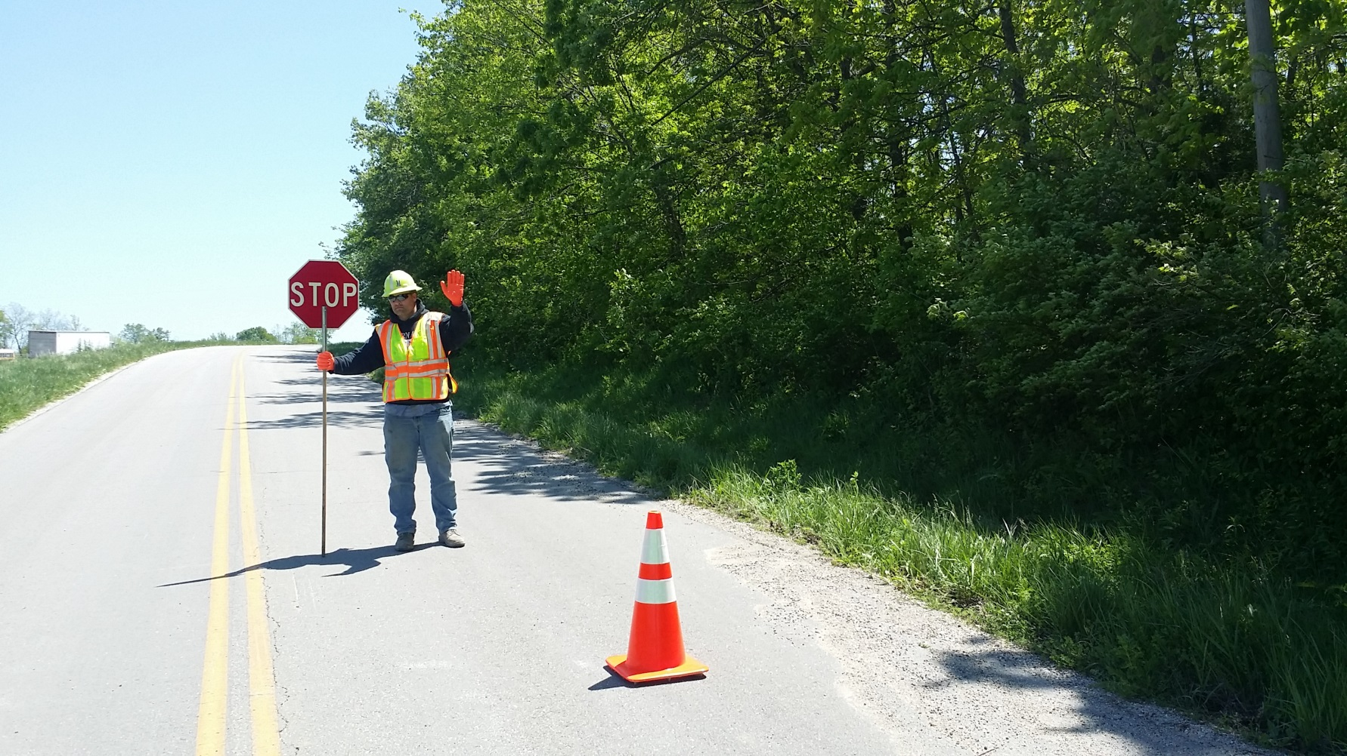
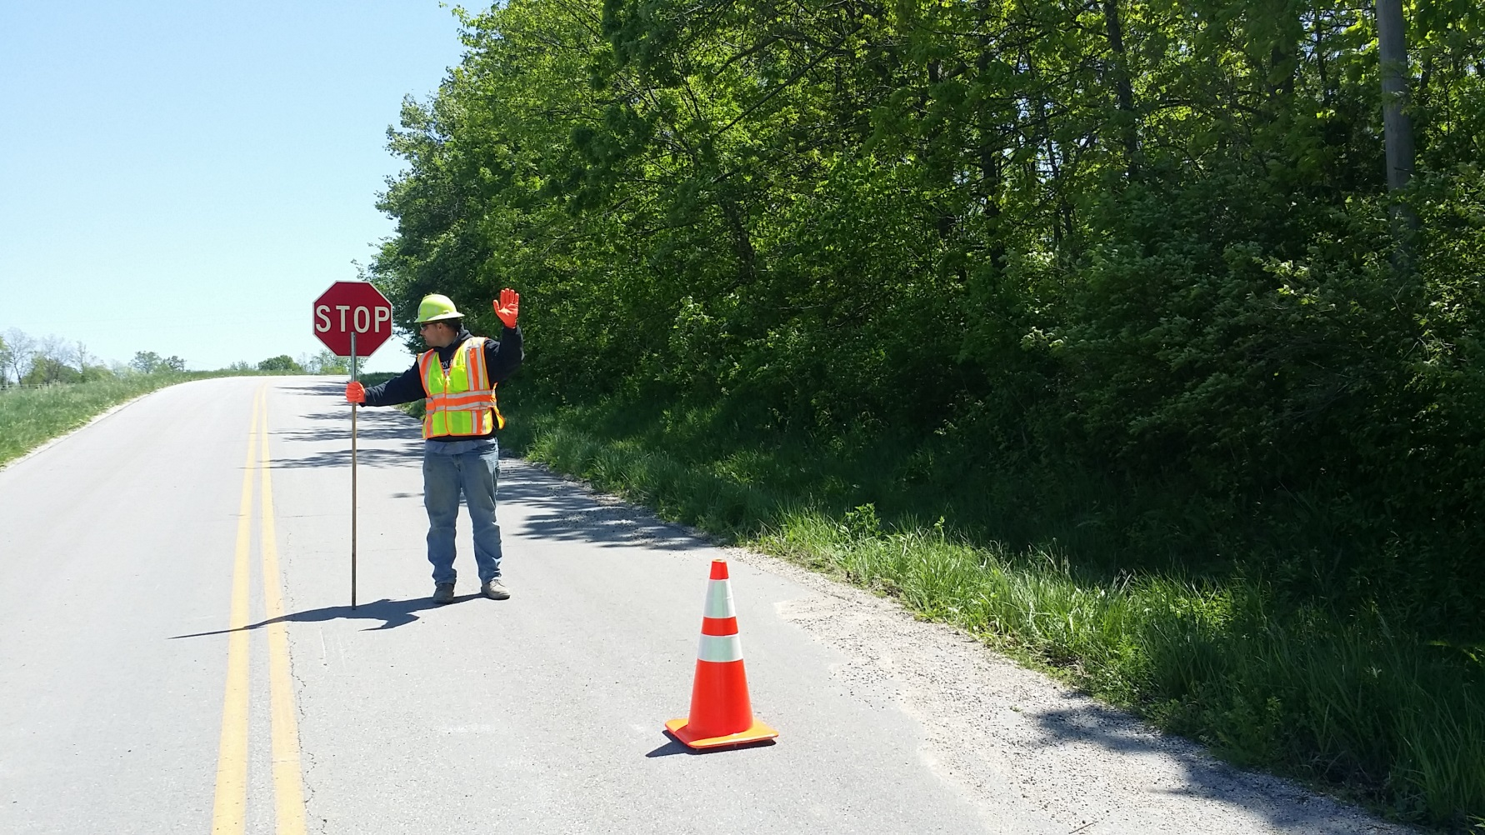
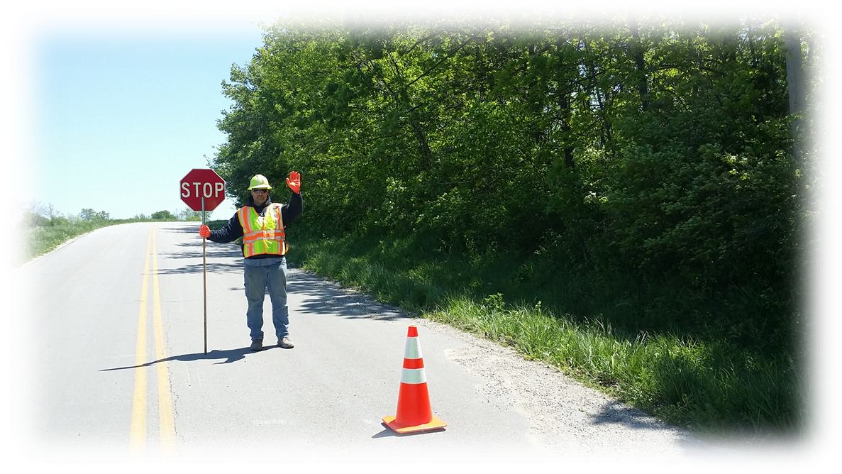
When you arrive at Center Line
You may put your left hand down once traffic has stopped
Continually monitor traffic flow, from the opposite lane along with the vehicle(s) you have stopped within your lane
Notes:
After you get to the center, if traffic will be stopped for several minutes, you do not have to keep your left hand up the entire time. Pay attention to what is going on, periodically checking on the traffic coming from behind from the flagger at the other end of the work zone. Do not turn your back to the traffic you already have stopped.

Slide 46
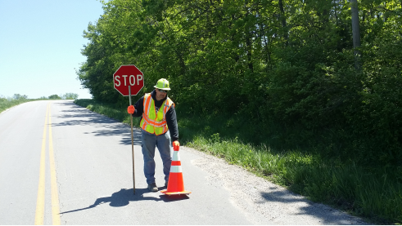
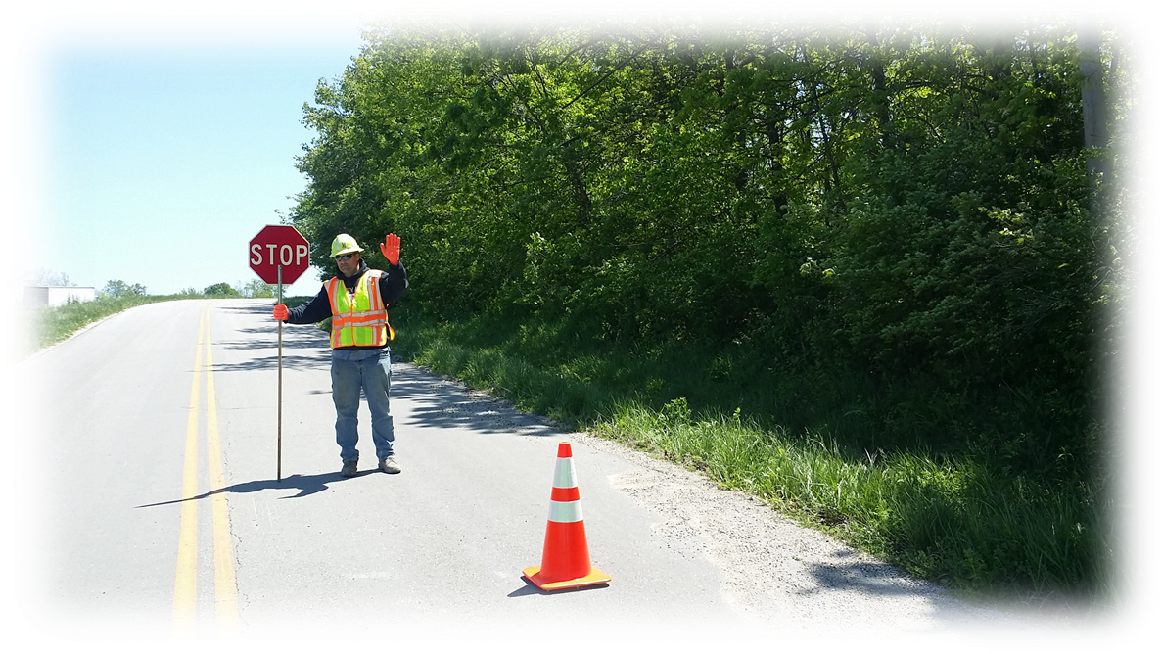
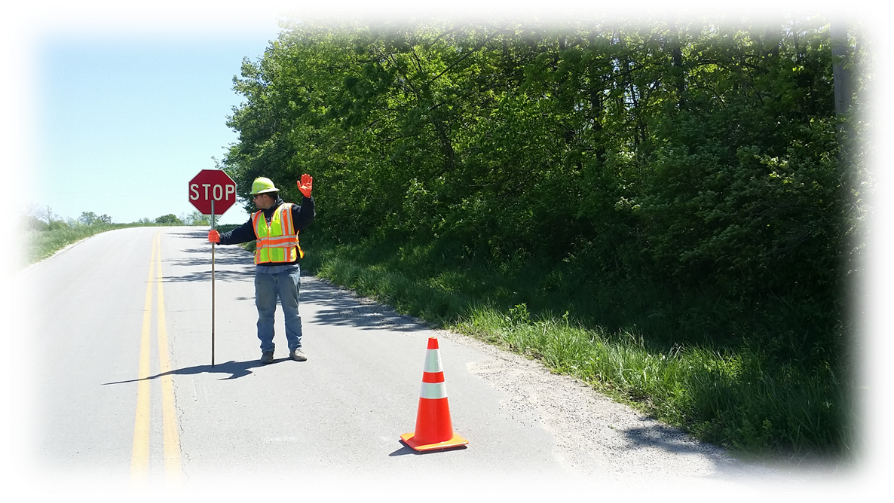
Step 3: Preparing to Release Traffic
Once you have confirmed opposing traffic is clear, make your way back to the shoulder taking the cone (as shown) with you
Be sure to keep STOP visible to the stopped traffic
Notes:
Once you have confirmed all opposing traffic has cleared, you are ready to release the traffic queue. Raise your left hand again, proceed back toward the shoulder of the road, keeping the STOP paddle visible at all times.

Slide 47
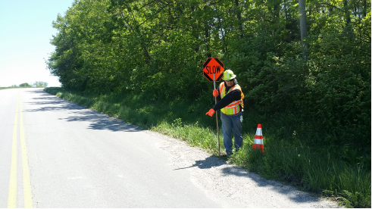
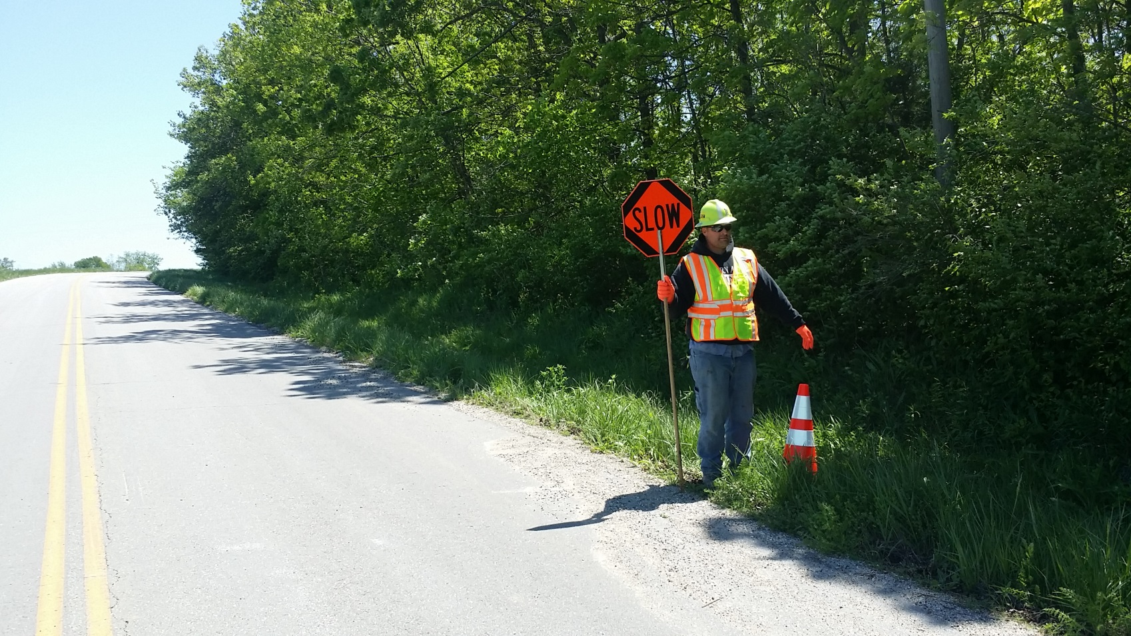
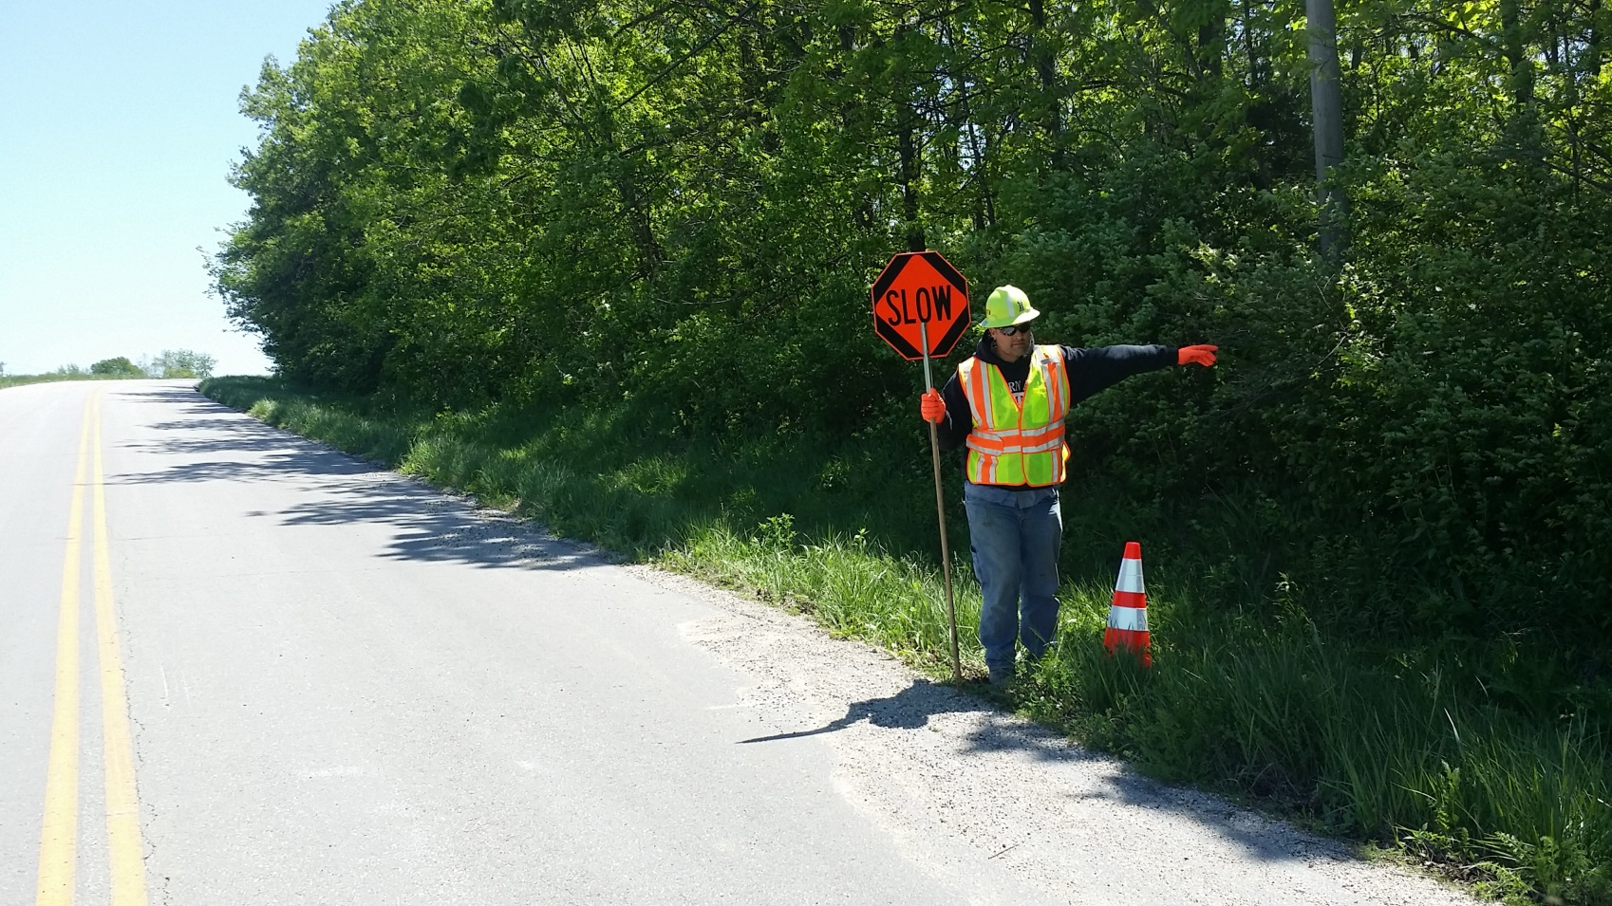
Step 4: Releasing Traffic
Once on the shoulder, rotate the Stop/Slow Paddle to SLOW and release traffic
Direct traffic by signaling with your arm and waving vehicles through
Notes:
When you reach the shoulder, turn the flag paddle to SLOW and use your left arm to motion traffic in the direction you want them to go. If it is the far lane, leave the paddle extended in the lane and give them a big sweeping motion into the far lane, if it is the near lane – bring them straight into the lane with smaller sweeping motions. If motorists are going to fast, slow them down by using an up and down motion with your left hand, palm facing down.

Slide 48
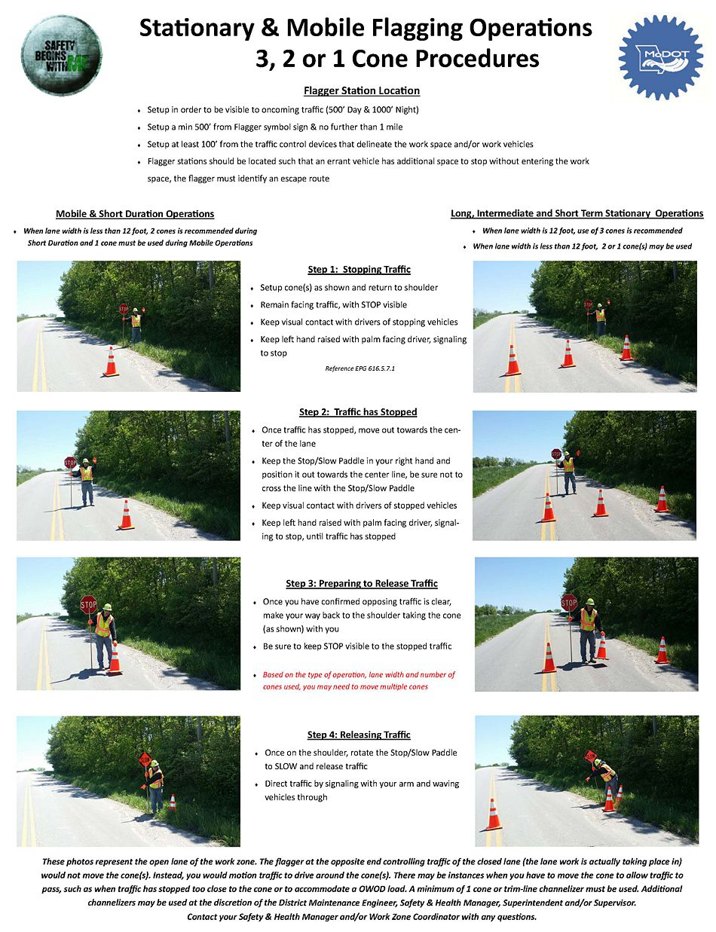
3-2-1 Cone Procedure
Mobile & Short Duration Operations
When lane width is less than 12 foot, 2 cones is recommended during Short Duration and 1 cone must be used during Mobile Operations
Long, Intermediate and Short Term Stationary Operations
When lane width is 12 foot, use of 3 cones is recommended
When lane width is less than 12 foot, 2 or 1 cone(s) may be used
Notes:
The expectation going forward is to channelize the entire work area for longer duration operations, such as bridge inspections or any operation where the crew will be there for a while. This will draw attention as vehicles are coming up and show them where to go. If this is not done, use the 3-2-1 cone method. When using 3 cones, place one on the center line, one in the middle of the roadway, and the other on the shoulder. Stand on the shoulder a little bit away from the channelizers. The cones act as a stop bar, indicating to motorists where to stop. Stop the first vehicle and follow normal procedures, moving toward the center of the roadway. If you will be releasing traffic into the other lane, you can leave the cones in place and move back to the shoulder when ready to release traffic. If using the lane closest to the flagger, remove the middle cone as you proceed back to the shoulder. When on the shoulder, turn the paddle to SLOW and release traffic. When all cars have gone through the gate, turn the paddle back to STOP and return the cone to the roadway.
When using 2 cones, it can be done a couple different ways – put one in the middle and one on the centerline, one in the middle and one on the edge line, or one on the edge line and one on the center line. The goal is to draw attention to drivers, so it is recommended to always have one in the center. If a motorist is not paying attention and runs over a cone, it will wake them up.
When using only 1 cone, it goes in the center of the roadway. Flagger stations are required to use at least 1 cone if not channelizing the entire work area. It is preferred to use at least 1 cone even when the entire work zone is channelized. Follow the same procedures to stop and release traffic, carrying the cone with you as you proceed back to the shoulder. Channelizers may used at the discretion of the: District Maintenance Engineer, Safety & Health Manager, Superintendent and/or Supervisor. Contact your Safety & Health Manager and/or Work Zone Coordinator with any questions
There may be instances when you have to move the cone to allow traffic to pass, such as when traffic has stopped too close to the cone or to accommodate an over-weight over-dimension load.

Slide 49
Fifth quiz
Flaggers should not flag for more than __________ at one time without a break.
a. 4 hours b. 2 hours c. 8 hours d. 6 hours
How many hand signals are there for flaggers?
6 b. 2 c. 5 d. 3
Which hand is the flag paddle held in?
Right left
When flagging, the right hand should be
down by your side b. straight up in the air c. fully extended d. behind you
When releasing traffic, the flagger should stand
In the center of the roadway b. on the shoulder c. in the opposite lane d. in a ditch
Flaggers are required to use at least 1 cone when flagging.
True false

Slide 50
How Do Flaggers Communicate?
Notes:
How do flaggers communicate?

Slide 51
Flagger Communication Rule
One flagger should be designated as the lead flagger
This person has control over all flagging operations and emergency vehicles right-of-way
Notes:
Before the day begins, a lead flagger needs to be designated; this person has control over the flagging operations. They will be the one who makes decisions on how to handle the situation in the event of an emergency. If you hear or see an emergency vehicle, communicate with the lead flagger who will determine further actions. This job is not suited for a new flagger.

Slide 52

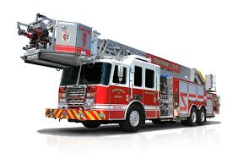
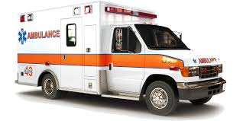
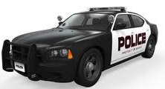
Emergency Vehicles
Have right of way priority in a work zone
  Only when it is safe to proceed
Notes:
Emergency vehicles do have the right of way, but, it should be understood they cannot pass through the work zone until it has been cleared and safe for them to proceed. If you can hear sirens coming in the distance, the lead flagger should hold all vehicles, let traffic already inside the work area flush out, then allow the emergency vehicles to enter unaffected. There will generally be more than one emergency vehicle; do not allow other traffic to start moving again until the lead flagger feels comfortable it is safe to proceed.

Slide 53
How Do Flaggers Communicate to Each Other?
Two-way hand held communications
Maintain a clear sight distance
Hand signals
Raising a stop/slow paddle
Notes:
How do flaggers communicate? The preferred method is 2-way hand-held radios. If radios are not available or you are in a short work zone where you can see both flaggers at each end as well as the cars that are coming through, you can flag without radios. If not using radios, the lead flagger can dictate hand signals to be used among flaggers. These should be kept simple and easily understood. For example, if you have more than 2 flaggers, the lead flagger can raise the paddle twice, to signal the second flagger to release his queue of stopped traffic.

Slide 54
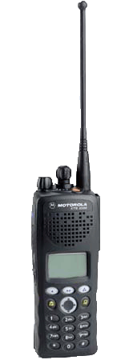
Communication Devices
Preferred method of communication
Use when sight distance is a problem
Use whenever possible while flagging
Only use approved FCC devices
Do you need to take extra batteries?
Is the unit fully charged?
Notes:
Hand-held radios are the preferred ones to use. They can reach up to 3 miles, but they are not guaranteed beyond 2 to 3 miles. Keep in mind the surrounding terrain; sometimes a large hill will not allow radio communication to work, but a radio should be used when possible. MoDOT workers are allowed to use only FCC devices. Flaggers should ensure radios are fully charged and have extra batteries before leaving for the jobsite. If radios are not available or stop working in the middle of a job, a pilot vehicle should be used. The pilot vehicle will escort the traffic queue through the work zone. In an emergency situation where a radio and pilot vehicle are not available, you can use the pass the hat method. Give the last car in the line of traffic a hat and ask them to give it to the flagger on the other end of the work zone. This lets the other flagger know it is safe to release his line of traffic.

Slide 55
Sixth quiz
Who has control over flagging operations?
Lead flagger b. crew leader c. flagger at beginning of work zone d. crew members
Can emergency vehicle pass through a work zone with out stopping?
Yes No
What is the preferred method of communication between flaggers?
Walkie talkie b. pilot vehicle c. 2-way hand held radio d. hollering at each other
If radios are not available for use, flaggers can use what? (select all that apply)
Hand signals
Sticks
Pilot vehicle
Pass the hat method
Flashing lights

Slide 56
Methods of Flagging:
Single
Two Flagger
Advanced Flagger
Notes:
There are 3 common types of flagging - single, two flagger operations, and sometimes the advanced or additional type flagger.

Slide 57
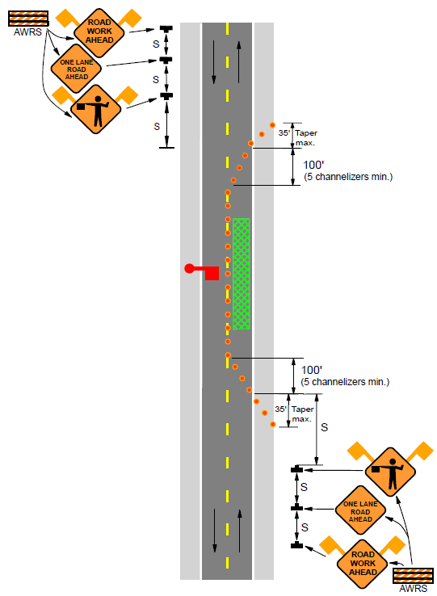
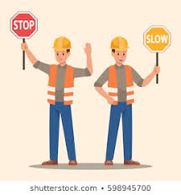
Single Flagger Operation
Notes:
A typical work area for a true single flagger who will be controlling both directions of traffic, should look similar to this illustration. The flagger needs to be opposite the work crew so they are separate and visible. This would be for low volume and low speed routes. This is not the preferred method and should be used only when all three of the following are met – traffic volumes are less than 500 vehicles per day; sight distance in both directions is greater than 1,000 feet, and the activity area is less than 500 feet. An example would be filling a pothole or removing a large piece of debris from the roadway. Single flagging operations should NOT be conducted during nighttime work zone operations.

Slide 58
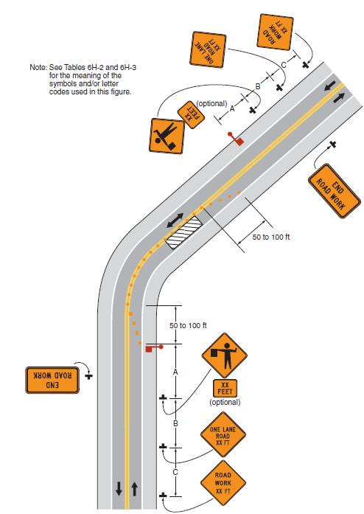
Two Flagger Operation
Notes:
The most common flagger method used by MoDOT is the two flagger operation, having a flagger at each end of a two-lane road, alternating traffic as show in the picture.

Slide 59
Advance/Additional Flaggers
Use when sight distance is limited
Side roads and parking lot entrances
Lengthy work zones
Use during long lines of traffic backup
Notes:
There are multiple scenarios when an advance or additional type flagger method will need to be used. Some examples include; when sight distance is limited, lengthy work zones, long lines of traffic backup, or having multiple side roads and parking lot entrances within the work zone. The additional flagger can help slow traffic.

Slide 60
Advanced or Additional Flagger Operations
Notes:
The example shown represents the use of an advanced or additional flagger operation.

Slide 61
Seventh quiz
How many flagging methods does MoDOT use?
4 b. 1 c. 3 d. 2
What is the most common flagging method used by MoDOT?
a. Single flagger b. two- flagger c. advanced d. pilot vehicle
When would an advance/additional flagger operation be used? (select all that apply)
Use when sight distance is limited
Radio quits working in middle of a job
There are lots of side roads and parking lot entrances
Lengthy work zones
Pilot car is being used
Use during long lines of traffic backup

Slide 62
Advanced Warning & Traffic Control Devices
Notes:
Now, let’s talk about advanced warning and traffic control devices

Slide 63
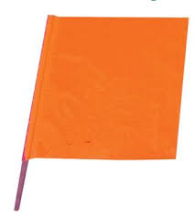



Advanced Warning Signs
EPG 616.23.2.5.1 Signs & EPG 616.6.2
General Characteristics of Signs (MUTCD 6F.02)
Except in emergency situations, Advanced Warning Signs must be in place prior to work taking place
“Optional”
Notes:
MoDOT standards say, except in emergency situations and short duration operations, which is defined as 30 minutes or less, advanced warning signs must be in place prior to work taking place. MoDOT’s typical sign package includes the road work ahead, one lane road ahead, be prepared to stop, and flagger symbol signs. Be prepared to stop is an optional sign.

Slide 64

EPG 616.3.3
Components of Temporary
Traffic Control Zones
(MUTCD 6C.03)
Notes:
All signs should be placed in the advance warning area. This graphic shows the parts of a work zone, with the advance warning area being the first thing motorists see before reaching the actual activity work area where the crew will be located.

Slide 65

Refer to the Engineering Policy Guide 616.8 Typical Applications
(MUTCD 6H)
Notes:
This is an example of TA-10, a typical application used by MoDOT on 2-lane roads. This image comes from the EPG. When looking in the MUTCD, you will see a similar image, but without the detailed notes like the EPG example. Every time we plan a job, the TA should be printed off. Flagger station locations and sign placement should be identified in advance, preferably the day before the work is to be done. The first sign motorists come to shall have flags on it. Beyond that, the only signs required to have flags attached are the flagger ahead symbol and truck crossing. On a 2-lane roadway with a 60 to 70 mph speed limit, signs should be placed 1,000 feet apart. The maximum spacing allowed between channelizers is 120 feet, which is every third skip. The MUTCD rule states two-times the speed limit.

Slide 66



Advanced Warning
EPG 616.19.2.2.7 Sign Coverings
Signs must be removed or covered when not in use
Notes:
Signs must be covered or removed when not in use, including during lunch time. You can fold them down, cover or turn them, or lay them down. Signs should not be giving direction when not applicable.

Slide 67


Channelizers
EPG 616.23.2.5.4 Channelizers & 616.6.63 Channelizing Devices (MUTCD 6F.63)
Trim Line
42 inches in height
Cone
28 inches in height
*For daytime operations on minor roads only
Notes:
A 42-inch trim line is the typical channelizer used by MoDOT operations. Cones can be used at flagger stations due to the weight of the base on a trim line. Cones may also be used on daytime operations on minor routes if wanting to channelize the entire work area with cones. Traffic counts can determine if a roadway is low volume.

Slide 68
Eighth quiz
What are the signs included in MoDOT’s typical sign package? (select all that apply)
Road work ahead ▪ road work next 2 miles
Stop ahead ▪ flagger symbol sign
One lane road ahead
Be prepared to stop
Where should signs be placed?
Transition area b. activity area c. buffer space d. advanced warning area
Which signs should have flags on them? (select all that apply)
▪ flagger ahead symbol ▪ the first sign motorists come to
▪ truck crossing ▪ Expect delays
If the speed limit is 60-70 mph, what is the minimum amount of spacing between signs on a two-lane roadway?
1,000 ft. b. 500 ft. c. 700 ft. d. 850 ft

Slide 69
Eighth quiz cont.
What is the maximum spacing allowance between channelizers?
100 ft. B. 120 ft. C. 175 ft. d. 140 ft
When not giving directions, signs should be?
open b. visible c. covered d. lit up
What determines if a roadway is low or high volume?
a. traffic counts b. an engineer c. the channelizer used d. how long it is

Slide 70
Additional Considerations
Notes:
Some other things to think about

Slide 71



LED Stop/Slow Paddle
2016 Innovations Showcase
Notes:
There are a few different types of the lighted flag paddle which draws attention by either flashing lights, lighting of the edges, or having the words light up. Anything you can do to safely highlight the flagger station is a good idea. Several innovations have been introduced to assist with bringing attention to flaggers.

Slide 72

Pilot Vehicle
Pilot vehicles are a safe and efficient means of moving traffic when a lane must be shared by traffic and the work zone area is lengthy or difficult to navigate
Two flaggers must be used when using a pilot vehicle
What are some advantages to using a pilot vehicle in a work zone during flagging operations?
Notes:
As previously mentioned, pilot vehicles are another great option to use when flagging. A pilot car leads travelers through a complex, long, one-way work zone and are specifically marked so you can tell them apart from other construction vehicles. This is not necessary on a shorter length work zone where you can see both ends. The more crossroads, lane changes, equipment crossings, and other obstacles in the work zone; the more beneficial the pilot car is. When using a pilot vehicle, two flaggers are required. A pilot car continuously drives back and forth through the work zone; all traffic should follow only the pilot car. The pilot car driver will not pass through a work zone until it is safe to do so; they know which lanes to use and always maintain a safe speed. They also coordinate with equipment and other construction trucks. The pilot car driver will pull off the road at the end of the work zone to allow traffic to continue on their way.

Slide 73



Automated Flagger Assistance Devices (AFAD)
Designed to be remotely operated
Positioned out of the lane of traffic
  Red/Yellow Lens AFAD shall alternately display a steadily illuminated CIRCULAR RED lens and a flashing CIRCULAR YELLOW lens
  Red/Yellow Lens AFAD shall include a gate arm
Notes:
An AFAD, is another great tool for longer-term stationary jobs where you will not have to move the device often. The most common type is the red/yellow lens AFAD which has an arm that comes down and will sound an alarm if someone drives around it while the arm is extended. One person can control both AFADs at each end of the work zone from one location if you can see both ends of the work zone; or you can still use 2 flaggers, but they would not be in the roadway exposed to traffic. Flaggers should understand how an AFAD functions and how long it takes for the arm to go down for this to be a successful method.

Slide 74




Short-term Rumble Strips
Long-term Rumble Strips
616.6.87 Temporary Rumble Strips (MUTCD 6F.87)
Notes:
Rumble strips can be used for short or long-term duration operations. There is required spacing when using each type of rumble strip. These should not be placed on hills or where there will be a lot of braking because the rumble strips will move. It is recommended to place these before the flagger symbol sign to alert motorists something is ahead. Short term rumbles are placed in and out each day; they are not left on the roadway when work is not taking place or overnight. Long-term rumbles have a sticky back to help hold them in place for long term projects and can stay out for the duration of a project.

Slide 75
Work Zone Inspections
EPG 616.19 Quality Standards for Temporary Traffic Control Devices
Drive through your work zone once it is set up
Monitor compliance
Identify deficiencies
  Document deficiencies or any needed changes
  Take action
Photograph work zone
  Especially after an incident
Notes:
Inspections are important. After you set up your work zone, drive back through it to ensure everything looks correct. Check everything from sign placement and visibility, and ensure flagger stations are set up to where flaggers can see and so on. Monitor compliance and identify any deficiencies and correct them immediately. Make sure to document the deficiencies and take photos and videos while driving both directions, especially if a crash has occurred. Sometimes, in the event of a crash, the work zone will need to be extended to incorporate the accident into it. Measuring and taking pictures of the sign placement is also something that should be done. If signs are set up differently from what the TA suggests, it must be documented as to why this is a safer way for legal purposes.

Slide 76

Protecting Yourself
And Co-workers
In the event of an incident
Protect yourself and co-workers
Get vehicle and driver’s description
Do not leave your post
Stay focused and alert
Notes:
Do not leave your post! Flaggers shall never leave their post, even in the event of a crash. A flagger’s job is to protect everyone. If you have a driver go around your flagger station, gather as much information as possible including vehicle description, license plate number and driver’s description; to report to authorities. A good example of not leaving your post would be having a vehicle stopped at the flagger station. Another vehicle hits the first one and the driver runs off. Flaggers should not leave their post, except to move in front of the accident to flag around it.

Slide 77
Ninth quiz
What are the additional considerations that can be used to advance a flagging operation? (select all that apply)
LED STOP/SLOW paddle ▪ Stop sign
AFAD ▪ Paddle cart
Pilot vehicle
Temporary rumble strips
When inspecting a work zone you should _____________ and _____________ any deficiencies immediately.
Look at, move b. document, correct c. certify, photograph d. leave alone, move on from
Flaggers shall _________ leave their post.
a. Always b. sometimes c. never d. randomly

Slide 78

Notes:
So, what is wrong with this picture? There is no escape route and he made his own shade, which is a problem because it does not allow him to stand out and be visible. The flagger is not paying attention to traffic; he has his back turned away. He is not wearing a hard hat, so does not have the required PPE.

Slide 79
Notes:
This is another picture of the same guy a little later in the day. He is playing on his cell phone and not paying attention to traffic. Cell phone use is prohibited while flagging. The use of a dolly to hold the paddle is not allowed, these items cannot be on the road surface. Flag paddles shall not be left unattended. Flaggers shall be separated by at least 100 feet from other objects to remain visible.

Slide 80

Notes:
This is a pretty common scenario seen every day. If you see this, you should stop and correct the situation or at the very least make a phone call to someone who can. This flagger is facing the opposite direction of the traffic he has stopped. The flag paddle should not be on a cart in the roadway or left unattended.

Slide 81

Notes:
This flagger is not paying attention while he plays on his cell phone and not moving from one spot letting motorists know he is there.

Slide 82

Notes:
Traffic control devices shall not be left taped to another sign while work is being performed.

Slide 83

Notes:
How long has this flagger been there, and how can you tell? He has a cooler next to him, which is a pretty good indication he has not and is not planning to leave that spot. This is not allowed. We shall not have objects on the roadway that have not been crash tested or could cause a hindrance for an escape route. Flaggers should not flag for more than 2-hours at a time. He is also too close to the crew; this does not allow enough stopping distance or area for crew members to get out of the way in the event of an errant vehicle.

Slide 84

Notes:
Again, carts should not be in the roadway. Flaggers need to be visible and stand out; they should not be standing over the crest of a hill.

Slide 85

Notes:
Getting something from your lunch box and not paying attention to traffic is not a good idea and shall not be done. Flaggers should always face traffic and be alert to what is going on around them.

Slide 86

Notes:
Talking on the phone is not allowed while flagging because it does not allow you to focus on the task at hand and be alert. Traffic shall not be released with oncoming traffic still present.

Slide 87

Notes:
Again, flaggers should always face the traffic they are stopping. This guy is too close to the flagger symbol, not allowing enough advanced warning in this scenario. When designing your work zone, think about the users – the new driver or the elderly. We do not want to surprise them when coming up on this. Allow enough advanced notice for motorists to safely get stopped. Flaggers should not be placed over the crest of a hill.

Slide 88

Notes:
Flaggers shall not sit in a truck to flag traffic. When a flagging station needs to be moved, an additional flagger should take their place, directing traffic while the flagger station gets moved to the new location. This takes some pre-planning and should be considered when designing a work zone.

Slide 89

Notes:
Flaggers shall be separated from other objects and visible; leaning on a vehicle is not acceptable or allowed. Flaggers should always have an escape route.

Slide 90

Notes:
Make sure an escape route has been identified in all work zones. Standing next to a vehicle does not allow for this.

Slide 91

Notes:
Flag paddles should be held in the right hand closest to the roadway for best visibility. High-visibility hard hats are required and defined as orange or yellow/green. The escape route should be a clear path and not cluttered with a water jug or lunch box.

Slide 92


Notes:
Is this how we should be training new employees on proper flagger procedures? NO! Trainers should be demonstrating proper procedures 3 to 4 times, then allow the trainee to attempt without distraction. If you don’t feel comfortable with something they are doing, take over and demonstrate again until they pick it up and understand. You do not stand in front of the flagger symbol sign or in the roadway with the trainee. Training a flagger should be taken seriously.

Slide 93

Notes:
Employees shall not be standing next to a vehicle using truck radios. You can see the entire work zone in this case, so it could have been flagged without the use of radios. The flagger at the other end is in the shade, making both flaggers less visible.

Slide 94
Let’s Review
Importance of proper flagger operations
Abilities of a good flagger
Proper flagging signals and procedures
Notes:
In review, flaggers should always follow proper flagger guidelines and procedures. Flaggers should be mentally alert and in good physical condition. A minimum of one cone is required to be used during all flagging operations.

Slide 95







So We Go Home Safe
Notes:
This should be the ultimate goal every day at MoDOT. To accomplish this, it requires buy-in from every employee. Have the attitude that we rely on one another as TEAMMATES to make sure we go home safely every day.

Slide 96
Final Test
By providing guidance, the MUTCD ensures ___________ of traffic control devices across the nation.
uniformity b. compliance c. agreement d. obedience
What Chapter of the MUTCD discusses minimum requirements for flaggers across the country?
6D b. 6E c. 5B d. 5E
Article _____ of the EPG covers Temporary Traffic Control.
612 b. 616 c. 6E d. 614
What does TA stand for?
a. top additions b. traffic alert c. typical application d. typical alert
Each person whose actions affect ______________________work zone safety, from upper level management to field workers, should receive training appropriate to the job decisions the individual is required to make.
a. Temporary traffic control b. flagging operations c. typical applications

Slide 97
Final Test Cont.
Section 161.4.3 of the Missouri Standard Specifications for Highway Construction states that each flagger, AFAD operator, portable signal flagging device operator or pilot vehicle operator shall maintain a valid _________________that certifies the individual has been trained by a qualified person as defined by OSHA, in the principles and procedures of flagging in accordance with Chapter 6 of the MUTCD.
a. driver’s license b. authorization c. permit d. flagger certification card
How long is a flagger certification card valid?
a. 6 months b. 2 years c. 4 years d. 18 months
Flaggers should visible from at least _____ foot away during the day and at least _____ feet at night.
a. 500, 1,000 b. 300, 800 c. 500, 800 d. 800, 1,000
Flaggers should always have a pre-planned ________ route in the event of an errant vehicle.
a. Communication b. escape c. radio d. wireless

Slide 98
Final Test Cont.
A flaggers job is to protect
a. the crew b. themselves c. drivers d. equipment e. all of the above
Flaggers must have good sight, ___________ and the ability to move quickly.
a. Clarity b. posture c. hearing d. stance
What are the qualifications of a flagger? (select all that apply)
Ability to receive and communicate specific instructions clearly, firmly, and courteously
Ability to sit for long periods of time
Ability to sufficiently operate a computer
Ability to move and maneuver quickly in order to avoid danger from errant vehicles
Ability to recognize dangerous traffic situations and warn workers in sufficient time to avoid injury

Slide 99
Final Test Cont.
Flaggers shall wear high visibility safety apparel that meets class 2 or _ requirements of the ANSI 107-____ publication.
a. 3, 2004 b. E, 2004 c. 1, 2015 d. 3, 2015
The retro-reflective safety material shall be designed to clearly identify the wearer as a. a worker b. an object c. a person d. a statue
For nighttime flagging operations, employees are required to wear class __ pants or gaiters.
a. A b. E c. D d. 3
ANSI recommends a minimum of ___ square inches of reflective material on a hard hat for nighttime operations.
5 b. 15 c. 12 d. 10
Flag paddles should be at least ___ inches with ___ inch letters.
a. 18, 6 b. 12, 5 c. 18, 4 d. 20, 16

Slide 100
Final Test Cont.
All flag paddles should be (select all that apply)
retro-reflective yellow
Square octagon
Flaggers should be stationed at least ___ feet away from any other object, so they stand out and are easily visible.
a. 50 b. 150 c. 200 d. 100
Flaggers should ______ oncoming traffic at all times.
a. Turn away from b. guard c. face d. confront
A flagger station cannot be more than __ mile away from the flagger symbol sign.
a. 1 b. 2 c. 1.5 d. ½
Any sign that does not apply to the current condition, should be _________________.
a. painted b. taken down c. thrown away d. smashed

Slide 101
Final Test Cont.
Nighttime starts half an hour ______ sunset and ends half an hour ______ sunrise.
before, after b. later than, before c. before, until
How many retro-reflective bands are required on channelizers and cones?
a. 1 b. 3 c. 2 d. 4
What factors impact the glare from a lighting station? (select all that apply)
Lighting Unit Set-Up Location
Color of lights
Height of Light Unit
Direction the Light Units are aimed
Number of vehicles in the queue
Flaggers should rotate every __ hours.
2 b. 6 c. 3 d. 4
How many hand signals do flaggers use?
a. 1 b. 5 c. 3 d. 6

Slide 102
Final Test Cont.
The flag paddle should always be held in the ______ hand.
a. opposite b. right c. left d. dominant
To stop traffic, the right arm should be fully extended, and left arm should be straight up in the air.
a. down, up b. down, straight up in the air c. fully extended, hanging d. fully extended, straight up in the air
To release traffic, you use a _______ motion.
a. jagged b. sweeping c. tactful d. up and down
To slow traffic, use a simple up and down motion.
a. up, down b. rough, up c. up, jump d. calm, down
When the lane width is less than 12 foot, __ cones is recommended during short duration and __ cone must be used during mobile operations.
a. 3, 1 b. 1, 2 c. 2, 1 d. 1,3

Slide 103
Final Test Cont.
When lane width is 12 foot, use of __ cones is recommend for long, intermediate and short-term stationary operations.
a. 3 b. 1 d. 2 c. 4
Flaggers are required to use at least 1 cone when flagging? True False
Who has control over flagging operations?
a. crew leader b. supervisor c. superintendent d. lead flagger
What is the preferred method of communication between flaggers?
Hand signals b. 2-way hand held radio c. shouting d. smoke signals
Advanced warning signs must be in place ________ to work taking place.
When b. prior c. after d. while
The _________ flag motorists come to shall have flags on it.
a. First b. last c. third d. second
What is the maximum allowance between channelizers?
a. 130 feet b. 110 feet c. 120 feet d. ½ mile

Slide 104
Final Test Cont.
When would an advance/additional flagger operation be used? (select all that apply)
Use when sight distance is limited
Radio quits working in middle of a job
There are lots of side roads and parking lot entrances
Lengthy work zones
Pilot car is being used
Use during long lines of traffic backup
Which signs should have flags on them? (select all that apply)
flagger ahead symbol the first sign motorists come to
truck crossing Expect delays
What are the signs included in MoDOT’s typical sign package? (select all that apply)
Road work ahead road work next 2 miles
Stop ahead flagger symbol sign
One lane road ahead Be prepared to stop
Flaggers shall ___________ leave their post
a. Always b. sometimes c. never d. randomly

