Slide 1


2020 MODOT & MSHP Medical and Life Insurance Plan Updates
Disclaimer: Information provided in the 2020 Benefits Presentation is subject to change based upon rules and regulations related to Patient Protection Affordable Care Act or other legislation.

Slide 2
AGENDA
2020 Medical Update
Open Enrollment October 1-31
Health and Wellness Tools
Employee Assistance Program
Dental/Vision through MCHCP
Cafeteria Plan

Slide 3
2020 medical updates
No increase in medical plan premiums for all rate categories in calendar year 2020 .
No plan changes for 2020.
Deductible and OOP Max start over January 1.
Continue to use your same medical and Rx ID cards. New cards will not be mailed.

Slide 4
open enrollment **October 1- 31**
IF YOU ARE NOT MAKING CHANGES
NO ACTION IS NECESSARY
From October 1 – 31
You can add or drop yourself and/or dependents from coverage.
You may switch between the PPO and HDHP plans.
If you are enrolled in the HDHP w/ HSA you must submit a new HSA contribution form to establish your 2020 contributions.
All Open Enrollment changes are effective 1/1/20. You will notice the change in premiums on your 12/15/19 pay check.
Notes:
Enrollment Period
If no change to coverage, No action is required to remain in your current level of coverage for 20.
The Plan allows subscribers to add, terminate, or remove dependents from their coverage during October effective January 1, 2020. The Plan also allows you to switch between the PPO plan and the HDHP w/ HSA. Contact your insurance representative to complete necessary paperwork. HSA member’s can also make changes to their HSA contribution amount.
During the year, to terminate coverage or remove dependents, you must have the following change of status if enrolled in the Cafeteria Plan Premium Only Category:
Death of spouse/dependent;
Divorce finalized;
Employment of your spouse/dependent; gain/loss of dependent due to age, military status, marriage, divorce, etc.; and
Your employment ends or you retire.
The Plan’s next Open Enrollment Period is tentatively scheduled during October 2021 for January 1, 2022 coverage

Slide 5


MoDOT and MSHP Total Wellness
Boasts a variety of health initiatives and activities designed to encourage and support a healthier lifestyle for you and your family!
Look for a new 2020 Incentive Program!!
Stay up to date- Like the MoDOT & MSHP Total Wellness Facebook Page
Notes:
The Plan’s wellness program boasts a variety of health initiatives and activities designed to encourage and support a healthier lifestyle for you and your family. Each month has a different focus topic, with information provided by your local Wellness Champion.

Slide 6

Health and wellness tools
Anthem.com
Live Health Online
myStrength
Walker Tracker
Sydney - new 9/1
24/7 Nurse Line 800-337-4770
Naturally Slim
Notes:
As an Anthem member you have access to health and wellness tools that can change the way you think about healthcare and how you use your benefits.
.
Naturally Slim- Naturally Slim is an online program that will teach you how. And here’s a hint: it doesn’t include starving, counting calories or spending hours prepping approved foods. MoDOT and MSHP are giving you the chance to learn how to eat the foods you love while reducing your risk of developing serious conditions, like diabetes or heart disease.
The program is available at NO COST to you and is accessible via computer and mobile device, so you can participate whenever it’s convenient, wherever you are. Active employees, spouses, adult dependents (age 18 or older), and pre-medicare retirees on the Anthem Blue Cross and Blue Shield Medical Plan are eligible to apply for the Naturally Slim program.
But class sizes are limited so watch for more information to apply for the next class in 2020.

Slide 7


Anthem.com The foundation of our online experience
Find a doctor
Estimate your cost
View your ID card
See benefits and claims
Read about your condition
Notes:
Anthem.com- Our secure member portal allows you to access important information you need to help you get the most from your benefits. After you register and log in, you can find a Doctor or hospital that participates in your plan, estimate the cost of an upcoming procedure, check out doctor ratings or view your ID card.

Slide 8


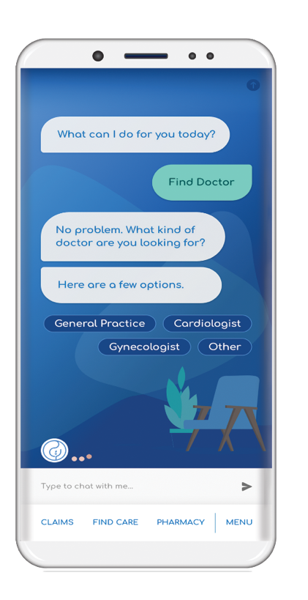
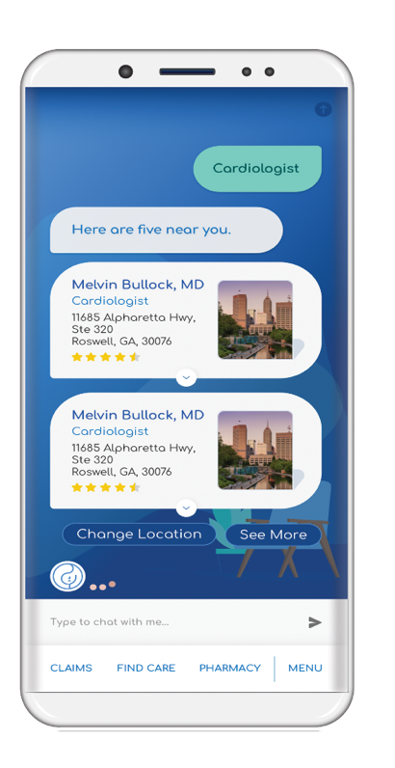
Sydney
A partner in health in the palm of your hand.
Notes:
New 9/1/19- replacing Anthem Anywhere app

Slide 9

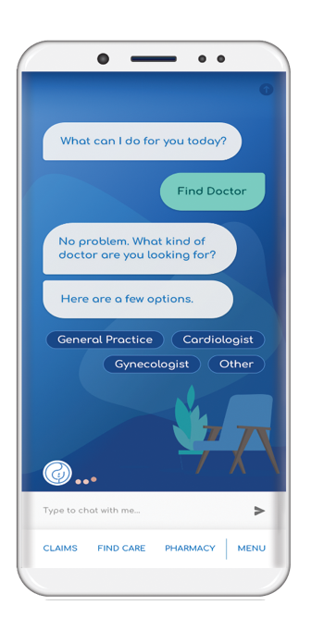

Driving next-level engagement
Sydney, a partner in health in the palm of your hand.
Our new digital platform uses AI to deliver a health care experience with a personal touch
A single, convenient location for a digital ID card, plan details, spending accounts, claims and more
Robust tools to help find care, view costs, online appointment scheduling and one-click access to LiveHealth Online and anthem.com
Personalized dashboard based on identified health topics and wellness goals
Timely, insight-driven push messages based on the employee’s health profile using clinical and claims data
Integrated help and support with click to chat features and ability to schedule a call back
Notes:
Sydney- Anthem’s new mobile app. Sydney replaces Anthem Anywhere app. With Sydney members can see their benefits and get access to medical claims all in one place. It also features an interactive chat that gives members answers right away for common questions- no need to call Member services every time.

Slide 10




Available to all MoDOT & MSHP members
Provides around the clock, toll-free access to a registered nurse for accurate and important information about any health issue
Receive coaching, access an audiotape library or web resources, anytime day or night
24/7 NurseLine
Save this Phone Number for Easy Access
Access to trained, registered nurses
800-828-5891
Notes:
24/7 Nurse Life- As a MoDOT or MSHP member, you and your families have access to registered nurses who can answer all of your health questions. 24 hours a day, seven days a week. Any time, day or night. They can even help you decide where to go for additional care if needed. Anthem’s 24 7 Nurseline program is fast, easy and free! To speak to a registered nurse, just pick up the phone and call 800-337-4770. Be sure to save this number now so you have it when you need it in the future– encourage employees to take out their phone and save the number!!

Slide 11
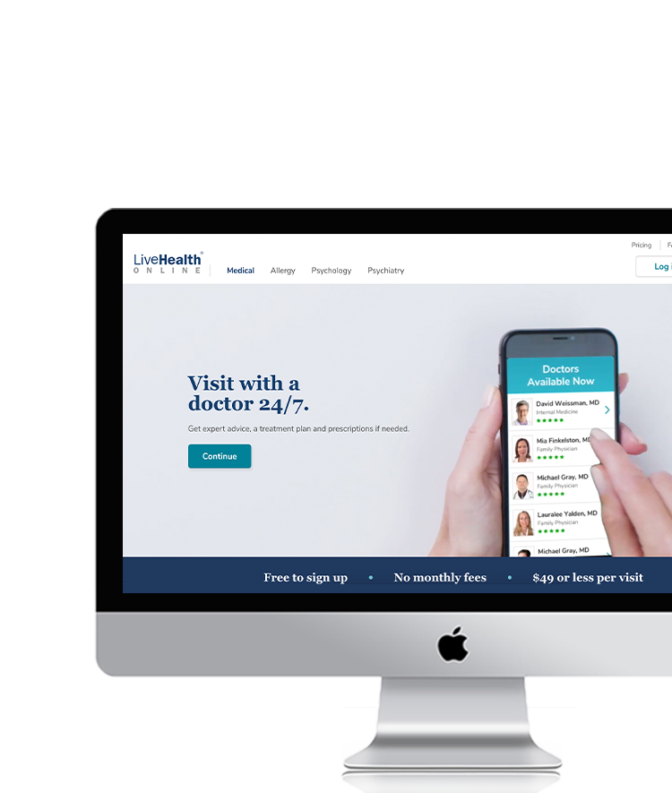


Access to care anywhere.
LiveHealth Online is the trade name of Health Management Corporation, a separate company providing telehealth services on behalf of Anthem National Accounts Blue Cross and Blue Shield.
Notes:
Live Health Online- LiveHealth Online connects you with a board-certified doctor in just a couple of minutes from your smartphone, tablet or computer.
A doctor can assess your condition, provide a treatment plan and even send a prescription to your pharmacy, if it’s needed.
You don’t need an appointment, doctors are always available. You can also visit with a licensed therapist in four days or less to get help with anxiety, depression, grief, panic attacks and more. Appointments with a board-certified psychiatrists are available within two weeks. LiveHealth Online also offers visits with Spanish speaking doctors.

Slide 12


Know Where to Go and Save
Emergency Room
Urgent Care
Doctor’s Office
Retail Clinic
$75 copay*
$25 copay*
$25 copay*
$25
copay*
$25
Copay*
*Copay covers visit only, other services apply to medical deducible plus 10% coinsurance
*Copay covers visit only, other services apply to medical deducible plus 10% coinsurance
*HSA plan subject to deductible and coinsurance. $59 plan cost
*Copay covers visit only, other services apply to medical deducible plus 10% coinsurance
*10% coinsurance after medical deductible
Notes:
This chart shows you just how much you can save by being a smart health care consumer and knowing where to go for care.
Depending on your Anthem plan, you can pay as little as $25 for an effective alternative to an emergency room
Being aware of all of your options, and knowing where to seek care before you need it can help you make the right decision when the time comes.

Slide 13


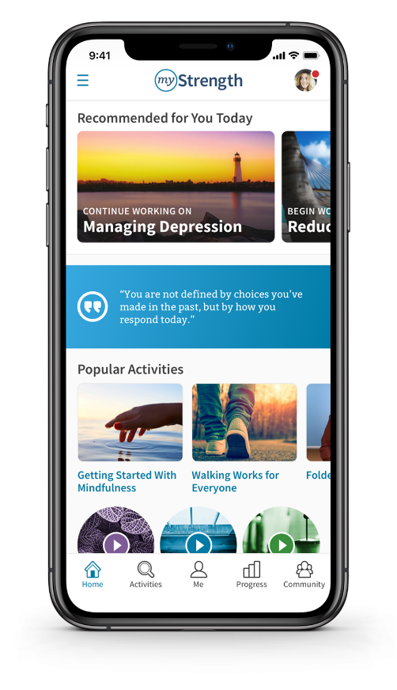


Register Today!
To access myStrength, visit anthem.com/mystrengthMO.
After you register online, download myStrength:
Notes:
myStrength- myStrength is an online mental health resource that helps you manage symptoms of depression, anxiety, substance use, stress, long-term pain, and sleep problems. Anyone covered under your Anthem plan can use this free resource

Slide 14


Join the movement challenge with
Walker Tracker
Log steps and track progress against the daily, weekly, and monthly step goal.
Register today at modotmshp.walkertracker.com
Last 2019 Challenge Runs September 9th – November 10th!
Join your district, troop or central office for a team challenge.
Who will take home the bragging rights?
Notes:
Walker tracker- Did you guys participate in a Walker Tracker challenge in 2019? Walker Tracker offers wellness and step challenges with virtual maps routes as your activity is tracked. Walker Tracker can be easily synced with all major wireless devices and mobile apps, and features fun and engaging virtual map challenges and social features for motivation. If you are already registered for Walker Tracker, make sure you are tracking your steps and daily activity. If you are not registered yet, it’s easy to get started. Simply visit modotmshp.walkertracker.com, click register now and enter your first and last name, a valid email address, a user name and password and then join a team.

Slide 15

Find your Happy Plates
You don’t have to give up your favorite foods to lose weight and look and feel your best.
The next Naturally Slim program starts in 2020
More information coming soon
Notes:
Naturally Slim- Naturally Slim is an online program that will teach you how. And here’s a hint: it doesn’t include starving, counting calories or spending hours prepping approved foods. MoDOT and MSHP are giving you the chance to learn how to eat the foods you love while reducing your risk of developing serious conditions, like diabetes or heart disease.
The program is available at NO COST to you and is accessible via computer and mobile device, so you can participate whenever it’s convenient, wherever you are. Active employees, spouses, adult dependents (age 18 or older), and pre-medicare retirees on the Anthem Blue Cross and Blue Shield Medical Plan are eligible to apply for the Naturally Slim program.
But class sizes are limited so watch for more information to apply for the next class in 2020.

Slide 16
Employee assistance program
Administered through Compsych Guidance Resources.
Phone Number - 800-808-2261
Available to all active state employees and members of their household, even if medical coverage is waived.
Up to six visits, per event, per year, for each member of your household.
100% confidential
Notes:
ComPsych is the Employee Assistant Program provider.
ComPsych is the world’s largest provider of EAP programs. The toll-free number is 1-800-808-2261.
EAP continues to offer 100% confidential services to all active employees and members of their household, even if medical coverage is waive. As an employer, you may also offer EAP services to other classifications of employees who are not eligible for medical coverage.
Employees will receive up to six visit a year, per member, per issue at a network clinician for no charge. If additional visits are required, ComPsych will coordinate coverage with your health care plan.

Slide 17
2020 Dental & Vision Open Enrollment
Enroll or cancel online or by paper
Make changes to your coverage
Enroll and/or cancel a dependent
If you do not change coverage during Open Enrollment and you are currently enrolled in a dental or vision plan, your coverage will continue at the same level.
No change in vision premiums for 2020
Slight increase in dental premiums for 2020
Same plan administrators- MetLife and NVA
Enrollment Questions
800-487-0771 or www.mchcp.org, MyMCHCP
October 1 – 31

Slide 18
2020 Cafeteria Plan Enrollment Period: October 1 – December 1, 2019
Health Care FSA max individual contribution limit- $2,700
Debit Cards will continue to be offered
Grace period- expenses can be incurred up to March 15, 2020 to use up the remaining 2019 balance in your Health and Dependent Care FSAs.
By Web:
www.mchcp.org (MCHCP’s website) or
www.mocafe.com (MoCafe’s website) or
https://my.asiflex.com (your MoCafe account detail website) or
https://ess.mo.gov (Missouri’s employee self service portal)
Questions: 1-800-659-3035 or www.asiflex.com/Mocafe/

Slide 19
CONTACT INFORMATION
If you need additional information or have questions, please contact:
Your local insurance representative
Employee Benefits Toll-free at 877-863-9406
https://www.modot.org/modot-mshp-employee-benefits-0

Slide 20
Questions?

