Slide 1
MoDOT Prequalification Process
ACEC Winter Meeting
February 9, 2018
Notes:
Introduction
Thank ACEC & Mike
We realize the prequalification process can be detailed, takes resources you could use on building your business or working on a project and it can be frustrating.
That’s why we were so pleased to be invited to your winter meeting so maybe we could help reduce the amount of resources you are using to complete the process.

Slide 2

MoDOT Task
Provide Reasonable Assurance an overhead is prepared in accordance to the Federal Acquisition Regulation (FAR)
Notes:
The prequal process assists MoDOT in providing the Federal Highway Administration with reasonable assurance federal funds are allocation in accordance to the FAR.

Slide 3
Example - Most Common Issue
Not enough clear information to understand the accounting processes used by your firm.
TIMESHEETS:
For example, timesheets do not have enough detail to show how Direct (project related hours) or Indirect (non-project related hours) are recorded consistently.
How do you take the information from the timesheet to the accounting process?
Notes:
One reason it may take several email communication to complete the preliminary review of your financial prequal documents is because we do not have enough information to understand the accounting process used by your firm.
An example would be how detailed your timesheet/timekeeping process is. During our review, we determine if enough detail have been provided to adequately report direct and indirect labor costs. How is the costs reported on the overhead rate schedule and is there a way to identify unallowable activities.

Slide 4
MoDOT Tasks
Review overhead rate schedules
Does the accounting system have the ability to:
  Segregate direct (project related) and indirect costs (non-project related)
  Identify unallowable costs
    Are those costs:
      Reasonable,
      Allocable to the A/E services
      Allowable.
Notes:
We review the overhead rate schedule and the Internal Control Questionnaire to determine adequate accounting controls to segregate direct and indirect costs identify unallowable costs and ensure the cost reported on the overhead are Reasonable, Allocable and Allowable.

Slide 5
MoDOT Consultant Services
www.modot.org
Notes:
So first, we have to go to the MoDOT Consultant Services website – NOTE: the website will be changing the future as our platform used will be changed. The information will still be here but it will have a different look.

Slide 6

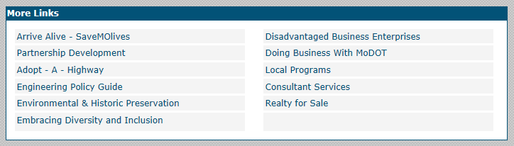
MoDOT Consultant Website
www.modot.org or www.modot.gov
Notes:
Let’s go to our website at www.modot.org or .gov and near the bottom of the page is a box titled MORE LINKS select the CONSULTANT SERVICES link in the right hand column.

Slide 7

Consultant Home Tab
Notes:
This opens to the main consultant website with a number of tabs across the top. The first tab, Consultant Home, has all the latest news and announcements from MoDOT’s Design Division.

Slide 8
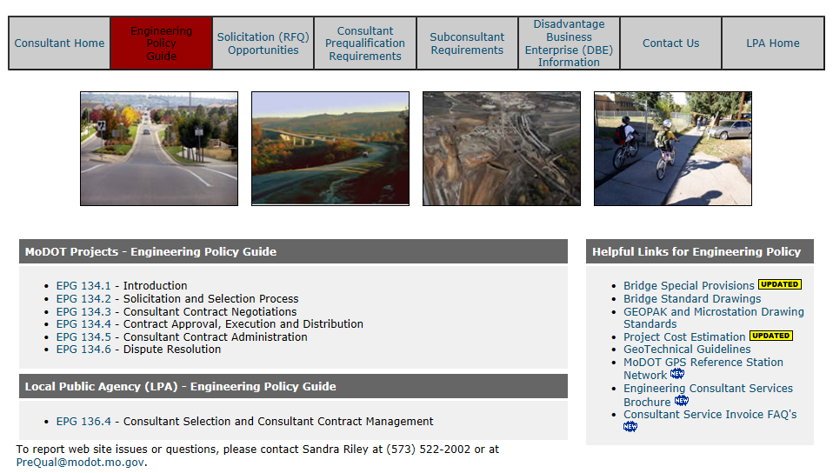
Engineering Policy Guide
Notes:
The EPG tab contains links to the MoDOT Engineering Policy Guide. So if you have time become familiar with the EPG. One thing you will notice is the MoDOT and LPA has separate Sections in the EPG. The processes are very similar but different as the LPA is responsible for providing support for their projects

Slide 9
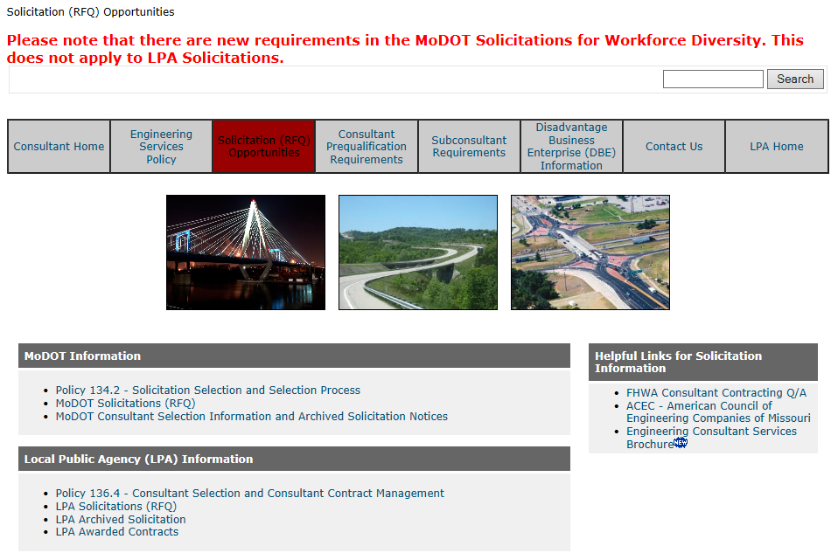
Solicitations (RFQ) Opportunities
Notes:
Solicitation (RFQ) Opportunities are also identified as MoDOT projects or LPA projects.
You will also find a link that contains the consultant selected for each solicitation.

Slide 10
Solicitation (RFQ) Opportunities
MoDOT Information
Policy EPG134.2
Solicitation and Selection Process
Are you on the Design Division Solicitation Distribution List? If not, send an email to CODEConsultPreq@modot.mo.gov and Design will add you to the list.
Notes:
So to be clear – MoDOT Solicitation and Selection Process is under EPG Section 134.
If you are not receiving auto notification of opportunities as they are posted to the web, send an email to the address below and request to be placed on the Design Distribution List CODEConsultPreq@modot.mo.gov.
This will allow you to receive notification at the time a new opportunity is posted.

Slide 11
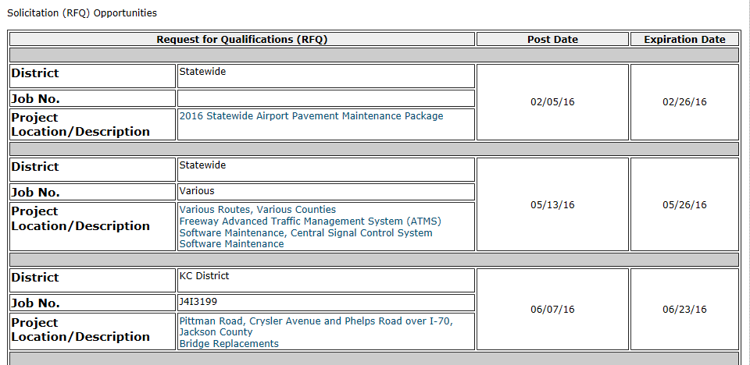
MoDOT Solicitations (RFQ)
Notes:
The posted solicitations will be under the agency that is requesting the services. As you can see, this screenshot advertises MoDOT opportunities

Slide 12
Local Public Agency (LPA) Information
EPG 136.4
Consultant Selection and Consultant Contract Management
Notes:
LPA Solicitations and Consultant Contract Management Policies and Processes are under EPG Section 136.

Slide 13
Local Program Solicitations
The table includes:
Posting Date;
Project Number;
Link to the Solicitation;
Contact Information;
Due Date
Notes:
LPA has solicitation list look a little different but the information provided is the same.

Slide 14
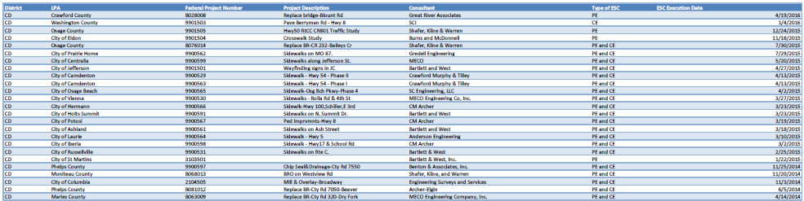
List of LPA Awarded Contracts
If your firm primarily works as a sub-consultant, you may find this list helpful in working with Prime Consultants.
Notes:
If you wish to provide professional services as a sub-consultant, you find the list of awarded contracts beneficial.

Slide 15
Helpful Links for Solicitation Information
FHWA Consultant Contracting Q/A
ACEC – American Council of Engineering Companies of Missouri
Notes:
Additional information to use would be FHWA Consultant Contracting Q/A and the ACEC website.

Slide 16
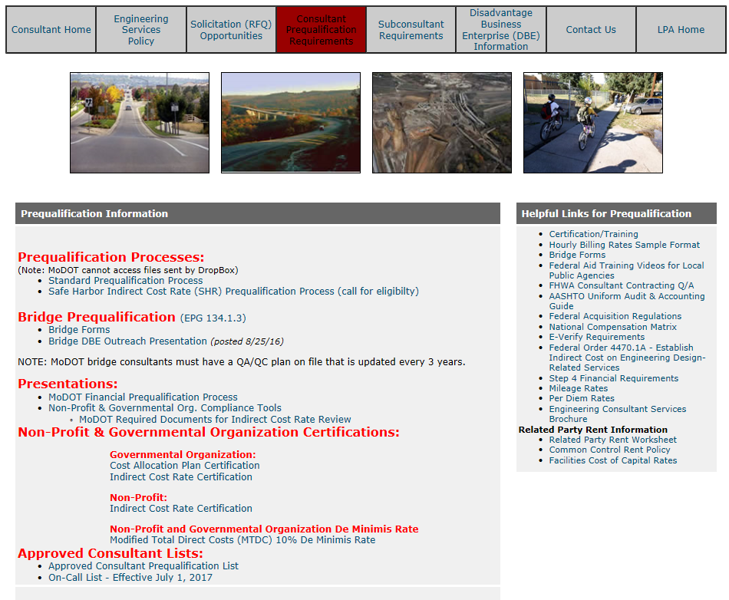
Consultant Prequalification Requirements
Notes:
Tab 4 – Consultant Prequalification Requirements - This is the main page for information regarding the prequalification process.
Bridge Prequalification

Slide 17
134.1.3 Consultant Qualification
MoDOT Bridge Consultants Only (Not required for LPA Consultants)
All bridge plans for MoDOT projects must be signed and sealed by a professional engineer from a firm that is prequalified for bridge design (with the firm’s logo shown in the title block of the bridge plans).
Notes:
So I don’t overlook it – Let’s talk about the MoDOT Bridge Prequalification forms. NOTE: these forms are not required for LPA Consultants.

Slide 18
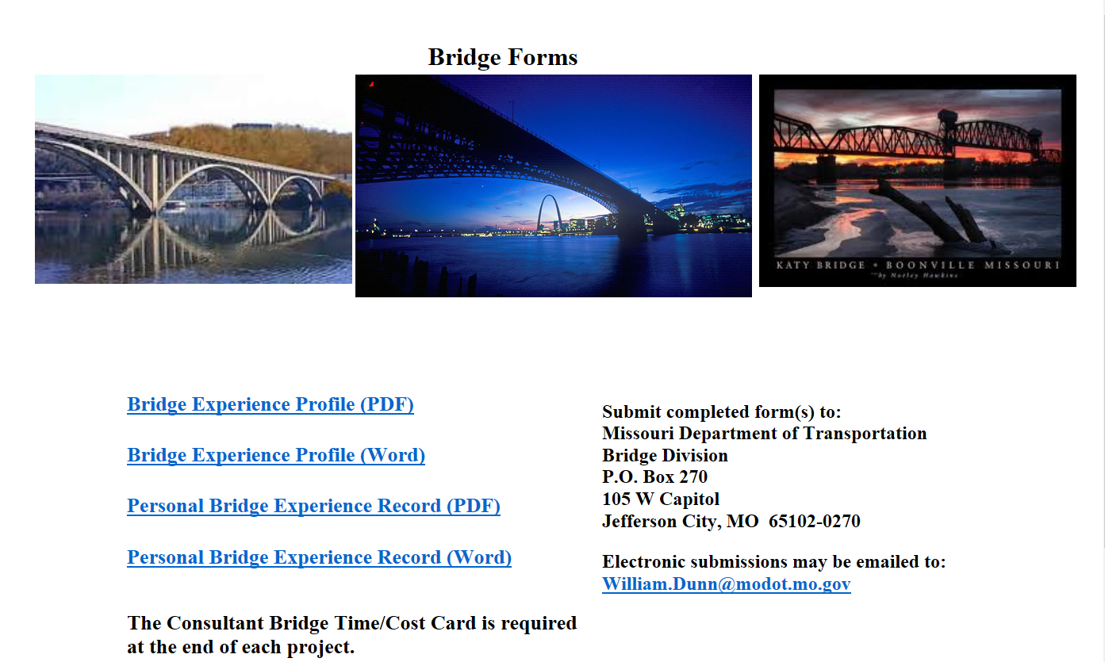
Bridge Forms
Notes:
When you select the Bridge Forms it will open you to this page and your contact is William Dunn. I’m not experienced in the requirements so any questions you have will need to be directed to Mr. Dunn.

Slide 19
Consultant Prequalification Requirements
Notes:
Let’s go back to the top and select the Standard Prequal Process link

Slide 20
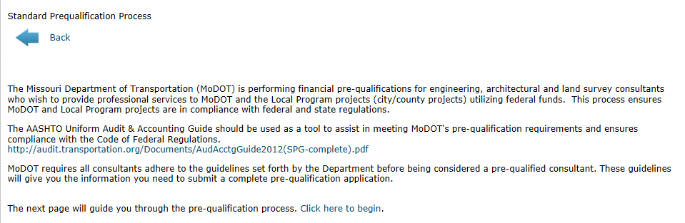
Consultant Prequalification Requirements
Standard Prequalification
Click the text to proceed
Sub-Consultants are not required to be prequalified
Notes:
Now let’s talk about MoDOT’s Prequalification Process. Most of you here will select the Standard Prequalification Process link. The link will take you through the 4 steps it takes to complete the requirements.
NOTICE:
MoDOT does not require Sub-Consultants to be prequalified, however, some LPA or Prime Consultants require subs to be prequalified. If a sub is not prequalified, the responsibility of assurance and compliance with state and federal regulations becomes the responsibility of the Prime Consultant.

Slide 21
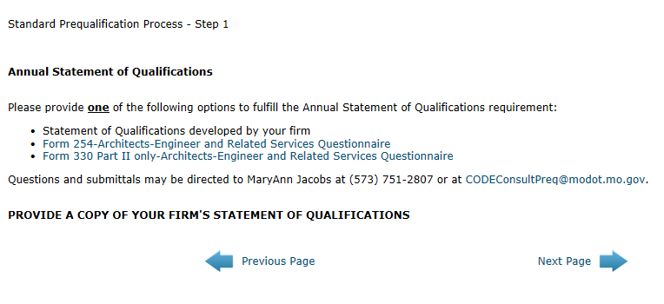
Consultant Prequalification Requirements
Step 1 – Statement of Qualifications
Notes:
SOQ

Slide 22
Consultant Prequalification Requirements Design Division Manages Steps 1, 2 & 3
Step 1 – RSMo Chapter 8.285 through 8.291
Annual Statement of Qualifications (SOQ) Provide one of the following:
SOQ developed by your firm
SF Form 254- Architects, Engineers & Related Services Questionnaire
SF Form 330 Part II only - Architects, Engineers & Related Services Questionnaire
Notes:
MoDOT adheres to the State Statutes in completing Steps 1, 2 & 3.
It is a business decision on what form you provide. The SOQ is used as a supplement to your letters of interest when responding to a solicitation.
SOQ developed by your firm
SF Form 254 – is an old Federal Form but allows for work history and references
SF Form 330 Part II is a profile of your firm

Slide 23
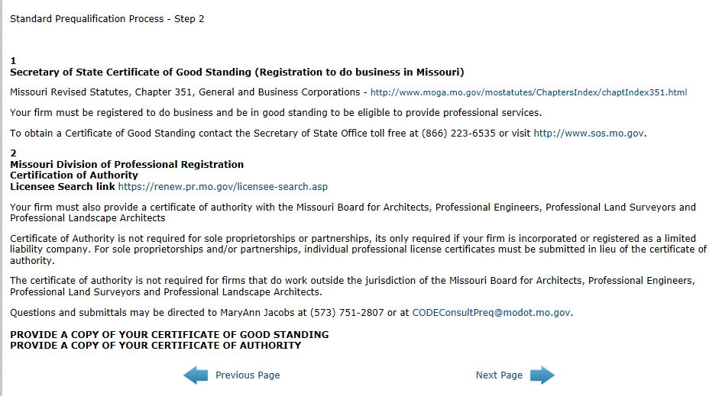
Consultant Prequalification Requirements
Step 2 - License & Registration
Notes:
Step 2 is the certifications, registrations & licenses

Slide 24

Consultant Prequalification Requirements
Certifications and Registrations
Step 2
Secretary of State - Certificate of Good Standing RSMo 351
MO Div. of Professional Reg. Certification of Authority
Your firm must also provide a certificate of authority with the Missouri Board
for Architects, Professional Engineers, Professional Land Surveyors
and Professional Landscape Architects
Certificate of Authority is not required for sole proprietorships or
partnerships, its only required if your firm is incorporated or registered
as a limited liability company. For sole proprietorships and/or
partnerships, individual professional license certificates must be submitted
in lieu of the certificate of authority.
Notes:
You must be registered and in Good Standing or Active with SOS before you can provide a professional services to MoDOT or a Local Public Agency as required by State Statutes RSMo351
You also must provide a Certificate of Authority from the Missouri Professional Registration – SOLE PROPRIETORS or PARTNERSHIPS provide individual professional licenses

Slide 25
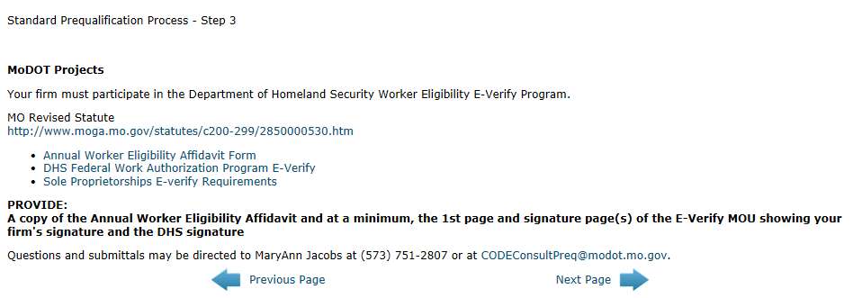

Consultant Prequalification Requirements Step 3 – E-Verify Documentations
www.uscis.gov/e-verify
Notes:
Step 3 is the E-Verify Requirements

Slide 26
Consultant Prequalification Requirements Step 3 – E-Verify Documentations
Required for contracts exceeding $5,000
E-verify MOU
  Does not change and requires your firm’s signature and the signature of the DHS to be valid. (electronic signatures are accepted)
The affidavit is required annually and provides assurances that your firm is still in compliance of the E-Verify MOU.
Sole Proprietors without an EIN cannot participate in the E-Verify Program
Sole Proprietors will need to provide Affirmative Proof of Citizenship, that may be a document used when renewing or obtaining a license from the Dept. of Revenue. See EPG 236.3.11.2
Notes:
Again a State Statute – Required for any Contract Exceeding $5,000
First – Provide a copy of the Memorandum of Understanding your firm has with the Department of Homeland Security. Once you have the MOU, the document doesn’t change. What is required annually is the Worker Eligibility Verification Affidavit.

Slide 27
Financial Prequalification Process – Step 4

Slide 28
Consultant Prequalification Requirements
Step 4 - Financial Prequalification Documents
MoDOT utilizes a risk based review process that provides a realistic assessment of A/E firm’s financial situation.
MoDOT auditors review the firm’s Internal Control Questionnaire (ICQ) to determine if accounting processes and procedures are in place to segregate direct and indirect costs, as well as, identify and remove unallowable costs from the overhead rate schedule.
MoDOT accepts financial information throughout year; however, firms are encouraged to submit their info, for the most recent completed fiscal year, no later than six months after the close of that fiscal year.
Notes:
MoDOT uses a risk based process to obtain a realistic assessment of you firm’s financial situation. Part of the assessment include understand you firm’s accounting policies, processes, and practices to ensure FAR compliance.
We accept financial information throughout year; however, we encourage firms to submit their info, for the most recent completed fiscal year, no later than six months past the that fiscal year end.

Slide 29

Consultant Prequalification Requirements
Step 4 - Financial Prequalification Documents
Consultants must use the most up-to-date forms on the MoDOT Consultant Prequalification Requirements website.
MoDOT’s request for information should be responded to within 30 days of receipt.
Notes:
Consultants must use the most up-to-date forms on the MoDOT Consultant Prequalification Requirements website and respond to requests for information within 30 day.

Slide 30
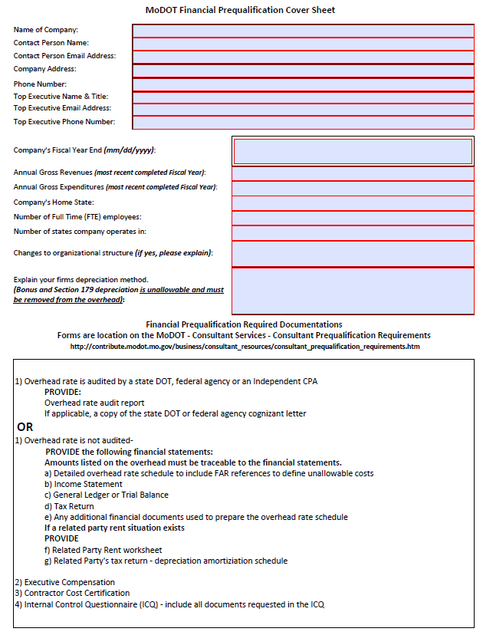
Consultant Prequalification Requirements
Step 4 - Financial Prequalification Documents
ITEM 1 – Prequalification Cover Sheet
The prequal documents are inter-related and
must be cohesive on to another.
Prequal Process
OH
FS
ICQ
Cert
Exec
Comp
Cover Sheet
Notes:
Item 1 of Step 4 is the Prequalification Cover Sheet the top portion of the form is a profile of your firm. The financial prequalification documents are inter-related so ensure the document is updated annually.

Slide 31
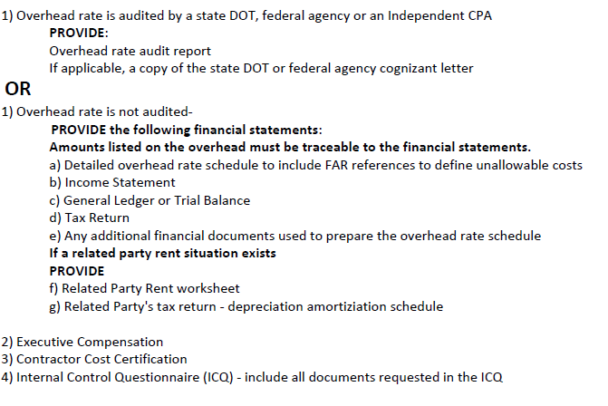
Consultant Prequalification Requirements
Step 4 - Financial Prequalification Documents
Audited
Auditors review the FAR compliant audit;
Tax return and financial statements are not necessary.
Remember: Item 2, 3 & 4 is still required.
The lower half of the Prequalification
Cover Sheet shows the required documents
Not Audited
Auditors reference overhead rate accounts and costs to supporting financial statements.
The financial statements accounts and costs are then referenced to the tax return.
Notes:
On the lower portion of the cover sheet is the instruction of what needs to be provided to ensure a complete submission.
If the overhead rate schedule is audited you need to provide the full audit report and Executive Compensation; Certification of Final Indirect Costs and the ICQ.
If the overhead is not audited you will need the overhead rate schedule and the supporting financial reports used to develop the overhead, as well as, the tax return followed by the Executive Compensation, Certification of Final Indirect Costs and the ICQ.

Slide 32
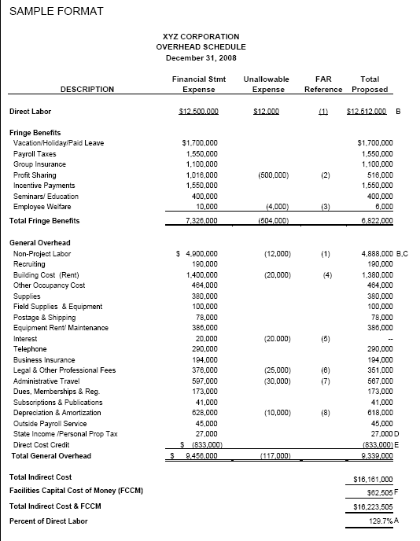
Consultant Prequalification Requirements
Step 4 - Financial Prequalification Documents
Overhead Rate Schedule must demonstrate a firm’s fundamental understanding of the FAR.
The overhead rate schedule must be:
Provided in the required format with FAR references;
Report actual costs;
Traceable to financial statements if not audited;
Be mathematically correct.
Notes:
Auditors will review the overhead rate schedule for unallowable costs and FAR references, ensure it is mathematically correct, trace costs to the financial reports and tax return.
If you are combining several accounts from the financial reports to the overhead, it may be beneficial to show that on a supporting document. This will decrease the review time when verifying the costs from the overhead to the financial.

Slide 33

Consultant Prequalification Requirements
Step 4 - Financial Prequalification Documents
Reasonable Cost
A cost is reasonable, if, in its
nature and amount, it does not
exceed that which would be
incurred by a prudent person in the conduct of competitive business.
Allocable Cost
A Government contract cost that is necessary to the overall operation of the business.
Notes:
During the overhead rate schedule review, we are looking at reasonableness and if the costs are allocable or necessary to the overall operation of the A/E firm.

Slide 34

Consultant Prequalification Requirements
Step 4 - Financial Prequalification Documents
Examples:
A seminar is being held in your home town and also in New York. New York is more fun but is it reasonable to fly to New York with all of the other costs associated with the trip or stay in your home town to attend the seminar?
You need to fly – do you purchase a first class ticket or business class? The FAR will reimburse for the airline ticket based on lowest price available. If the lowest price is not available, provide documentation demonstrating no available seats. The documentation can be a print screen to show date time flight availability.
Other unallowable costs include, but not limited to, early boarding privileges or costs above per diem rates.
Notes:
What is reasonableness?
A seminar is being held in New York and in your state.
Is it reasonable to incur the expense of traveling to New York when it is more economical to attend the seminar in your state?
Rental car Mercedes vs Ford Taurus
First Class over Business Class
Early Boarding privileges
Document-Document-Document Provide documentation to support air travel, hotel, meal & travel costs to not exceed per diem rates. Provide the Information for the seminar, which would include the agenda and sign-in sheet.

Slide 35
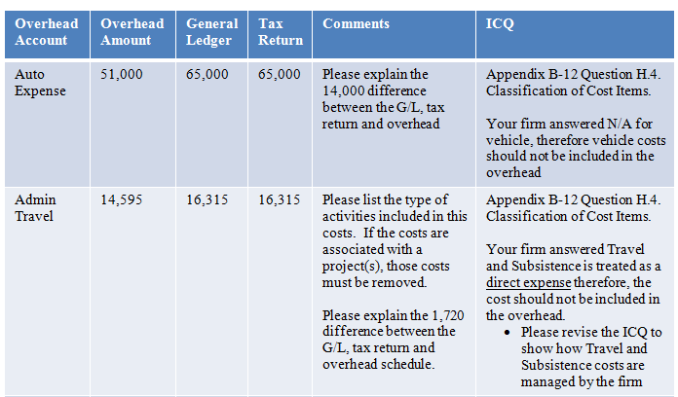
Consultant Prequalification Requirements
Step 4 - Financial Prequalification Documents
It is important to have cohesion between the prequalification documents. The following table shows how the documents are inter-related and must reference one to another.
Notes:
Another situation that will take time is no cohesion between prequal documents. FS do not trace one to another or to the tax return or ICQ.
In this example, auditor would ask for an explanation to why the amount reported on the overhead does not trace to the financial report or the tax return. We would ask why it is included in the overhead based on the information provided in the ICQ.

Slide 36
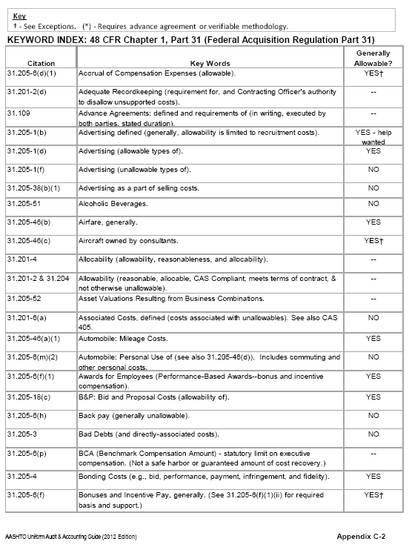
Consultant Prequalification Requirements
Step 4 - Financial Prequalification Documents
Additional FAR references can be found on Appendix C in the AASHTO Uniform Audit and Accounting Guide.
High Risk Categories included but are not limited to:
Direct Selling, Marketing, Employee Morale;
Food, Lodging, Travel-Per Diem Rates
Mileage Reimbursement
Professional Services
Legal Cost
Notes:
Auditor review High Risk Categories using the most common unallowable costs table and the AASHTO Audit Guide, as well as, the FAR.

Slide 37
Example: Meals and Entertainment – High Risk
Consultant Prequalification Requirements
Step 4 - Financial Prequalification Documents
Taken together, the cost principles at FAR 31.205-13, Employee Morale, and FAR 31.205-14, Entertainment, expressly disallow certain costs, including:
  Entertainment provided as part of public relations employee relations, or company celebrations;
  Costs of amusement, diversions, social activities, and any directly associated costs, including tickets, meals, and lodging; and
  Employee social events, including company picnics, theme and
  holiday parties.
Consultants often do not disallow all of the costs that should be disallowed for meals and entertainment.
Notes:
Additional information may be necessary to verify if all unallowable cost have been identified in the overhead.
The FAR does not recognize materiality. If is unallowable, it must be removed from the overhead rate.

Slide 38
Internal Control Questionnaire (ICQ)

Slide 39

Consultant Prequalification Requirements
Step 4 - Financial Prequalification Documents
The Risk-Based Assessment includes but is not limited to the review of the firms:
Accounting, Timekeeping, Bonus & IT policies and procedures;
  Examples: security of data, approval levels, etc…
Control environment of the accounting system;
Ability of the firm to demonstrate fundamental FAR knowledge;
The firm’s ability to segregate direct and indirect cost and identify unallowable cost;
Proper allocation of labor cost to direct and indirect costs;
Prequalification information is also used during Final Invoice Audits.
Notes:
The ICQ should include policies and processes. If no policies or process exist, we may request a written description of the process used when entering the information in the accounting system and how are the costs reviewed at the time the overhead is prepared.

Slide 40
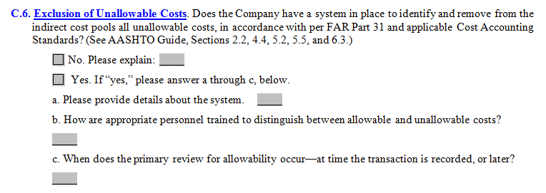
Consultant Prequalification Requirements
Step 4 - Financial Prequalification Documents
No will trigger questions
Recognize the impact staff has to the reported financial statement
amounts and subsequent impact to direct and indirect costs at the time
the transaction is recorded?
If your firm does not have written policies, provide an explanation to demonstrate your firm’s ability to consistently track costs between direct and indirect labor and how unallowable costs are identified and removed from the overhead.
Notes:
Major indicator of FAR compliance.

Slide 41
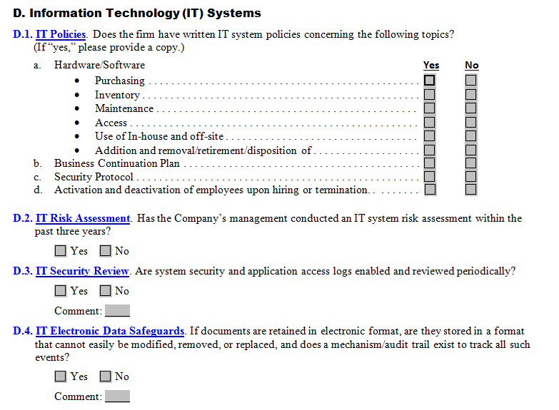
Consultant Prequalification Requirements
Step 4 - Financial Prequalification Documents
Policies and Procedures - If no written policies exists, comments should be provided to demonstrate a system is in place to identify edits & deletions that may occur to the firm’s business records.
Notes:
IT security is important to help ensure an auditable trail and ensure the integrity of the documents.
Looking at threat of cyber attacks

Slide 42
Consultant Prequalification Requirements
Step 4 - Financial Prequalification Documents
Total-Hour Accounting System
A total-hour accounting system records all hours worked by all employees, regardless of whether the employees are exempt from overtime pay or whether all direct labor hours are billed to specific contracts.
Over 40 hours worked in a week must be recorded and equitably allocated to all related activities, including Federal awards.
Additional information is included as part of uncompensated overtime.
Notes:
A total-hour accounting system record all hours worked by all employees, regardless of whether the employees are exempt from overtime pay or whether all direct labor hours are billed to specific contracts.
A total-hour accounting system is required by the FAR to account for equitable allocation to all related activities, including Federal awards. This also ensures consistency.

Slide 43
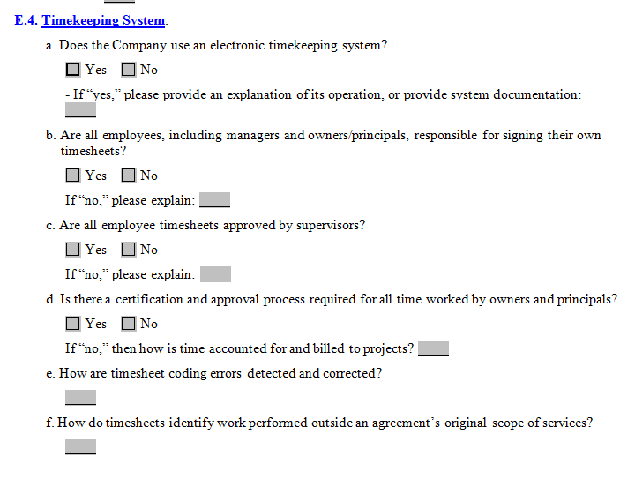
Consultant Prequalification Requirements
Step 4 - Financial Prequalification Documents
Does my firm allow timesheet revision/adjustments without the employee’s approval?
Who in our firm can revise/adjust timesheets?
How are revisions/adjustments on timesheets approved and tracked?
Who is authorized to review and edit/adjust timesheets?
Notes:
Timesheets processes relate directly to the accuracy of the labor hours recorded on the overhead rate schedule.

Slide 44
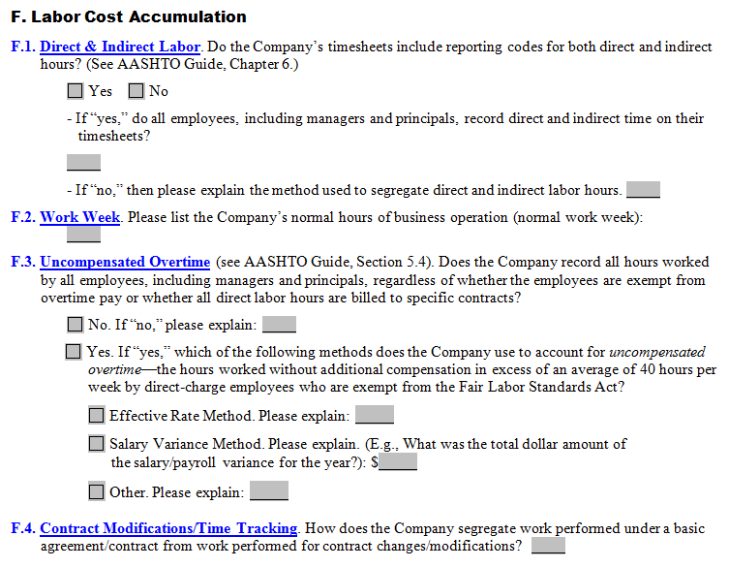
Consultant Prequalification Requirements
Step 4 - Financial Prequalification Documents
Uncompensated Overtime – the company is required to have an all hours worked by all employees, including managers and principals, regardless of whether the employees are exempt from overtime pay or whether all direct labor hours are billed to specific contracts.
Notes:
Uncompensated Overtime – the company is required to have an all hours worked by all employees, including managers and principals, regardless of whether the employees are exempt from overtime pay or whether all direct labor hours are billed to specific contracts. PRO BONO Work is considered direct labor costs, which could be viewed as a conflict of interest.

Slide 45
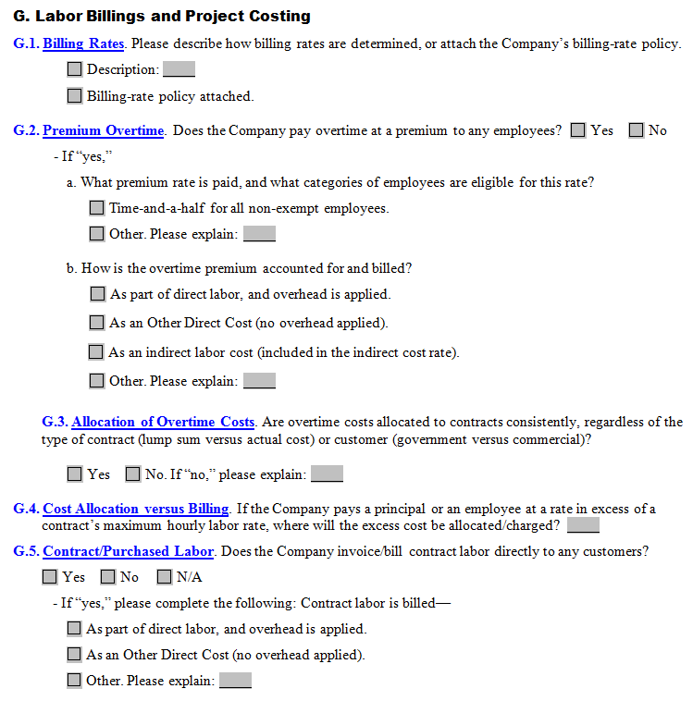
Consultant Prequalification Requirements
Step 4 - Financial Prequalification Documents
Contract labor is a High Risk Category.
If not clear, MoDOT will ask for additional information to determine if costs are allowable.
Provide a written explanation of the process, policies and procedures to identify, calculate, and track the labor costs to include taxes and fringe benefits that are paid to the contract/purchase labor.
Notes:
Contract labor is a High Risk Category as it could have a significant impact on the labor reported on the overhead rate schedule.
If not clear, MoDOT will ask for additional information to determine if costs are allowable.
Provide a written explanation of the process, policies and procedures to identify, calculate, and track the labor costs to include taxes and fringe benefits that are paid to the contract/purchase labor.
Does contract labor receive a 1099?

Slide 46
Premium Overtime (Time and a Half)-High Risk Category
Consultant Prequalification Requirements
Step 4 - Financial Prequalification Documents
Consistent methodology is necessary to account for overtime premium:
22.103-2 Overtime Policy
Contractors shall perform all contracts, so far as practicable, without using overtime, particularly as a regular employment practice, except when lower overall costs to the Government will result or when it is necessary to meet urgent program needs. Any approved overtime, extra-pay shifts, and multi-shifts should be scheduled to achieve these objectives.
Reference 22.103 for additional guidance
Notes:
Consistent methodology is necessary to account for overtime premium. Premium Overtime must be approved by MoDOT or the LPA and documentation of the approval should be kept in the project file.
22.103-2 Overtime Policy
Contractors shall perform all contracts, so far as practicable, without using overtime, particularly as a regular employment practice, except when lower overall costs to the Government will result or when it is necessary to meet urgent program needs. Any approved overtime, extra-pay shifts, and multi-shifts should be scheduled to achieve these objectives.

Slide 47
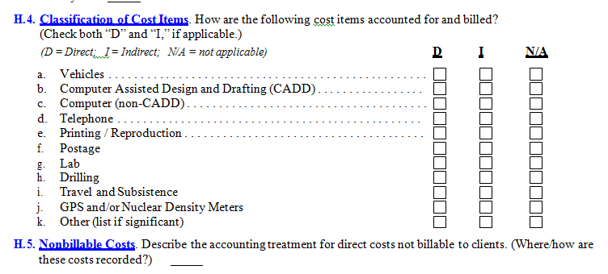
Consultant Prequalification Requirements
Step 4 - Financial Prequalification Documents
Notes:
I didn’t include slides for Section H – Expense Accumulations and Billing but want to discuss a few common items.
Question H.4. Classification of Cost Items - The items listed should be accurately marked as to how the costs are treated in your accounting system. I review this section and compare your answers to the accounts reported on the overhead. If you mark Direct Costs, I expect to see the costs identified as unallowable.
If I see only Indirect – I will probably ask questions to why the costs are indirect when the cost item can also be used for direct costs activities.
If I see N/A – I do not anticipate seeing it in the overhead.
SR will give examples
Question H.5. Nonbillable Costs. If costs are direct costs, whether billable or nonbillable to the client, it is still a direct cost and must be identified in the overhead as unallowable.
Also, any associated costs to that direct expense is also unallowable.

Slide 48
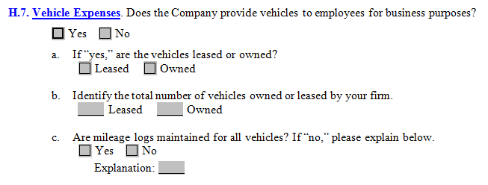
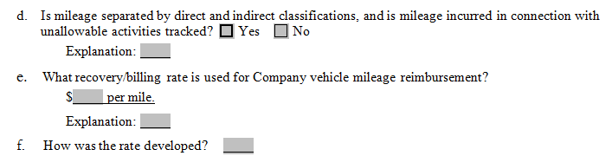
Vehicle Expenses – High Risk Category
Consultant Prequalification Requirements
Step 4 - Financial Prequalification Documents
Notes:
Vehicle Expense is another High Risk Category.

Slide 49
Personal Use of Company Vehicles - High Risk Category
Consultant Prequalification Requirements
Step 4 - Financial Prequalification Documents
The cost of personal use of vehicles is unallowable.
This includes the portion of cost related to commuting to and from work.
  As indicated in FAR 31.205-6(m)(2), costs are unallowable regardless of whether the cost is reported as taxable income to the employees!
If the Consultant owns and/or leases vehicles, there will almost always be some disallowance. A disallowance can only be completely avoided if:
  Vehicles are not available for personal use and are not used to commute to work (i.e. they are left at the Consultant’s office).
  Employees reimburse the company for any personal use.
  If there are luxury vehicles, costs must also be reviewed to ensure they are reasonable in accordance with FAR 31.201-3.
Notes:
The cost of personal use of vehicles is unallowable.
This includes the portion of cost related to commuting to and from work. As indicated in FAR 31.205-6(m)(2), costs are unallowable regardless of whether the cost is reported as taxable income to the employees.
If the Consultant owns and/or leases vehicles, there will almost always be some disallowance. A disallowance can only be completely avoided if:
Vehicles are not available for personal use and are not used to commute to work (i.e. they are left at the Consultant’s office).
Employees reimburse the company for any personal use.
If there are luxury vehicles, costs must also be reviewed to ensure they are reasonable in accordance with FAR 31.201-3.

Slide 50
Consultant Prequalification Requirements
Step 4 - Financial Prequalification Documents
Support that may be requested to determine allowability of costs
  Mileage logs;
  Support for expenses;
  Accounting procedures manual;
  Executive compensation analysis work papers.
Notes:
Support that may be requested to determine allowability of costs
Mileage logs;
Support for expenses;
Accounting procedures manual;
Executive compensation analysis work papers.

Slide 51
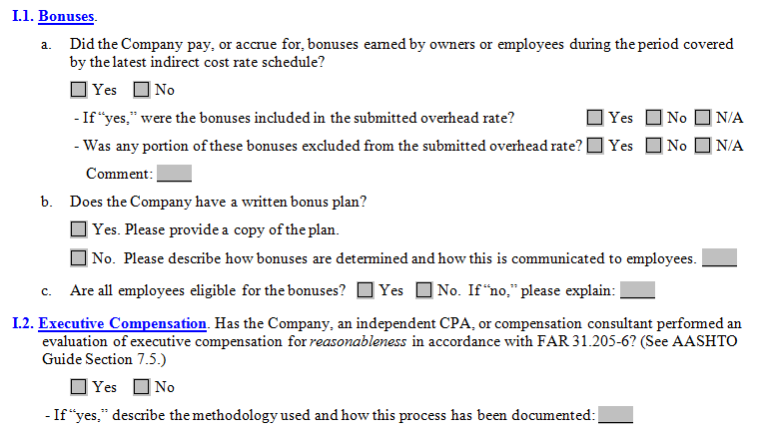
Executive Compensation Analysis
Consultant Prequalification Requirements
Step 4 - Financial Prequalification Documents
Policies and Procedures - If no written policies exist, provide an explanation to demonstrate a system is in place to consistently manage how you determine eligibility for bonuses.
Notes:
The submittal should include Policies and Procedures - If no written policies exist, provide an explanation to demonstrate a system is in place to consistently manage how you determine eligibility for bonuses.

Slide 52
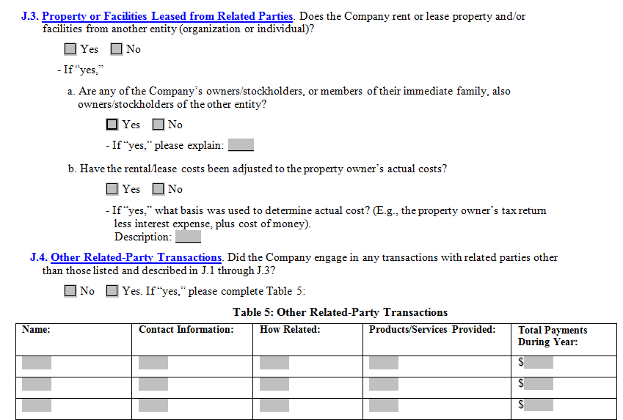
Consultant Prequalification Requirements
Step 4 - Financial Prequalification Documents
This is the most misunderstand question on the ICQ. If the answer is “Yes” the firm rents from an entity with no common interest in the firm.
Common Control
Exists in related-party transactions when business is conducted at less than arm’s length between businesses and/or persons that have a family or business relationship. Examples are transactions between family members, transactions between subsidiaries of the same parent company, or transactions between companies owned by the same person or persons. Common control exists when a related party has effective control over the operating and financial policies of the related entity. Effective control may exist even if the related party owns less than 50 percent of the related entity.
What is the process the firm follows to demonstrate rent paid to a related party has been adjusted to the owners actual costs?
Notes:
Exists in related-party transactions when business is conducted at less than arm’s length between businesses and/or persons that have a family or business relationship.
Examples are transactions between family members, transactions between subsidiaries of the same parent company, or transactions between companies owned by the same person or persons.
Common control exists when a related party has effective control over the operating and financial policies of the related entity. Effective control may exist even if the related party owns less than 50 percent of the related entity.

Slide 53

Consultant Prequalification Requirements
Step 4 - Financial Prequalification Documents
Related Party Rent cannot be developed using fair market value.
Firms must provide documentation showing their methodology in determining owners actual costs, such as depreciation, taxes, insurance, facilities capital cost of money, and maintenance, provided that no part of such cost is a duplicate of any other allowed cost.
Notes:
Firms must provide documentation showing their methodology in determining owner actual costs, such as depreciation, taxes, insurance, facilities capital cost of money, and maintenance, provided that no part of such cost is a duplicate of any other allowed cost.
Fair Market Value is not recognized by the FAR

Slide 54
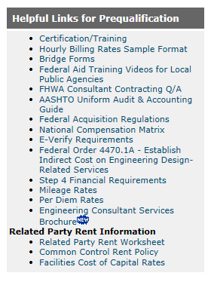
Consultant Prequalification Requirements
Step 4 - Financial Prequalification Documents
Helpful Links for Prequalification includes Related Party Rent Information. The information is in the
form of a worksheet, MoDOT Policy
and Facilities Cost of Capital Rates.
Also, note the Related
Party Rent Information
Notes:
Related Party Rent policy and worksheet can be found on the Consultant Prequal Requirement Tab under Helpful Links

Slide 55
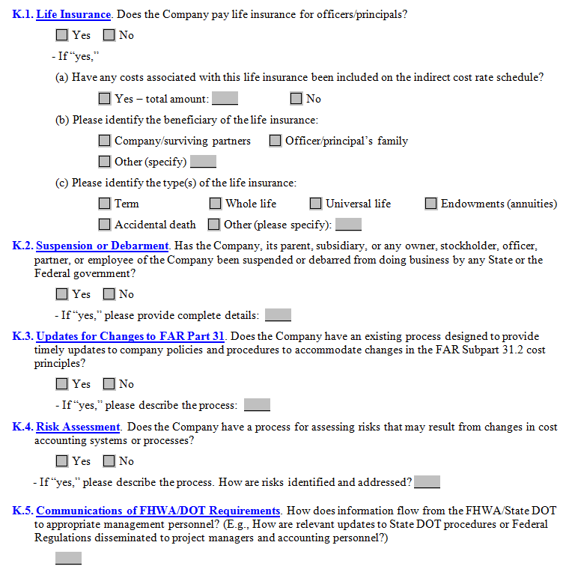
Life Insurance
Consultant Prequalification Requirements
Step 4 - Financial Prequalification Documents
NOTE:
If the Company or its partners are beneficiaries, these costs are unallowable (Key Man Life Insurance) and must be removed from the overhead schedule.
Notes:
If the beneficiary of the life insurance is Key Company Personnel, the costs are unallowable (Key Man Life Insurance) and must be removed from the overhead schedule.

Slide 56
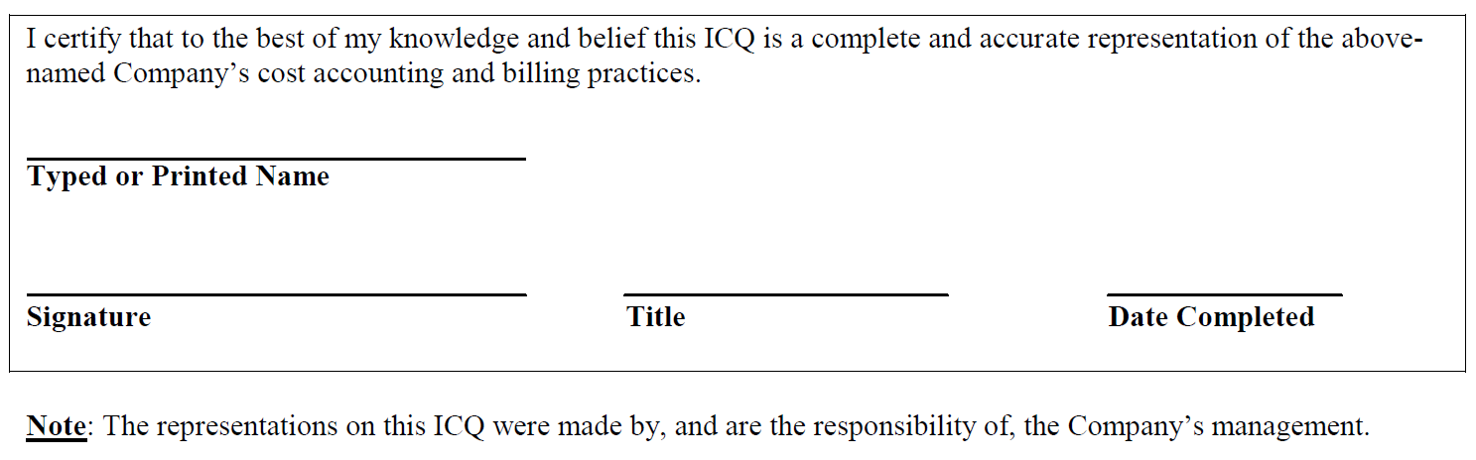
Consultant Prequalification Requirements
Step 4 - Financial Prequalification Documents
Signature and Date is required for the document to be valid

Slide 57
Executive Compensation

Slide 58
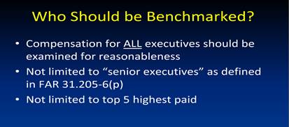
Consultant Prequalification Requirements
Step 4 - Financial Prequalification Documents
The AASHTO website includes the recorded NCM webinar with the following slide.
I encourage you to take the time to listen to the presentation
​​National Compensation Matrix Webinar

Slide 59
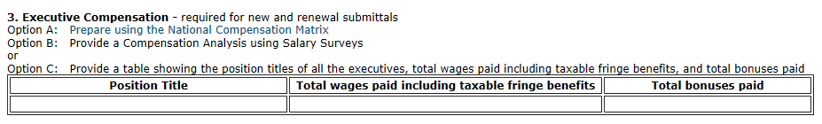
Executive Compensation Analysis
Distribution of profit is not allowed
Consultant Prequalification Requirements
Step 4 - Financial Prequalification Documents
Option A: Provide NCM worksheet on the AASHTO website. Submittal should include compensation document(s) of how the compensation was calculated.
Option B: Provide work papers to demonstrate three salary surveys were used to determine reasonableness of compensation and FAR compliance
Option C: Provide position title, total wages paid including taxable fringe benefits and total bonuses paid. MoDOT Auditors will compare the compensation to the NCM tool.
Notes:
If the compensation includes unallowable activities or cost (personal vehicle use, dividend, distribution of profits, marketing, lobbying) it must be identified and removed from the total compensation amount.

Slide 60
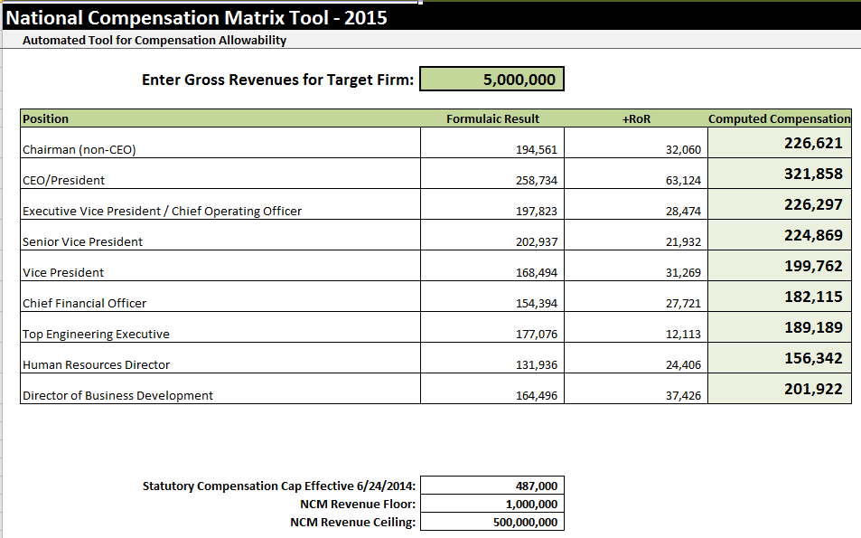
Consultant Prequalification Requirements
Step 4 - Financial Prequalification Documents
Amount may be obtained from
ICQ or Prequal Cover Sheet
Notes:
The Annual Gross Revenue is on the Prequal Cover Sheet and ICQ now the same amount is used on the NCM

Slide 61
Certification of Final Indirect Costs

Slide 62
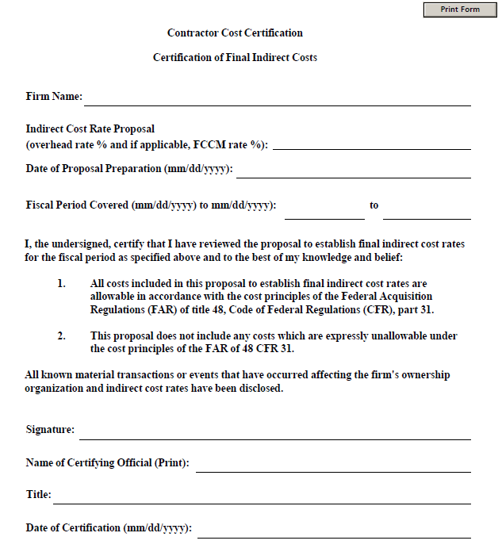
Consultant Prequalification Requirements
Step 4 - Financial Prequalification Documents
Provide this document in same format and with same language
IDC rate must match the rate reported on the overhead
List separately the overhead rate and Facilities Capital Cost of Money Rate (FCCM). The FCCM is a calculation to claim an imputed interest amount to recuperate a firm’s capital costs employed when performing government contracts. FCCM is calculated on actual labor hours without overhead or fixed fee applied.
Fiscal Period Covered must be accurate
Document must be signed and dated to be valid
Notes:
MoDOT will accept only the overhead and, if applicable, FCCM certified on the form.

Slide 63
Questions

Slide 64

Is averaging overhead allowable?
FAR regulations do not allow for an averaging of overhead rates.
Reference 31.201-4, 31.203(f); CAS 401, 402, 403, & 405; 23 U.S.C. 112(D) & 23 CFR 172.7(b).
You may wish to use a voluntarily reduced, as long as, less than the actual rate. Firms may elect to use a voluntarily reduced overhead rate to bring the negotiated rate into a more competitive range, especially if the firm has experience significant fluctuations in their overhead rate from year to year.
For example, the actual cost rate is 150% and is in effect in Year 1 of the contract, the parties can agree to lock this rate in, or extend it for some period of time beyond one year, if all the parties agree. This applies only on a contract-by-contract basis, not necessarily for general prequalification requirements.
Notes:
The FAR does not allow for a 3 year average.
The regulations do not contemplate use of a 3-year average rate, but, for instance, let’s say an actual cost rate of 150% is in effect in Year 1 of the contract, then the parties can agree to lock this rate in, or extend it for some period of time beyond one year, if all the parties agree. This applies only on a contract-by-contract basis, not necessarily for general prequalification requirements.

Slide 65
How long does it take to complete a prequalification review?
The time spent to complete the financial prequal review is dependent on the quality and content of the documents provided by the firm.
Audited OH rates are typically reviewed more quickly then unaudited OH rates.
Notes:
Dependent on the quality and content of the submittal.
I want to get the turn around time to 1 month.

Slide 66
  Pro Bono
    Records as direct labor same as non-billable costs
    Could be considered a conflict of interest
    Chamber of Commerce
    Allowable if the entity can demonstrate unallowable activities were identified and removed from overhead
Notes:
Pro Bono
If a consultant provides “Pro Bono” work to the LPA – Design should review to determine if there is a conflict of interest.

Slide 67
  Approved Consultant Prequalification List
  What does “pending” mean?
  Pending indicates the financial prequalification documents are adequate for a preliminary determination
  Is a consultant eligible to submit a letter of interest to a RFQ/RFP?
  Yes, the firm is eligible to respond to RFQ and RFP advertisements
Notes:
If you know you are on the prequal list or think you should be – call or send me an email to ensure I have received your documents.
I can revise the unpublished list.
MoDOT’s Design Division uploads the lists to the web.
I am always happy to help so you don’t miss an opportunity.

Slide 68
Internal Revenue vs FAR
ALLOWABLE
UNALLOWABLE
Internal Revenue Code (IRC) allows deductions for advertising; interest; 50% of entertainment costs, including alcoholic beverages; and full rental
Federal Acquisition Regulation disallows marketing; advertising; interest, alcoholic, entertainment…
In Short, IRC is not the same as FAR
Notes:
Internal Revenue is not compliant with the FAR

Slide 69
Selecting a CPA
The AASHTO Guide provides criteria in selecting a CPA.
Among other factors, the Guide indicates that the CPA should:
  Experienced in GAGAS, the provisions of FAR Part 31, Cost Accounting Standards, related laws and regulations, and the guidelines and recommendations set forth in the Guide, and
  Should have knowledge of the A/E industry and common operating practices.
Notes:
Audit reports must state FAR compliance or we review the overhead as if it was not audited.
If FAR is not recognize the overhead will include unallowable costs.

Slide 70
Overhead Rates
How are reasonableness of cost determined?
FAR 48 CFR 31.201-3, Determining Reasonableness
Reasonable Cost - A cost is reasonable, if, in its nature and amount, it does not exceed that which would be incurred by a prudent person in the conduct of competitive business.
MoDOT & LPA will review Other Direct Cost.
High Risk Categories include but are not limited to the following.
Food
Lodging
Travel & Mileage Reimbursement
Notes:
Reasonable Cost is by its nature and amount it does not exceed that which would be incurred by a prudent person conducting competitive business.
High Risk Categories are viewed to determine GSA rates are followed the costs is allowable.

Slide 71
Sub-Consultants and Prequalification Requirements
Are sub-consultants required to be prequalified? No
MoDOT does not required sub-consultants however, it is strongly encouraged.
Requirements:
Sub-consultants must be registered to do business in Missouri,
If applicable, registration through Missouri Professional Registration,
Participate in the DHS Program known as E-Verify
Provide a Certification of Final Indirect Costs
Additional information provided on the MoDOT Consultant Services website - Sub-Consultant Requirements tab.
Notes:
PRIME may require sub-consultants to be prequalified to lessen the burden of determining compliance.

Slide 72
Can the depreciation cost listed on the overhead include accelerated methods of depreciations? No
The FAR does not allow for Section 179 or bonus depreciation costs as an allowable expense on the overhead or in the related party rent calculations.
Allowable depreciation is limited to what is acceptable to the financial statements.
Financial Statements developed in accordance with Generally Accepted Accounting Practices.
Notes:
Generally, any item with a useful life over 1 year is depreciated.
Capitalization of expenses could be viewed the same as Section 179 or accelerated depreciation and therefore, unallowed.

Slide 73

Thank You
Contact:
Sandra Riley
Missouri Department of Transportation
Audits and Investigations Division
573.522.2002
sandra.riley@modot.mo.gov

