Slide 1
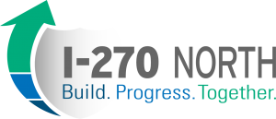
Eric Kopinski – MoDOT

Slide 2
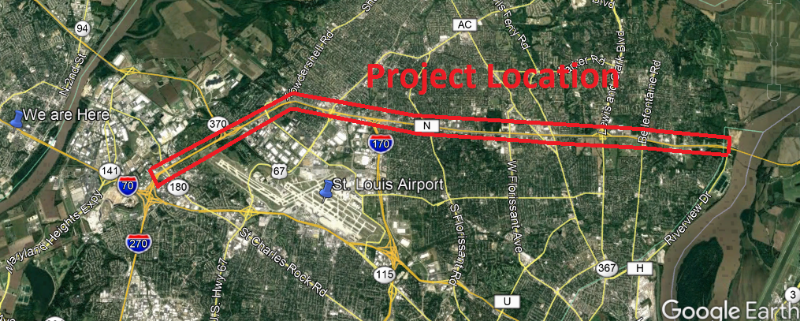
I-270 North Design-Build Project Location

Slide 3
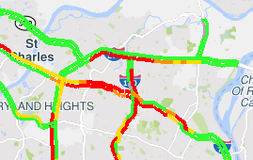
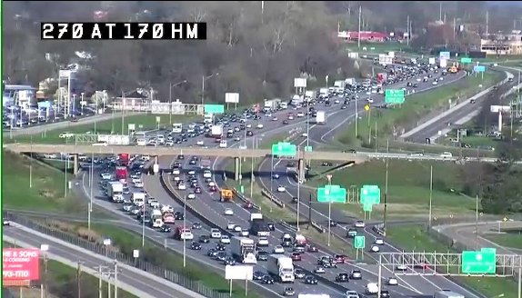
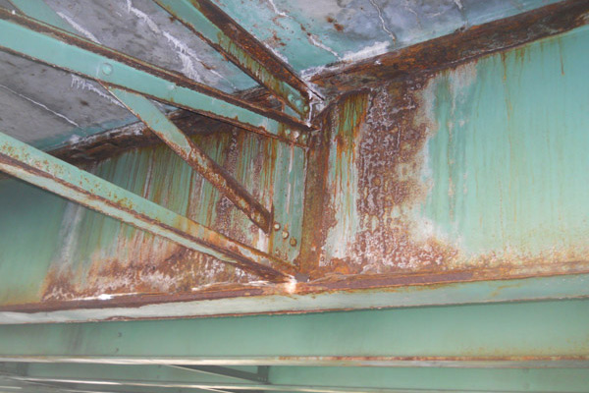
I-270 North Design-Build Project Challenges
CURRENT ISSUES
One of the heaviest traveled interstates in Missouri
140,000 vehicles travel the corridor daily
18% heavy trucks
Limited pedestrian facilities

Slide 4
I-270 North Design-Build Project Goals
Deliver the Project by December 1, 2023 within the program budget of $225 million.
Maximize reliability and safety while linking communities for all users.
Provide a durable and maintainable transportation network making Interstate 270 the conduit for a prosperous region.
Grow and utilize a diverse workforce.
Minimize and mitigate impacts to customers through innovation.

Slide 5
I-270 North Design-Build Project Schedule
PROJECT TIMELINE

Slide 6







I-270 North Design-Build Project
DBE and Workforce Goals
DISADVANTAGED BUSINESS ENTERPRISE
(DBE) GOALS
WORKFORCE GOALS
14.7% Minority
6.9% Female
18% for construction activities
22% for professional services activities
TRAINING PARTNERS

Slide 7
How Can You Get Involved?
Visit the website and subscribe for email updates at www.i270north.org
Industry Meeting – Next Tuesday (April 30th) at MoDOT’s TMC from1pm-3pm
Contact me at: Eric.Kopinski@modot.mo.gov

