Slide 1

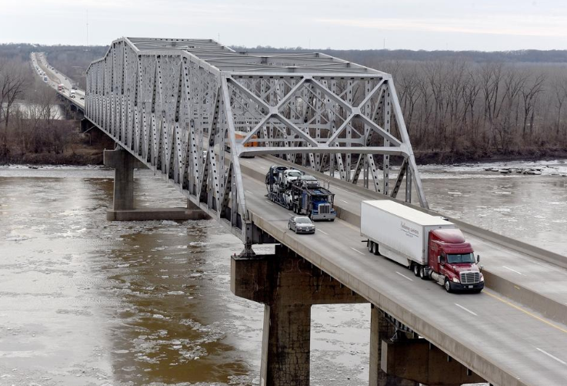

I-70 Rocheport Bridge Design-Build
Industry Meeting
January 29, 2021

Slide 2
Project Team
Brandi Baldwin– Project Director
Derek Lepper– Deputy Project Director
Project Staff – Nicole Gharbawi, Drew Bowman, Patrick Haslag, Andrew Bertels, Bill Dunn
FHWA – Charles Pursley
Owner Consultant – HDR with Trekk

Slide 3
Agenda
Project Description
Goals, Schedule, and Budget
Risk Items
Request for Qualifications (RFQ)
Early Release Information
Draft RFP

Slide 4

Please place your questions and comments in the Q&A pod. We will respond to them verbally.
www.modot.org/RocheportBridge
RocheportBridge@modot.mo.gov

Slide 5
Reminder…
Meet and Greet opportunities directly preceding the Industry Meeting.
First come first served
Contact RocheportBridge@modot.mo.gov to get signed up today!!

Slide 6
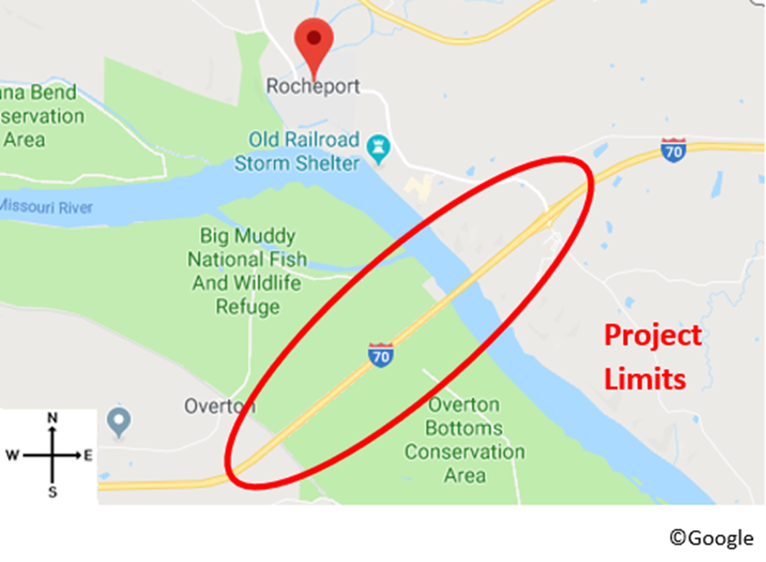
Project Location
I-70 in Boone and Cooper Counties
Railroad Bridge to East Ramps of RT BB
Notes:
Entirely in St. Charles County. Mostly in St. Charles City, with a little St. Peters thrown in
As you know, this was one of the first interstates built in the country.
Upgraded but not reconfigured to keep up with demand.
Length: 4 miles
Trucks: 10%
Configuration: 3-4 through lanes
Interchanges: 4 existing
Outer Roads: Discontinuous
Safety: standard number of crashes based on facilities of similar size, over half of crashes are rear end

Slide 7
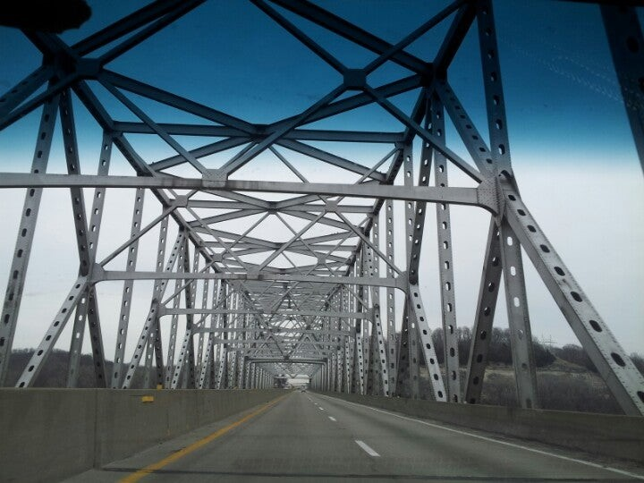
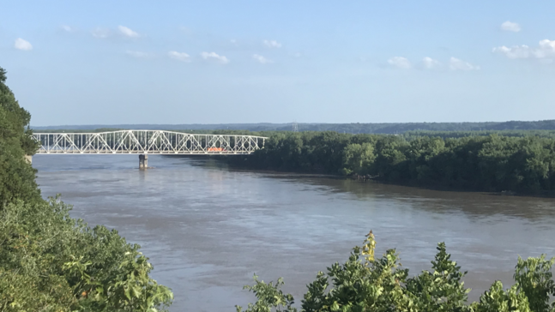
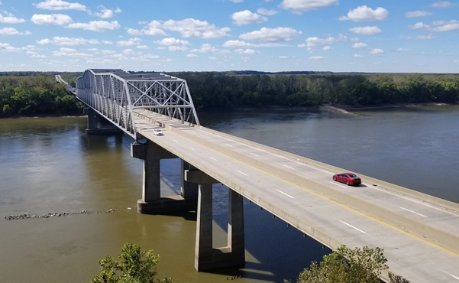
Existing Bridge
Built in 1960
4 Lane
37,890 vehicles per day with 24% trucks

Slide 8
Project Goals
Meet the expectation of delivering the project under budget.
Provide a high quality, durable, low maintenance project that improves safety and reliability.
Minimize traffic impacts during and after construction while maximizing safety and capacity.
Maximize safety for workers while beating the project completion deadline of 12/31/24.
Deliver the Project with a diverse workforce that fosters future DBE and workforce development.
Demonstrate a commitment to quality and innovation in all phases of the project.

Slide 9
RFQ Milestone | Tentative Date
Deadline for submitting RFQ questions | Wednesday, February 10, 2021
SOQ Submittal Deadline | Friday, February 19, 2021
Oral Presentations | February 24 – 26, 2021
SOQ Shortlist Released | Tuesday, March 2, 2021

Slide 10
RFP Milestone | Tentative Date
RFP Released | Friday, March 12, 2021
Proposal Submittal Deadline | Friday, June 11, 2021
Best Apparent Value Selection | Thursday, July 1, 2021

Slide 11
Project Budget
Program Budget: $240 million
  Preliminary Engineering
  Right of Way
  Utilities
  Stipends: $425,000 *
  Incentive
Design-Build Contract $220 Million*
* Amounts will be finalized in Request for Proposals

Slide 12
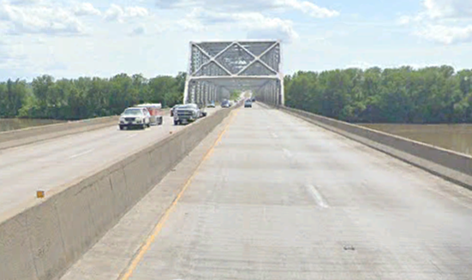
Risk Items
MoDOT is proactively working on these Risk Areas
  Utility Coordination
  Third-Party Agreements
  Environmental Clearances
  Right of Way

Slide 13
Utility Coordination
Meeting with Utilities and coordinating UIS based on Preliminary Design for reference
No relocations prior to award
Known Utilities:
  Ameren
  AT&T
  Boone County CPWD
  Lumen (formerly CenturyLink)
  Boone Electric
  CoMo Electric Coop – Electric & Fiber
  Charter Communications
  CenturyTel Missouri
  Cooper County PWSD
  MoDOT

Slide 14
Third-Party Agreements
    Executed:
      Missouri Department of Natural Resources – Katy Trail State Park
    Drafted & In Review:
      Overton-Wooldridge Levee District No. 1 of Cooper County

Slide 15
Environmental Clearances
MoDOT is working with USACE on all required permits
MoDOT is working with USCG on bridge permit
MoDOT obtained concurrence with USFWS
Contractor is responsible for Land Disturbance
Contractor is responsible for No-Rise & Floodplain Development Permit

Slide 16
Right of Way
Parcel #1 – USA – being acquired with USACE via TCL
Parcel #2 – MDC – 6(f)
Parcel #3 – Access to MDNR is established by agreement
Parcel #4 – in progress

Slide 17
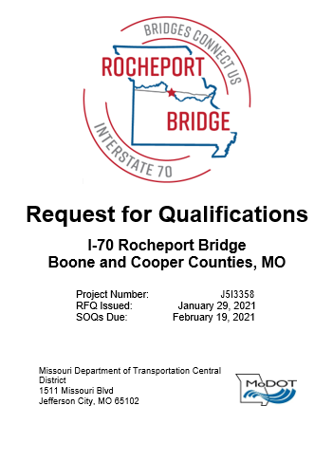
Request for Qualifications
RFQ Evaluations will include 3 parts:
  Submitter Experience (100 Points)
  Key Personnel (100 Points)
  Oral Presentation (75 Points)

Slide 18
Request for Qualifications
Submitter Experience (100 Points)
  Executive Summary & Reference Projects
    Approach to Ensuring Safety – requesting OSHA specifics
    Quality Management Program - requesting additional specifics
    DB-102: Reference Project Summary – adding safety and quality specifics per project

Slide 19
Request for Qualifications
Key Personnel (100 Points)
  Project Manager
  Construction Manager
  Quality Manager
  Design Manager
  Up to 4 additional positions allowed

Slide 20
Request for Qualifications
Oral Presentation (75 Points)
  60 to 75 minutes
  Only Key Personnel may attend
  No Additional Documentation
  15 minute Introduction/brief presentation
    Presentation may be pre-recorded or done live
    Only Key Personnel will be allowed to present
February 24 – 26, 2021

Slide 21
Early Release Information
Items released:
  As-Built Plans
  Environmental Data
  Survey Data
  Draft Geotechnical Report
  Traffic Data
For access, please email RocheportBridge@modot.mo.gov

Slide 22
Draft RFP
The Draft RFP can be found on the SharePoint Site along with the Early Release Information.
  Book 1, 2, 3, and the ITP
  Draft Scoring Categories:
    Project Definition (55 points)
    Safety (25 points)
    Quality (5 points)
    Public Involvement (5 points)
    Price Allocation (10 points)

Slide 23
Questions about the RFQ or Draft RFP?
Submit all questions to the Project Director:
  RFQ:
    All questions, RFCs, and responses will be posed on the Project SharePoint site
    February 10th 11:00 am – deadline for submitting
    February 11th – final responses will be posted
  Draft RFP:
    Comments can be submitted as feedback; formal responses will not be provided.

Slide 24
Diversity Goals
Disadvantaged Business
Enterprise (DBE) Goals
Federal Workforce
Diversity Goals
15% Professional Services
10% Construction Activities
6.3% Minority
6.9% Female
On-the-Job Training Goal
(1000 hours per position)
1 trainee for Professional Services
4 trainees for Construction Activities
DBE firms must be certified with the Missouri Regional Certification Committee (MRCC) www.modot.mo.gov/business/contractor_resources/External_Civil_Rights/DBE_program.htm

Slide 25
Ineligible Firms
The following firms are serving as MoDOT’s owner representative and are ineligible to compete:
  HDR
  TREKK Design Group, LLC
  Geotechnology

Slide 26
Project Contact Info
Project Director: Brandi Baldwin
RocheportBridge@modot.mo.gov
https://www.modot.org/design-build-information
https://www.modot.org/RocheportBridge

Slide 27
2019
Funding Acquired
2020
NEPA Re-evaluation has been completed, Preliminary Design Work, & Design-Build Procurement Preparation
2021
Construction Continues through the end of 2024
2022 – 2025
Design-build Procurement, Project Award, Construction Begins

Slide 28
Design-Build Project Goals
High-level, measurable goals to set vision for project
  Prioritized to aid in decision making
  Used throughout project development, design, and construction
  Developed by representatives of MoDOT
  Approved by MoDOT Senior Management

Slide 29
Goal #1: Meet the expectation of delivering the project under budget.
Source | Amount
Infra Grant | $81.6 million
Boone County | $2 million
Cooper County | $2 million
TOTAL | $220 million
Funding includes federal, state, and county dollars.

Slide 30
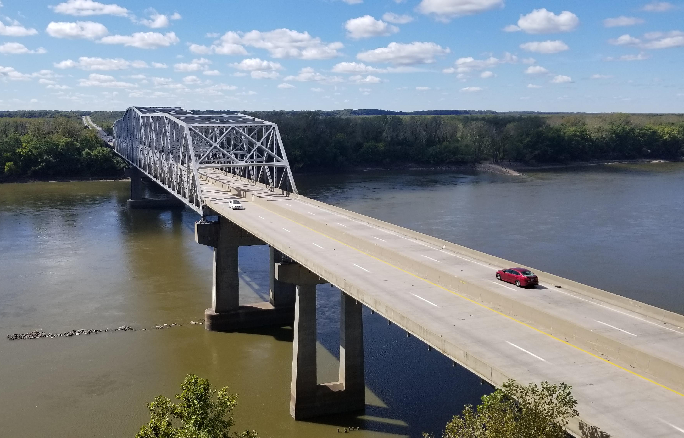
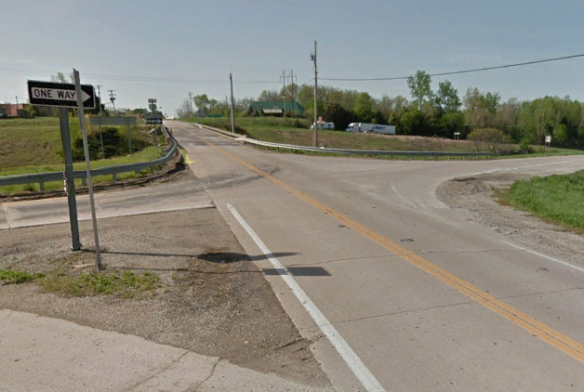
Goal #2: Provide a high quality, durable, low maintenance project that improves safety and reliability
High quality design and construction practices
Durable Project
Minimize the maintenance needs of the Project
Improve safety by reducing fatal and serious injury crashes along the I-70 corridor
Improve reliability along the corridor by improving incident management and accommodating future expansion of I-70

Slide 31

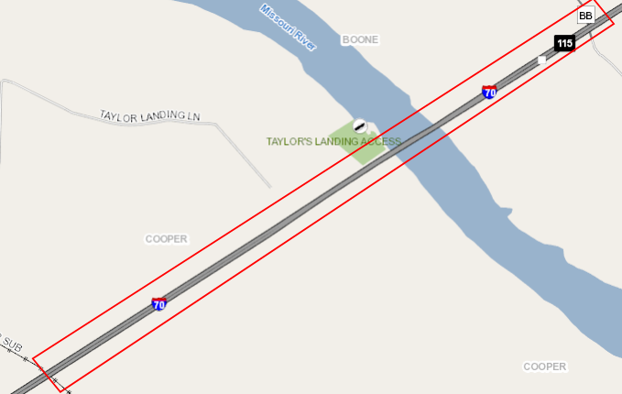
Goal #3: Minimize traffic impacts during and after construction while maximizing safety and capacity
Develop Maintenance of Traffic solution that minimize traffic impacts
Develop scope solutions that maximize capacity, reliability, and safety within the corridor

Slide 32
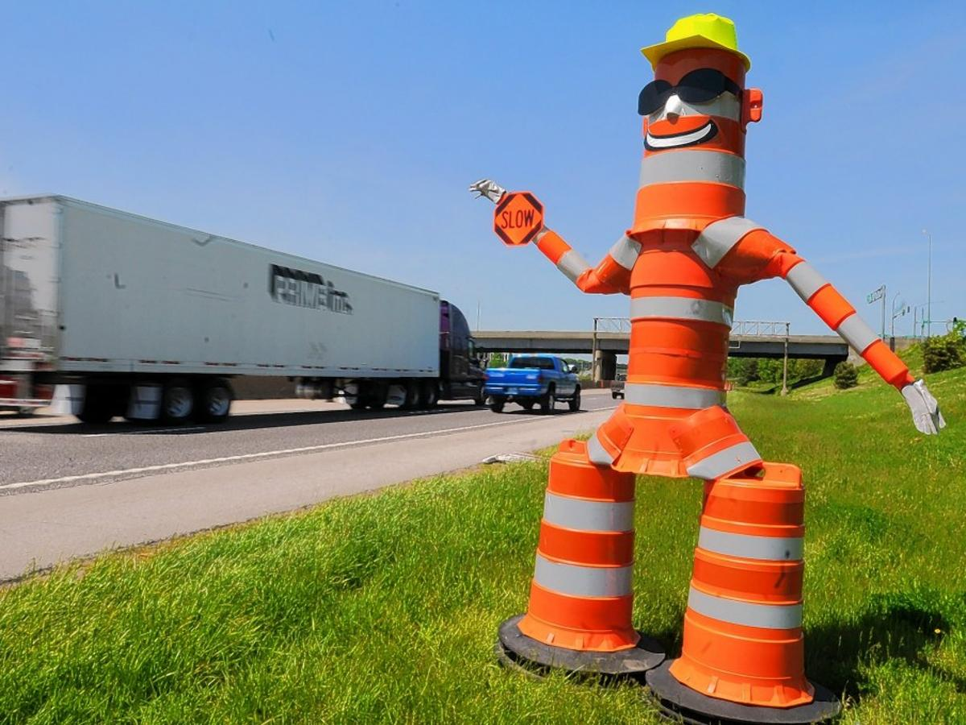
Goal #4: maximize safety for workers while beating the project completion deadline of 12/31/24
Worker safety and health is a priority and will not be compromised
Develop the Project schedule including a Project Completion Deadline as early as practical, but no later than December 31, 2024

Slide 33
Goal #5: deliver the Project with a diverse workforce that fosters future dbe and workforce development.
Provide a project workforce that will be diverse and representative of the local community
MoDOT’s objective is to deliver the Project with the future in mind – foster the local workforce through STEM initiatives and innovative workforce and DBE development

Slide 34
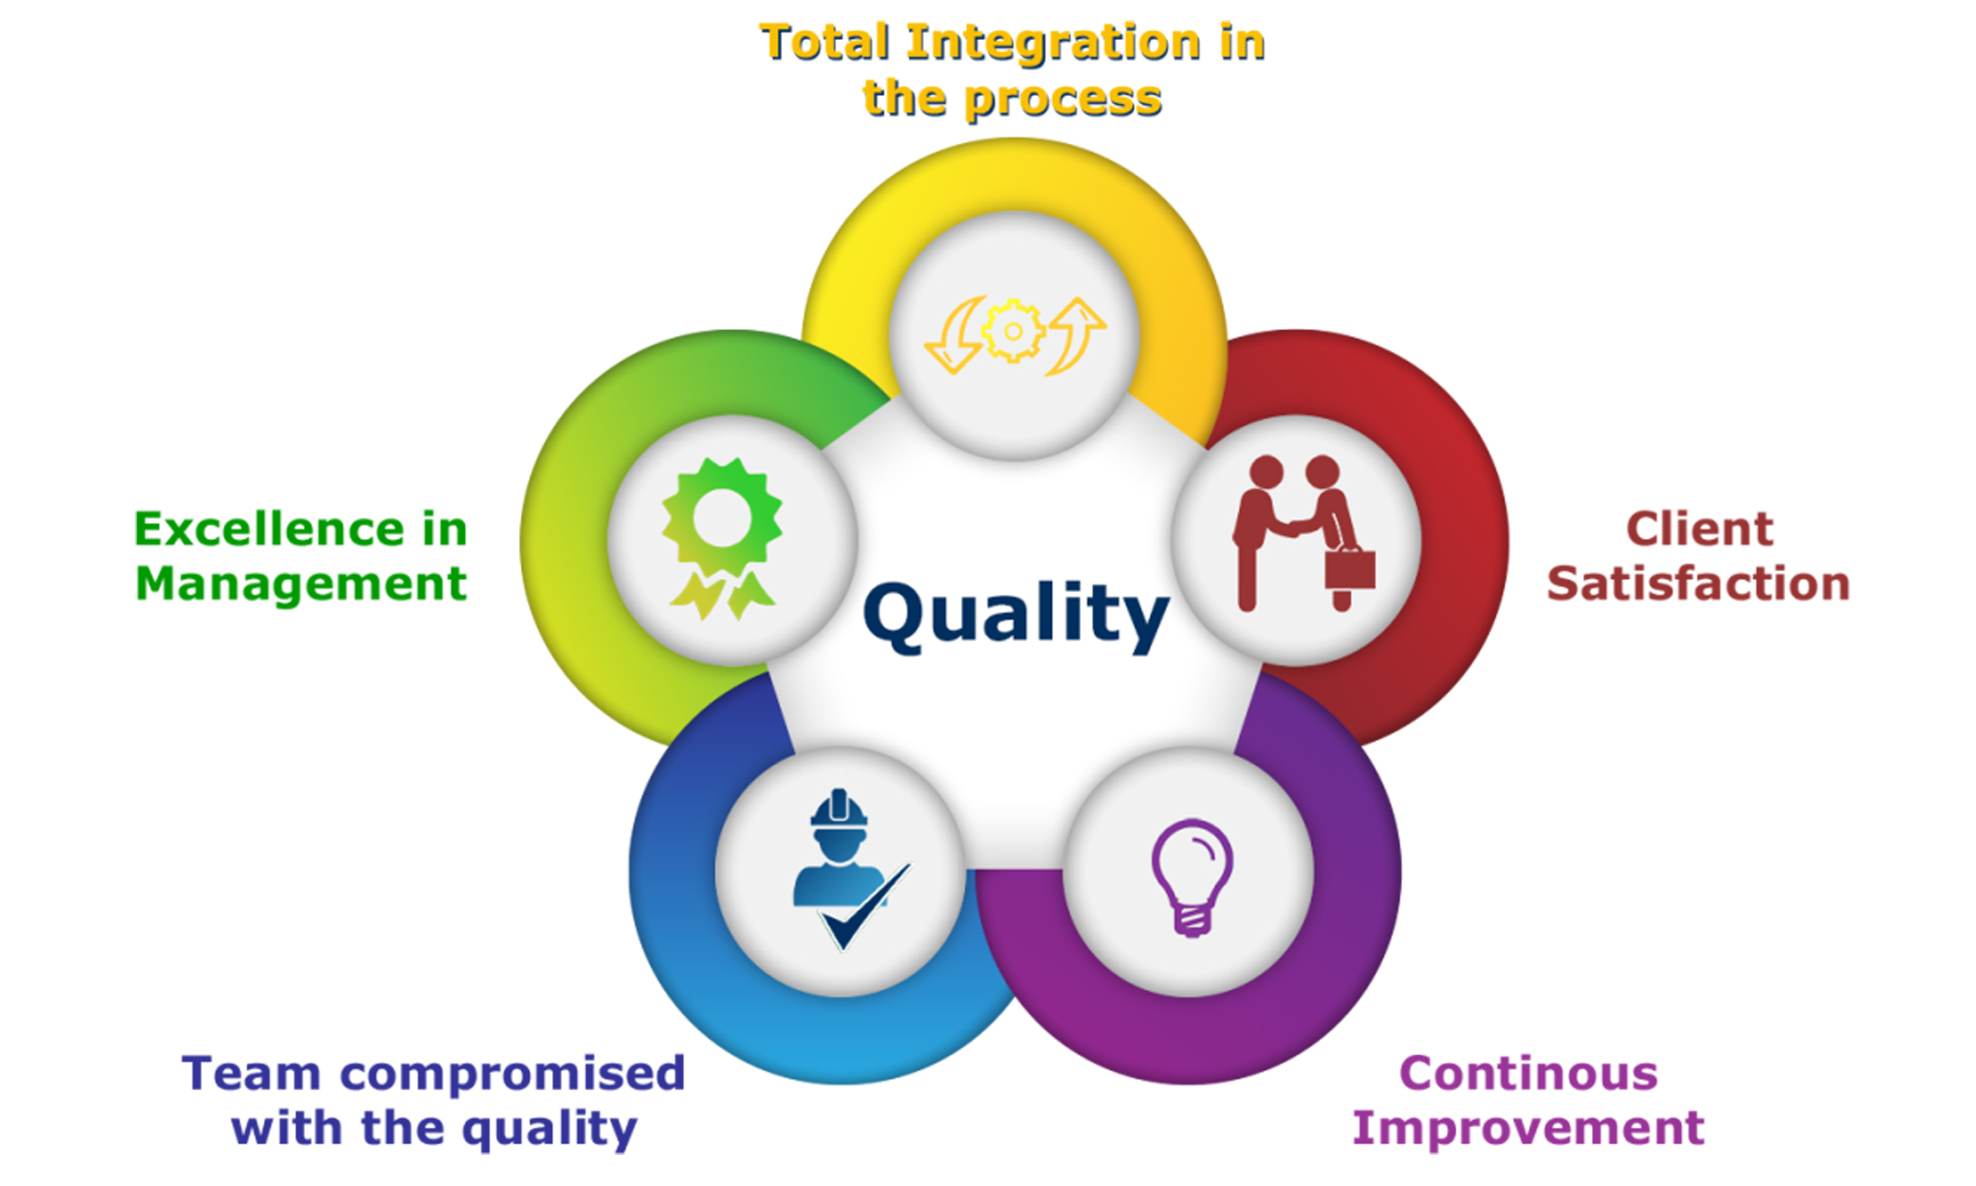
Goal #6: demonstrate a commitment to quality and innovation in all phases of the project.
Provide a project that exhibits quality and innovation in all aspects.

