Slide 1
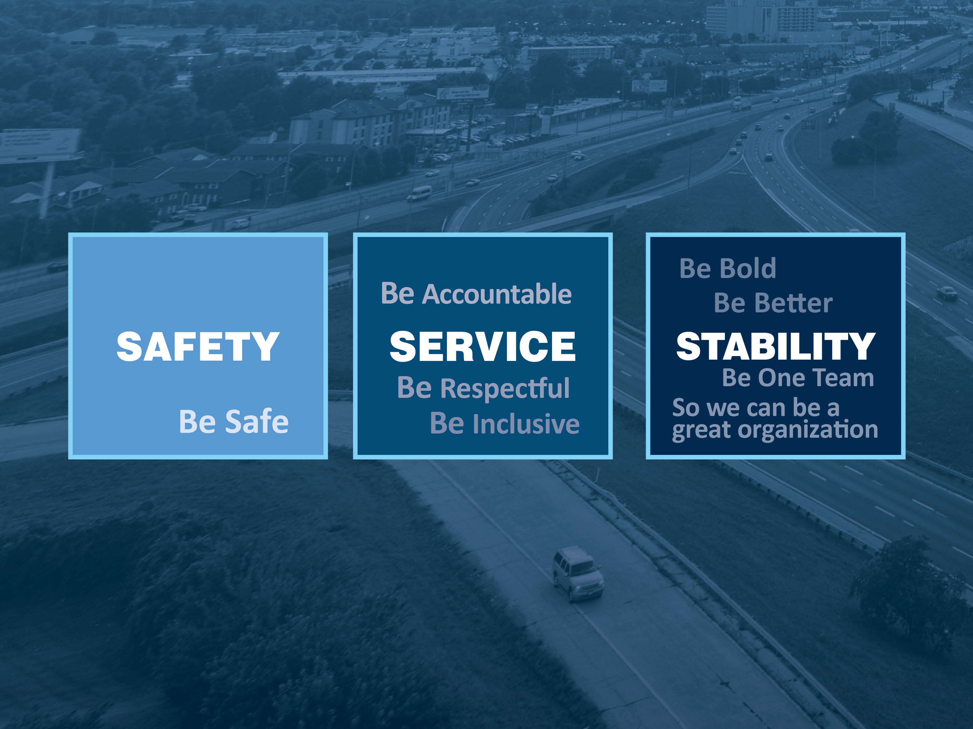
MoDOT: Year In Review
Ed Hassinger
Deputy Director/Chief Engineer

Slide 2

Mission Statement:
Our mission is to provide
a world-class transportation system that is safe, innovative, reliable and dedicated to a prosperous Missouri.

Slide 3

Our Three Pillars
Safety
  Keep customers and ourselves safe
Service
  Provide outstanding customer service
  Deliver transportation solutions of great value
  Use resources wisely
Stability
  Keep roads and bridges in good condition
  Operate a reliable and convenient transportation system
  Advance economic development

Slide 4








Missouri Transportation Funding
FISCAL YEAR 2018 (Dollars in Millions)
Missouri User Fees and Other Revenue
^{(Gas Tax)}
^{$1,582}
^{Federal Revenue}
^{(Gas Tax)}
^{$1,011}
^{Missouri General Revenue}
^{(Income Tax)}
^{$12}
^{Total} ^{Revenue $2,605}
$393
$1,571
$261
$290
$90
Cities and Counties
State Roads and Bridges
Other State Agencies
Debt Payment
Multimodal
State = $277
Federal = $835
Federal = $60
Federal = $116
Revenue &
HWY Patrol
State = $736
State = $18
Gen. rev. = $12

Slide 5
Operating Budget
Over 66,000 Line Miles of Striping
Over 750,000 Tons of Asphalt Pavement Repair and Patching
Over 440,000 Pounds of Crack Sealing
Over 3,400 Lane Miles of Chip Sealing
Over 4.9 Million Square Feet of Bridge Deck Sealing
Over 150,000 Linear Feet of Pipe Culverts Repaired
Over 500,000 Acres of Right-of-way Mowed
Over 24,000 Lane Miles of Sweeping
Over 23,000 Square Yards of Concrete Pavement Repair
Over 11,000 Miles of Edge Rut Repair
Over 7,200 Bridges Flushed At Least Once
Over 88,000 Square Feet of Bridge Deck Repair
Over 2,500 Signals Managed and Maintained
Over 250 Dynamic Message Signs Operated
Over 150,000 Square Feet of Signs Installed
Over 600 Cameras Operated
Three Traffic Management Centers

Slide 6
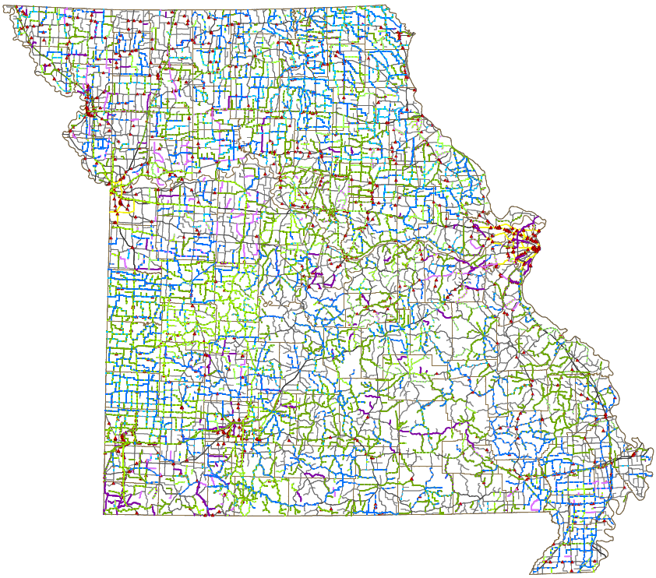
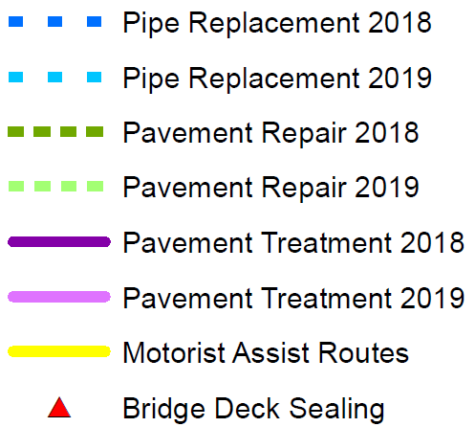
2018 and 2019 Maintenance Plans

Slide 7
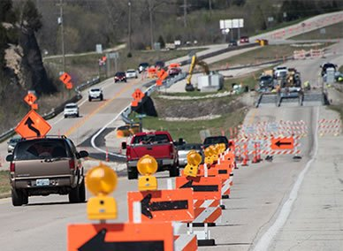
Delivering Results
FY 2018
381 projects completed
  6% under budget
  93% completed on time
Over the last 10 years
4,405 projects completed
  7.1% under budget
  94% completed on time

Slide 8
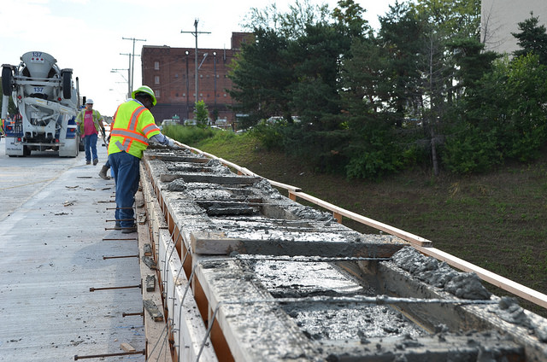
2019-2023 STIP
Annual contractor awards average $900 million
Nearly 82 percent is aimed at taking care of the existing system
1,319 projects

Slide 9
Notes:
Construction Awards –
$730 million for 2019--$170 million moved to 2020 for I-270 project
$1,070 million for 2020
$900 million for 2021 and 2022--Same as last year’s forecast
$875 million for 2023 and beyond
Federal Reduction
Reduces to $570 million starting in 2021 through 2025

Slide 10
Asset Management Needs
Fiscal Year 2022
(Dollars in Millions)
Maintain System Conditions = $583
Major Bridges = $94
Total = $677

Slide 11
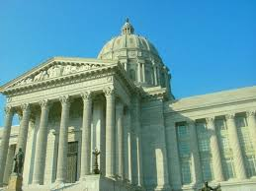
State Legislative Activity
Automatic Revocation of a Driver’s License When Striking a Highway Worker
Creation of a Mile Per Gallon Motor Vehicle Registration Fee Model
Prohibit the use of hand-held electronic wireless communication
devices while driving
Also being discussed, solutions to fix
several bridges across the state.

Slide 12
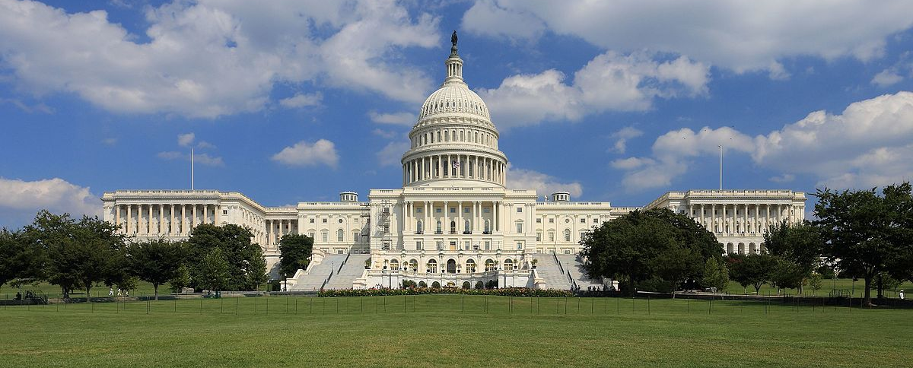
In Washington, D.C.
MoDOT will continue to look to the federal government for funding
National program that provides these funds might end in 2020

Slide 13

The Future?
Federal Highway Trust Fund
is at a crossroads.
MoDOT is creating two plans: one if the federal government does provide money and one if it doesn't.
We have to jointly make choices so we will know if the federal funds don't come through, what projects won't happen.
Notes:
If Congress doesn't act, and if the administration doesn't support the Highway Trust Fund, we could see a significant decline in federal resources starting in 2021.
Our current resources provide about half of the construction budget that the condition of the system, and its size, require to be in good repair.
Setting priorities among the many equally important transportation projects will be a tough job with limited resources, but we’ll continue to work closely with you to address Missouri’s most pressing needs.

Slide 14
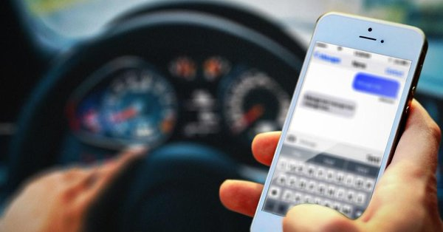
Safety First
70% of drivers using cell phones in Missouri traffic crashes were 22 years of age or older.
54 people were killed and 3,248 people were injured in work zone crashes in Missouri, between 2014 and 2018.
Distracted driving
is a leading cause
of these crashes.

Slide 15

Take the Challenge
Stand Up and Be Counted
Notes:
Join the national movement to buckle up every person every time and to put your phone down and end the alarming trend of distracted driving
Your number counts – so stand up and be counted. Take the Challenge to Buckle Up – Phone Down
Do your part to stop the tragic trend of fatalities on Missouri’s roads.

