Slide 1

23 Years of Hydrodemolition in Missouri

Slide 2
Outline
Start of Hydrodemolition in Missouri
Hydrodemolition Theory
Advantages of Hydrodemolition Process
Latex Modified Concrete & Very Early Strength LMC
Missouri Installations
Missouri Specification

Slide 3
Start of Hydrodemolition in Missouri
First Applications of Deck Restoration thru Total Surface Hydrodemolition in Missouri:
Bridge L0896, St. Mary’s Way over IS 44, Franklin County
(Maintenance Project) - 1996
Bridge A0174, IS 44 over Pickerel Creek, Greene County
(first programmed job) – 1998
Various Maintenance Projects in St. Louis Area
MoDOT Research on Hydrodemolition and Use of Rapid Set Latex
(December 2002, Wenzlick)

Slide 4
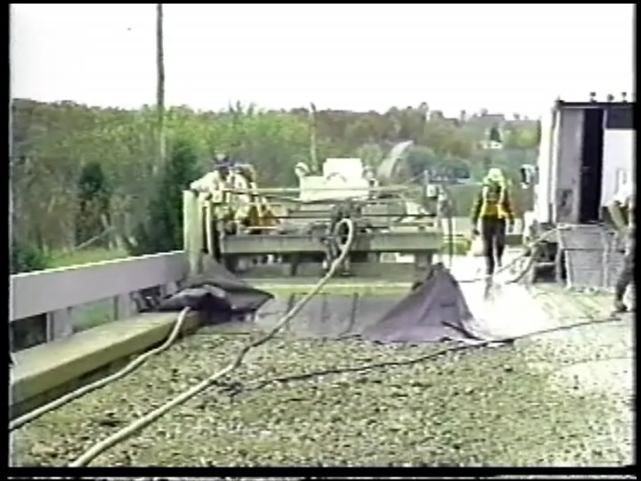

Slide 5
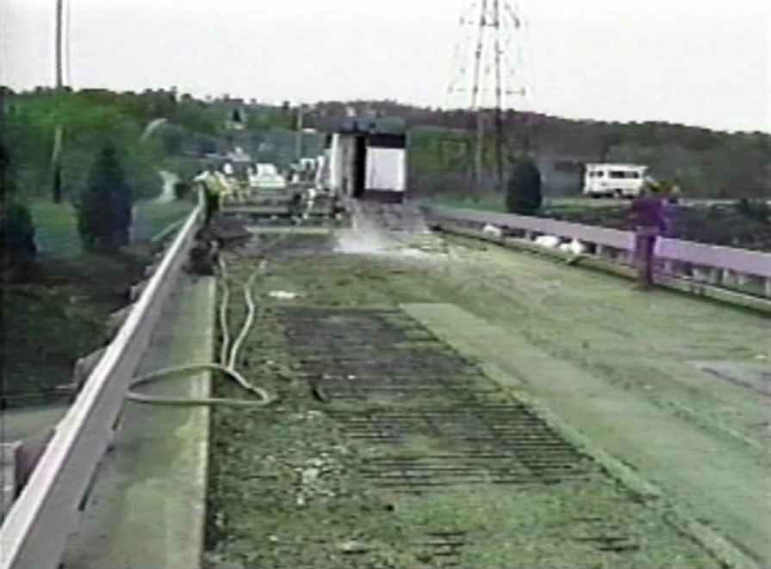

Slide 6
Hydrodemolition Theory
Deep Cut vs. Fast Track for Restoration
Production Rates
Water Pressure
Hydro vs. Jackhammering

Slide 7
Deep Cut Hydrodemolition
Deeper Removals to fully expose top mat
Large Quantities of Material Removed
Slow Production
More Expensive
More opportunity to damage top mat steel during cleanup

Slide 8
Fast Track Hydrodemolition
Selective Removal of Deteriorated or Weakened Concrete
Only Removes a Half Inch of Sound Concrete
Minimizes Rebar Exposure
Higher Production Rates
Cost Effective Alternative for Deck Restoration and Preservation

Slide 9
Fast Track Hydrodemolition
Surface Preparation Technique
Uses Single Pass of High Pressure Water Jet
Provides Highly Roughened and Bondable Surface
Most Effectively Used in Conjunction with Latex Modified Concrete

Slide 10
Depth of Delamination will Vary

Slide 11
Removal of sound concrete - unnecessary

Slide 12
What Does Selective Removal Approach Give us?
Productivity
Etched and highly bondable surface
Increased amplitude in cut
More surface area for bonding of concrete overlay

Slide 13
Factors in Hydrodemolition Production Rates
Quality of Concrete
Depth of cut
Water Consumption of Equipment
* More water – Faster Production Rates
* Not a Linear Correlation

Slide 14
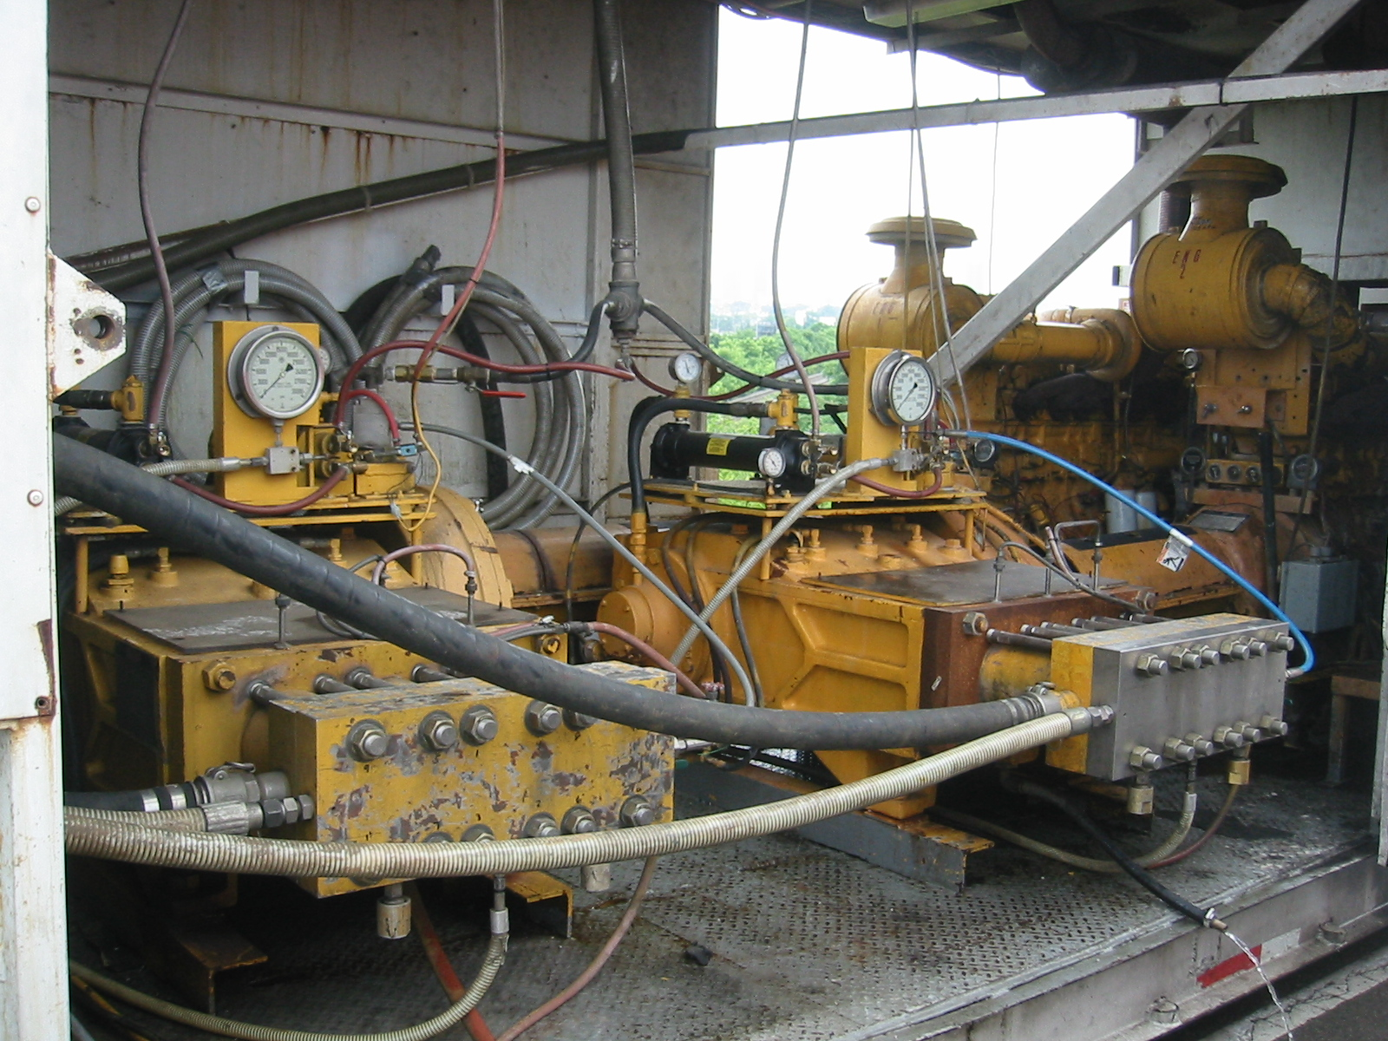

Slide 15
Relationship Between Water Pressure and Selective Zone Removal
Selective Removal
13,000 PSI
Pressure
17,000 PSI
15,000 PSI
19, 000 PSI
Source: Hydrodemolition for Bridge Repair,
H. Ingvarsson adn B Eriksson,
Nordisk Betong no 2-3 1988

Slide 16
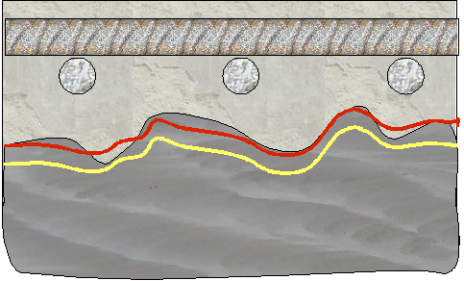
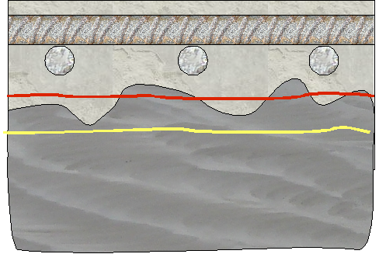
Hydrodemolition vs. Hydromilling
(Selective) (Non-selective)
15,000 - 20,000 psi 30,000 – 40,000 psi
* Water flow is the means of product

Slide 17
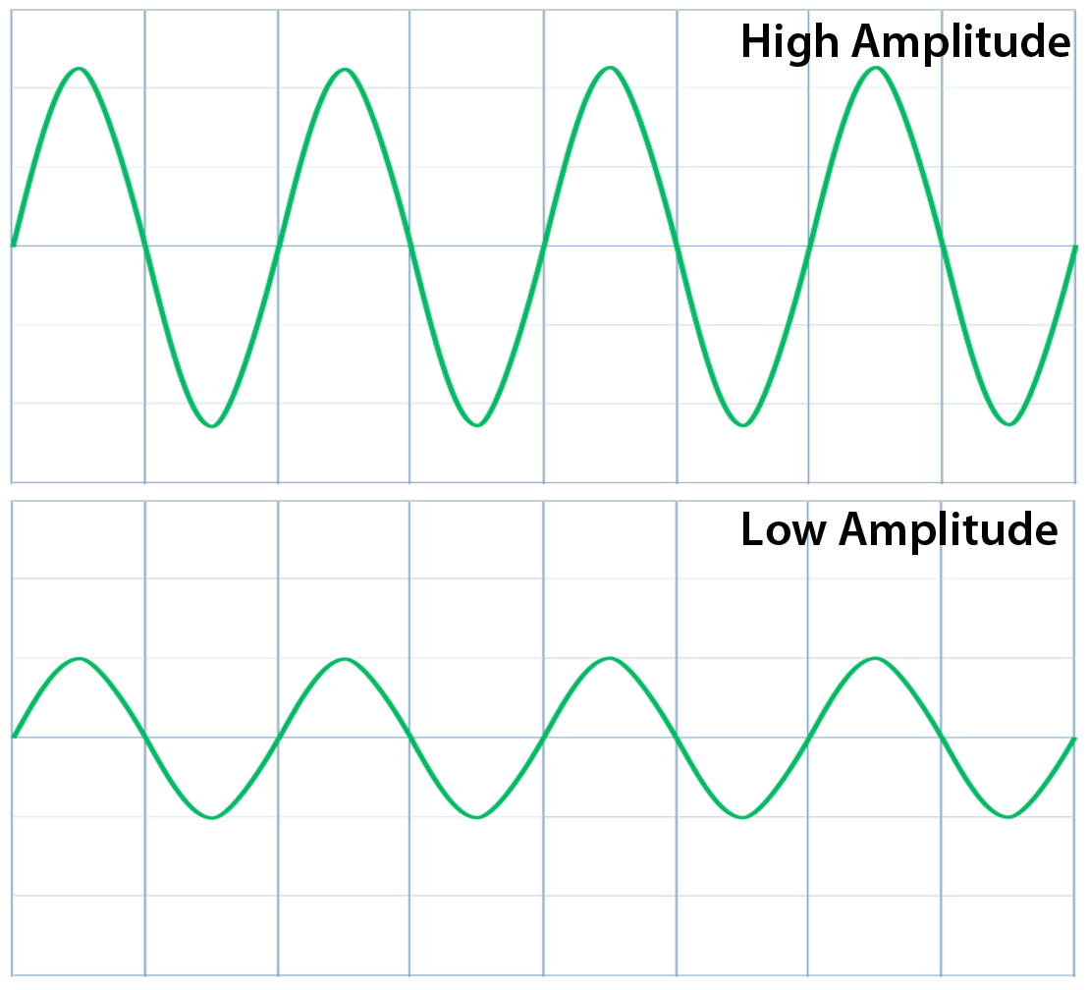
Fast Track Cutting
(with high volume water)
Lower Volume Water Cutting

Slide 18
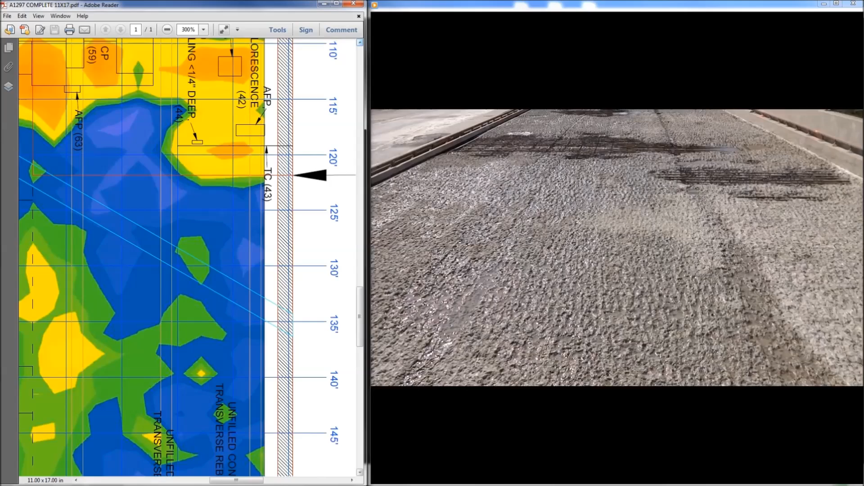
GPR Scan vs. Actual Removals

Slide 19
Hydrodemolition (Fast Track) Advantages:
Speed – Fast, Productive, Economical Preparation.
Quality - Selectively Removes Delaminated Concrete. Avoids Unnecessary Removal of Sound Concrete.
Will not Damage Existing Reinforcing Steel, but Cleans the Steel.
Surface Area - 300 % to 400 % More Bondable Area than Mechanical Milled Surface.
Controlled Cost – Bid and Performed at a SY Unit Price. No Need to Estimate Half Sole Quantities.
Construction - Replaces Jackhammers and Eliminates Micro-cracking of Deck Concrete.

Slide 20
Latex Modified Concrete (LMC)
Designed as thin bonded concrete overlay system (minimum 1 ½”).
Very adhesive - develops great bond strength to existing deck.
Impervious to water and chemical intrusion.
Greater flexural strength than conventional concrete.
Extends service life of bridge deck for over 25 years on hydrodemolition prepared concrete surface.
It’s quality has withstood test of time. First install in 1969 (Virginia).

Slide 21
What is LMC?
Suspension of tiny (.2 micron diam.) styrene-butadiene polymer particles in water.
Typically about 50% polymer solids. Added as part of mixing water.
S-B polymers are hydrophobic (excellent water resistance).
Polymer particles fuse together to form waterproof barrier within concrete.

Slide 22
Very Early Strength LMC
Add very early strength hydraulic/portland cement to the LMC mix. (Type III or CTS Rapid Set Cement)
Achieves compressive strengths over 2,500 psi in 3 hours – traffic ready.
Provides same benefits as LMC overlays.
Used on projects in US since 1991.
Excellent for weekend or overnight projects.

Slide 23
TYPICAL WEEKEND SCHEDULE:
Friday
9:00 pm to 10:00 pm - Close roadway.
10:00 pm to 12:00 am - Milling
12:00 am - Hydrodemolition
Saturday
12:00 am to 12:00 pm - Hydrodemolition & clean-up
12:00 pm to 12:00 am - VESLMC prep and pour
Sunday
12:00 am to 4:00 am - Cure VESLMC overlay
4:00 am to 12:00 pm - Cleanup work area.
12:00 pm to 2:00 pm - Open roadway

Slide 24
Missouri Hydrodemolition Jobs Thru 2018
To date we have let over 160 hydrodemolition jobs
21 projects let in 2018 alone
Including traditional hydrodemolition, substructure rehabilitation and slab edge removal work

Slide 25
Overlays
Over 250,000 SY Latex / Very Early Strength Latex
Over 15,000 Cubic yards of LMC/VESLMC
Other Dense Overlays – Low Slump, Low P, Microsilica Concrete

Slide 26
Notable T.S. Hydro/LMC Installations
St. Mary’s Road over I-44, Franklin County (first total surface install 1996) 16 years of service with only cracking issues
First Programmed Job I-44 over Pickerel Creek, Greene County (1998) 17 years of service on a busy interstate before patching started
MO 141 – 5 bridges in Jefferson/St. Louis Counties (2001) Still in service with only minor cracking noted.
Route A – 3 bridges in Jefferson County (2007) Still in service with only minor cracking noted.
I-70 in Kansas City (2011) – 6100 SY + on 15 bridges
US 50 / Lamine River (2013)– 4390 SY

Slide 27
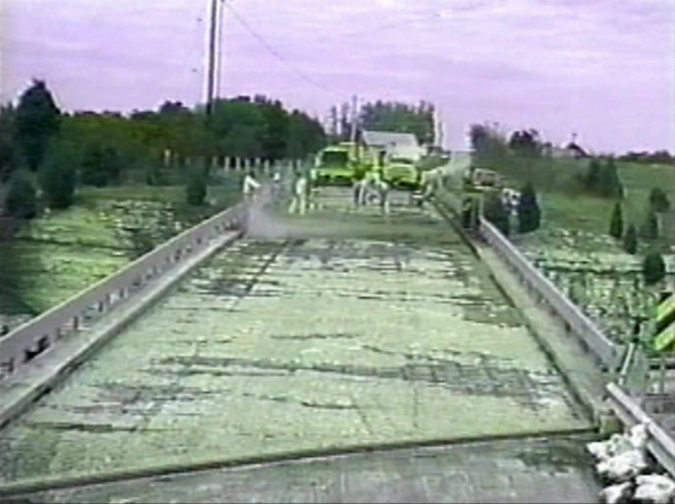

Slide 28
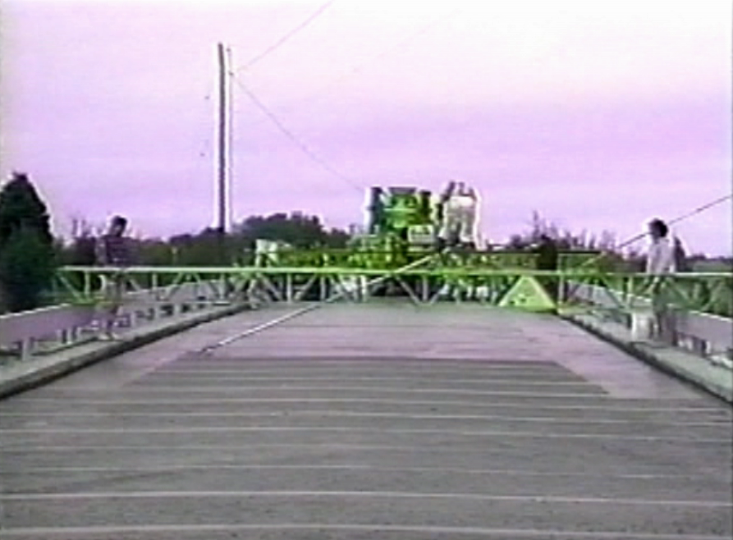

Slide 29
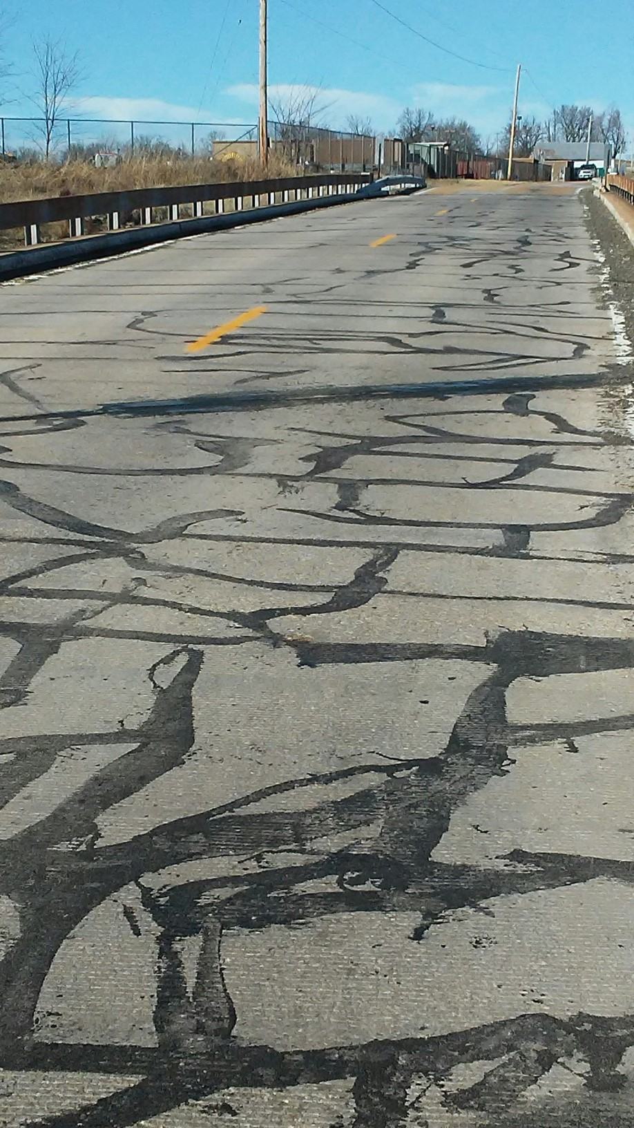
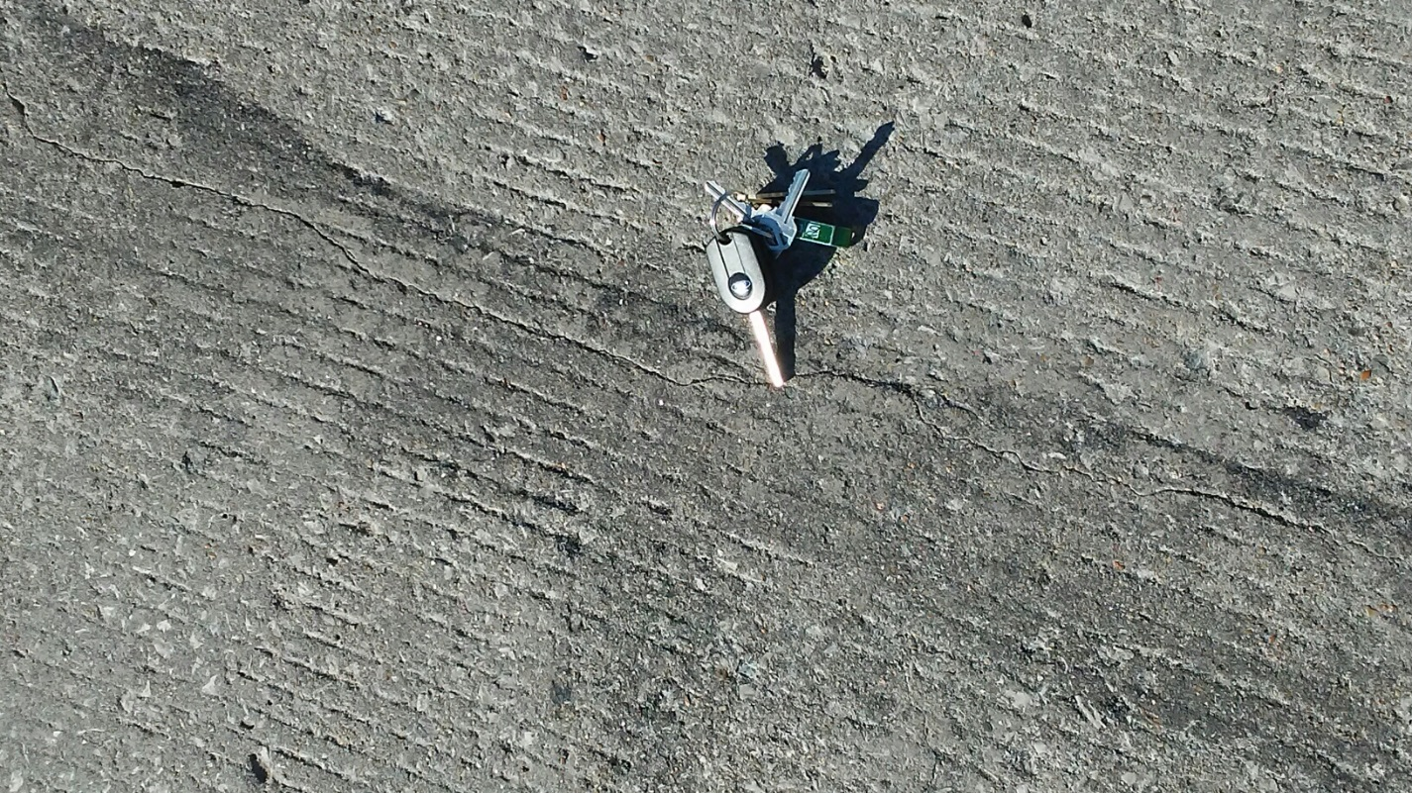

Slide 30
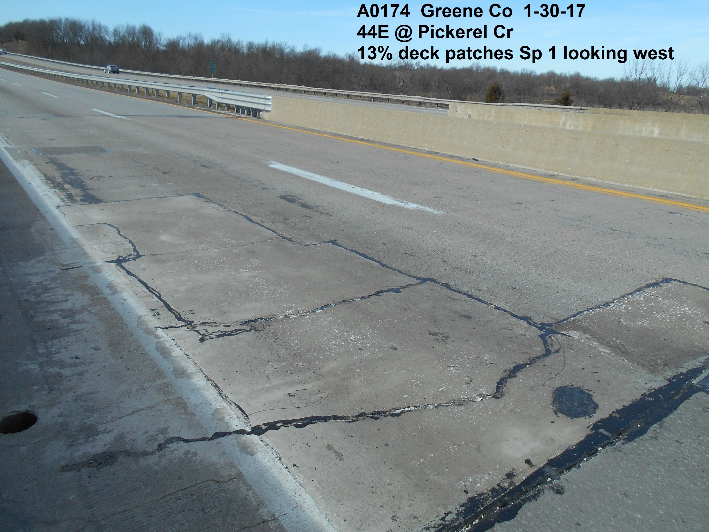

Slide 31
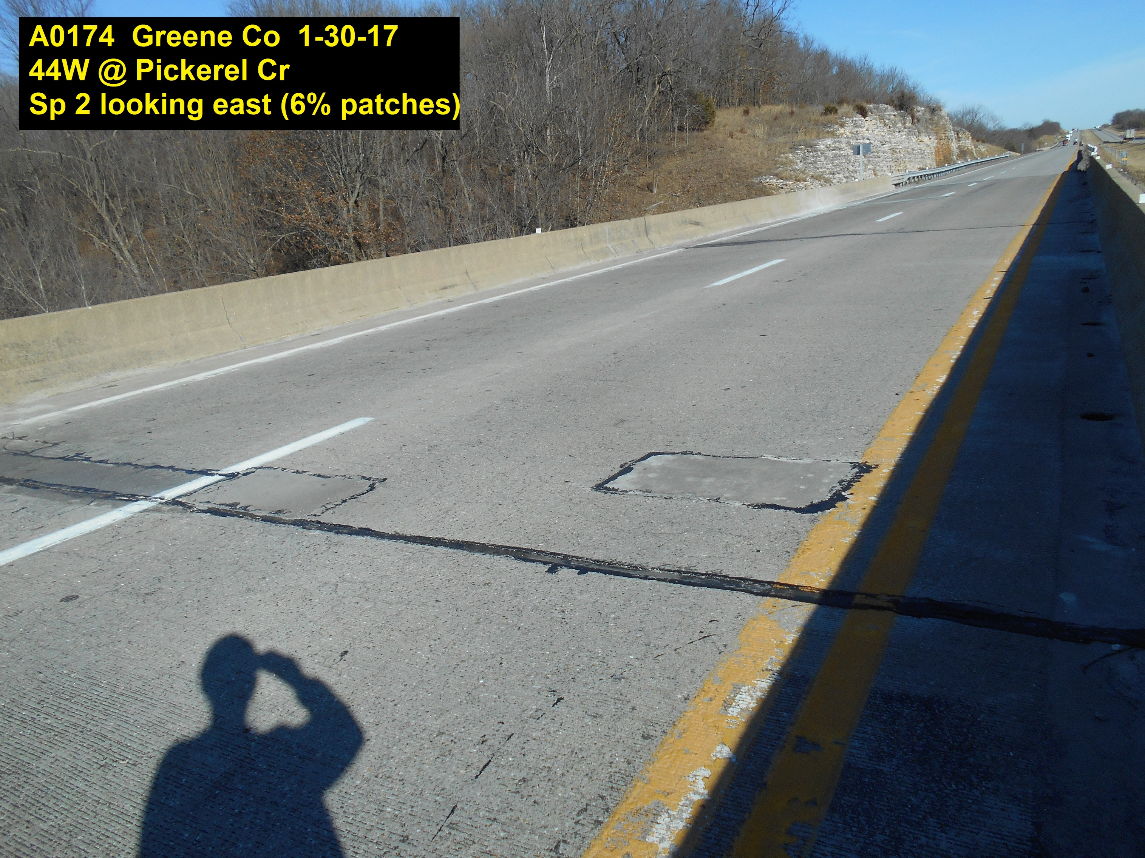

Slide 32
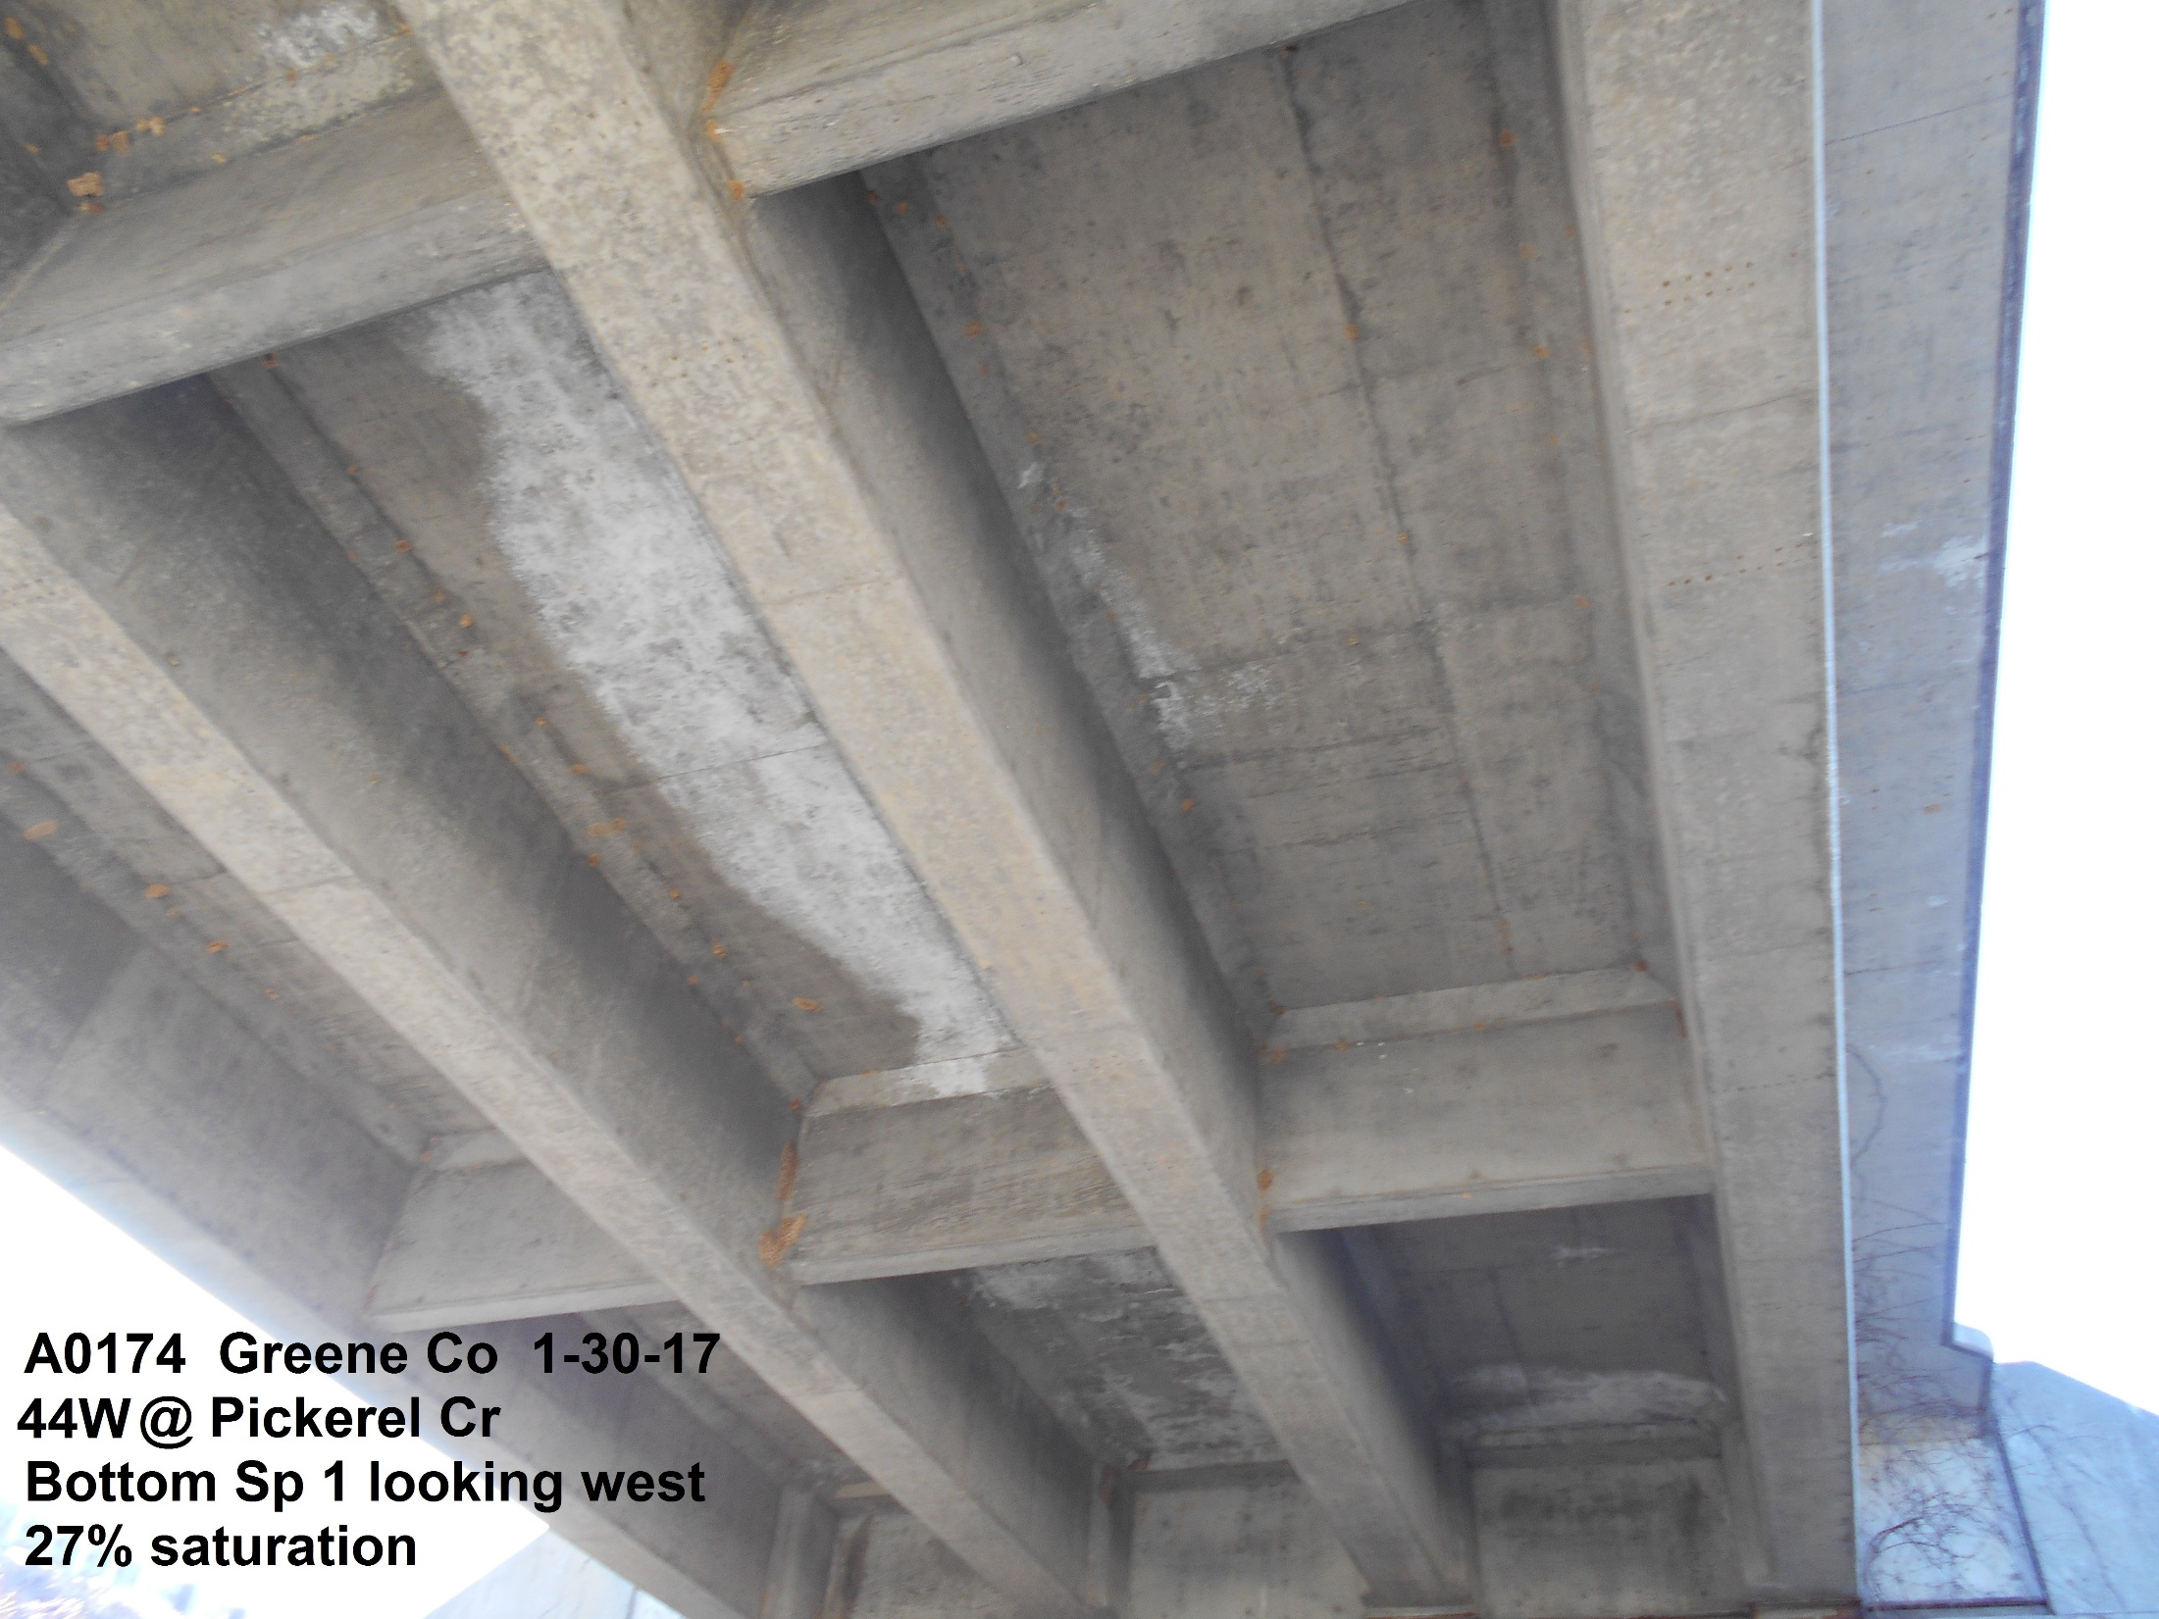

Slide 33
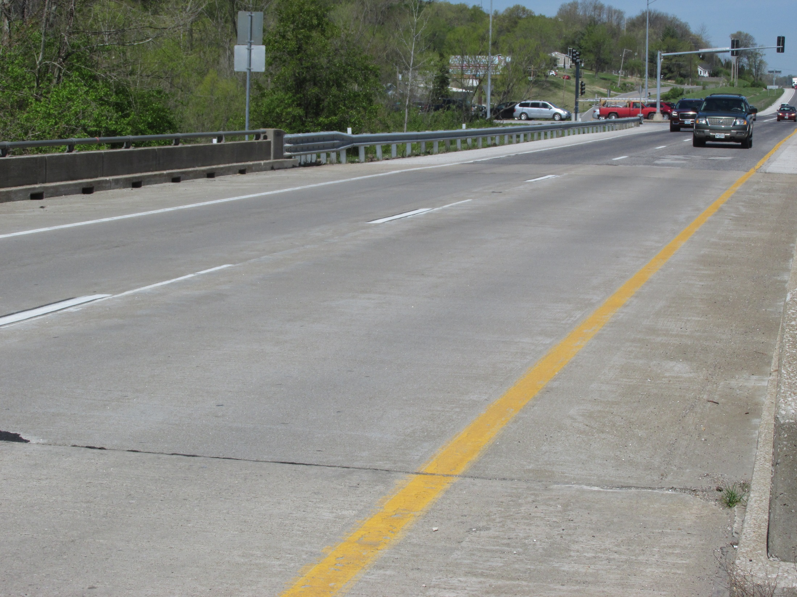
Jefferson County
MO 141
(2001)

Slide 34
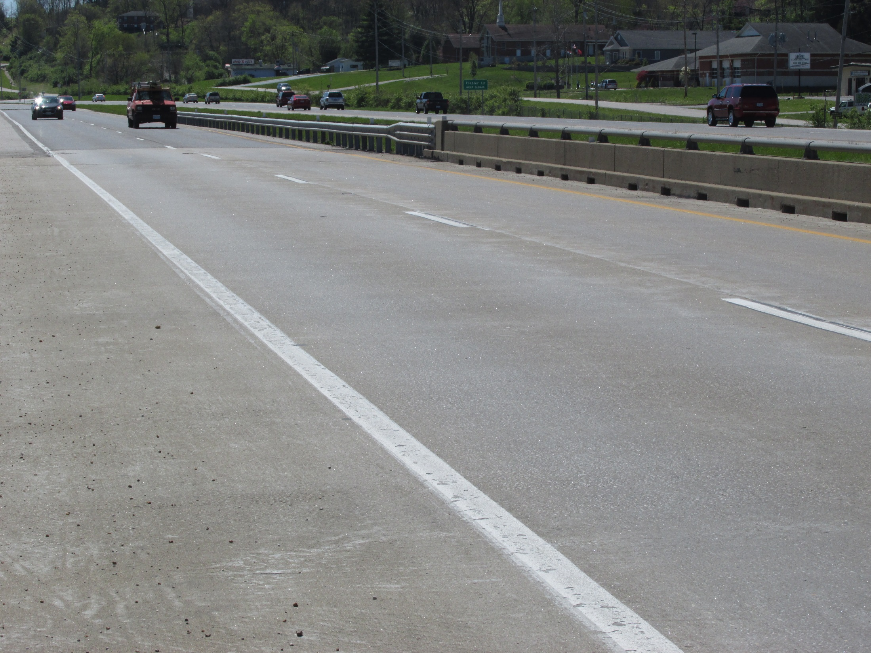
Jefferson County
MO 141
(2001)

Slide 35
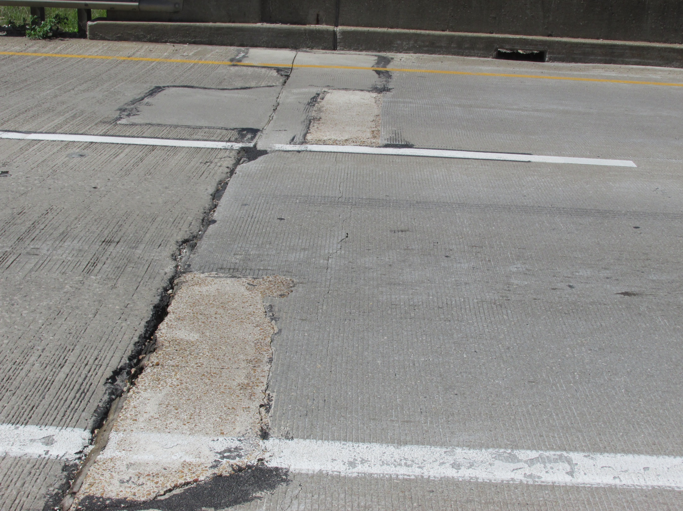
Jefferson County
MO 141
(2001)

Slide 36
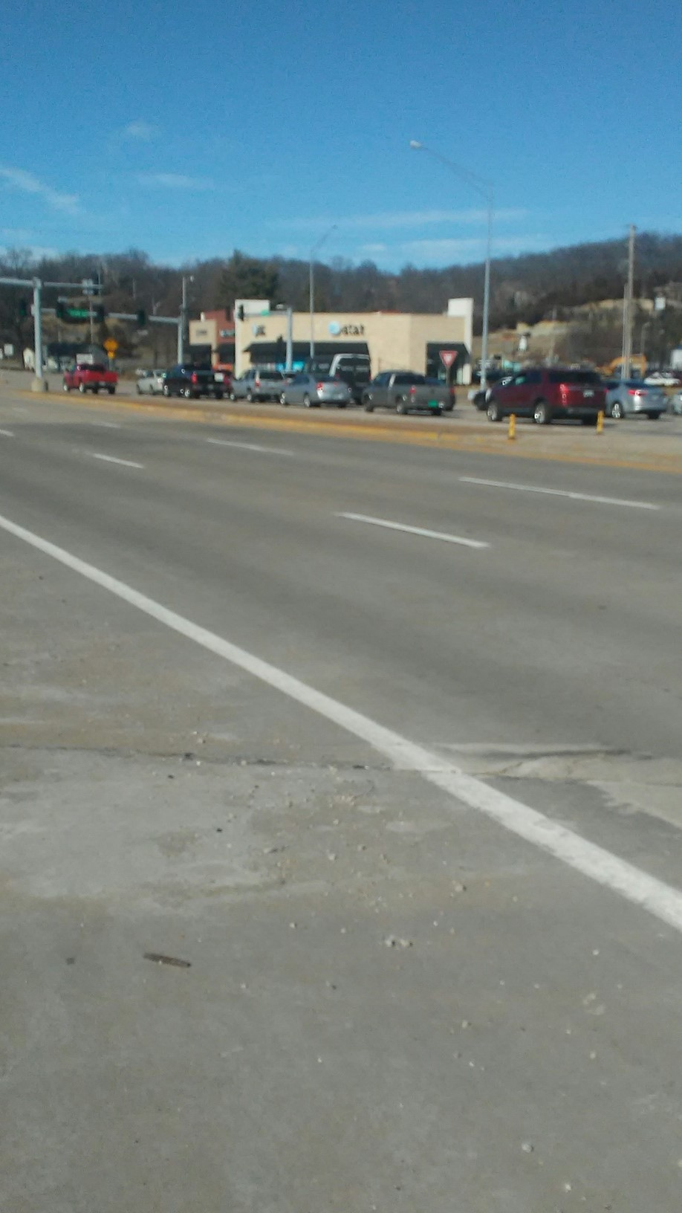
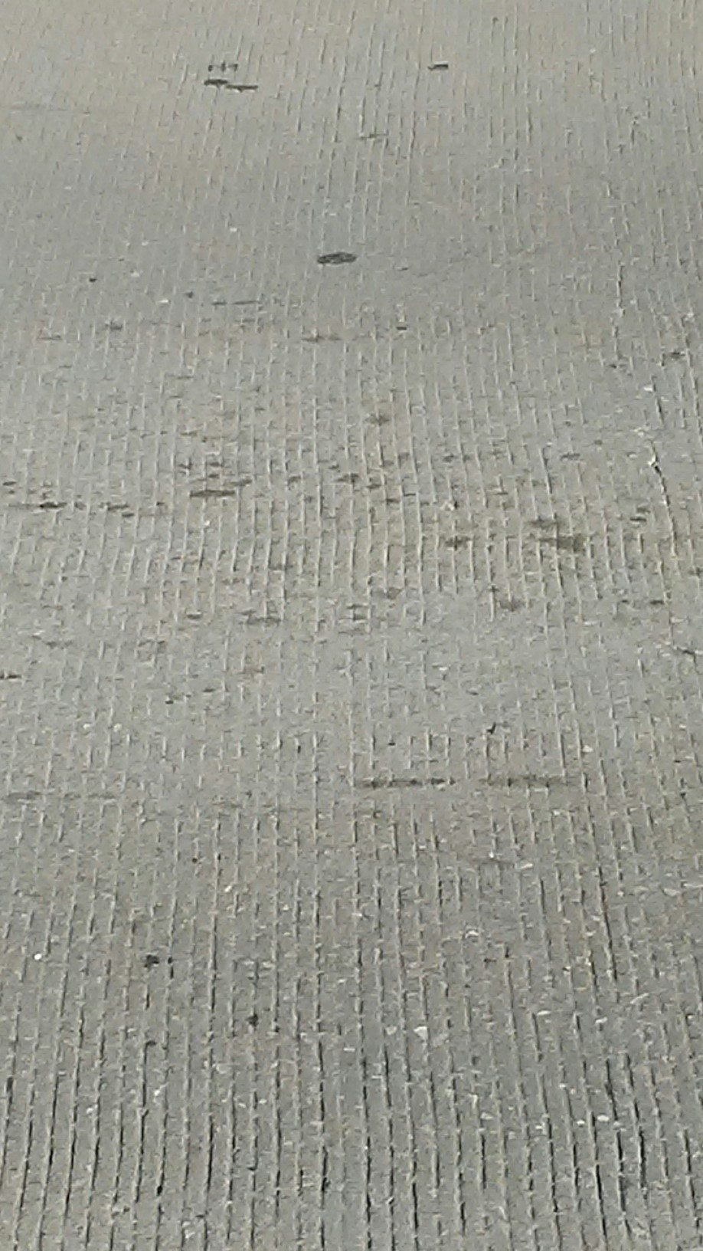
St. Louis County
MO 141
(2001)

Slide 37
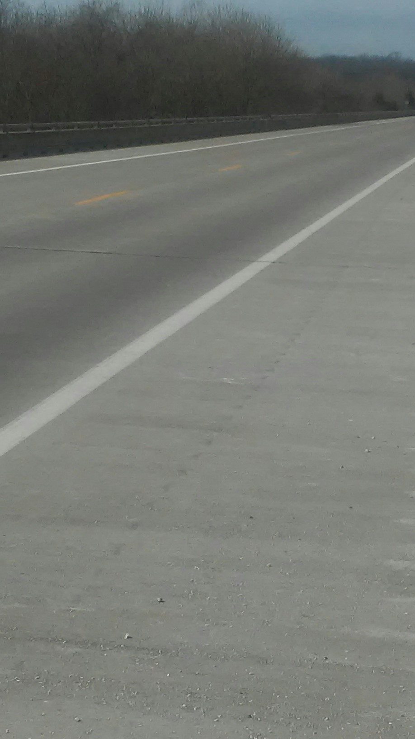
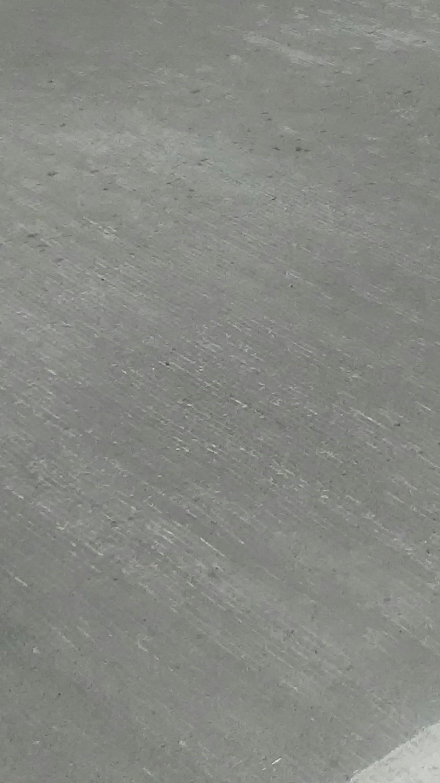
Jefferson County
Route A
(2007)

Slide 38
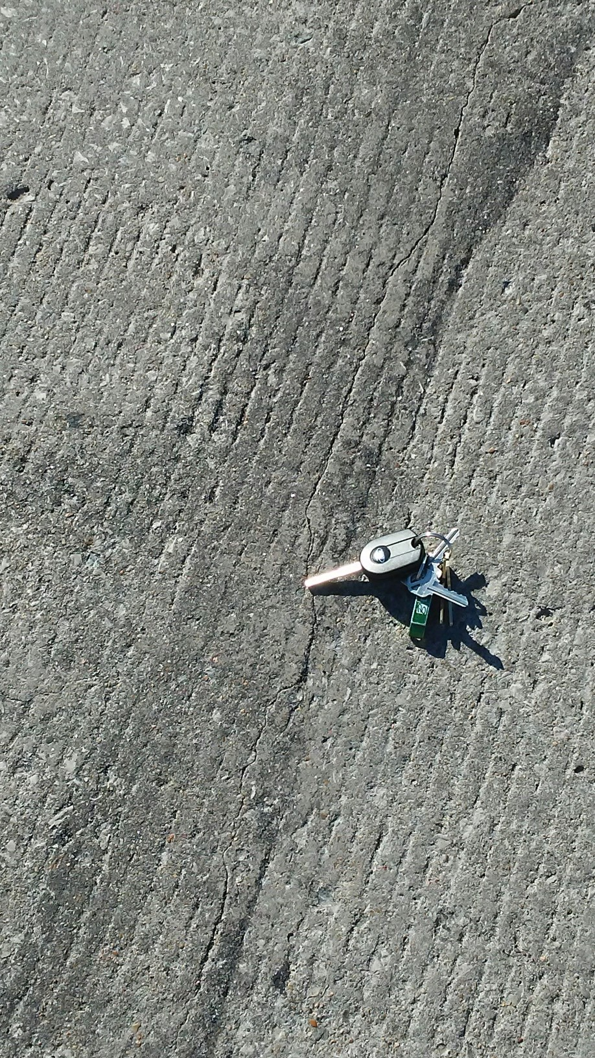

Slide 39
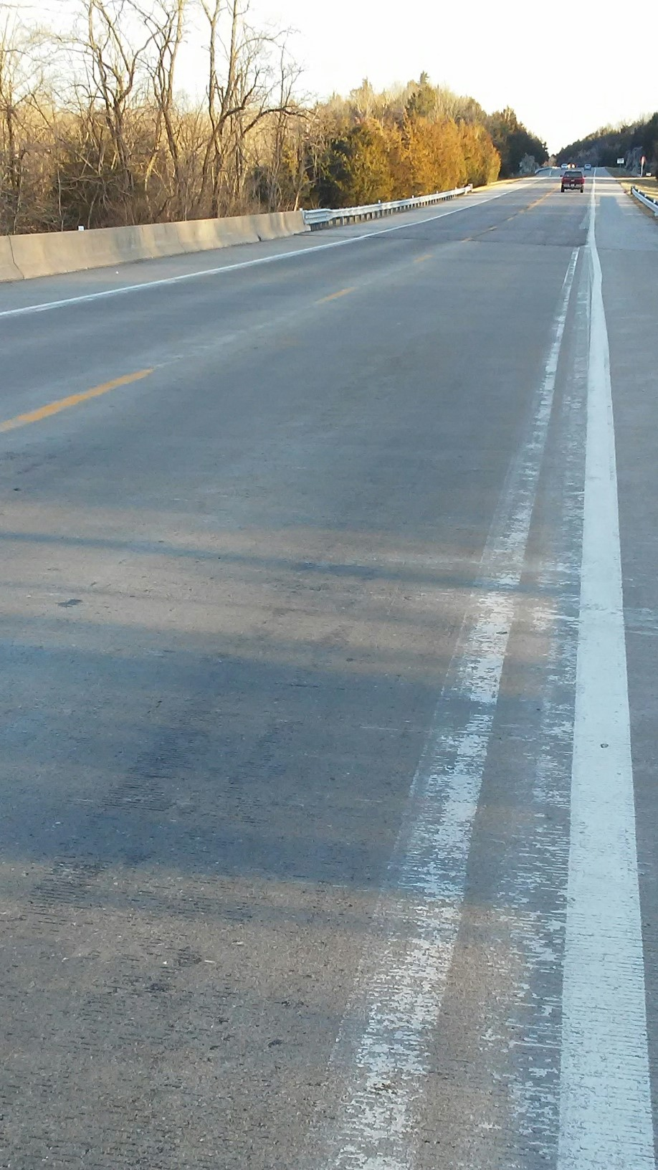
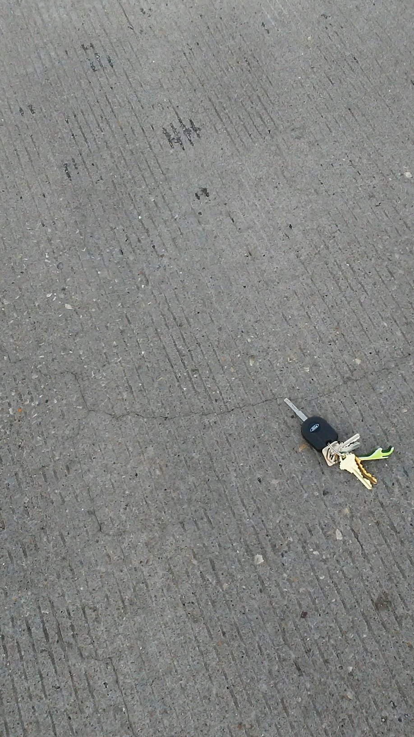
Jefferson County
Route A
(2007)

Slide 40
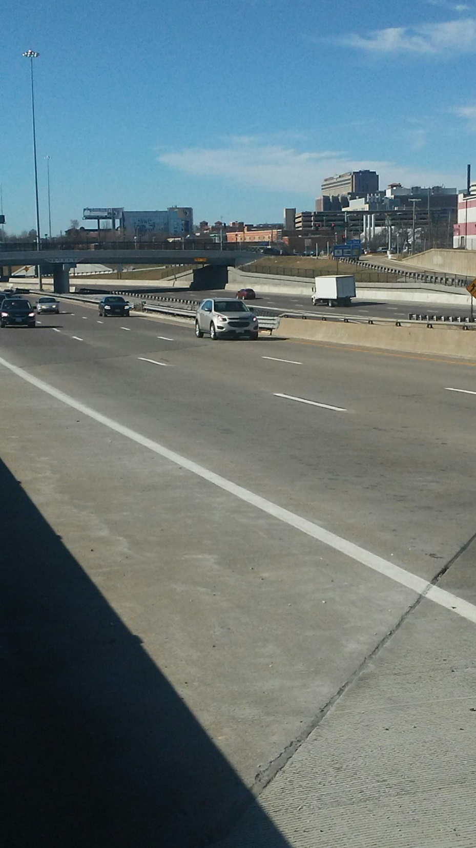
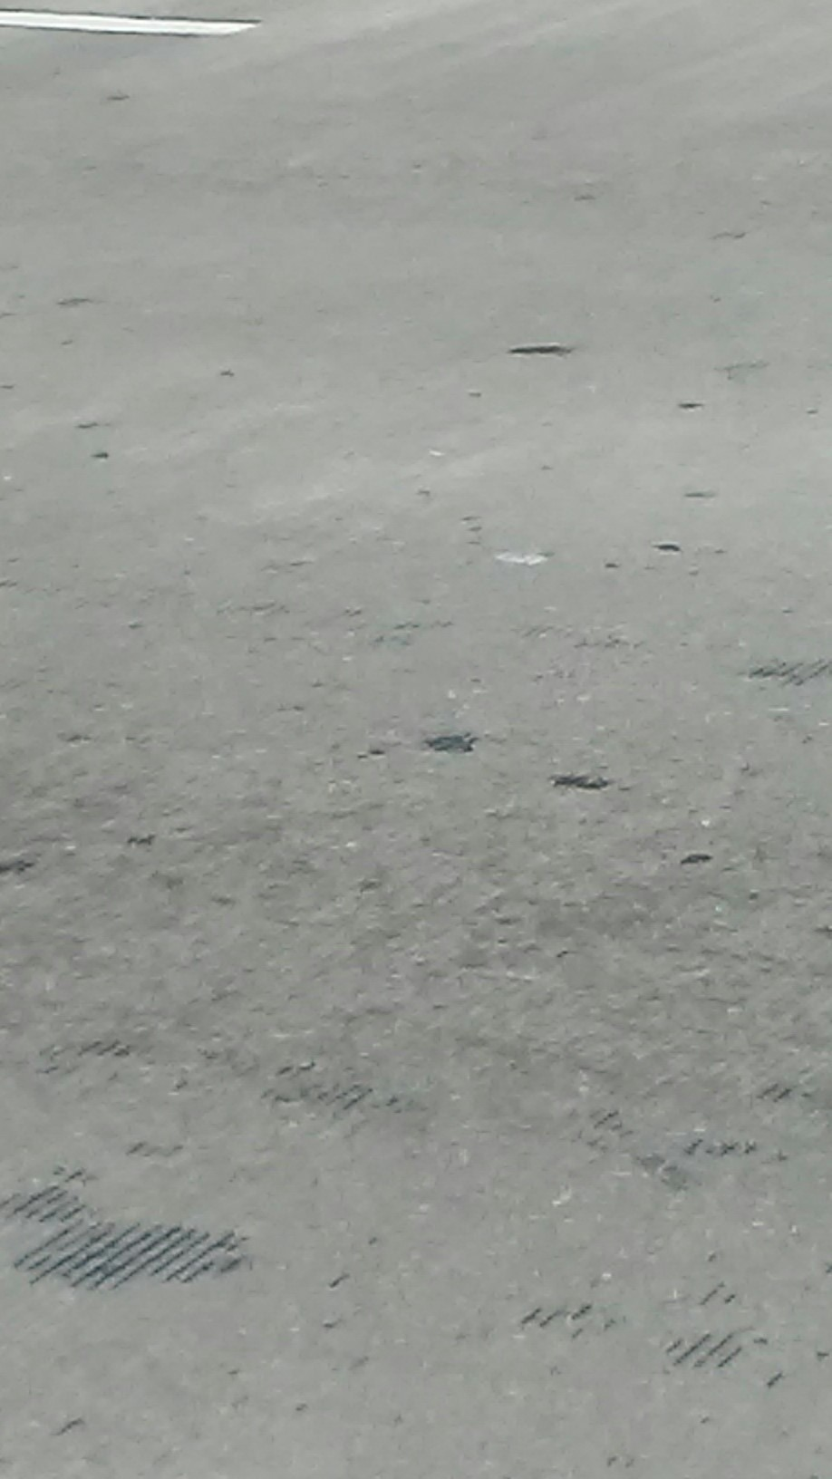
St. Louis City
I-64 EB
(2009)

Slide 41
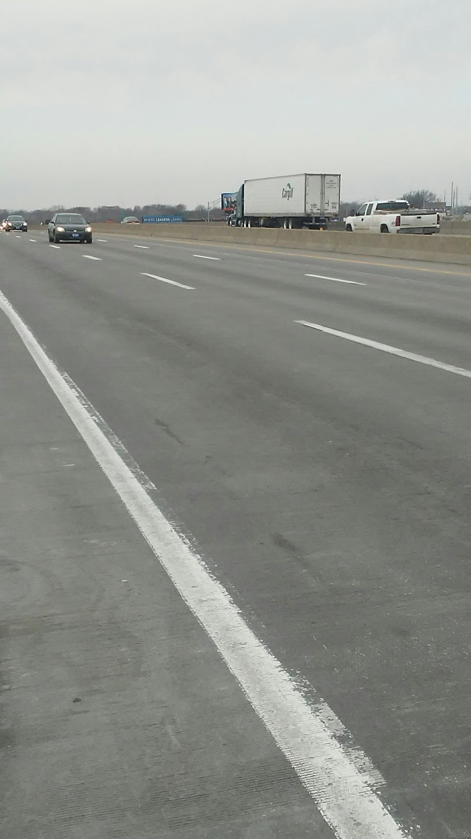
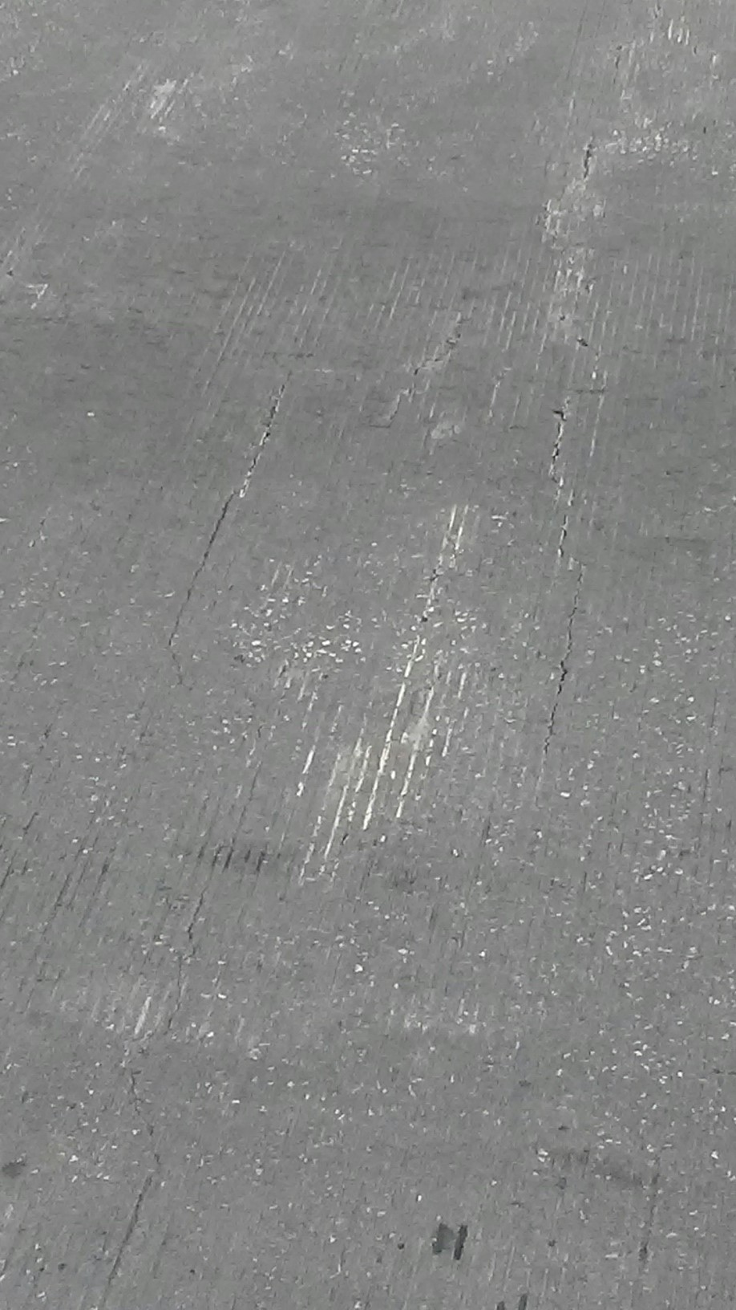
Jackson County,
I-70 / US 40

Slide 42
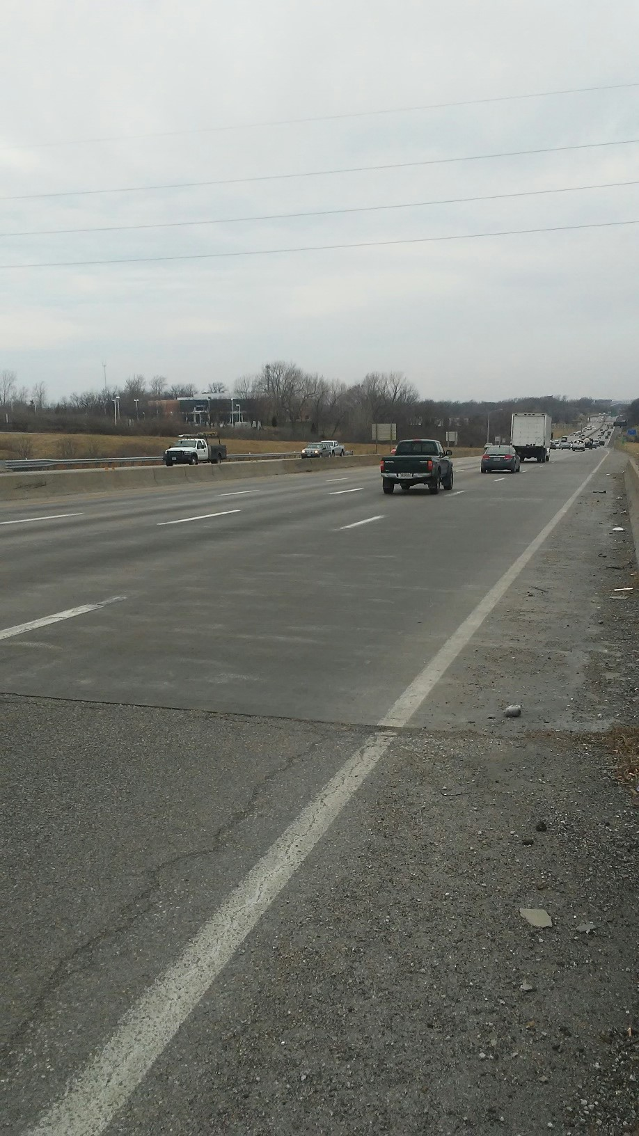
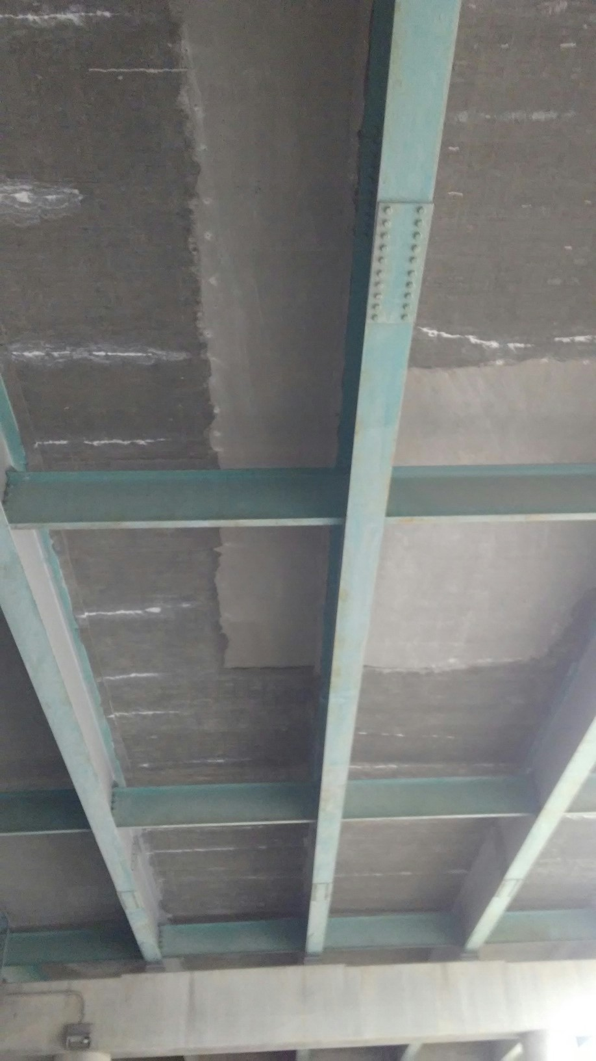
Jackson County,
I-70 @ Sterling

Slide 43
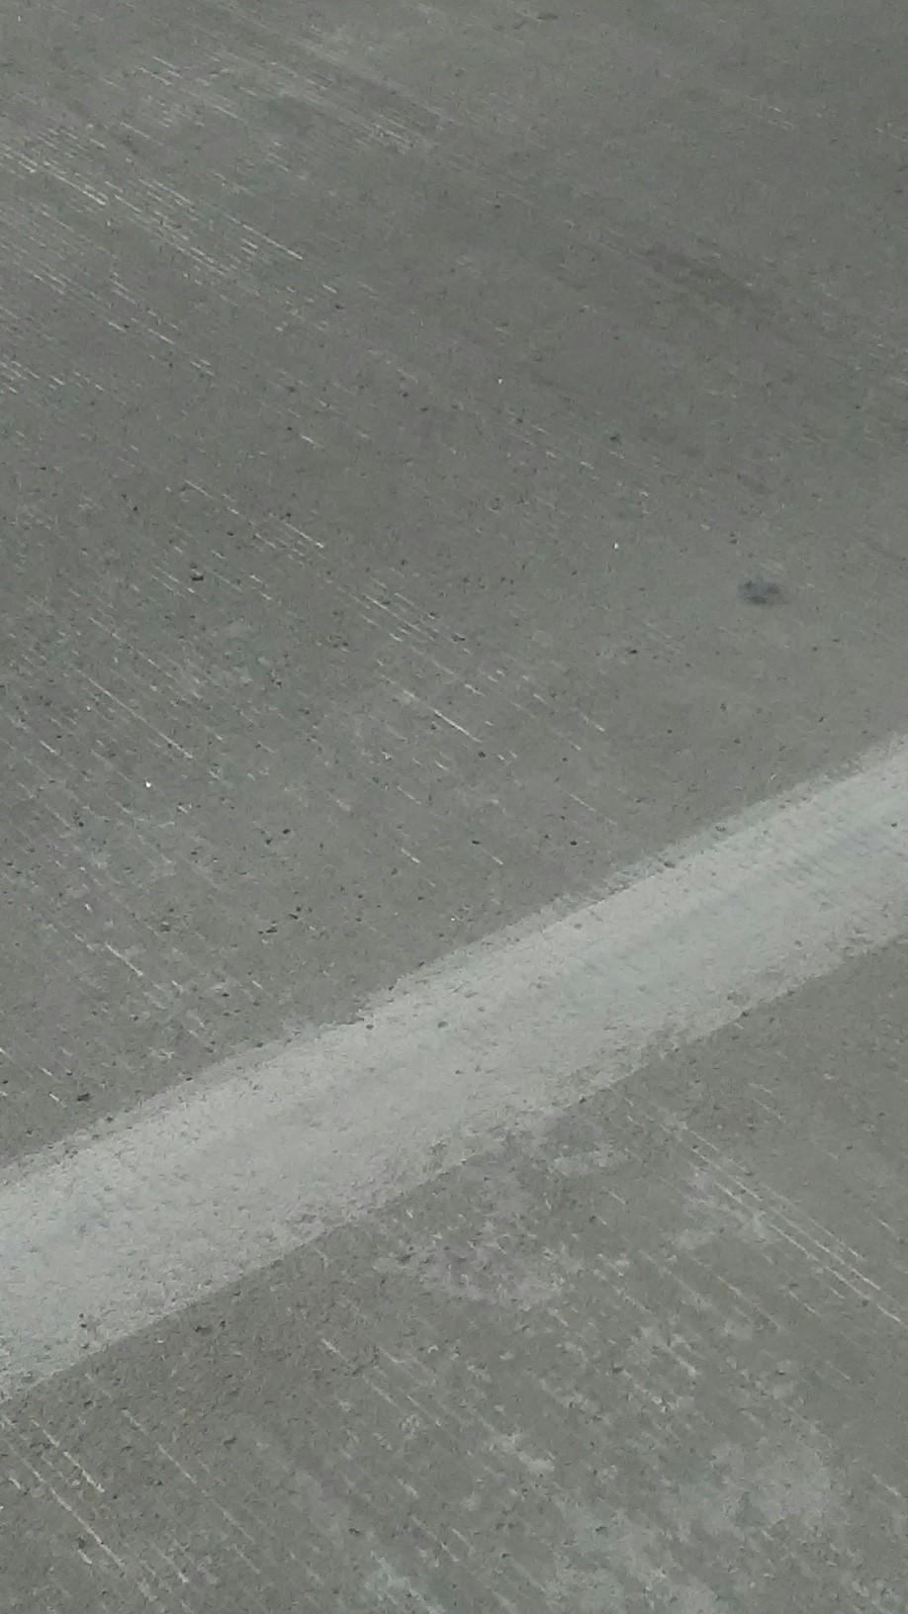
Morgan County
US 50
(2013)

Slide 44
Major Projects (with LMC/VESLMC)
Major Jobs include:
  Poplar Street Bridge Approach (E & W) – 51,000 SY + (2005,2006, 2011)
  3rd Street Viaduct (5) Downtown St. Louis – 56,000 SY + (U.C 2016-2017)
  Truman Lake Bridges (4) in Benton County – 40,000 SY + (2009)
  MO 185 / Bourbeuse River, Franklin County – 9700 SY + (2004) Still in service with only minor cracking noted.

Slide 45
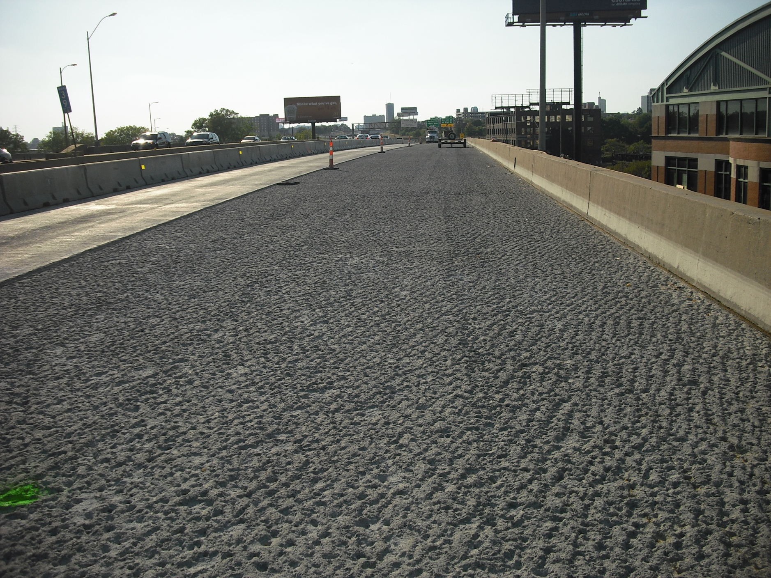
I-64 WB
St. Louis City
Poplar Street Approach
(2011)
Notes:
You can hydro decks for a preventive overlay, where the deck has little to no deterioration. It’s an excellent preservation treatment and even faster.

Slide 46
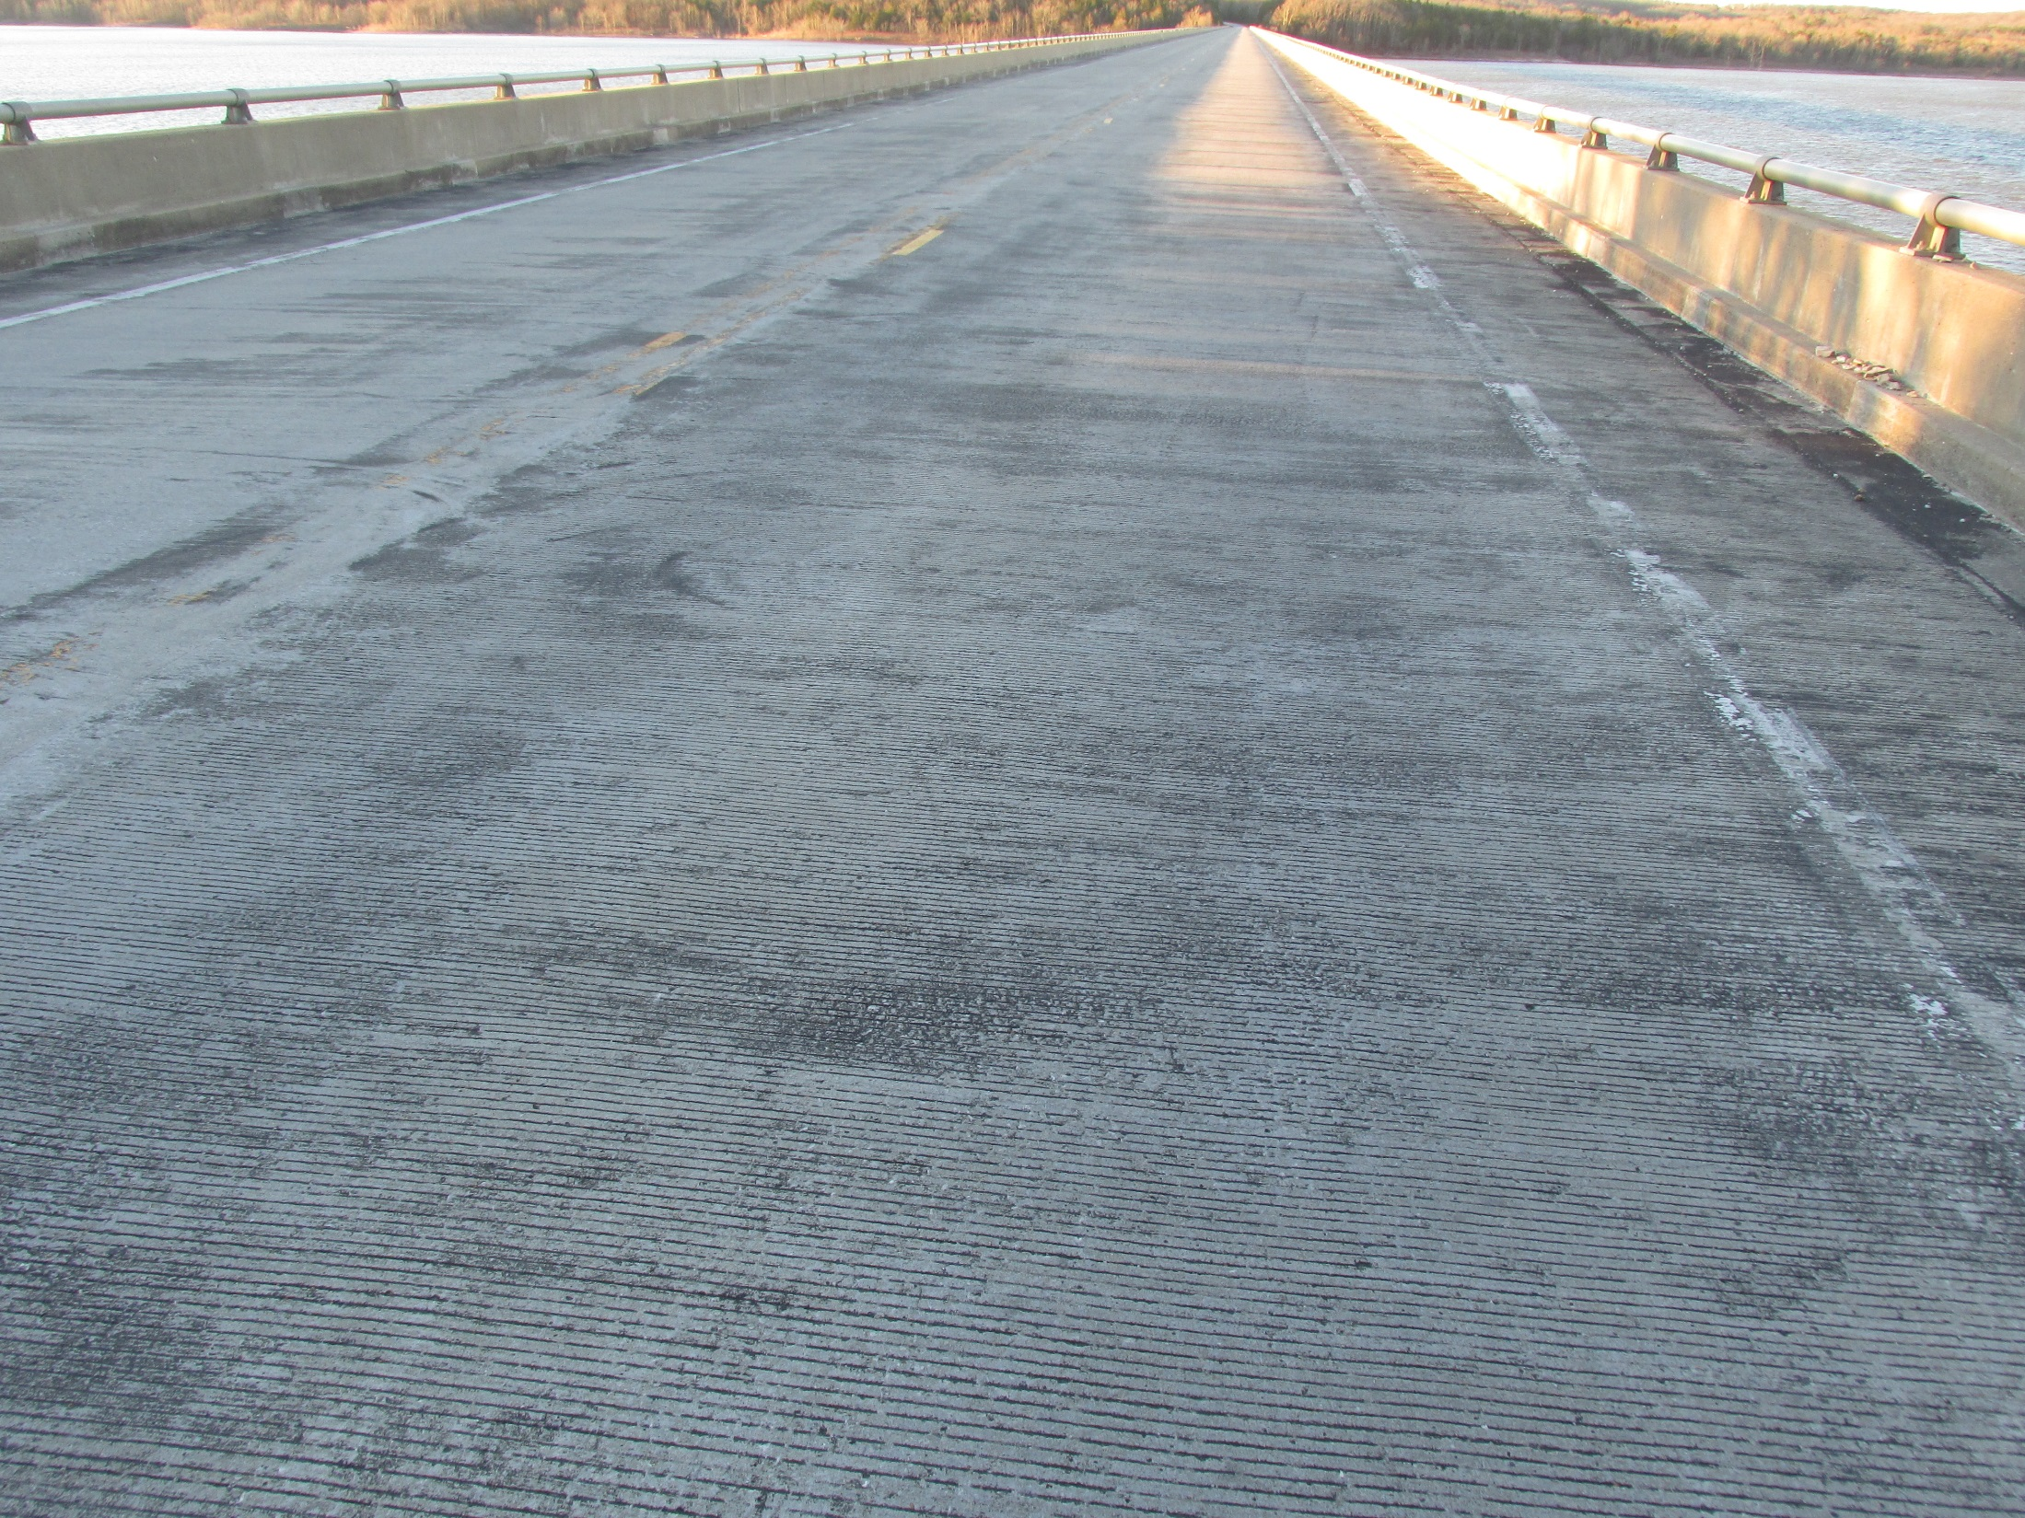
A3689 Benton Rte MO 83 (Truman Lake)
(2009)

Slide 47
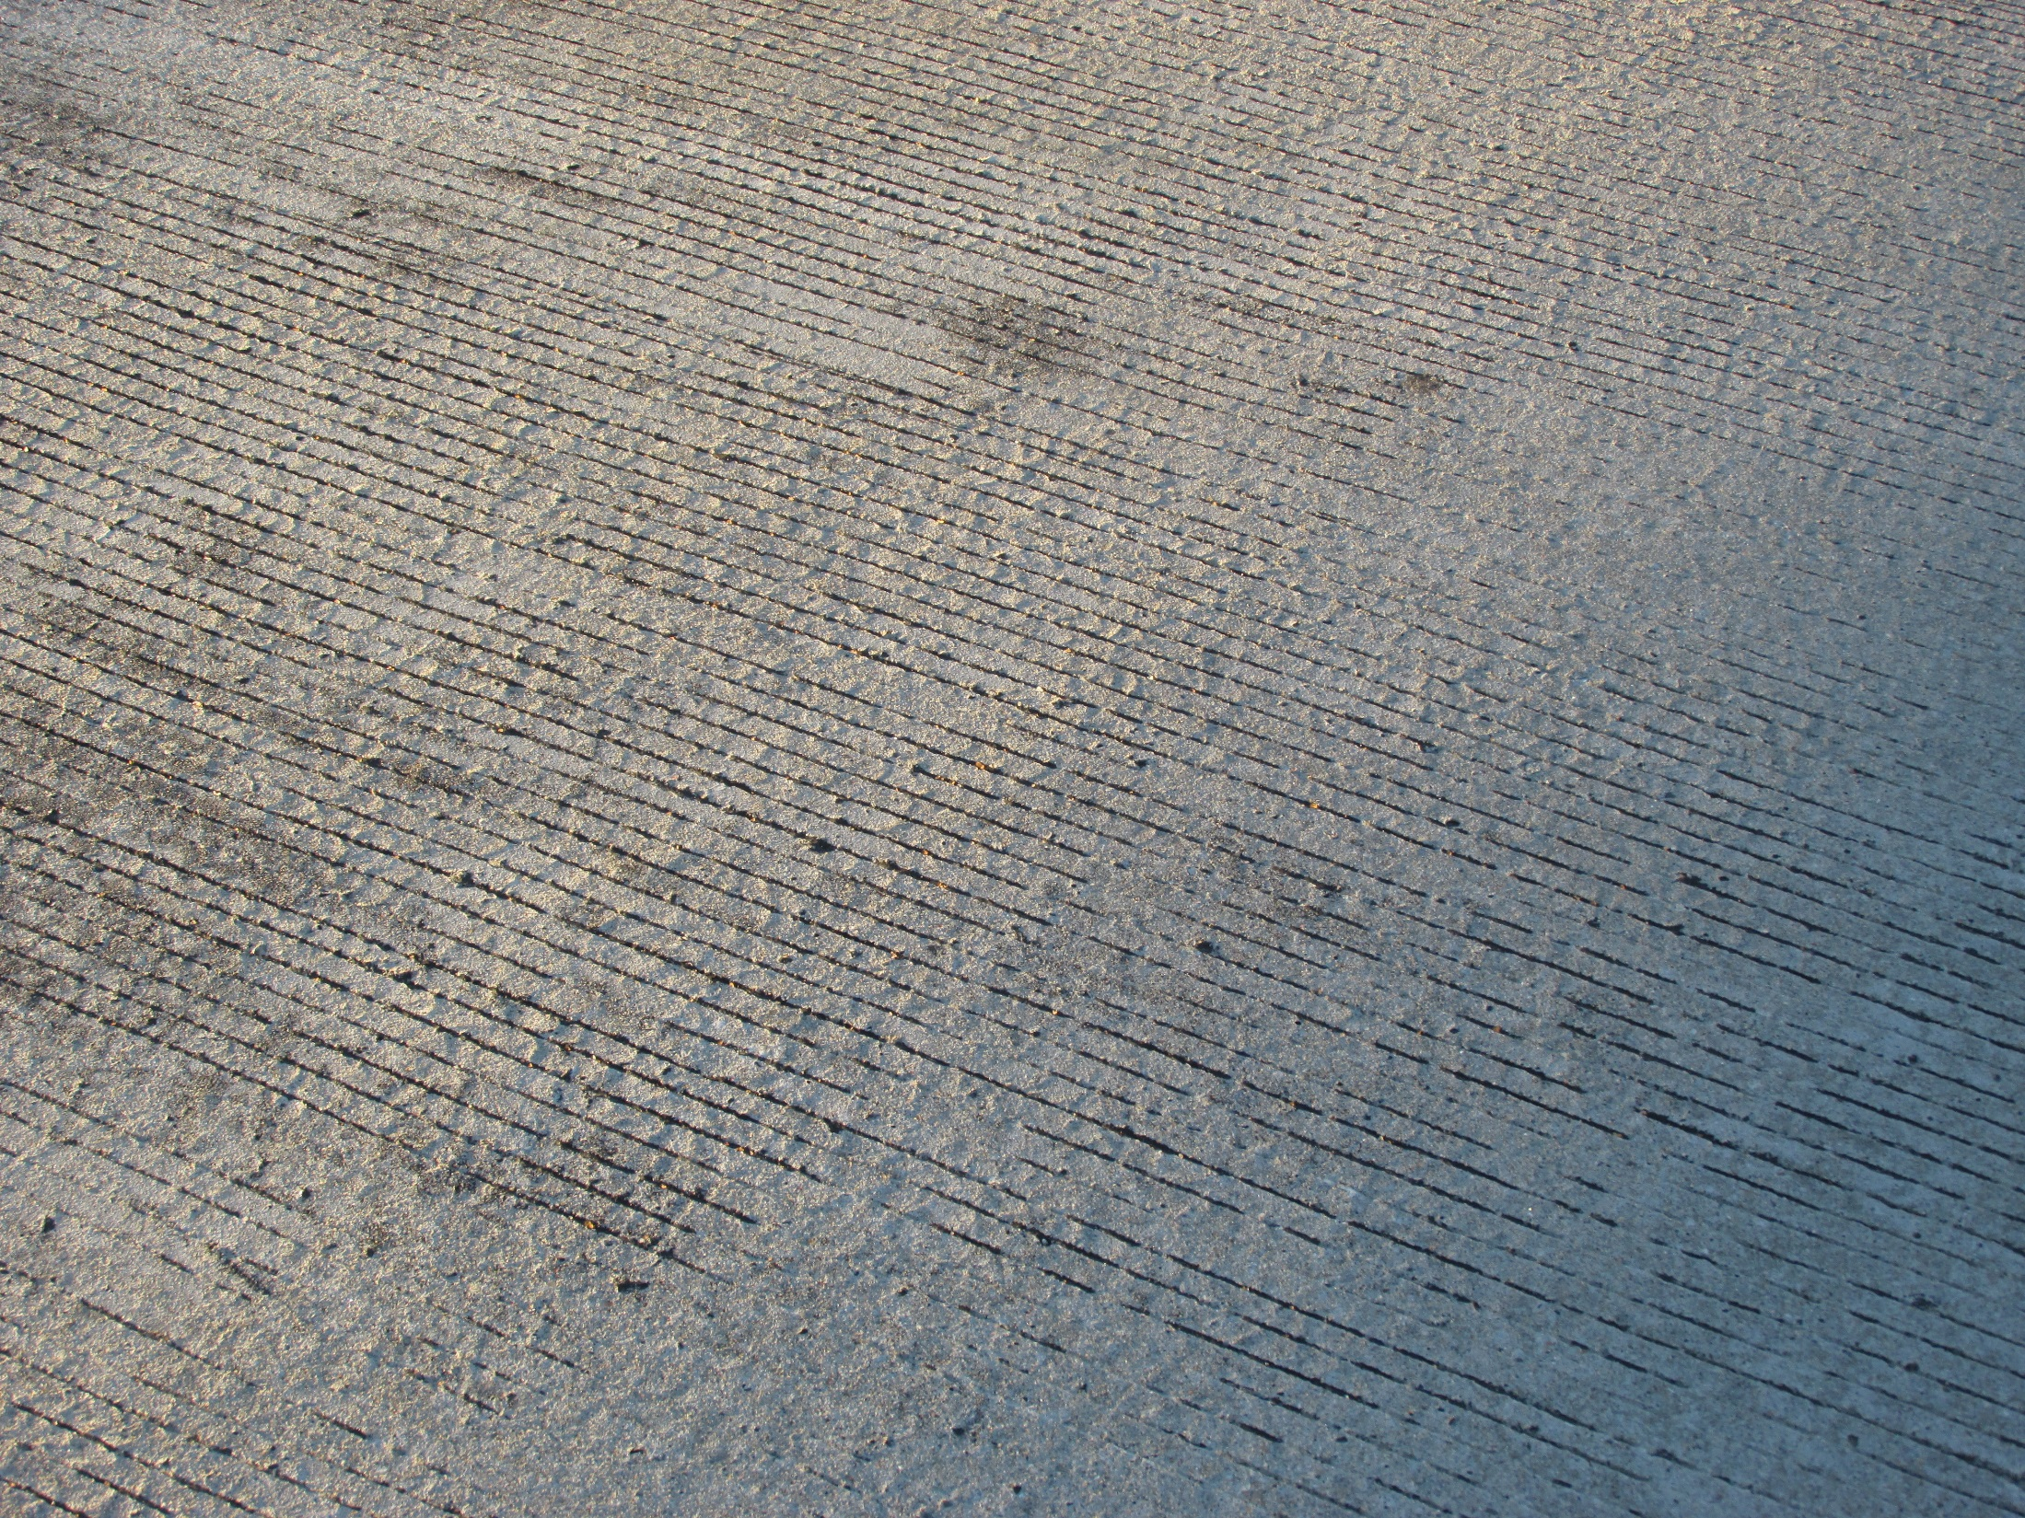

Slide 48
Very Early Strength Latex Modified Concrete
Poplar Street Approach Complex (St. Louis City)
I-270 over Ladue Road (St. Louis County)
I-70 EB over 5th Street (St. Charles County)
I-55 NB (partial) over BNSF RR (Jefferson County)
I-44/55 Interchange (St. Louis City)
Approximately 40,000 SY of VESLMC
20 bridges +/-

Slide 49
A1501 EB (East end)
High Production Hydro Equipment
VESLMC
Installed 2005
NBI 4 Rated Deck

Slide 50
A1501 WB (East end)
Ultra High Pressure Blasting
Low P Concrete
2006
NBI 5 Rated Deck
Few Spalls/Deck Patches Observed in 2017

Slide 51
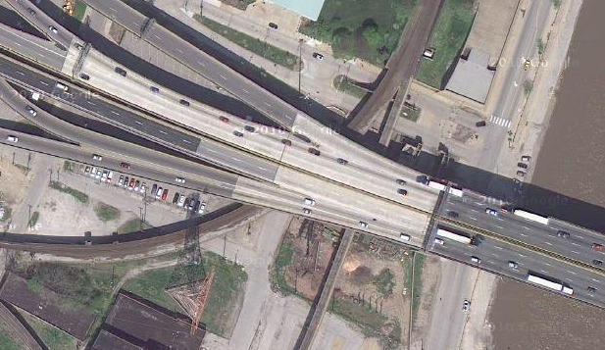
Poplar Street Approach Complex

Slide 52
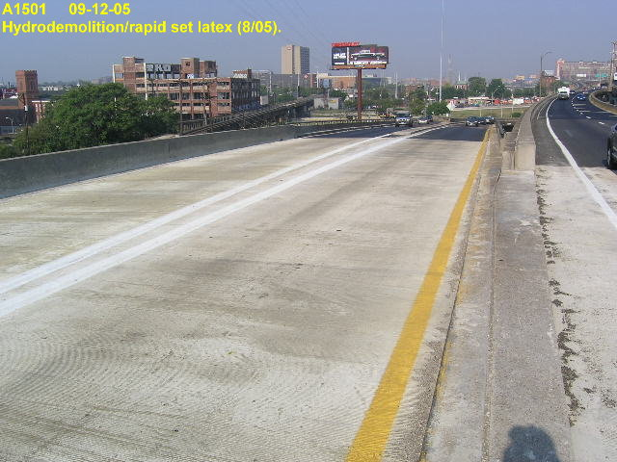
Poplar Street Approach (EB Ramp Entrance)

Slide 53
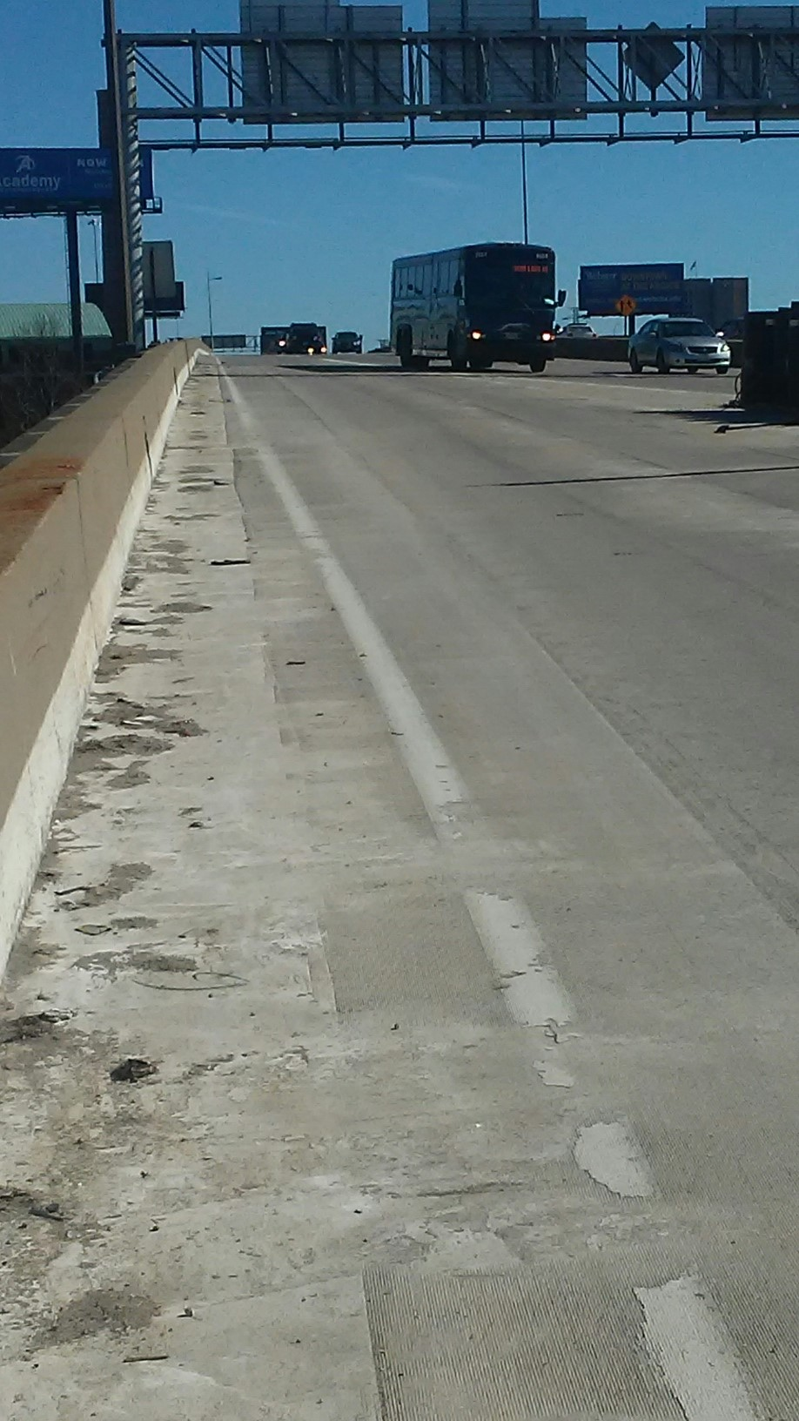
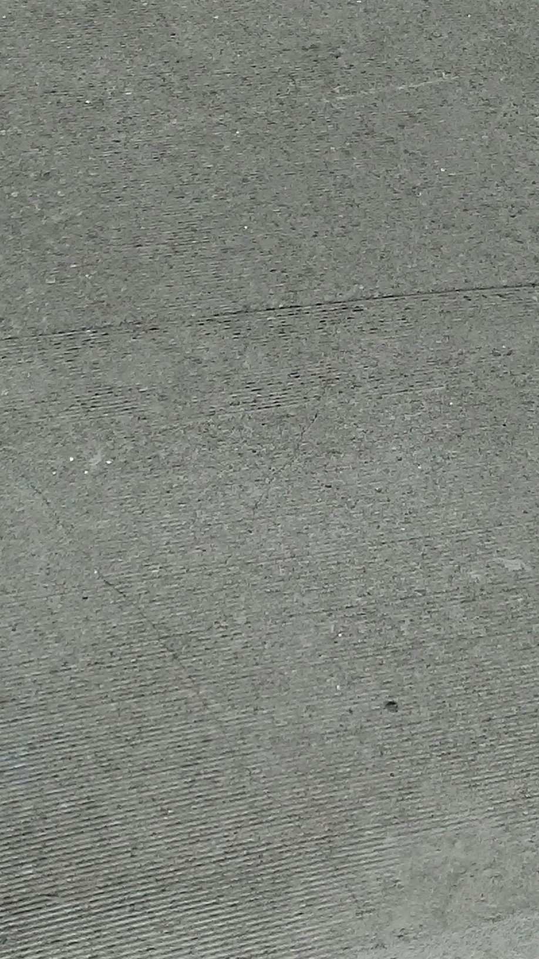
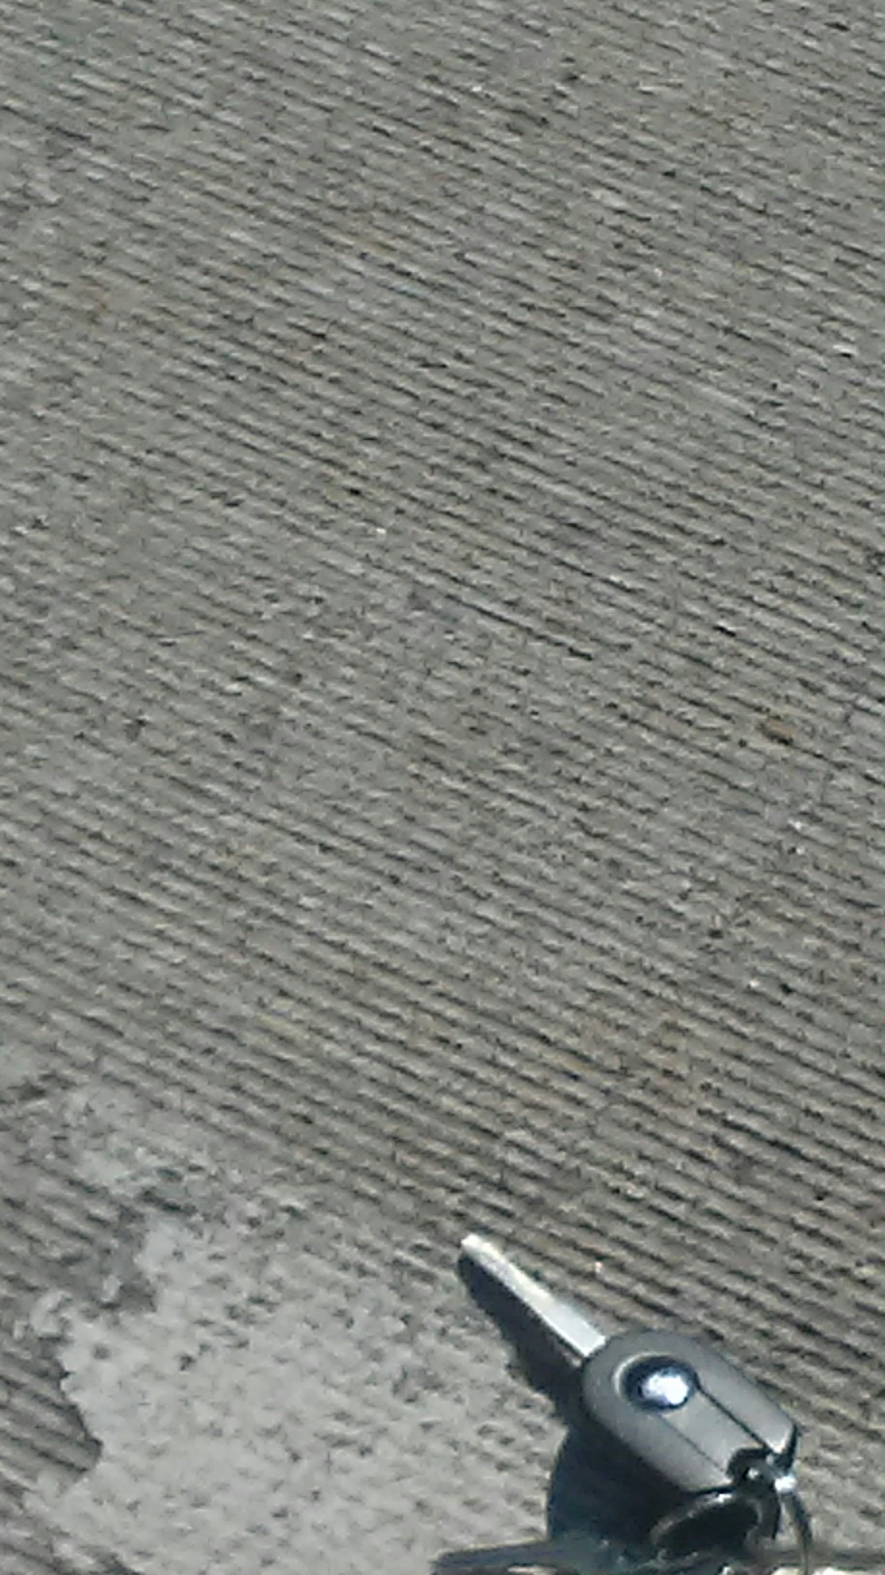
I-64 WB
St. Louis City
Poplar Street Approach (west end)
(2011)

Slide 54
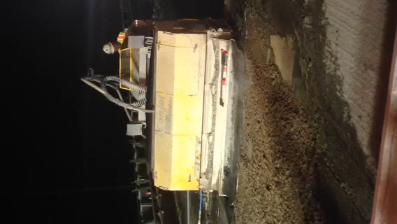

Slide 55
Missouri Hydrodemolition Specifications
15 years of work and industry feedback to get here
Tried both high pressure and ultra high pressure hydro
We like the speed and cost effective advantage of high pressure high water usage (Selective Removal)
Mainly used in conjunction with latex modified concrete

Slide 56
Missouri Hydrodemolition Specifications
Most jobs are set up with monolithic deck repair
Repairs are poured with overlay (Exceptions are large full depth repairs)
More cost effective than traditional half-sole repairs due to only added overlay material cost
Faster due to elimination of patch cure time
We work to limit post hydro chipping
Works best on structures with multi girder systems

Slide 57
Start with a half inch minimum scarification
Helps to eliminate some shallow deterioration in a cheap manner
Decks with an obvious surface issues can be milled deeper depending on steel depth
Gives a bruised and rough surface to help hydro bite
Ensures all of the existing overlay is removed
Helps to identify patches that are unsound

Slide 58
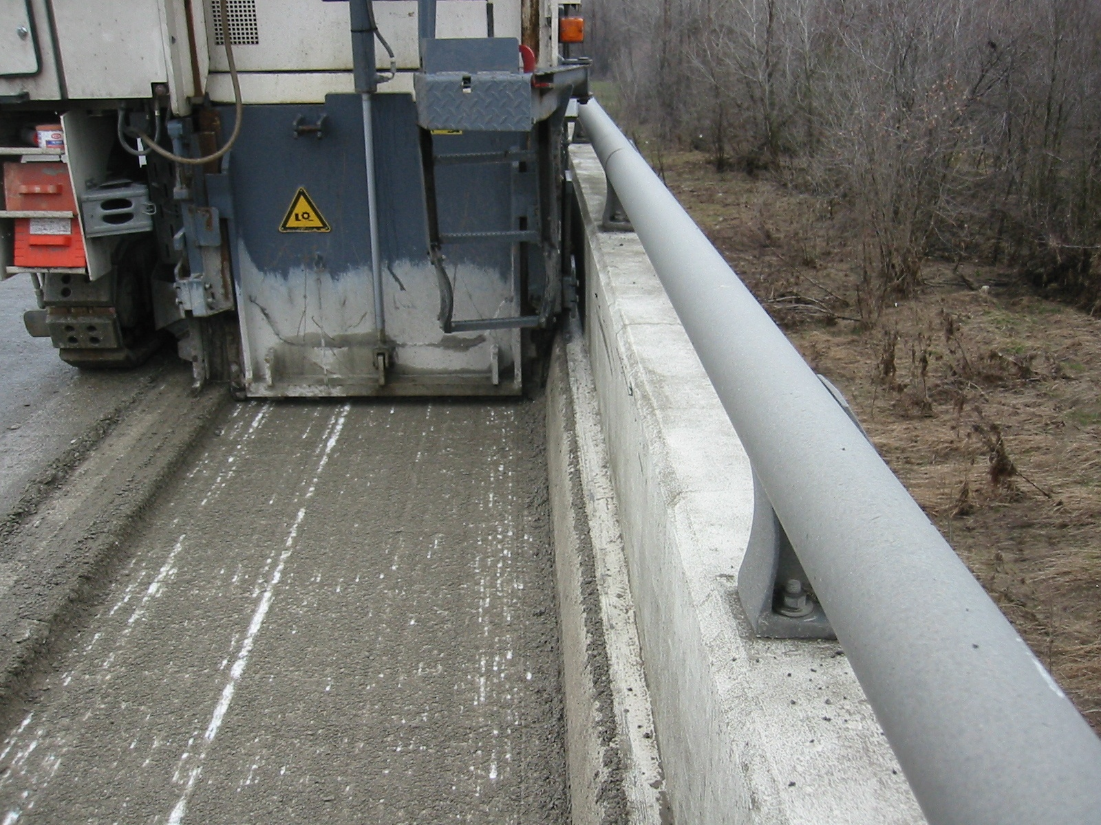
Notes:
Nice to have equipment that can get close to rails, joints, etc. to limit the handwork that might need to be done.

Slide 59

Mechanical Milled Surface Profile
Notes:
This is your typical milled surface. It cuts through everything, aggregates included, so it is cutting across the tips of the coarse aggregate. Later on I’ll show you the difference in a hydro’d surface and why it is so important.

Slide 60
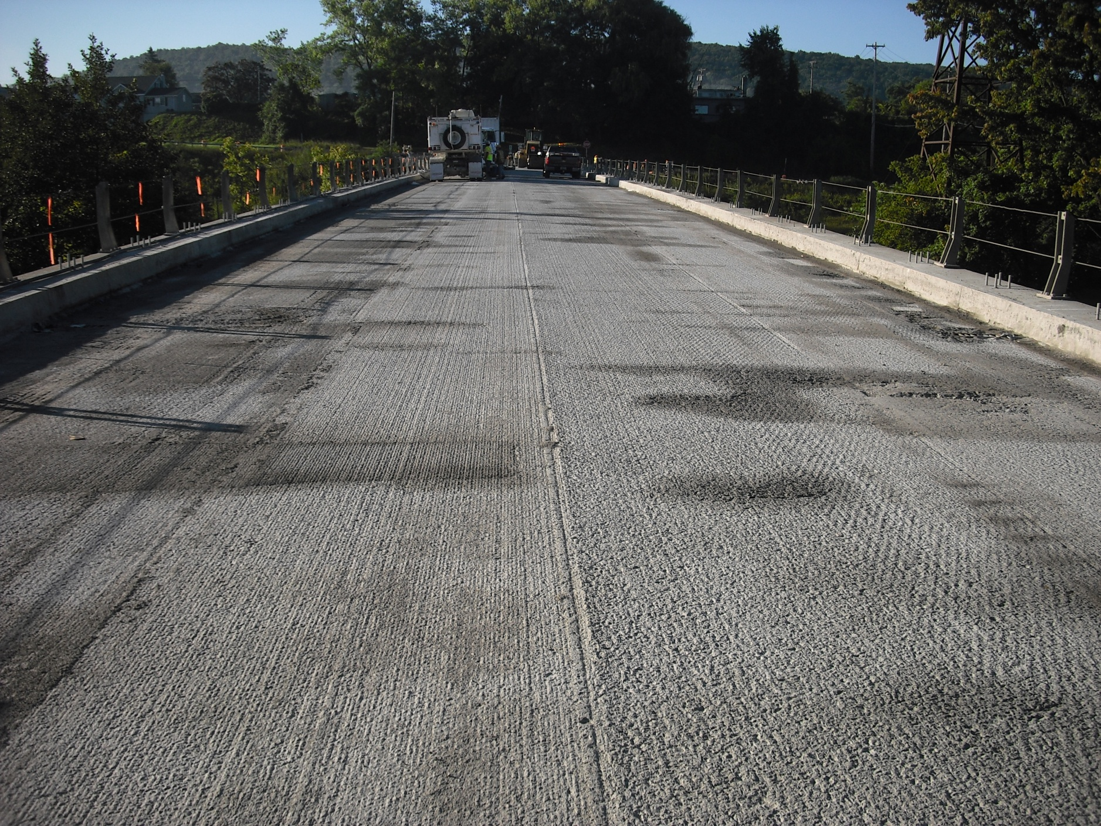
Notes:
Bottom line - this is what you want, a uniformly milled surface.

Slide 61
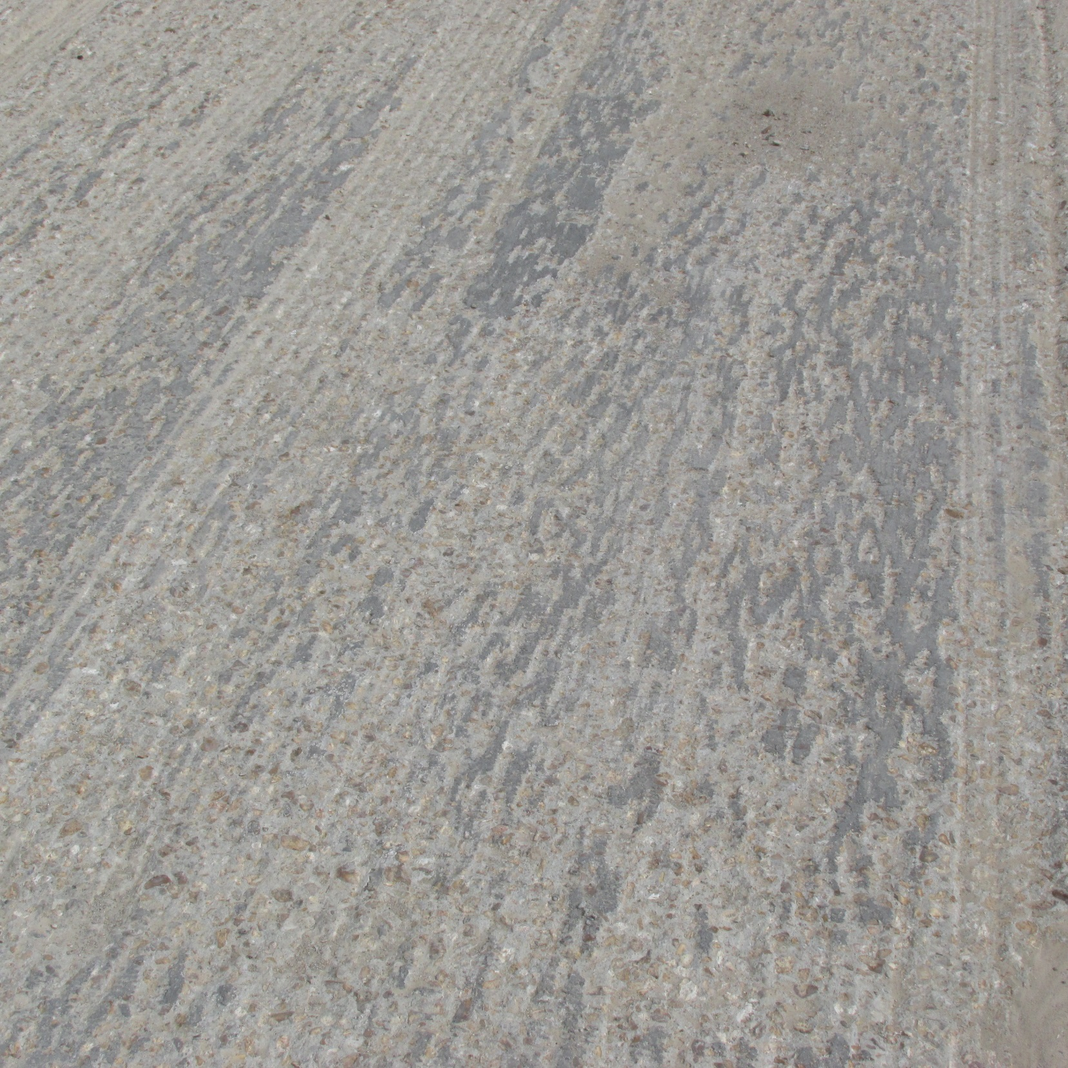
Not acceptable milling
Notes:
Now, I want to show you this. This is real important to understand. If you do not get milled down into the deck – notice these areas – you can see remnants of the surface still in the top of the surface. The milling was not deep enough. This will have a significant impact on the quality of the hydro cut.

Slide 62
Sound the deck
Identify and break up unsound exiting patches
Patch material is harder than existing deck
Can create high spots and shield deeper areas from hydro
Helps limit post hydro deck work with hammers
Paid for per square foot
Identify sound and unsound area for calibration

Slide 63
Calibrate Hydro Equipment
Find speed at which a half inch of sound concrete is removed
Most hydro equipment runs at a constant pressure
Variables are machine step speed, nozzle size and type and water flow rate
Check unsound area to see that all unsound concrete is removed
Record a key settings
We require a minimum of 20 gallons per minute water usage but often times need more than that to get selective removal

Slide 64
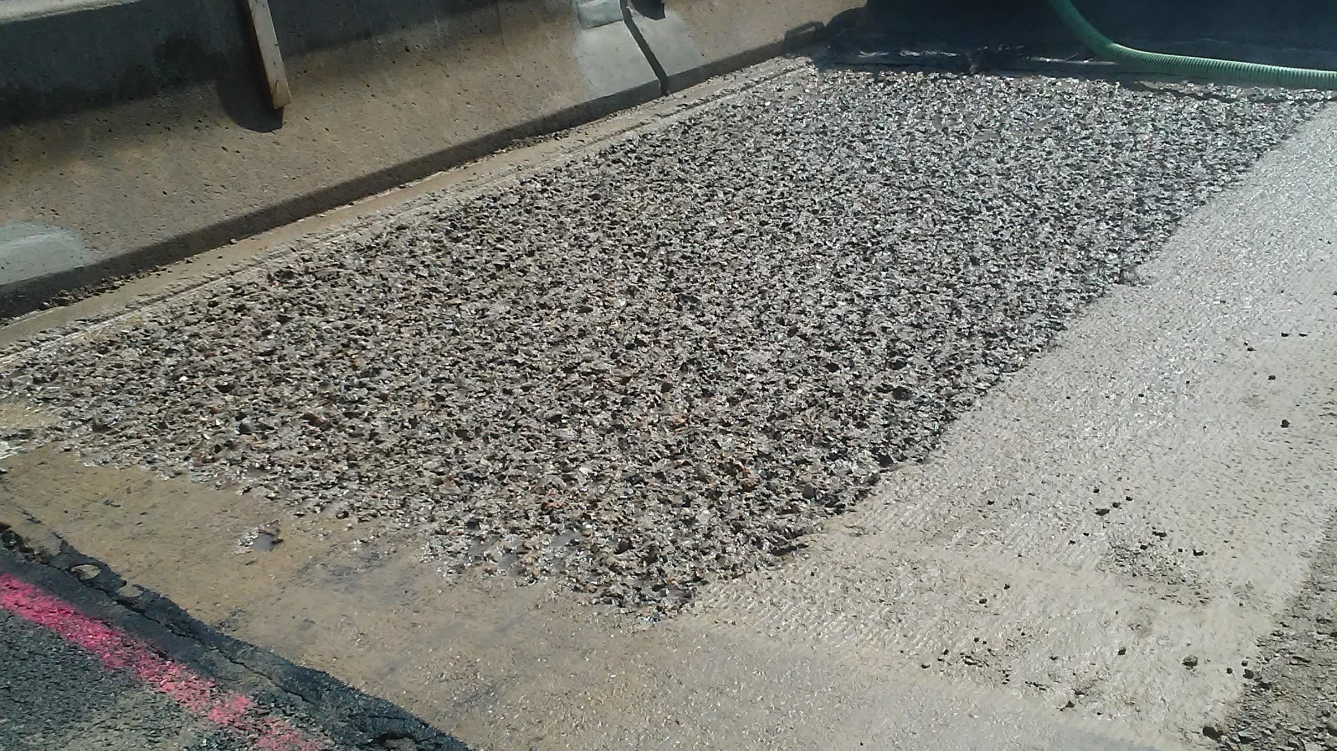
Calibration
Notes:
Let’s get back to the actual hydro. Once we get water control set up, now we are ready to cut. First though we have to calibrate the robot for the selective cut. Usually the specs will require an initial calibration to a depth of ½”.

Slide 65
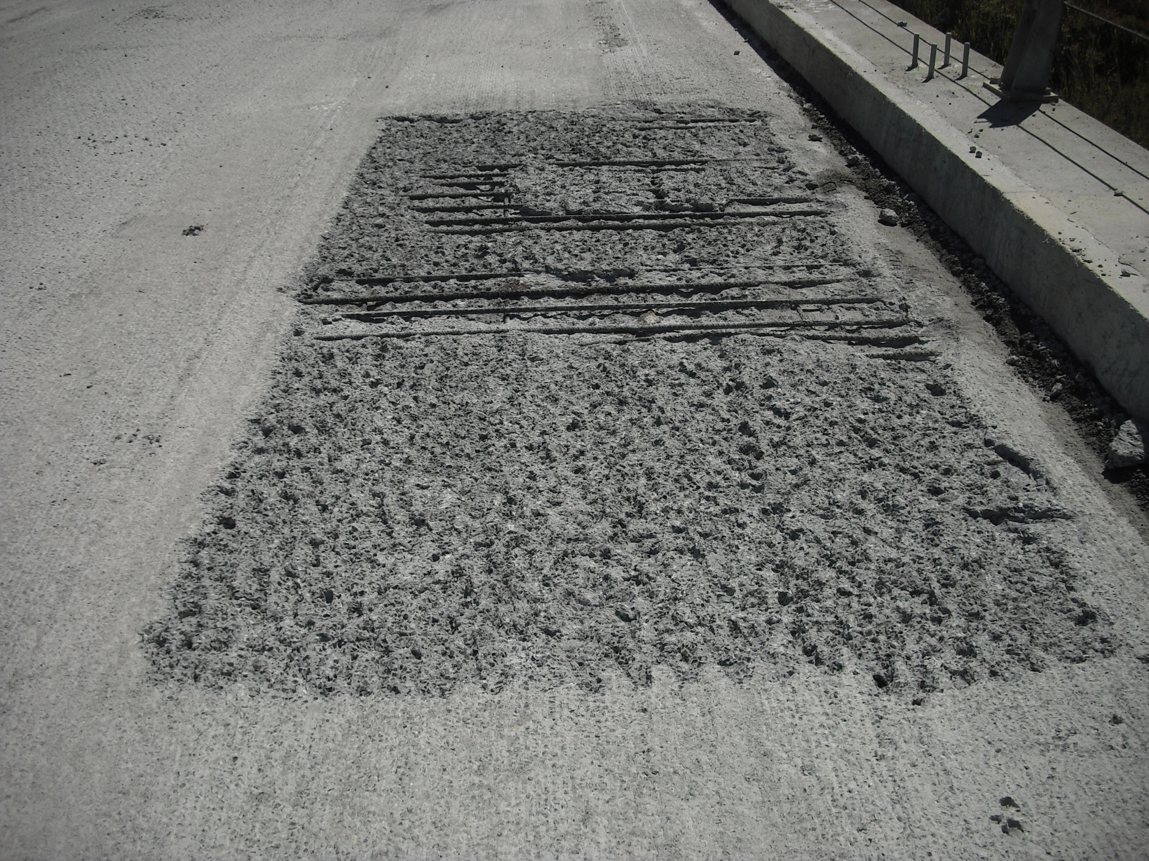
Calibration
Notes:
After calibrating on sound concrete, you then go to an area determined to be unsound and run at the same settings. This is to verify that the machine will selectively remove all the unsound concrete. And, are you getting a good roughened cut. If it does not satisfactorily provide this, more calibrating is required. If it does remove what it is supposed to, then you are ready to begin. Record all the settings.

Slide 66
Hydrodemolition Production Work
Maintain calibration settings unless desired results are not being achieved
Calibration is required on every bridge and when equipment is changed
Minimize overlap between hydro passes
Only hydro equipment and cleanup vehicles allowed on the deck
Must clean up slurry before it has a chance to dry
We require a vacuum system to be used

Slide 67
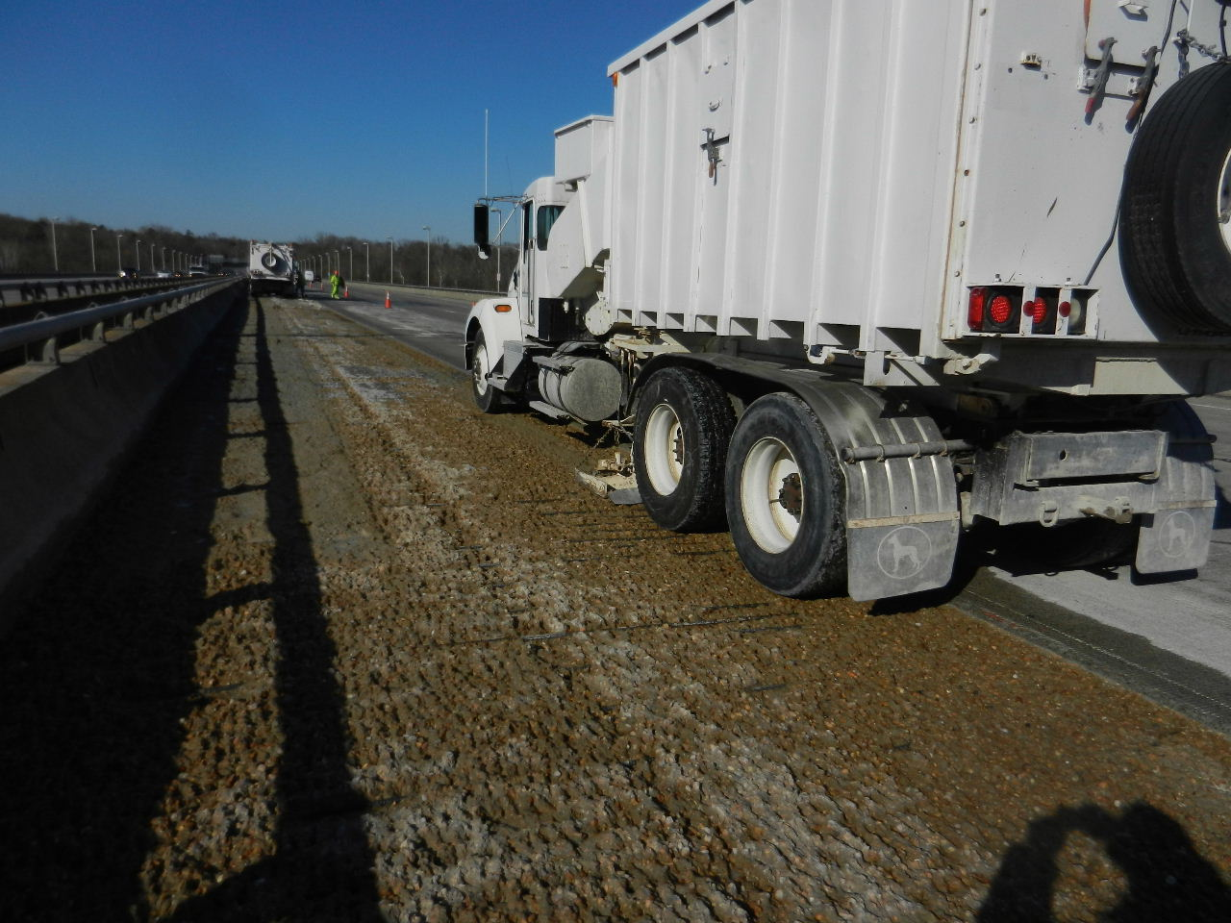
Notes:
And then, for horizontal applications, such as this one, a vacuum truck can collect up debris generated from the process.

Slide 68
Environmental Compliance
Conctractor must have an approved plan for water control and disposal or remediation of runoff water
Deck drains must be blocked off
We have many sensitive streams in our state where there can be no runoff into the stream or adjacent drainage
These areas are a good place to consider use of ultra high pressure/low water flow hydro to limit liability

Slide 69
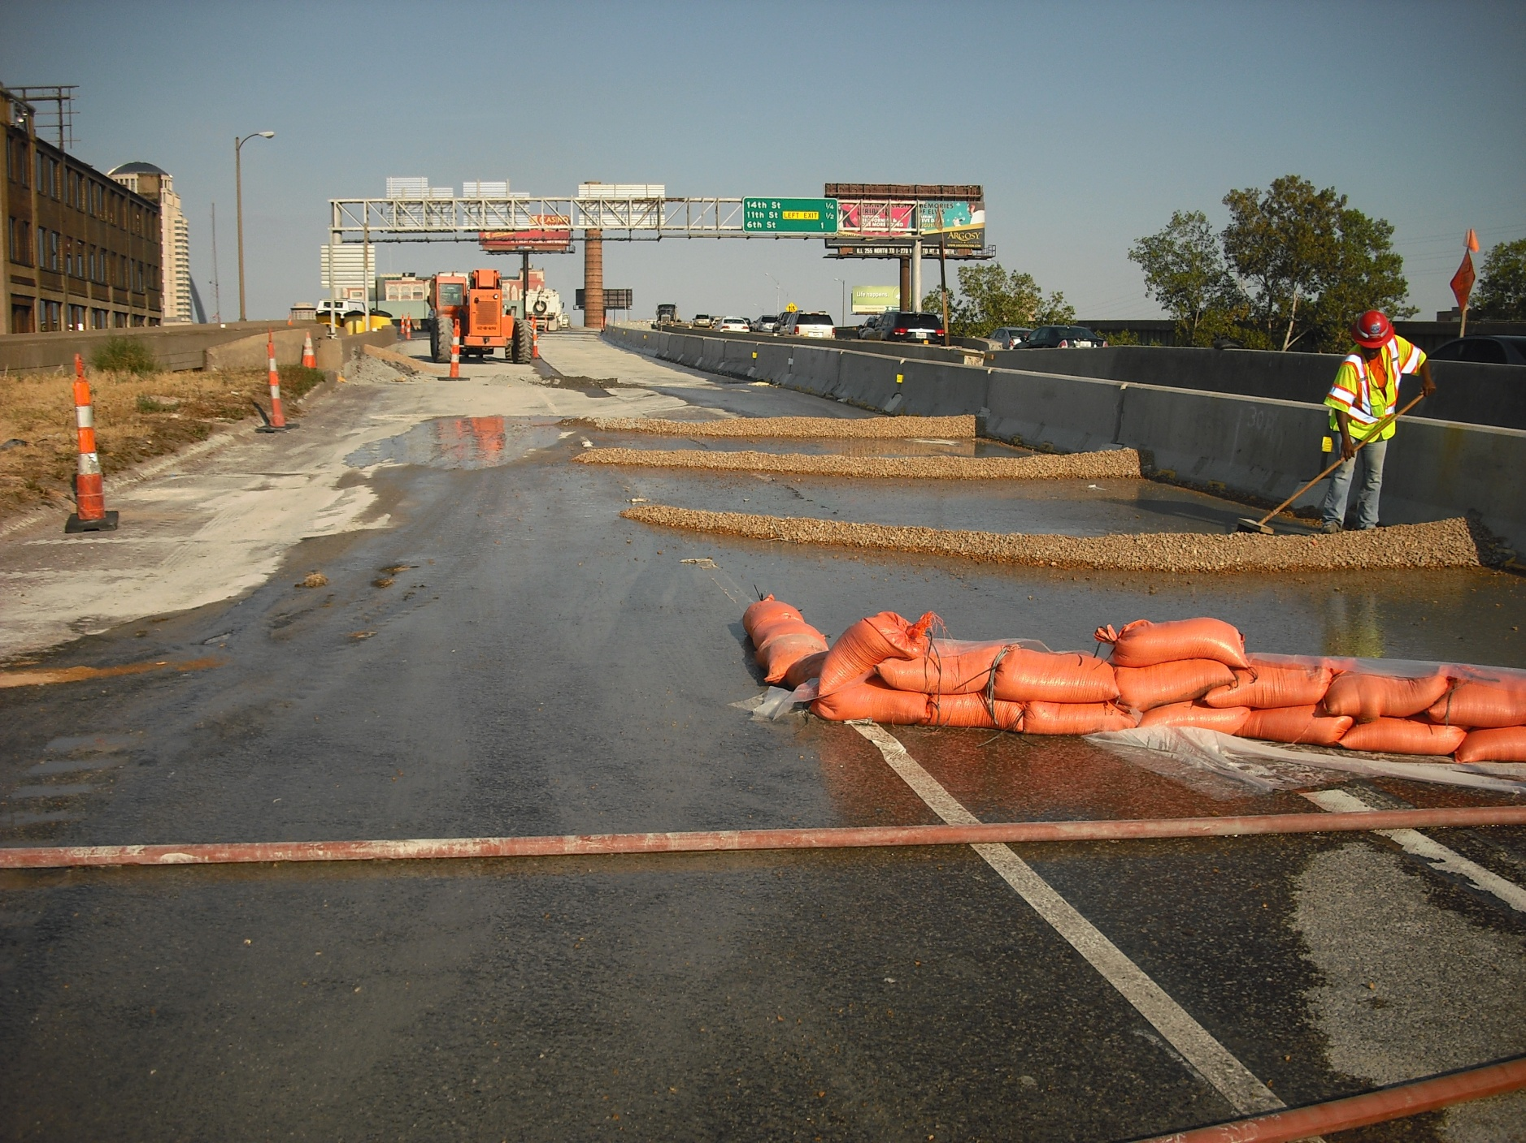
Need water control plan
Notes:
Let’s look at how some of these collections are being done. Typically, a first line of defense is to set up a series of pea gravel dams, sand bags, hay bales or other devices to help filter the fines, cement, etc. from the discharged water.

Slide 70
Post-Hydro Concrete Removal
Sound total surface
Remove all unsound areas(cost covered in hydro work)
Hammers must be less than 35 pound class
No chipping around rebar unless it is debonded or damaged and in need of replacement
We rely on the sticky latex and surface roughness for overlay bond
Deteriorated bars are paid for at a fixed unit price
Bars damaged due to contractor are paid for at their cost

Slide 71
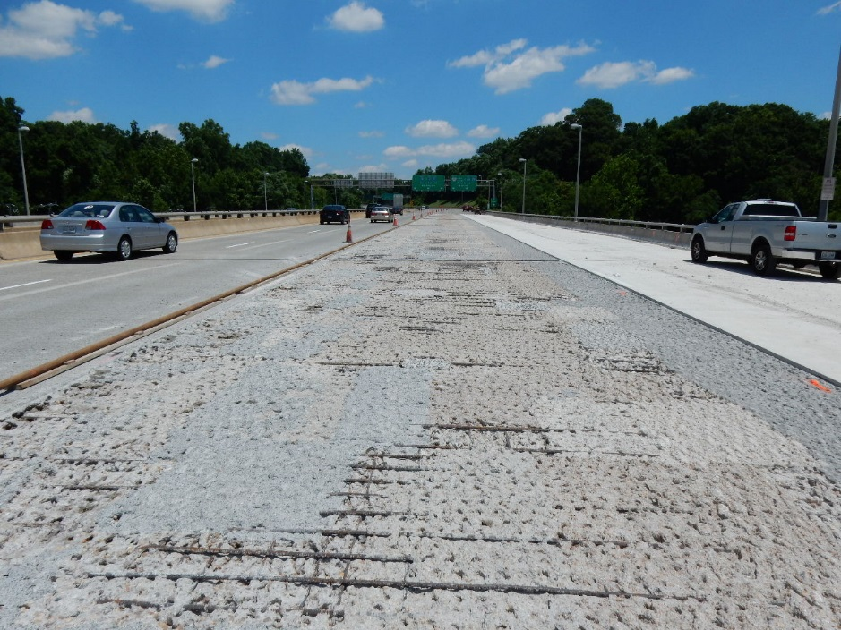
Total Surface Treatment
Notes:
The vast majority of the applications we see in the industry are horizontal on bridge decks and as a total surface application.

Slide 72
Full Depth Repair
We work to pick jobs that have little or no full depth repair
Small areas are just formed up and placed with the ovelay
Large areas that would cause a structural concern are treated as normal full depth repair and placed ahead of the overlay(Very Rare)

Slide 73
Deck Preparation
Areas with hammer work after hydro are sand blasted and high pressure water washed
Deck must be saturated surface dry just prior to overlay placement
No water ponding in low spots
Plastic sheeting is often used to hold it in a clean SSD state

Slide 74
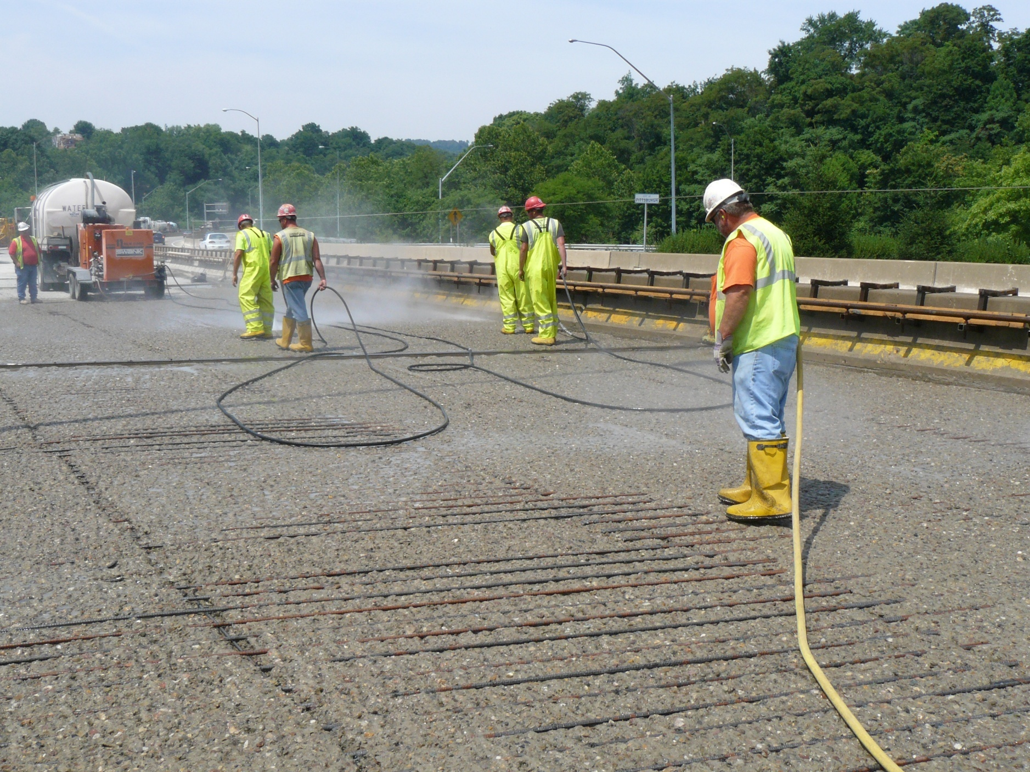
Notes:
You need a pristine surface to bond to. The better job you do cleaning, the better the end product. That’s the case with about anything, isn’t it?

Slide 75
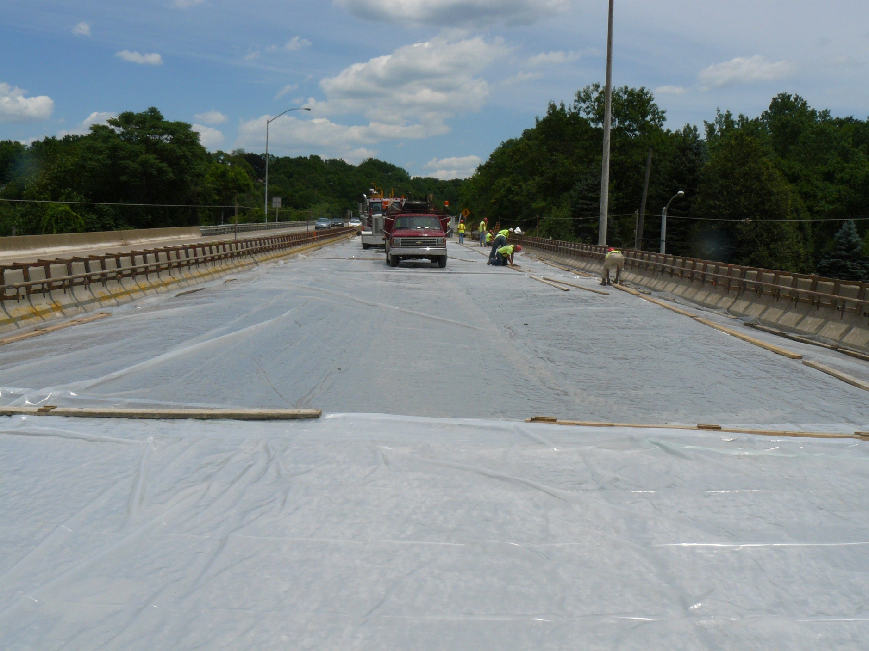
Notes:
Once you do have it cleaned, it’s important to cover it. You have to wet the surface down to a saturated state. If it has dry pockets, those areas can suck the moisture out of your mix. So it’s very important to get it well saturated (but you don’t want to leave standing water either).

Slide 76
Latex Overlay Placement
Monolithic repair areas are placed far enough ahead of the overlay so material stiffens and doesn’t roll back under during finishing
Hand vibration is required around deeper areas and rebar
Areas where concrete was removed due to over milling will not be paid for as Monolithic Repair

Slide 77

Notes:
You need a mobil mixer to pour latex concrete. Can’t ready mix it.

Slide 78

Notes:
A finish machine is the best choice. We have done some ramps and short stretches with a vibrating roller screed.

Slide 79


Slide 80
Basis of Payment
Latex Overlay is paid for per square yard (top 1 ¾ inches)
Monolithic Repair is paid for per cubic yard (Volume below overlay minus contractor errors)
Hydrodemolition is paid for per square yard
Full Depth Repair, if needed, per square foot

Slide 81
Hydrodemolition – Next Steps
Working to use it on structures where the deck is a main structural member, I.E. Voided Slabs and Box Girders
Complicated by zone repair areas
Trying longitudinal zones and false work as options

Slide 82
Summary
Fast Track Hydrodemolition with a latex overlay is our preferred method. We have many high volume bridges with overlays approaching 20 years of service and still going strong
Monolithic Deck Repair is a very efficient and cost effective way to handle traditional half-sole and full depth repairs
The low water usage of ultra high pressure hydro is useful in environmentally sensitive areas where water control can be difficult

Slide 83
Questions?
Patrick Martens, PE
Bridge Preservation Engineer
Bridge Preservation and Inspection Services
patrickmartens161@gmail.com
636-441-1376

