Slide 1
MoDOT/Industry Partnering Meeting
May 19, 2026
Capital Bluffs Event Center
Jefferson City, MO
Notes:
Slide deck will be made available
Sign in – Those that sign in and provide an email, will receive and

Slide 2
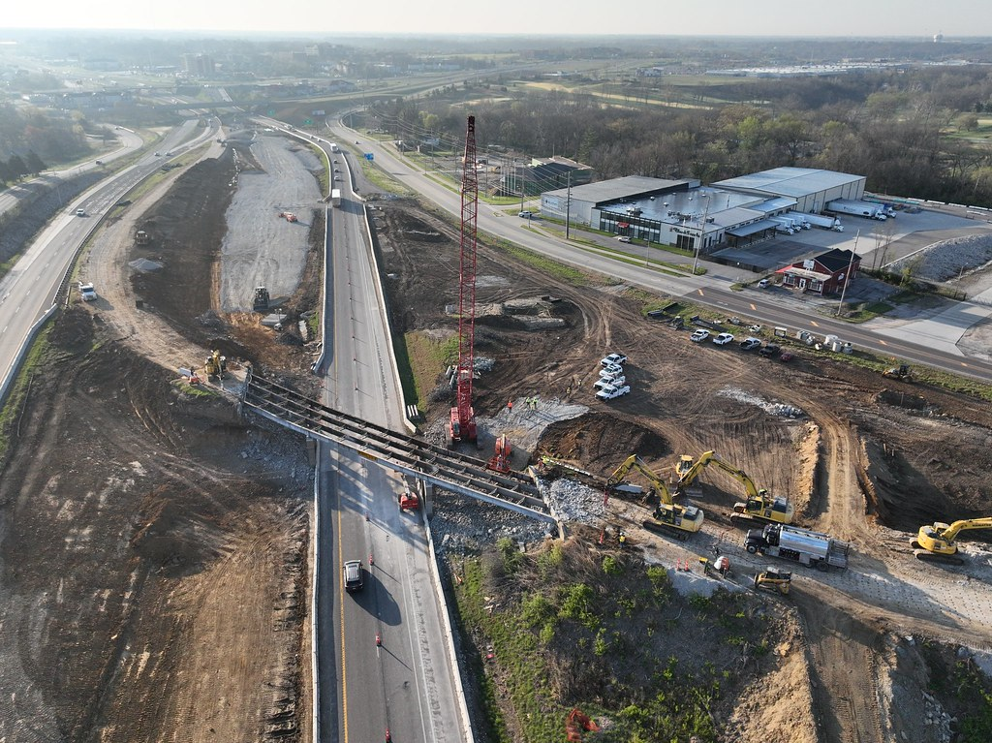
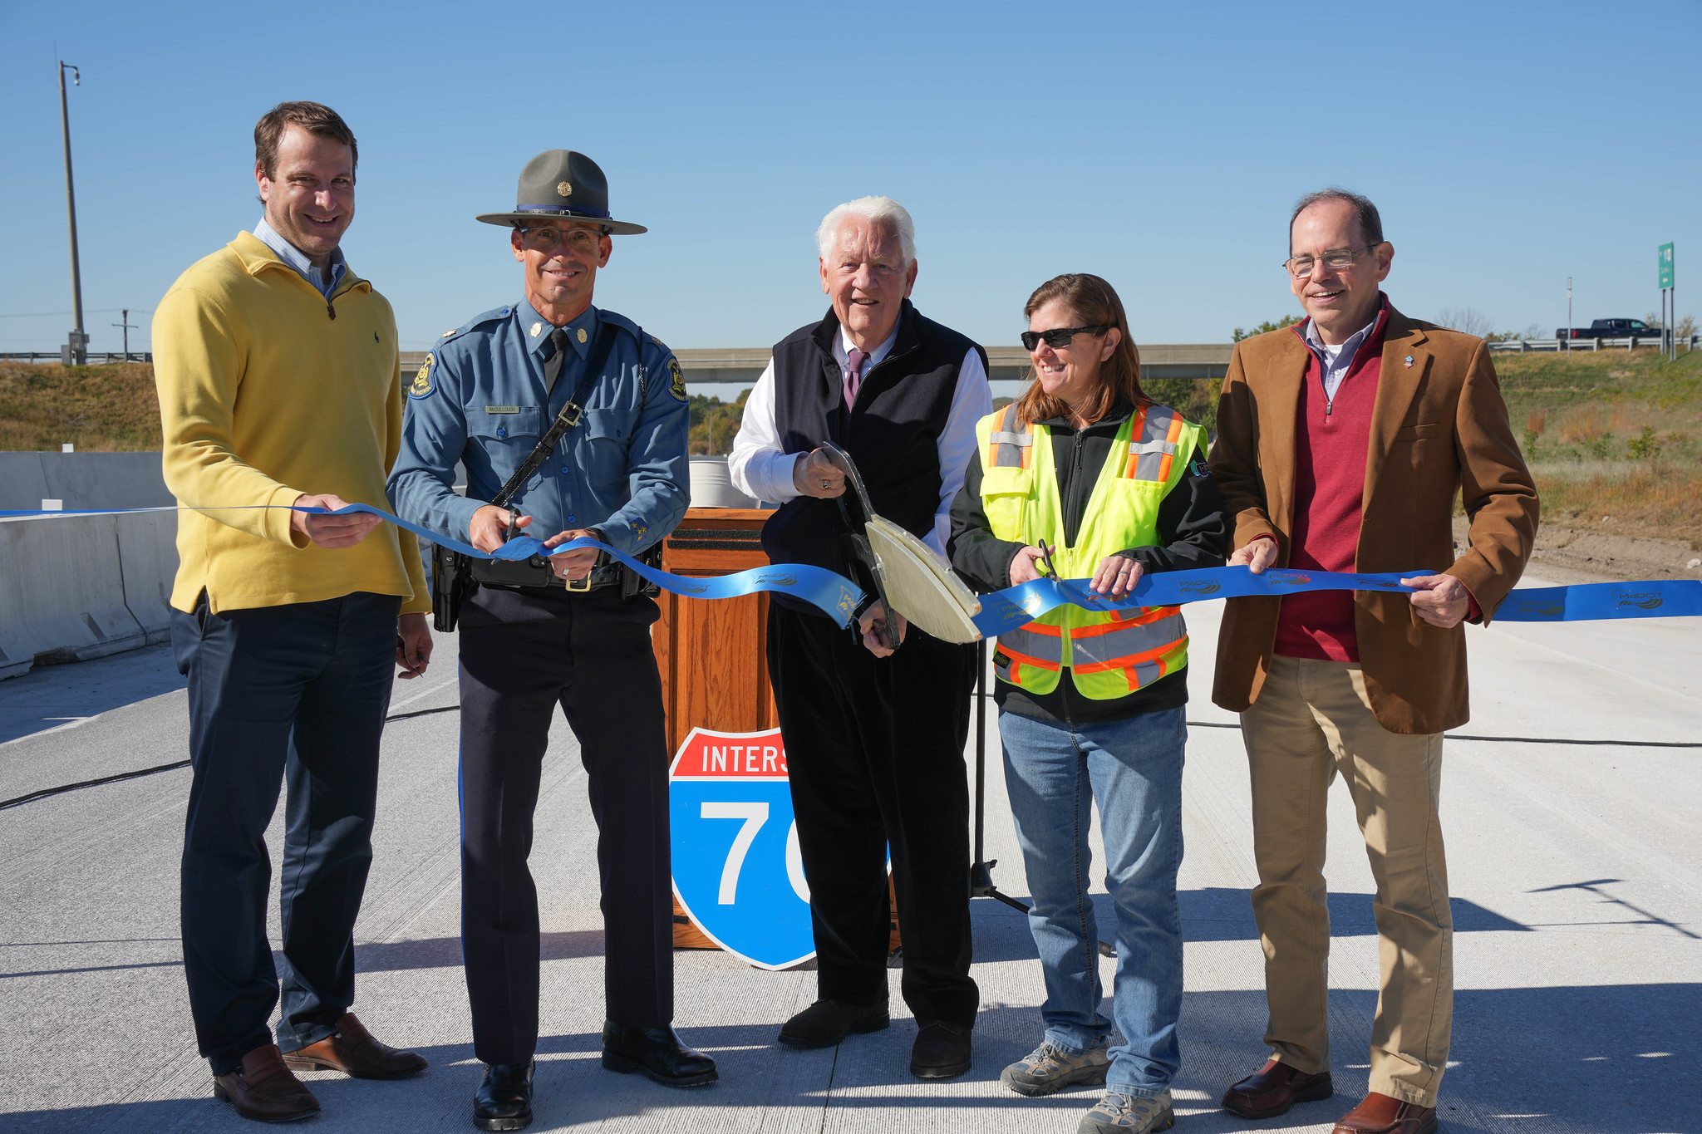
A Successful Partnership
4,000+ projects worth nearly $10 billion delivered in the last decade​
  Biggest programs ever
Innovative problem-solving: ​
  Value engineering​
  Design-Build
THANK YOU!

Slide 3
Pavement Cost Trends

Slide 4
Bridge Cost Trend

Slide 5
MoDOT Award History
Excludes right of way, utilities, non-contractual items, payments and suballocated funds.

Slide 6
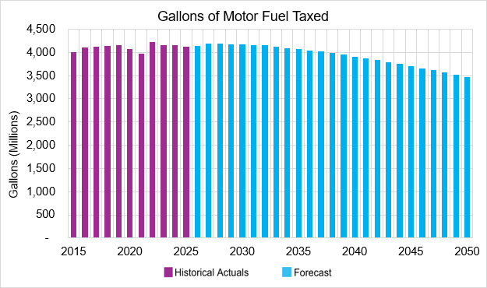
Long-Range Forecast

Slide 7
Inflation Impact

Slide 8
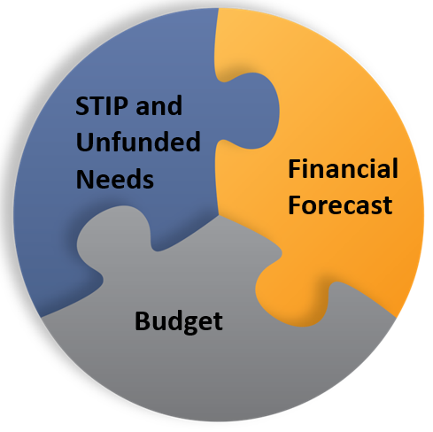
STIP
FINANCIAL PLANNING MODEL

Slide 9
Financial Forecast Graph
Notes:
In this graph, we include all revenues and disbursements except the Improve I-70 Program, Forward 44 Effort and the General Assembly Designated and Funded Projects. The red line summarizes the revenue, the blue line shows the disbursements and the green line shows the ending cash balance of the State Road Fund.

Slide 10
Improve I-70 Program, the Forward 44 Effort and the General Assembly Designated and Funded Projects graph
Notes:
This slide shows the additional investment for the Improve I-70 Program, the Forward 44 Effort and the General Assembly Designated and Funded Projects. This includes any bond issuances, if warranted, for the Improve I-70 Program and the Forward 44 Effort and the cashing out of any awards made for these projects

Slide 11
Contractor Awards and Contractor Payments graph
Notes:
This slide shows a comparison of Contractor Awards and Contractor Payments. This includes all road and bridge funding. Just a reminder, contractor awards is the amount that is included in the STIP and is the amount identified at the beginning of the project. For the forecast, we identify when those awards will actually result in cash out the door. The contractor payments will lag slightly behind contractor awards.

Slide 12
TRANSPORTATION
PLANNING APPROACH
A transparent, inclusive, and flexible approach to identifying the right transportation solutions
  THE PLANNING FRAMEWORK
  The planning framework relies on bottom-up decision-making, ensuring the correct stakeholders are actively engaged in determining each region’s highest priority needs and projects

Slide 13
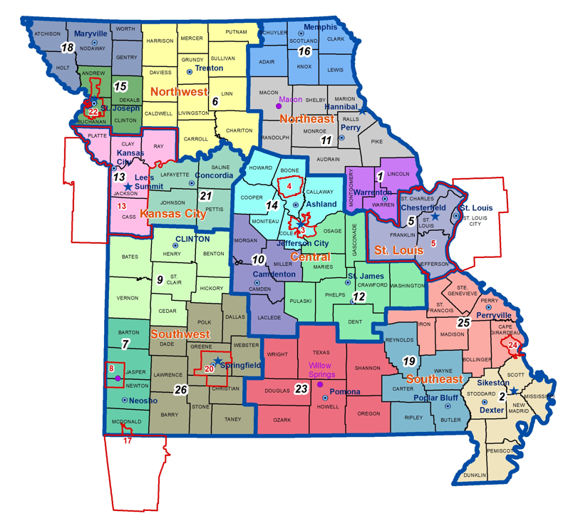
PLANNING PARTNERS
Metropolitan Planning Organizations
Regional Planning Commissions

Slide 14
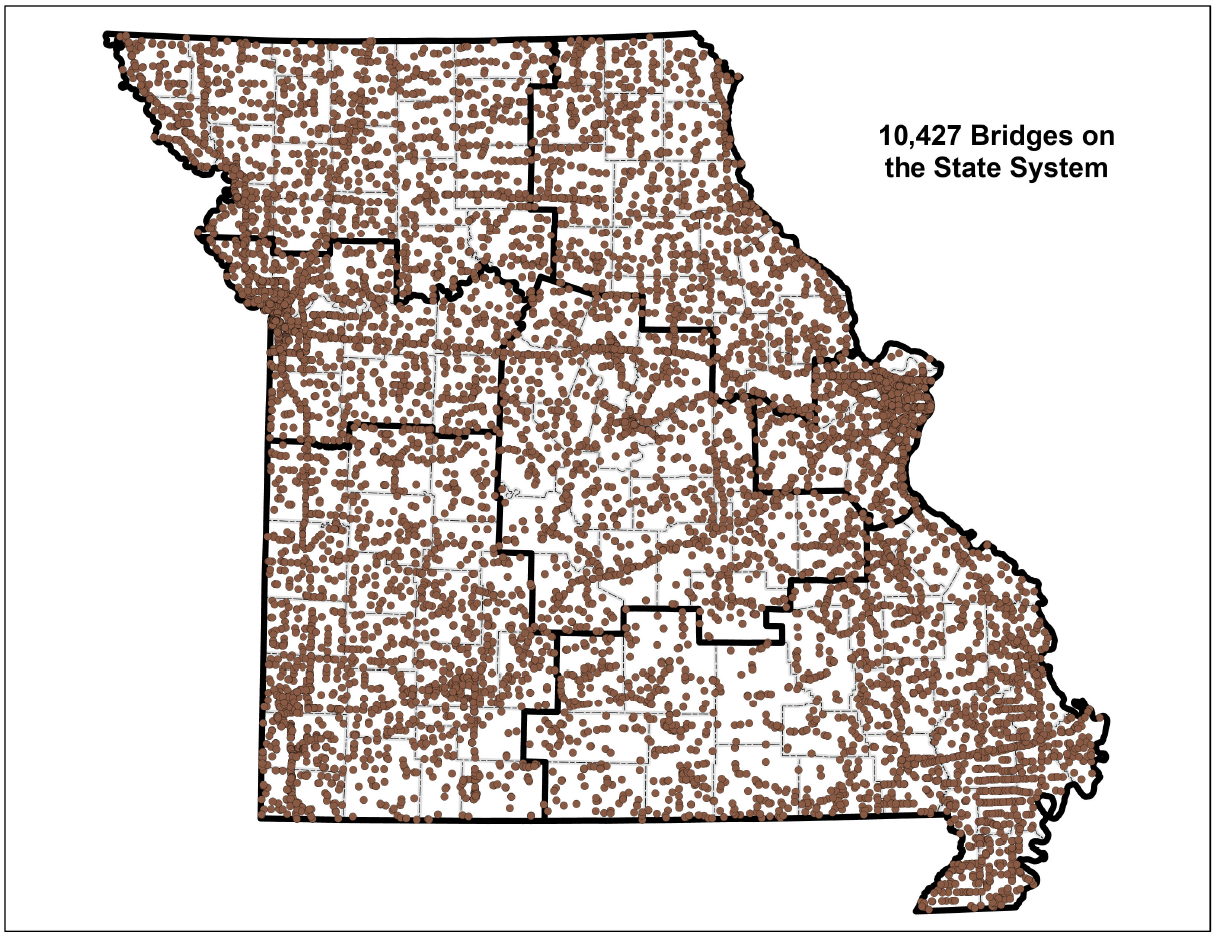
Based on 2025 National Bridge Inventory (NBI) submittal
Notes:
10,427 is 35 more than last year’s 10,392.
Every year we are required to submit the National Bridge Inventory to the FHWA.

Slide 15
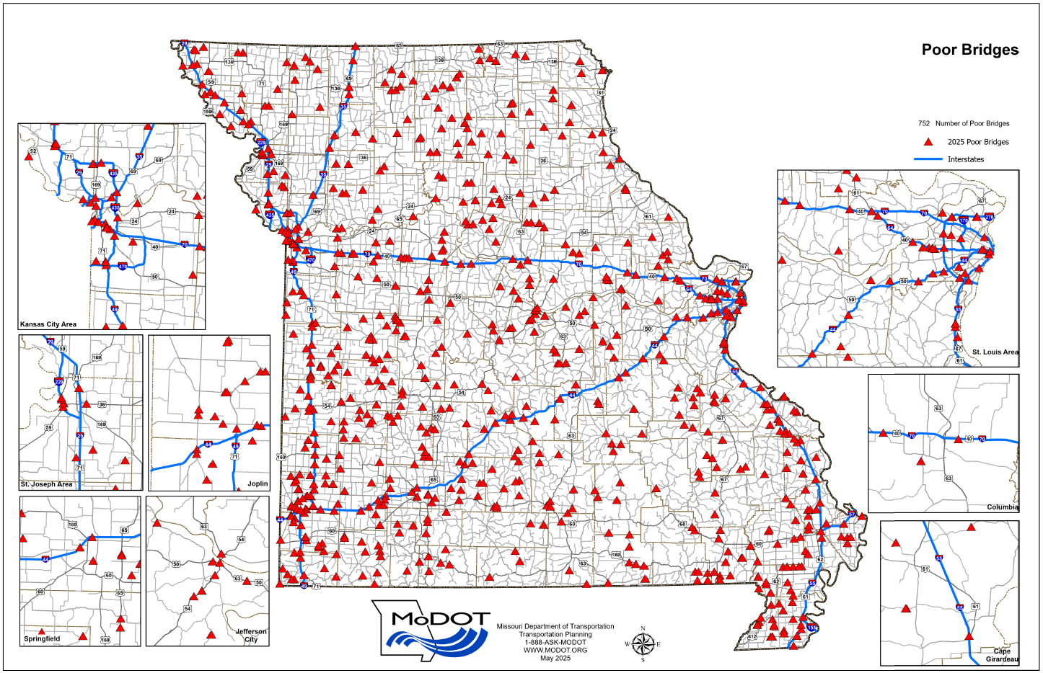
752 Poor Bridges

Slide 16
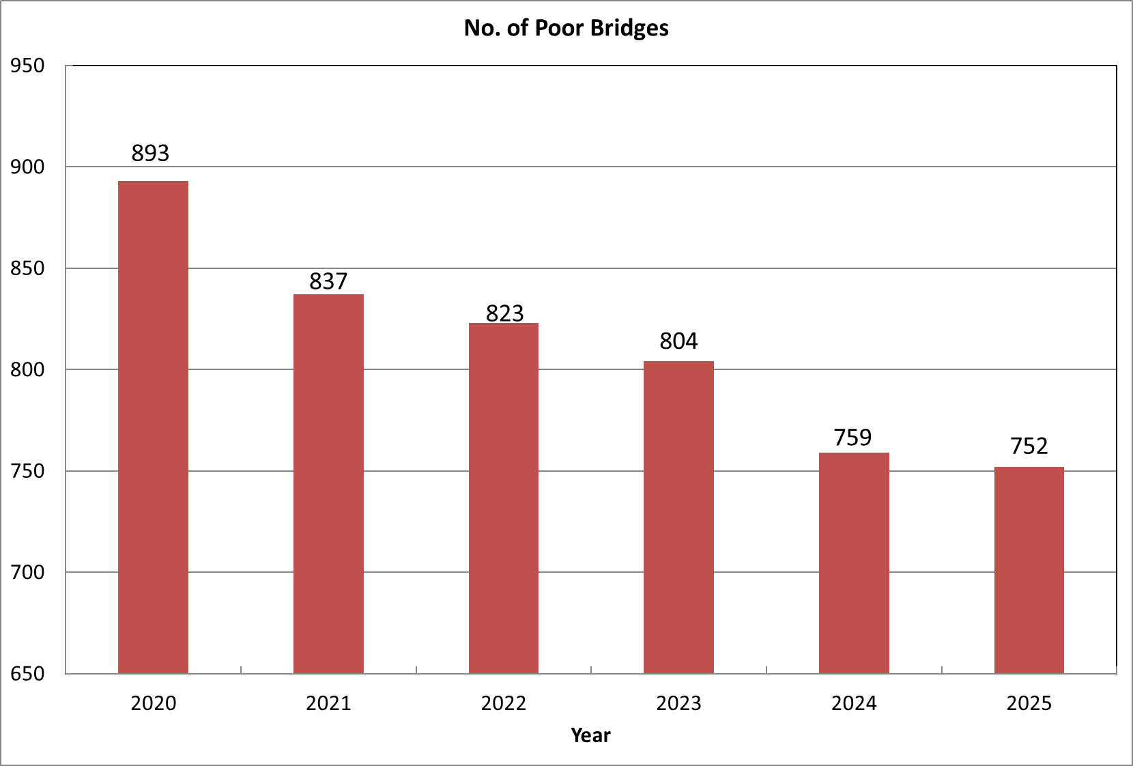
752 Poor Bridges
Notes:
The number of Poor bridges has dropped from 759 to 752. Our asset management goal is to keep it around 900. We attribute this drop to several things:
Continued progress with bridge bundles and Asset Management approach.
Average added over the last 5 years is 95 per year. 1 more than last year.
Average removed over the last 5 years is 123. 1 less than last year

Slide 17
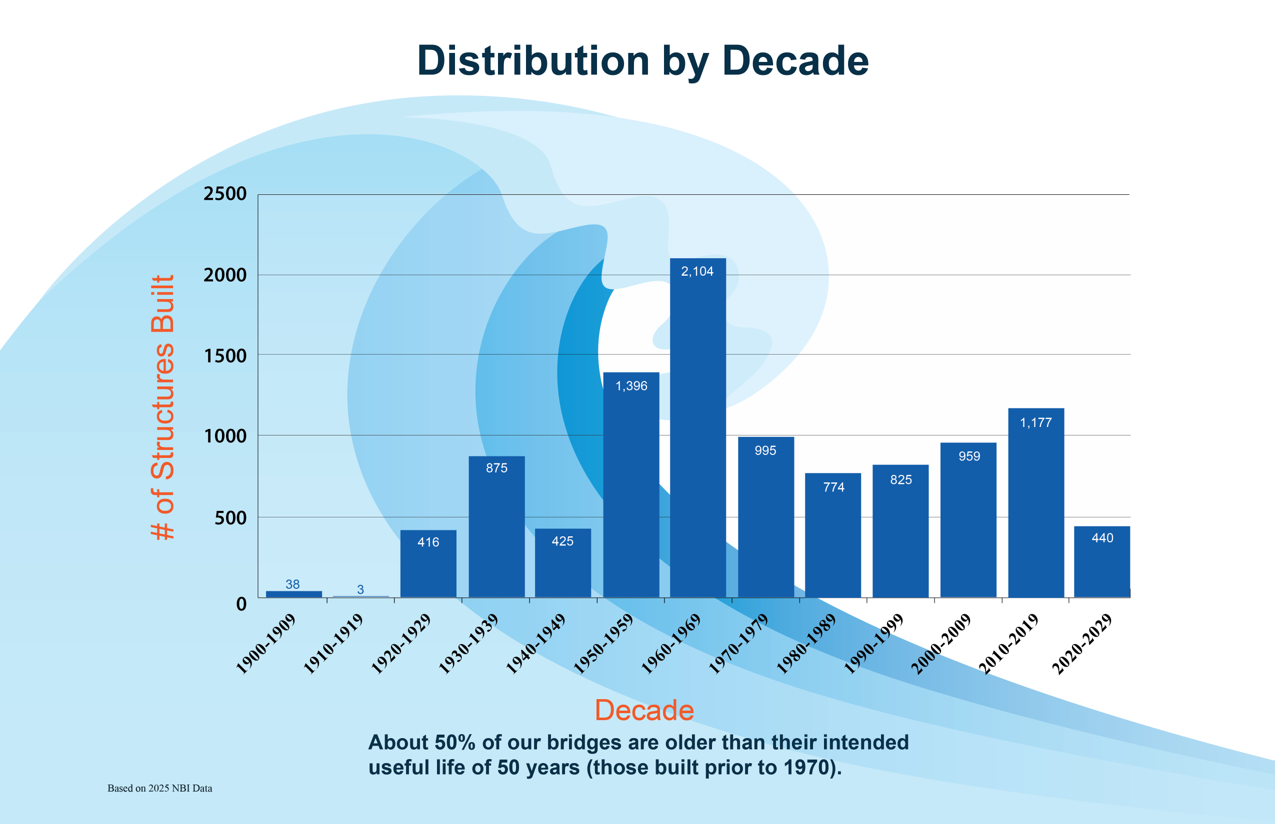
Notes:
From last year the number prior to 1970 was reduced by 55.

Slide 18
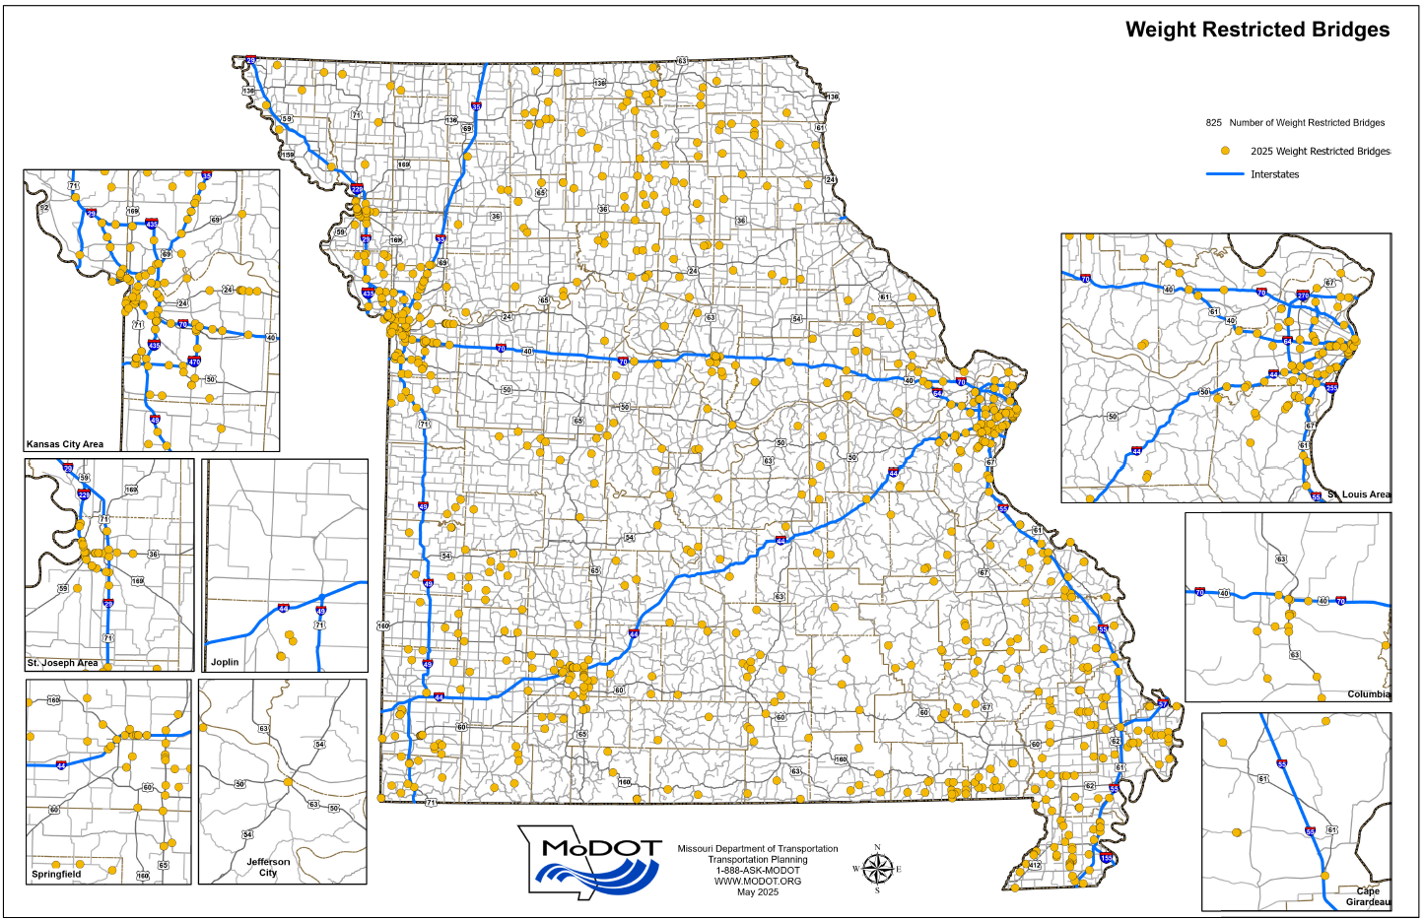
825 Weight-Restricted Bridges

Slide 19
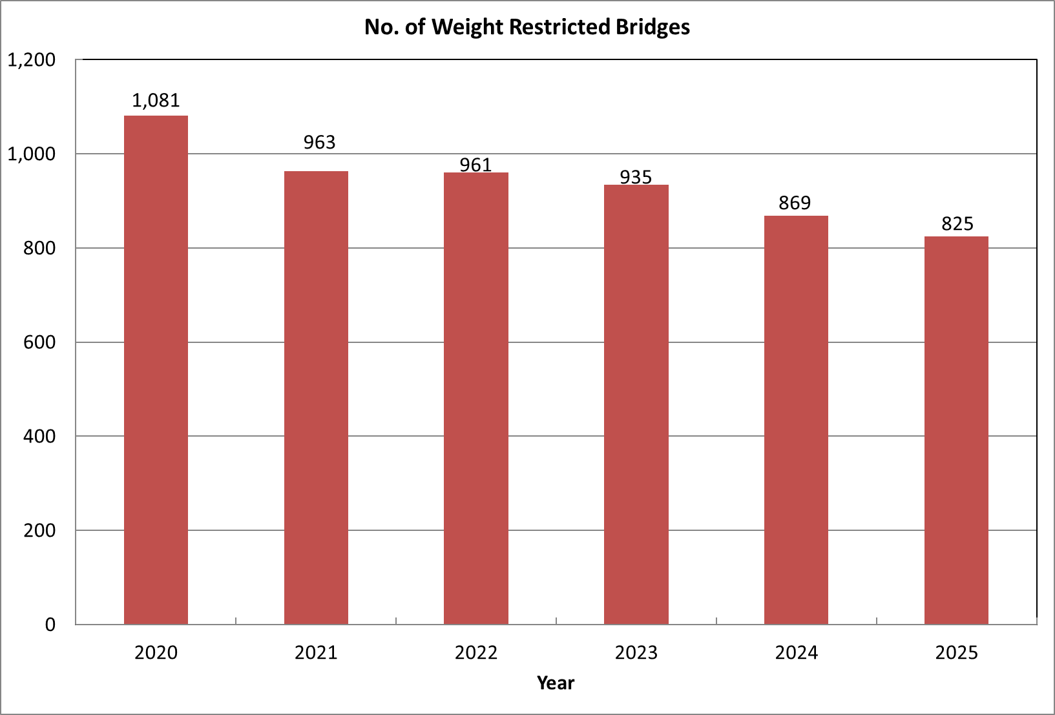
825 Weight-Restricted Bridges
Notes:
On the 2014 submittal this number was 1367. This was the largest number in the last 13 years.
This number will likely increase as we work the FHWA Plan of Corrective Action (PCA).

Slide 20
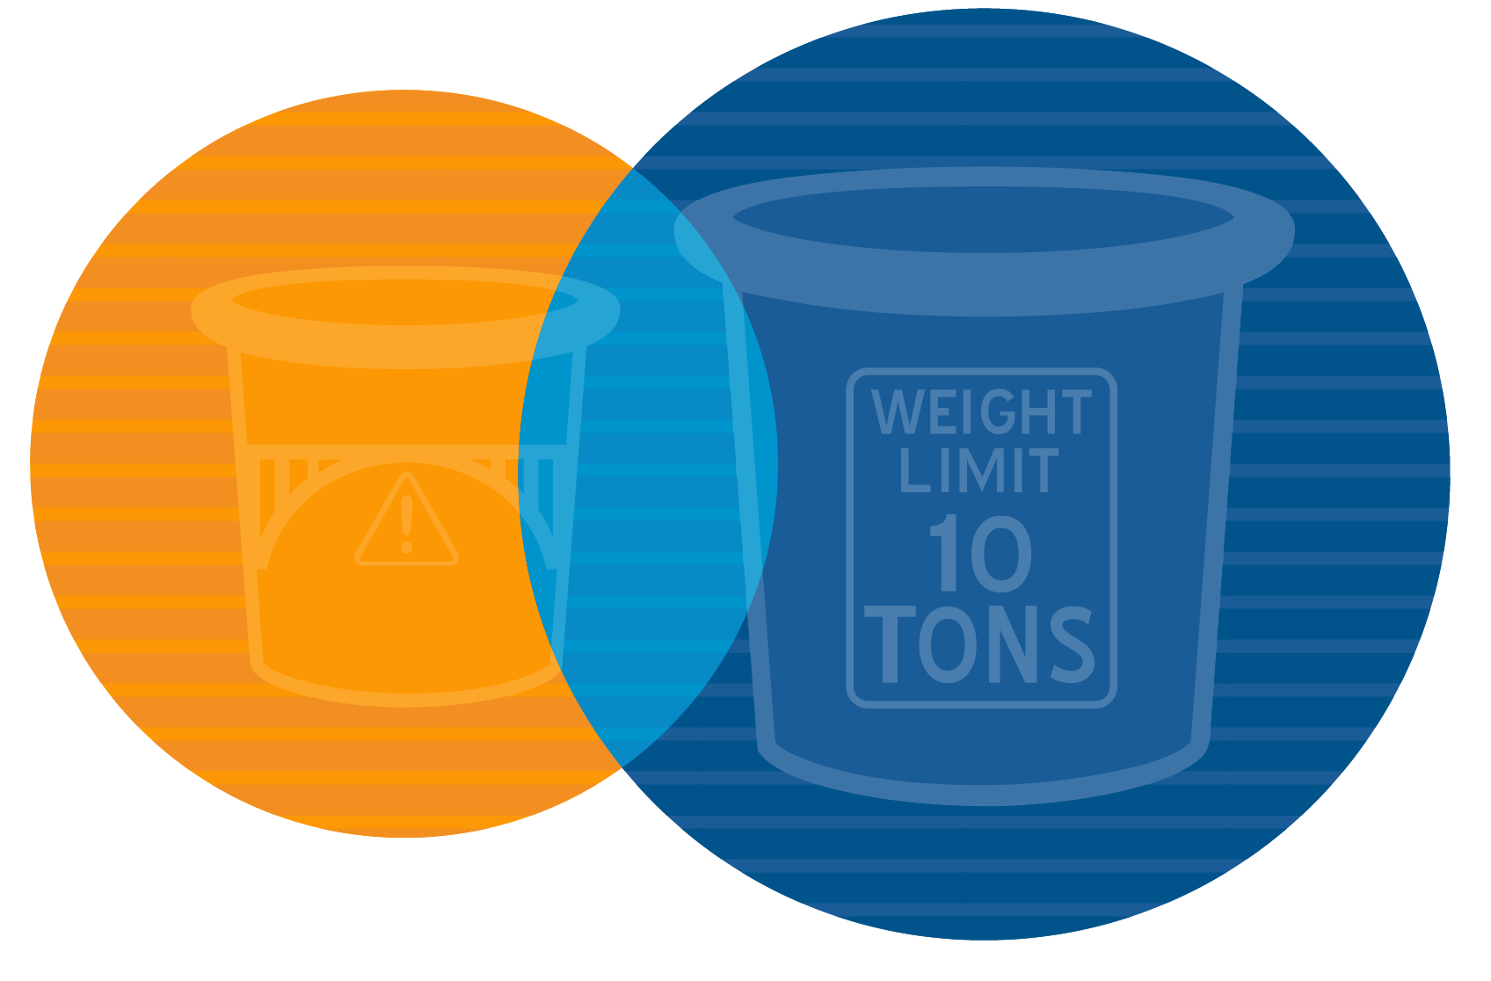
Poor & Weight-Restricted Bridges
825 WEIGHT RESTRICTED BRIDGES
752 POOR BRIDGES
249
BOTH

Slide 21
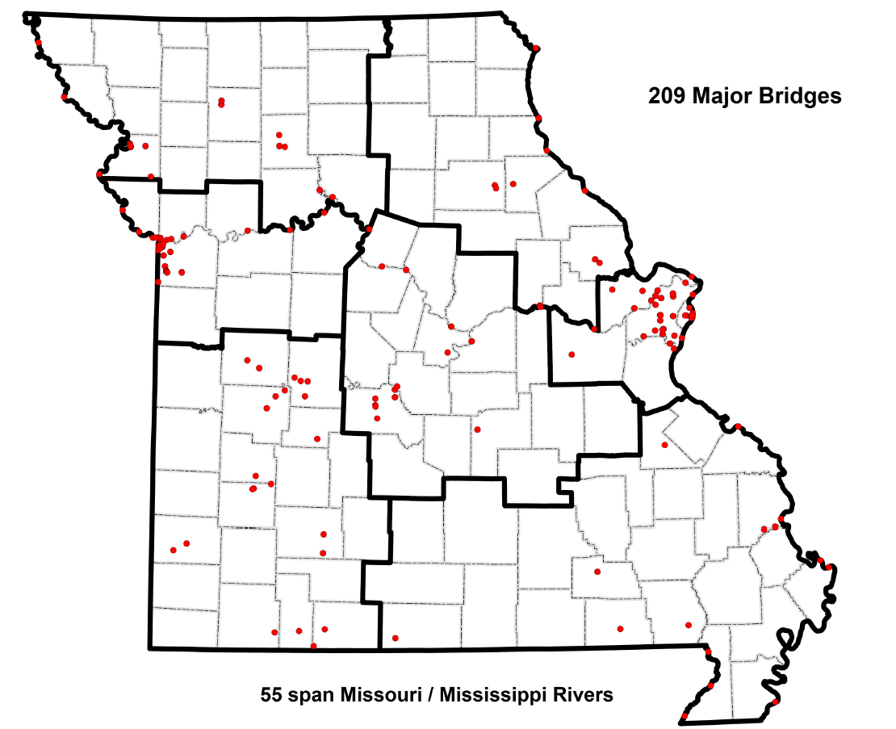
209 Major Bridges
Notes:
25 Major Bridges in poor condition.
Added 2 spanning river at Buck, 2 at Rocheport, Chain of Rocks
A1044 in Hannibal was removed. Long Creek and Buck O’Neil, Rocheport

Slide 22
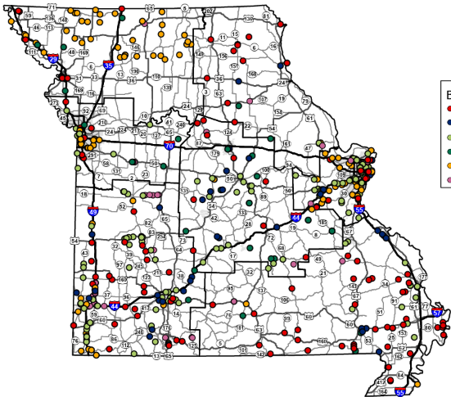
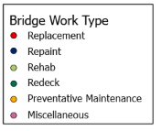
Map of the Anticipated Bridge
Project Locations FY 2027 and 2028
*Note: Tentative listing is subject to change.

Slide 23
Tentative 2027 Bridge Quantities
2027 | Number of Bridges | Sq. Ft. Bridge Deck
Miscellaneous | 38 | 809,185
Preventative Maintenance | 114 | 2,807,889
Redeck | 32 | 183,320
Rehab | 116 | 2,085,045
Repaint | 34 | 1,081,287
Replacement | 72 | 568,313
Total | 406 | 7,535,039
Note: Includes 32 Major Bridges.
*Tentative quantities based upon initial engineering and are subject to change.

Slide 24
Tentative 2028 Bridge Quantities
2028 | Number of Bridges | Sq. Ft. Bridge Deck
Miscellaneous | 31 | 471,039
Preventative Maintenance | 22 | 3,982,874
Redeck | 17 | 113,560
Rehab | 44 | 2,187,386
Repaint | 19 | 383,788
Replacement | 46 | 558,955
Total | 179 | 7,697,602
Note: Includes 32 Major Bridges.
*Tentative quantities based upon initial engineering and are subject to change.

Slide 25
Anticipated Major Bridge for FY 2027/2028
Fiscal Year | Number of Major Bridges | Total SQ FT | Construction Estimate*
2027 | 32 | 3.9 million | $210,400
2028 | 32 | 6.29 million | $374,800
*Thousands

Slide 26
Pavement Condition
Notes:
Have made great progress on managing our pavement assets over the last 4-5 years.
Interstates and Major's goal 90%, we are right at that goal.
Minor goal 80% - raised from 80 to 83% and climbing with the help of legislatively designated work.
Low Volume goal 70% - raised from 70 to 83 and climbing, another $100 million of work complete since numbers were published. In 2009 years ago low volume roads were only at 60% good.

Slide 27
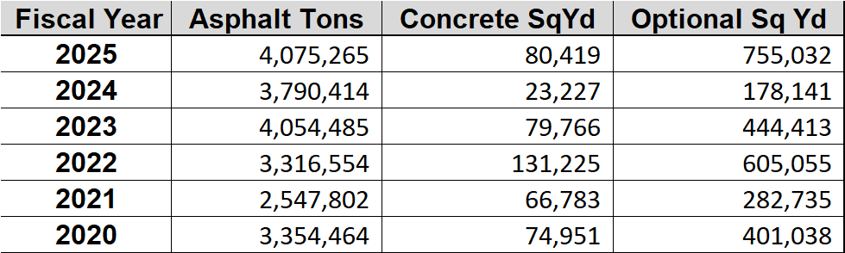
Recent Pavement Quantities History
Historic Quantities
Notes:
We are posting this presentation after our meeting today because we know information like this slide is too much to absorb, but we are using the best information we have to answer questions we have received.
I've seen a lot of different numbers on quantities per year, depending on state, federal, or calendar year. This chart is based on state fiscal year.
Pavement quantites are some of our most fluid projects. We plan on what we know, but conditions may deteriorate faster or last a little longer. It's easier to move a pavement to line up with bridge work than it is to move a bridge to line up with pavement work.
When cash flow is better than expected more pavement work gets moved into the program.
In my experience, we typically end up doing a little more pavement work each year than we plan because of other factors.

Slide 28
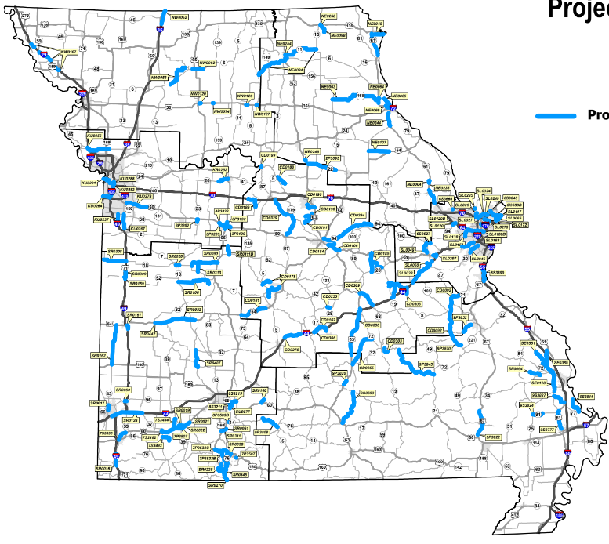
Anticipated
FY 2027
Paving Projects
*Note: Tentative listing is subject to change.
Notes:
This map show anticipated work for 2027. As I just mentioned, it wouldn't surprise me at all to see a little more paving work pulled in 2027.

Slide 29
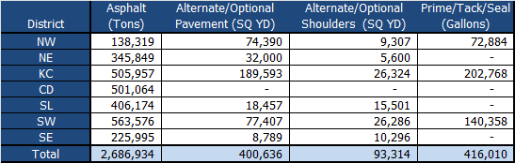
Tentative SFY 2027 Paving Quantities
*Note: Tentative quantities based upon initial engineering and are subject to change.
Notes:
Here are the paving quantites by district based on what is in the draft STIP today.

Slide 30
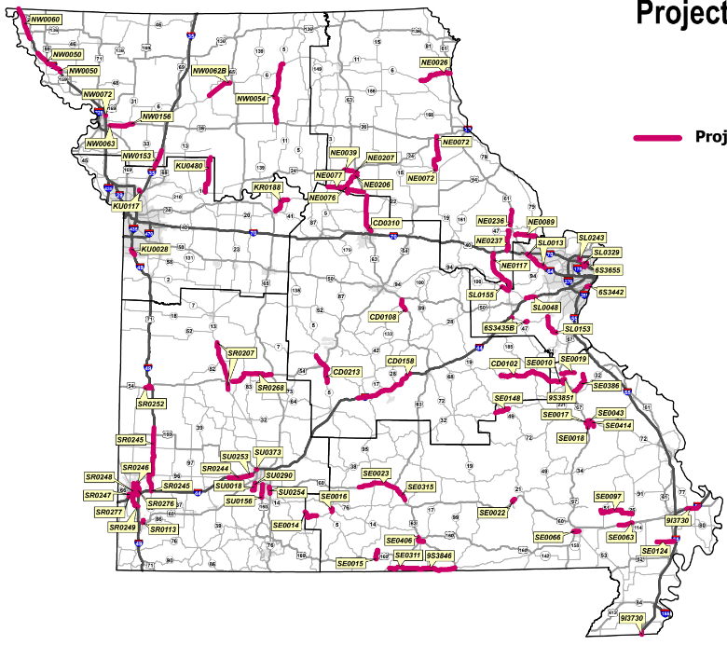
Anticipated SFY 2028
Paving Projects
*Note: Tentative listing is subject to change.
Notes:
I also have the 2028 paving projects.

Slide 31
Tentative SFY 2028 Paving Quantities
*Note: Tentative quantities based upon initial engineering and are subject to change.
Notes:
While you see a decline in quantites, I would say this if the floor.

Slide 32
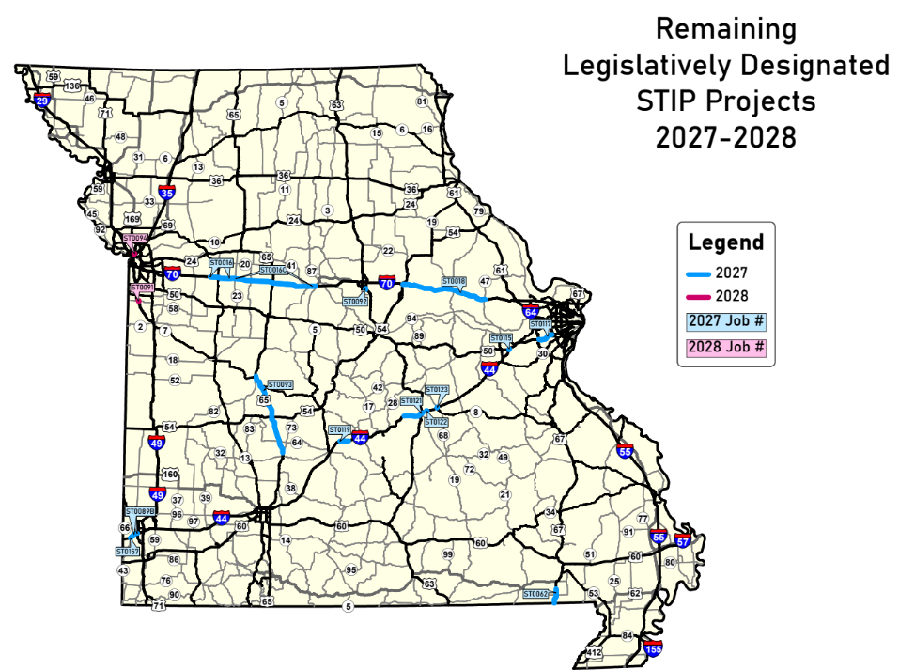
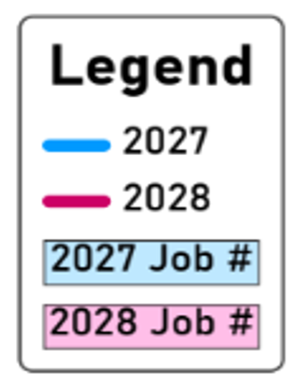
Remaining Legislatively Designated Project Locations
*Tentative quantities based upon initial engineering and are subject to change.

Slide 33
Quantities for Anticipated
Legislatively Designated Projects
 | Tons of Asphalt | Alternate or Optional Pavement SQ YD | Alternate or Optional Shoulder SQ YD | Gallons Fog Or Prime
2027/2028 | 183,947 | 5,145,303 | 1,575,573 | 8,432
*Notes: Tentative quantities based upon initial engineering and are subject to change.
Not all Legislatively Designated Projects included due to insufficient detailed design.
Notes:
*aestrick Not all projects have sufficient engineering to establish quantities, including projects in KC, CD, SL, and SW

Slide 34
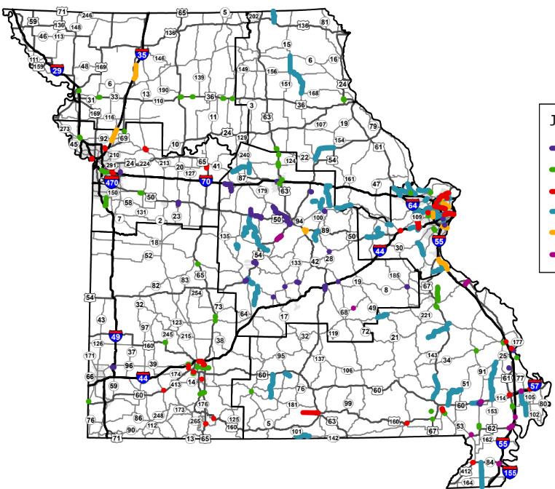
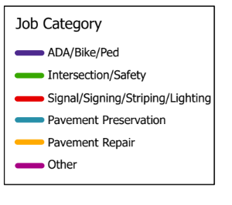
Map of Anticipated Additional Work Type
Project Locations
*Note: Tentative listing is subject to change.

Slide 35
Tentative FY 2027 Additional Work Type project details
*Note: Tentative listing is subject to change.

Slide 36
Tentative FY 2028 Additional Work Type project details
*Note: Tentative listing is subject to change.

Slide 37
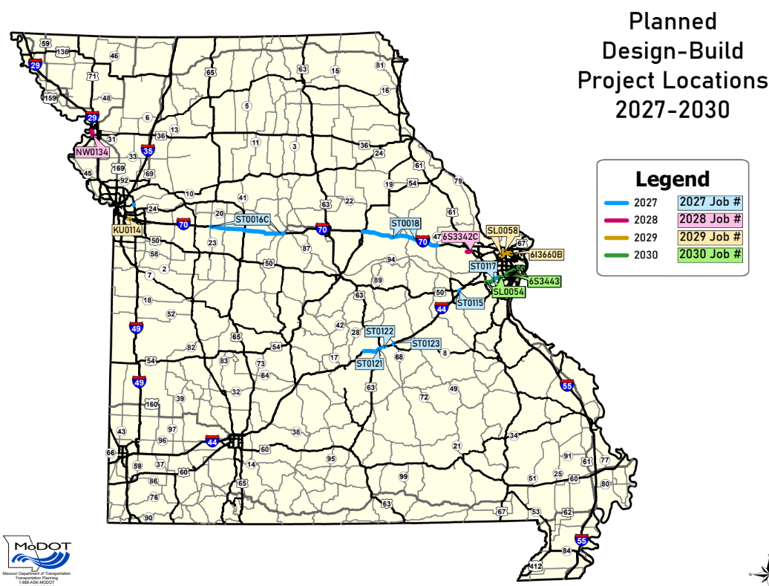
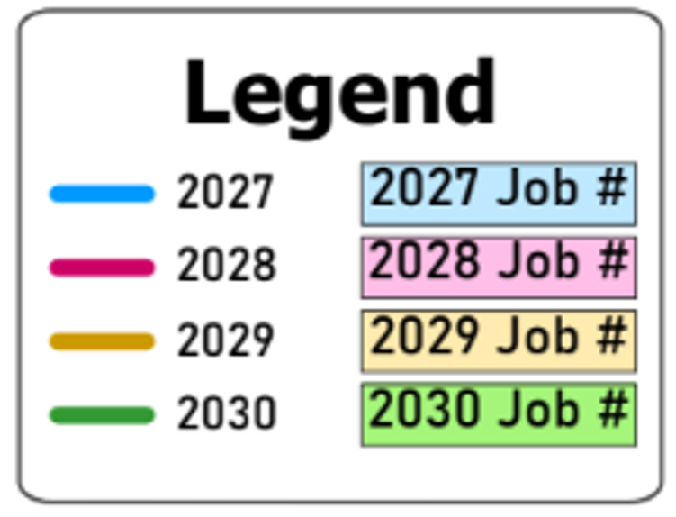
Upcoming Design Build Project Locations
*Note: Tentative listing is subject to change.
Notes:
*aestrick Not all projects have sufficient engineering to establish quantities, including projects in KC, CD, SL, and SW

Slide 38
Upcoming Design Build Project Details
Project Number | Project Name | District
4P3471 | Route 291 Bridge over Missouri River | KC
ST0117/ST0115 | Forward 44 St. Louis District | SL
ST0016C | Improve I-70 Concordia to Boonville | CD
ST0018 | Improve I-70 Kingdom City to Warrenton | KC
Notes:
Potential design build jobs….next slide

Slide 39
Tentative Potential Design Build
Project Details
Job Number | Description | District | Fiscal Year
NW0134 | I-229 Bridge removal, rehabilitation, and replacement from Highland Ave. to Rte. 36 | NW | 2028
KU0114 | I-70 Bridge replacements over Rte. 40 and Sterling Avenue | KC | 2029
ST0121/122/123 | Forward 44 Phelps County | CD | 2028
6S3342C | Rte. N Add lanes from Hopewell Rd. to Hawk Ridge Trail | SL | 2028
6S3443 | I-44 Various bridge replacements and rehabilitations | SL | 2030
SL0054 | I-44 Various bridge rehabilitations | SL | 2030
SL0058 | I-70 Corridor improvements from the Missouri River to Rte. 67 | SL | 2029
6I3660B | I-70 Modify interchange configuration from Rte. 67 to Rte. 115 | SL | 2029
SR0285 | Various routes bridge improvements | SW | 2030
*Note: Tentative listing is subject to change.
Notes:
Potential design build jobs….next slide

Slide 40
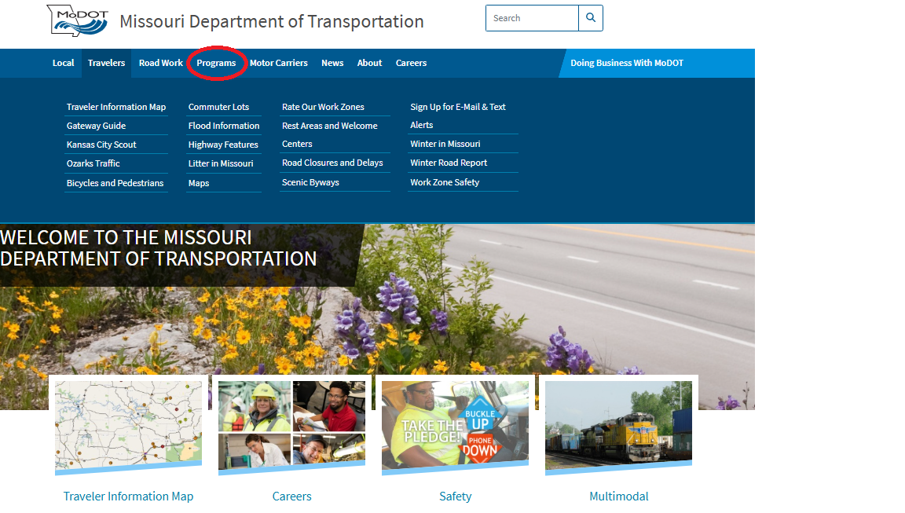
Available Resources

Slide 41
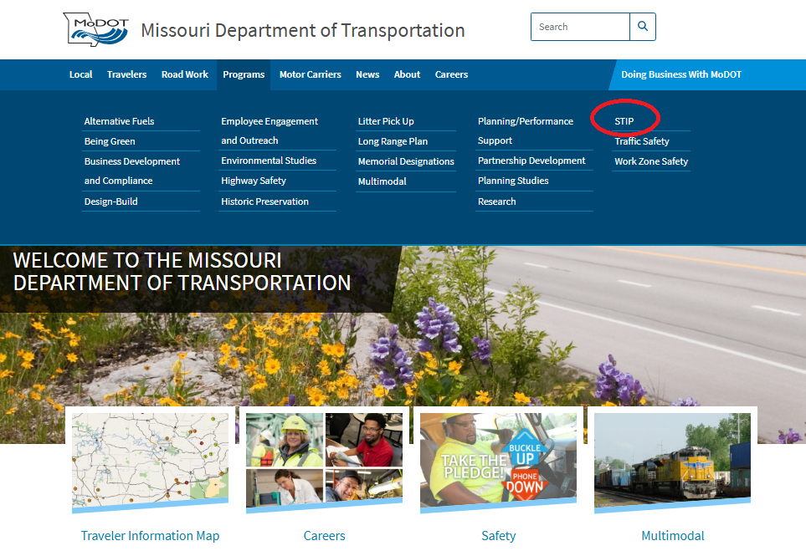
Available Resources

Slide 42
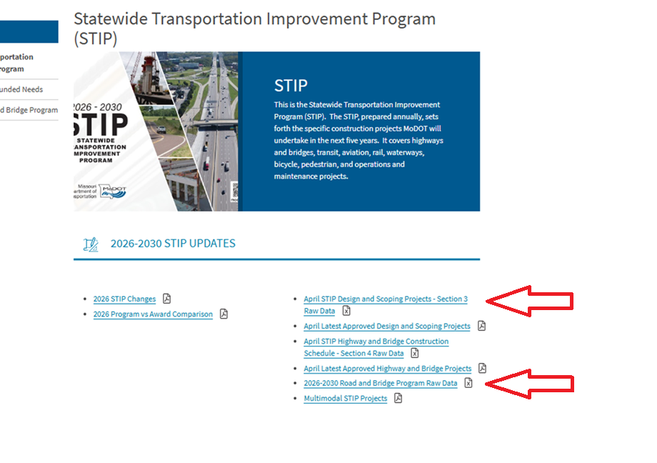


Available Resources

Slide 43
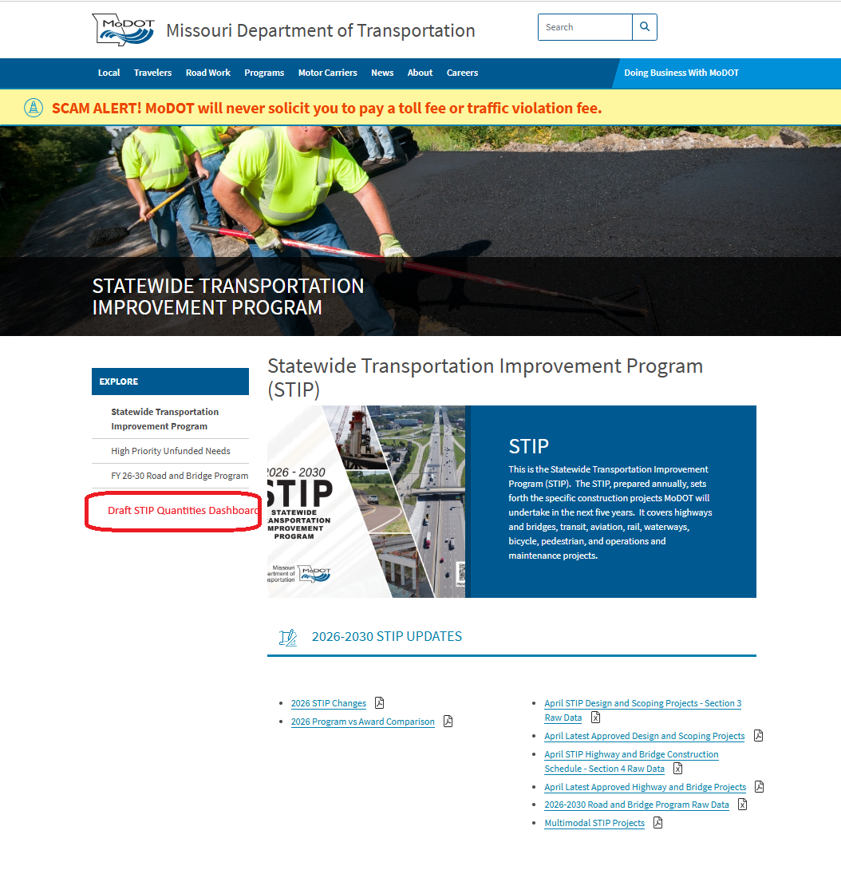
Available Resources

