Slide 1
Superpave Homework Review
09/10/2021

Slide 2
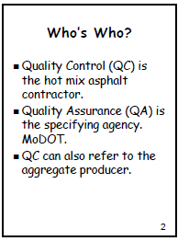

Slide 3
Module 1 Introduction to Superpave Homework
Question # 1.
What 4 types of pavement distress are minimized when mixes are designed in accordance with Superpave criteria?

Slide 4
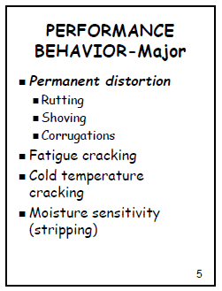
Answer - M1-Q1; (slide 5)
Permanent Distortion
Fatigue Cracking
Cold Temperature Cracking
Moisture Sensitivity (Stripping)

Slide 5
Module 1
2. Where are guidelines for testing and inspection of MoDOT projects found?

Slide 6
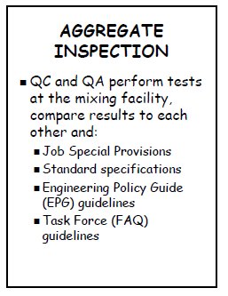
Answer - M1-Q2; (slide 71)
EPG guidelines
Task Force (FAQ) guidelines

Slide 7
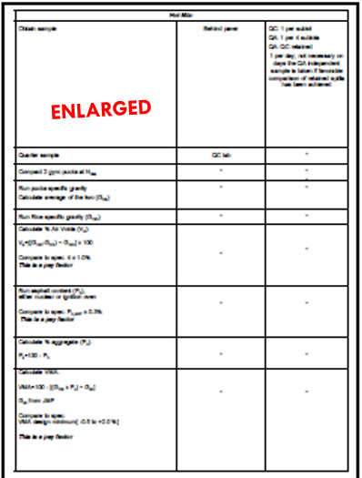
Module 1
3. What is the 403 target for air-voids for an SP250 mix?
Answer (Slide 74): Va = 4 ± 1.0%

Slide 8
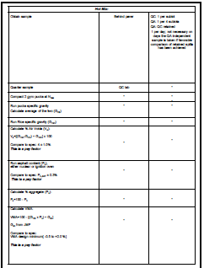
Module 1
4. What is the 403 - field tolerance for VMA?
Answer (Slide 74) :
VMA Design Minimum is - 0.5 to 2.0%
ENLARGED

Slide 9
Module 2 Mix Design Overview Mix Design/Pavement Structure Design
1. For an SP125B mix, what is the design traffic level in ESALS?

Slide 10
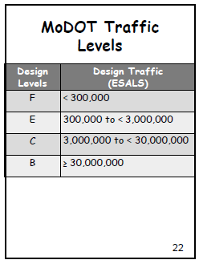
Answer - M2- Q1; (slide 22)
SP125B mix
≥ 30,000,000

Slide 11
Module 2
2. What specifications cover Superpave mixes for Hot Mix and for Aggregate?

Slide 12
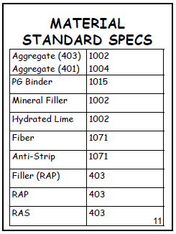
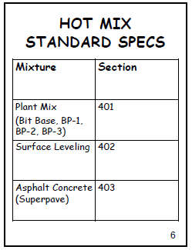
Answer - M2 - Q2; (slides 6 and 11)
1002 and 403 Superpave
NOTE:
SPECS = Specifications

Slide 13
Module 2B Mix Design Overview - Aggregate Quality
1. For SP125B mix, during the design phase, what is the minimum (or maximum, or acceptable range) acceptance level for the following:
a. Fractured face count (CAA)
b. Fine Aggregate shape (FAA)
c. Sand Equivalent (SE)
d. Flat and Elongated (F & E)

Slide 14
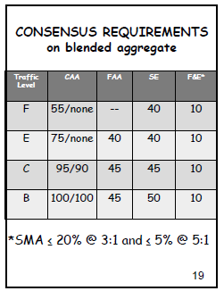
Answer - M2B - Q1; (slides 19)
a. Fractured face Count = 100/100
b. Fine Aggregate Particle Shape = 45
c. Sand Equivalent = 50
d. Flat and Elongated = 10
NOTES:
CAA = Coarse Aggregate
FAA = Fine Aggregate
SE = Sand Equivalent
F&E = Flat & Elongated

Slide 15
Module 2C Mix Design Overview - Binder, Rap, & Shingles
1. For a 70-28, what do the number signify?

Slide 16
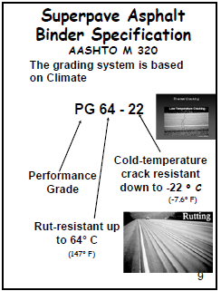
Answer - M2C - Q2; (slides 9)
70 = Rut Resistant up to 70°C
-28 = Cold temperature cracking resistant down to -28°C
NOTES:
PG= Performance Grade

Slide 17
Module 2C
2. For the following M320 binder grades, what are the ~ equivalent M322 grades?

Slide 18
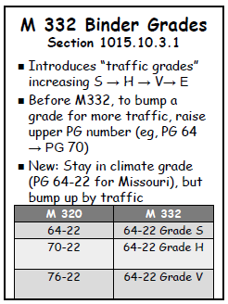
Answer - M2C - Q2; (slides 63)
M320 | M332
PG 64-22 | 64-22 Grade S
PG 70-22 | 64-22 Grade H
PG - 76-22 | 64-22 Grade V
NOTE:
S = Standard Traffic
H = Heavy Traffic
V = Very Heavy Traffic

Slide 19
Module 2C
3. What is the major extra test in M322 compared to M320?

Slide 20
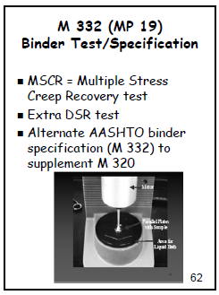
Answer - M2C - Q3; (slides 62)
MSCR Test
Multiple Stress Creep Recovery
NOTE:
Asphalt binder is tested on a DSR Instrument.
DSR = Dynamic Shear Rheometer

Slide 21
Module 2C
4. For a mix containing RAP, what materials may be in the IN-LINE binder grade compared to the contract grade?
NOTE:
RAP = Recycled Asphalt Product
A rejuvenator will most likely be used to
revive the aged binder of RAP. In addition, because the binder is aged it will grade high on a DSR machine, so the RAP will be mixed with a soft virgin binder, like a PG 58 – 22 to bring the grade down.
Virgin Binder : Is a binder that has NO additives or modifiers in it, sometimes it is also called a NEAT BINDER or NEAT ASPHALT.

Slide 22
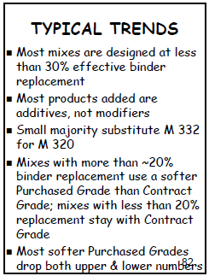
Answer - M2C - Q3; (slides 82)
Soft Virgin Binder
Additives/Modifiers/Rejuvenators

Slide 23
Module 2D Mix Design Overview Volumetrics
1. For an SP125B mix, during the design phase, what is the minimum or acceptable range) for:
a. Air-voids
b. VMA
c. VFA

Slide 24
Answer -

Slide 25
Module 2D
2. Calculate the combined (weighted average) Gsb of the aggregate blend shown on the attached JMF.
NOTE:
JMF = Job Mix Formula

Slide 26
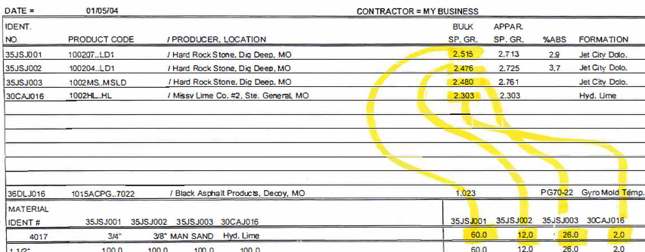
Job Mix Formula

Slide 27
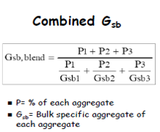
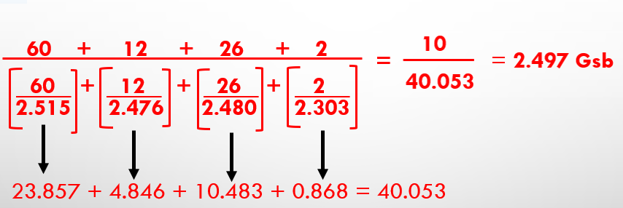
Answer - M2D - Q2; (Slide 73)

Slide 28
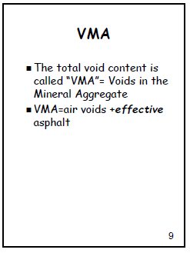
Module 2D
3. What 2 things occupy the space in VMA?
ANSWER(SLIDE 9):
VMA =
Air Voids + Effective Asphalt

Slide 29
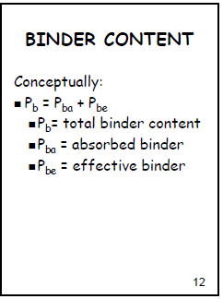
Module 2D
Total binder content has 2 portions.
What are they?
ANSWER (SLIDE 12):
Total Binder Content =
Absorbed Binder + Effective Binder

Slide 30
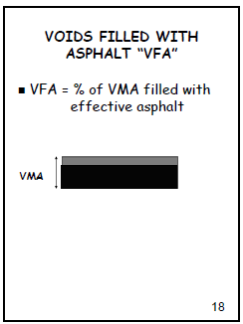
Module 2D
5. Describe what VFA represents?
ANSWER (SLIDE 18):
% of VMA filled with effective asphalt.

Slide 31
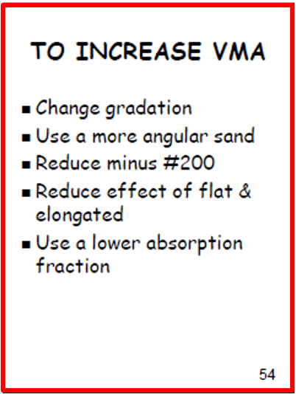
Module 2D
6. In general, what 5 things can be done to increase VMA?
ANSWER (SLIDE 54):

Slide 32
Module 2D
7. What 2 tests are used to determine Bulk Specific Gravity of aggregate?

Slide 33
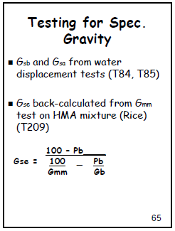
Answer - M2D - Q7; (slide 65)
1. T84
(Specific gravity of fine Aggregate)
2. T85
(Specific gravity of Coarse Aggregate).

Slide 34
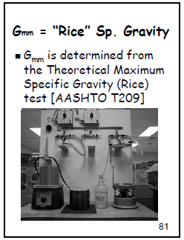
Module 2D
8. What test is used to determine Effective Specific Gravity of aggregate?
ANSWER (SLIDE 81):
T209 – Rice - Specific Gravity - Gmm

Slide 35
Module 2E and 2F Mix Design Overview - Mix Design Phase 1 & 2
1. During the design phase, for an SP125B mix, what are the required number of gyrations for Nini, Ndes, and Nmax?

Slide 36
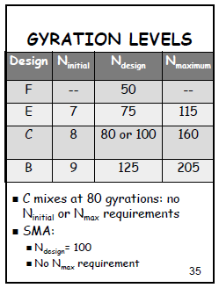
Answer - M 2E and 2F - Q1; (slide 35)
Nini = 9
Ndes = 125
Nmax = 205

Slide 37
Module 2E and 2F
2. During the design phase, for an SP125B mix, what are the required compaction levels (%Gmm) for Nini, Ndes, and Nmax?

Slide 38
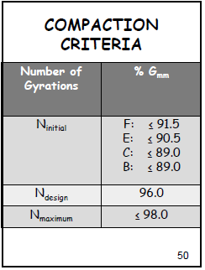
Answer - M 2E and 2F - Q2; (slide 50)
Nini : ≤ 89.0
Ndes: 96.0
Nmax: ≤ 98.0

Slide 39
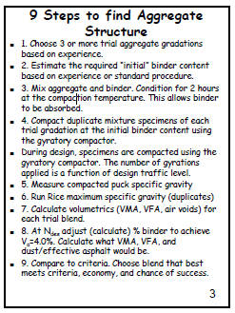
Module 2E and 2F
3. Phase 1 is to determine design gradation or final binder content?
ANSWER (SLIDE 3):
Gradation

Slide 40
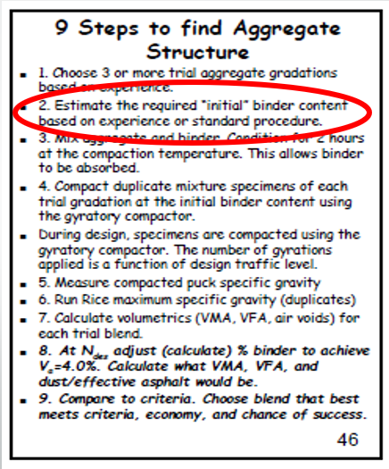
Module 2E and 2F
4. Phase 2 is to determine gradation or final binder content?
ANSWER (SLIDE 46):
Final binder content

Slide 41
Module 2G Mix Design Overview: TSR JMF & Field verification Miscellaneous
1. What 9 pieces of information on the JUM can be useful to the QC or QA?

Slide 42
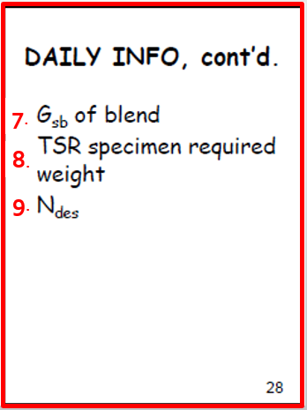
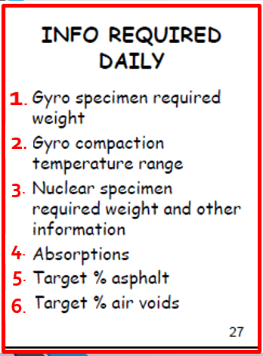
Answer – m2G; (slide 46)

Slide 43
Module 3 Plant Operations - Gradation
1. For QC; What is the minimum sampling frequency for gradation samples at the HMA plant?
Should they retain a split?

Slide 44
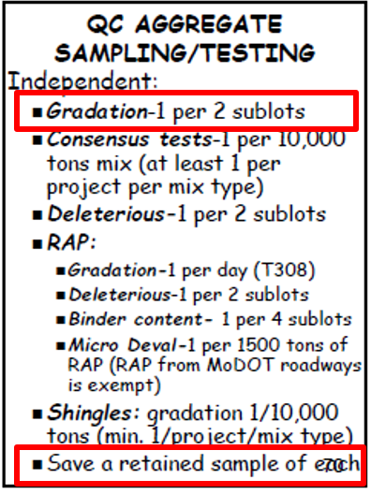
Answer - M3 - Q1; (slide 70)
1 per 2 sublots
Yes, they should retain a split.

Slide 45
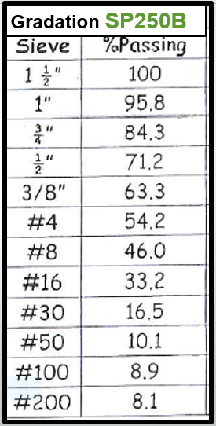
Module 3
2. For an SP250B mix, given the following QC, sample’s gradation off the cold feed at a drum mix plant, what specifications (with tolerances applied) should the sample meet?
Did the gradation pass?

Slide 46
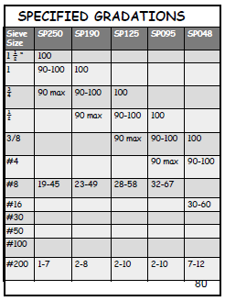
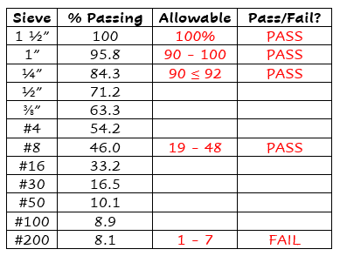
Answer - M3 – Q2; (slide 80)
NO, Failed on #200 sieve.

Slide 47
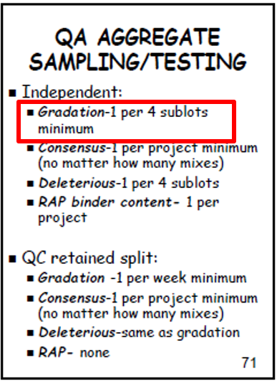
Module 3
3. For QA: What is the minimum sampling frequency for the independent gradation samples at the HMA plant?
ANSWER (SLIDE 71):
1 per 4 Sublots

Slide 48
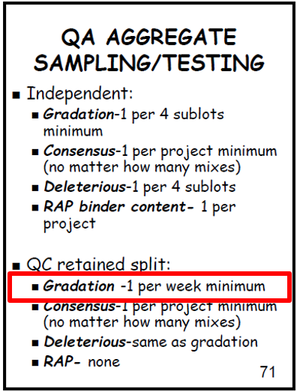
Module 3
4. What is QA’s minimum testing frequency for the QC retained splits for gradation samples at the plant?
ANSWER (SLIDE 71):
1 Per week minimum

Slide 49
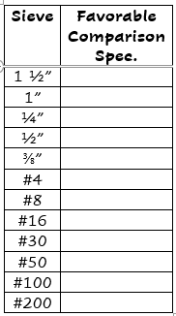
Module 3
5. When comparing QA to QC gradations from retained splits, what is considered “Favorable comparison”?

Slide 50
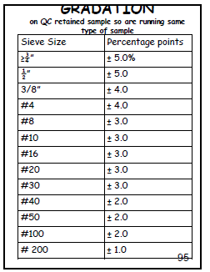
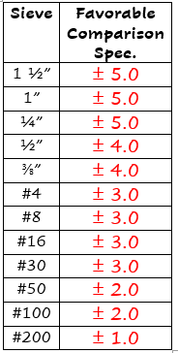
Answer - M3 – Q5; (slide 95)

Slide 51
Module 3 - Plant Operations - Consensus Tests
6. For QC, what is the minimum sampling frequency for consensus test samples at the HMA plant for QC?
Should they retain a split?

Slide 52
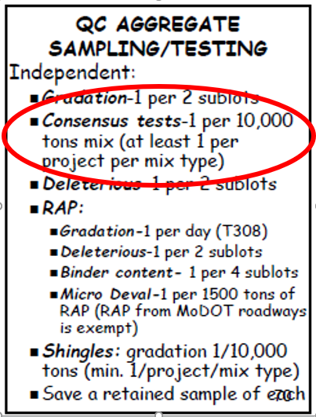
Answer - M3 – Q6; (slide 70)
1 per 10,000 TONS
1 per project per mix type
YES, retain a split

Slide 53
Module 3 - Plant Operations - Consensus Tests
7. For QC: For an SP250B mix, what are the allowable limits (Specification with field tolerances applied) for consensus test values? Given the following QC consensus test results, did the sample pass?

Slide 54
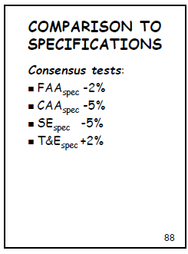
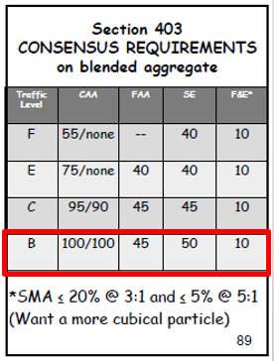
Answer - M3 – Q6; (slide 70)
No,
SE Sand Equilivent Test Failed

Slide 55
Module 3 - Plant Operations - Consensus Tests
8. For QA: What is the minimum sampling frequency for independent QA consensus test samples at the HMA plant?

Slide 56
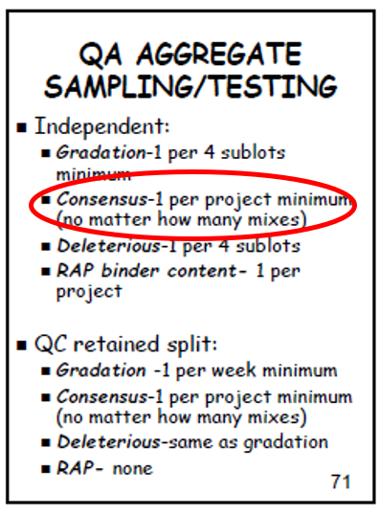
Answer - M3 – Q7; (slide 71)
1 per project per mix type
No matter how many mixes.

Slide 57
Module 3 - Plant Operations - Consensus Tests
9. For QA: What is QA’s minimum testing frequency for the QC retained splits for consensus test samples at the HMA plant?

Slide 58
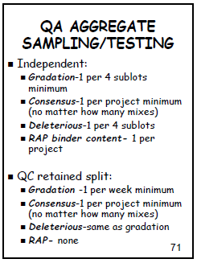
Answer - M3 – Q9; (slide 71)
1 per project minimum.
(no matter how many mixes)

Slide 59
Module 3 - Plant Operations - Consensus Tests
10. When comparing QA to QC consensus test results from retained splits, what is considered “favorable comparison”? Given the following, is there a “favorable comparison”?

Slide 60
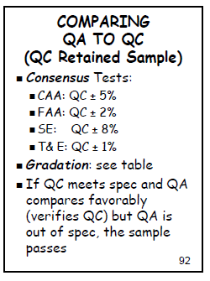
Answer - M3 – Q10; (slide 92)
YES, favorable comparison on all four tests.

Slide 61
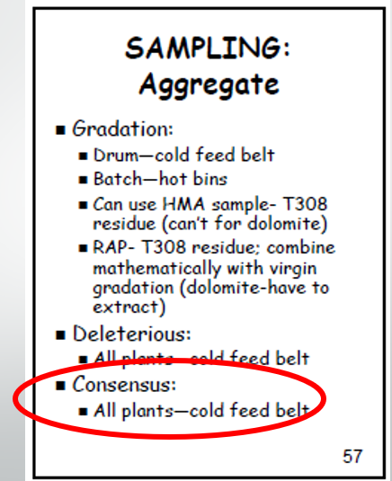
Module 3 - Plant Operations - Consensus Tests
Where should the consensus
sample be taken?
ANSWER (SLIDE 71):
Cold Feed Belt

Slide 62
Module 3 - Plant Operations - Deleterious Material
12. For QC: what is the minimum sampling frequency for QC deleterious material samples at the HMA plant?

Slide 63
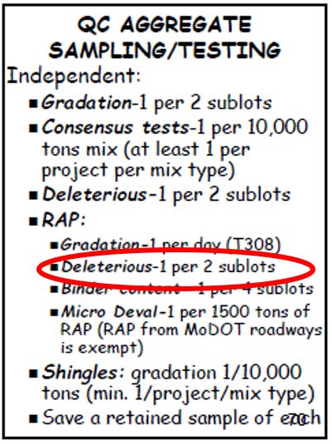
Answer - M3 – Q12; (slide 70)
1 per 2 Sublots

Slide 64
Module 3 - Plant Operations - Deleterious Material
13. For QA: What is the minimum sampling frequency for independent QA deleterious material test samples at the HMA plant?

Slide 65
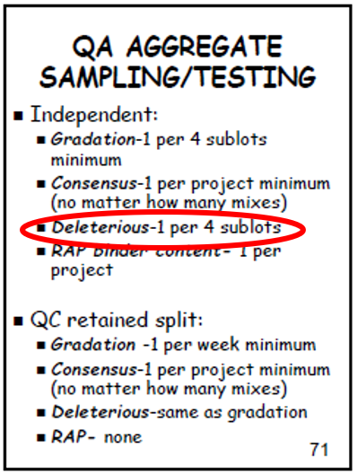
Answer - M3 – Q13; (slide 71)
1 per 4 Sublots

Slide 66
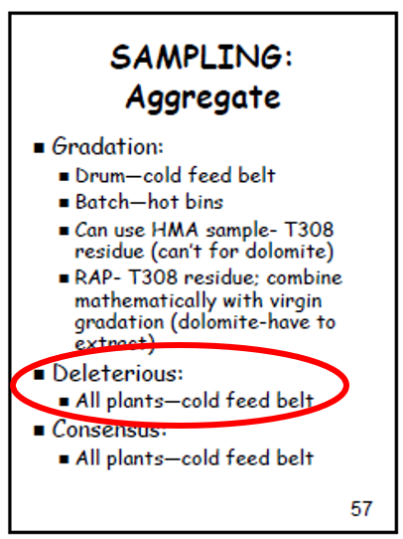
Module 3 - Plant Operations - Deleterious Material
14. Where should the deleterious sample for aggregate be taken?
ANSWER (SLIDE 71):
All plants – Cold feed belt

Slide 67
Module 3 - Plant Operations - General
15. What does MoDOT do on an annual basis at the quarry?

Slide 68
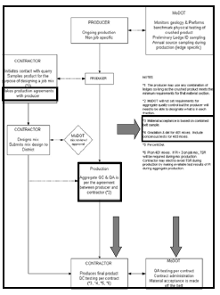
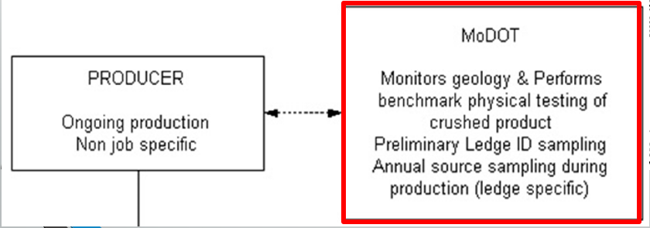
Answer - M3 – Q14; (slide 55)

Slide 69
Module 4 QC/QA Overview and Hot Mix Asphalt quality Control Plan
1. In the QC plan short form, what information is required about lots and sublots?

Slide 70
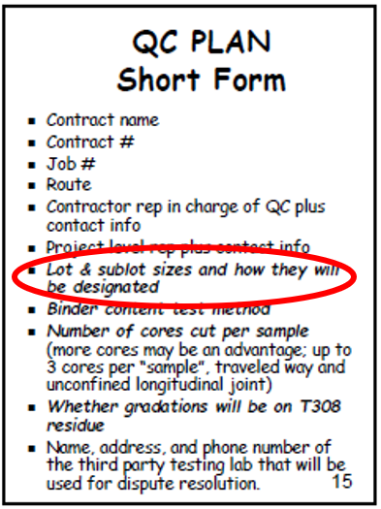
Answer - M4 – Q1; (slide 15)
Lot and Sublot sizes and how they will be designated.

Slide 71
Module 4
2. In the QC plan short form, what information is required about binder content testing?
ANSWER (SLIDE 15):
Binder Content Test Method

Slide 72
Module 4
3. In the QC plan short form, what information is required about coring?
ANSWER (SLIDE 15):
Number of cores cut per sample

Slide 73
Module 4
4. What is a very critical item in the agreement between the HMA producer and the aggregate producer?
ANSWER (SLIDE 5):

Slide 74
Module 4
5. In the QC plan short form, what information is required about the gradation sample?
ANSWER (SLIDE 15):
Whether gradations will
be on T308 residue.

Slide 75
Module 5 Sampling Loose Mix and Cores
1. For routine lots, are there requirements for lot size under the 403 specification contracts?

Slide 76
Answer - M5 – Q1; (slide 6)
No Specified Limitation.

Slide 77
Module 5
2. What are the minimum number of sublots per lot?
ANSWER (SLIDE 7):
4 sublots per lot.

Slide 78
Module 5
3. What is the maximum sublot size?
ANSWER (SLIDE 7):
1,000 TONS.

Slide 79
Module 5
4. Are non-integral shoulders included in the traveled way lot routine?
ANSWER (SLIDE 8):
NO

Slide 80
Module 5 – For Volumetrics / Binder content loose mix samples:
1. For QC: What is the frequency of sampling for QLA analysis?
Is a retained sample required?
Should the location be random?

Slide 81
Answer - M5 – Q1; (slide 16)
One per Sublot
Yes,
A retained sample is required.
Yes,
The location should be random.

Slide 82
Module 5 - For Volumetrics / Binder content loose mix samples:
2. For QA: Who should obtain the independent QA QLA loose mix sample QA or QC?
At what minimum frequency?
Is a retained sample required?
Should the location be random?
NOTE:
QLA = Quality Level Analysis

Slide 83
Answer - M5 – Q2;
(Slide 26) Who? Independent QA QLA. QA or QC? QA
(Slide 18) At what minimum frequency? One per 4 sublots
(Slide 19) Is a retained sample required? Yes
(Slide 21) Should the location be random? Yes

Slide 84
Module 5 - For Volumetrics / Binder content loose mix samples:
3. List the steps in the sample quartering process.

Slide 85
Answer - M5 – Q3; (slide 60 & 75)
1. Mix, avoid segregation.
Split/Quarter.
Combine & retain opposite quarter
(50 lbs.).
Combine other
two quarters (50 lbs.).

Slide 86
Module 5 - For Volumetrics / Binder content loose mix samples:
4. For QA: What is the minimum testing frequency of the QC retained sample?

Slide 87
Answer - M5 – Q4; (slide 18)
One per day

Slide 88
Module 5 - For Volumetrics / Binder content loose mix samples:
5. N/A? NOTE: Avoid heating above molding temperature
6. What are check samples used for?

Slide 89
Answer - M5 – Q6; (slide 11)
* Check how the mix is doing
* Investigate problems
* Determine Limits of the problem
NOTE:
QLA = Quality Level Analysis

Slide 90
Module 5 - For Volumetrics / Binder content loose mix samples:
7. In order for a check sample to be used for defining removal limits, what information must be tied to it?
ANSWER (SLIDE 15):
* Gyro pucks
* Gyration/height printouts
* Binder content printouts

Slide 91
Module 5 - For Volumetrics/Binder content loose mix samples.
ANSWER (SLIDE 11):

Slide 92
Module 5 – For TSR loose mix samples:
1. What is the frequency of sampling QC?
ANSWER (SLIDE 22):
One per 10,000 TONS

Slide 93
Module 5 – For TSR Loose Mix Sample
2. For QA: Who should obtain the independent QA loose mix sample QC or QA?
At what minimum frequency should the sample be taken?

Slide 94
Answer - M5 – Q2; (slide 22)
QA obtains the independent
loose mix sample.
QA = One per 50,000 TONS
or
Minimum 1 per combination of
projects.

Slide 95
Module 5 – For TSR Loose Mix Sample
3. List the steps in the TSR sample quartering process.

Slide 96
Answer - M5 – Q3; (slide 88, 89, 90)

Slide 97
Module 5 – For TSR Loose Mix Sample
4. What locations are allowable for TSR samples?

Slide 98
Answer - M5 – Q4; (slide 21,22)
Random Sample Locations.
Roadway, Plant Discharge
and Truck.

Slide 99
Module 5 – For TSR loose mix samples:
5. Should QA get their sample at the same location?
ANSWER (SLIDE 23):
Yes, but not at the same time.

Slide 100
Module 5 – cores from the traveled way:
1. Does QA obtain an independent core?
ANSWER (SLIDE 103):
Yes

Slide 101
Module 5 – cores from the traveled way
2. What is the minimum QA witnessing/testing frequency for cores?
ANSWER (SLIDE 103):
1 sample per 4 sublots.

Slide 102
Module 5 – Cores from the traveled way:
3. What is the minimum QC Sampling and testing frequency for core samples?
ANSWER (SLIDE 103):
1 sample per sublot.

Slide 103
Module 5 –
Cores from the traveled way:
4. What is meant by a core “sample”?
ANSWER (SLIDE 103):
ONE CORE

Slide 104
Module 5 – cores from unconfined longitudinal joints:
1. What is the sampling frequency?
ANSWER (Slide 116)
QC 1 per Sublot, QA 1 per Sublot
Module 5 – cores from non-integral shoulders:
1. What is the sampling frequency?
ANSWER (Slide 116)
QC 1 per Sublot, QA 1 per Sublot

Slide 105
Module 5 – sampling points homework:
1. For a 3,000 ton lot, divide into 4 sublots and determine at what tonnage the loose mix samples should be taken, and at what roadway offset. The roadway is 12ft wide, with no unconfined joints. For random numbers, use the table in Module 5: column 3, starting with number set 11 (from the top). Choose 4 pairs (A and B) of numbers moving down the column.

Slide 107
NOTE: 3,000/4 = 750 TONS
MODULE 5 – PROBLEM 1
Use Regular Rounding

Slide 108
MODULE 5 – PROBLEM 1
Use Regular Rounding

Slide 109
Module 5 – sampling points homework:
2. For the same lot, determine the sampling points for all QC cores in the lot. 1100 + 00. The sublot ending stations are 1050 + 50, 1100 + 50, 1149 + 00, and 1199 + 10. The roadway width is 12ft. For random numbers, use column 4, starting with number set 6 (from the top). Choose 4 pairs (A and B) of numbers moving down the column.

Slide 111
ANSWER -
Use Regular Rounding
MODULE 5 – PROBLEM 2

Slide 112
ANSWER -
MODULE 5 – PROBLEM 2
Use Regular Rounding

Slide 113
Module 6 Gyratory Compactor Operations AASHTO T312
What height should the volumetrics gyro pucks be compacted to at the end of the prescribed number of gyrations?
How about the TSR pucks?

Slide 114
Answer - M6 – Q1; (slide 17)
Volumetrics pucks: 115 ± 5 mm
TSR pucks: 95± 5 mm

Slide 115
Module 6
2. What is the difference between gyro verification and calibration?
NOTE: Gyro = Gyratory Compactor

Slide 116
Answer - M6 – Q2; (slides 70, 81,77)
Note: Extra information added by Donna
Verification:
Verifies if the calibration is still in spec.
No adjustments made
Uses external angle
Shorter version
Calibration:
Calibrates the gyro.
Adjustments can be made to bring the gyro in spec.
Uses internal angle
Full calibration – takes longer to do.

Slide 117
Module 6
3. How often should gyro verification be performed and in what condition should the gyro be in?
NOTE: Gyro = Gyratory Compactor

Slide 118
Answer - M6 – Q3; (slide 77)

Slide 119
Module 6
4. How often should calibration be performed on the Gyratory?
ANSWER (SLIDE 66):

Slide 120
Module 6
What five things do
you check during gyro verification?
ANSWER (SLIDE 76):

Slide 121
Module 6
6. During field verification of mix volumetric properties, specimens should be compacted to which number of gyrations: Nini, Ndes, or Nmax?
ANSWER (SLIDE 32):
N_{des}

Slide 122
Module 6
7. During field verification of mix volumetric properties, what do you use the gyro-compacted puck data (G_{mb}) for?
ANSWER (SLIDE 9):
Gmb is not only used to calculate volumetric properties, but also used for Tenderness potential (density), and Moisture sensitivity, (TSR).

Slide 123
Module 6
8. Where do you obtain the specimen weight for volumetric gyro pucks??
ANSWER (SLIDE 16):

Slide 124
Module 6
9. Is the required TSR puck weight different from the volumetric gyro puck weight?
ANSWER (SLIDE 124):
Yes

Slide 125
Module 6
10. Calibration is to be of which angle, internal or external?
ANSWER (SLIDE 70):
Internal

Slide 126
Module 6
11. The internal calibration angle should be?
ANSWER (SLIDE 70):
1.16 ± 0.02°

Slide 127
Module 6
12. How is angle verification handled?
ANSWER (SLIDES 80 and 81):
The external angle verified monthly during production; it must correspond to be within the proper internal angle range as established during calibration.

Slide 128
Module 6
13. How often should the critical mold dimensions be checked?
ANSWER (SLIDE 86):
Minimum of 12 months

Slide 129
Module 7 Maximum specific Gravity of Voidless loose mix (rice) - Gmm
On the accompanying data sheets, calculate G_{mm} of the loose mix, Gmb of the compacted gyro puck, and the volumetrics: air voids (V_{a}), VMA and VFA.
- Re-calculate G_{mm} if the dry-back procedure is used, and the new surface dry weight (A2) is 1574.4g.

Slide 130
ANSWER – M7 – Q1; (SLIDE 103)
Use Regular Rounding

Slide 131
ANSWER – M7 – Q1; (SLIDE 103)
Use Regular Rounding

Slide 132
ANSWER – M7 – Q1; (SLIDE 103)
Use Regular Rounding
DRY BACK

Slide 133
ANSWER – M7 – Q1; (SLIDE 103)
Use Regular Rounding
DRY BACK

Slide 134
Module 7
2. Of what use is Rice gravity (Gmm) data?
ANSWER (SLIDE 6):
Compute air voids and
to Compute Pavement density

Slide 135
Module 7
3. What should be the air void content of a Rice Specific Gravity Specimen?
ANSWER (SLIDE NA):
Zero

Slide 136
Module 7
4. Where do you obtain the Rice sample?
ANSWER (SLIDE 5):
Behind a paver,
TSR sample,
Truck,
Roadway, Plant

Slide 137
Module 7
5. What are the 2 ways of verifying that the moisture content in the Rice specimen is below the maximum allowed?
ANSWER (SLIDE 10):
Dry specimen to constant mass
or
Run AASHTO T329

Slide 138
Module 7
6. Under what condition do you employ the “dry-back” procedure?
ANSWER (SLIDE 20):
When the absorption is > 2%

Slide 139
Module 7
7. What are the minimum required sample sizes for the following?
a. SP125 -
b. SP190 -
c. SP250 -

Slide 140
Answer – M7 – Q7; M5, slide 75 Quartering Loose Mix Step 5

Slide 141
Module 7
8. Why do you crumble the Rice gravity specimen?
ANSWER (no SLIDE):
To eliminate air from the sample

Slide 142
Module 7
9. Why do you shake the
rice gravity specimen?
ANSWER (SLIDE 28):
To de-air the sample.

Slide 143
Module 7
10. Why do you pull a vacuum on Rice gravity specimen?
ANSWER (SLIDE 28):
To de-air the sample, to aid in reaching Zero Air-voids.

Slide 144
Module 7
11. What is the official name of the Rice gravity?
Theoretical Maximum specific Gravity
ANSWER :

Slide 145
Module 8 Asphalt content ignition oven method t308
1. What is the “aggregate Calibration (or, Correction) Factor” [now called the “Asphalt Binder Correction Factor”]? How is it applied? Who determines it?.
-What:
-How applied:
-Who determines QC or QA?

Slide 146
Answer – M8 – Q1; (slide 54, 55)
-What: To correct for loss of mass during the mix ignition due to aggregate burn-off.
Who determines QC or QA?
QC usually determined during mix design.

Slide 147
Answer – M8 – Q1; (slide 54, 55)
-How applied:
The difference between the measured and the actual % binder is the Asphalt binder Cf.

Slide 148
Module 8
2. For the Thermolyne brand oven, what is the “Temperature compensation”?
What?
How is it applied?

Slide 149
Answer – M8 – Q2; (slide 66)
-What is the “Temperature compensation”? Apparent loss in weight due to heating = TCF
How is it applied? Taken off the oven print out if weighed in the oven.
Subtracted from total loss.

Slide 150
Module 8
3. What is the “Chamber Set Point”? Who decides which of the standard values should be used?
What?
Who decides (QC or QA)?

Slide 151
Answer – M8 – Q3; (slide 58)
- What is the set point: 538C, High Cf’s (>1.0%): 482 C
Very High Cf’s 427C
Who decides (QC or QA)?
QC

Slide 152
Module 8
4. On the accompanying “calibration” data sheet, calculate the Asphalt Binder Correction Factor [Aggregate Correction” Factor] (Cf). Assume that the moisture content of the [ab-produced mix is zero. All weighting steps will be performed on an exterior scale.
5. On the accompanying “HMA Moisture Correction” data sheet, calculate moisture content of a plant-produced HMA sample.

Slide 153
Module 8
6. On the accompanying HMA Asphalt Content (NCAT oven method) data sheet. (“Reproducing Oven Ticket Values”), record the appropriate information from the oven ticket and calculate the moisture-corrected asphalt content of the plant-produced HMA sample (use the moisture determined in question 5).
Note: oven tape Weight loss = 135.6g
oven tape Temperature compensation (%) = 0.12%
oven tape Calib. Factor (Cf) = 0.98%

Slide 154
Module 8
7. Something happens during an ignition oven test, and you must finish the test manually. You obtain the [Final mass of basket + burned specimen] by weighing on your bench balance. Previous information about this specimen is that there was 0.1% moisture in it, and the aggregate correction factor for the mix is 0.98%. On the accompanying form (Manual Weighing Method”), calculate the binder content.

Slide 155
Answer – M8 – Q4 to Q7; (slide 57)
Use Regular Rounding
M1 = 4500 – 3000 = 1500
M2 = 4480 – 3000 = 1480
M1 = (81/1500) x 100 = 5.40
M2 = (79.2/1480) x 100 = 5.35
M1 = 5.40 – 5.01 = 0.39
M2 = 5.35 – 5.02 = 0.33

Slide 156
Answer – M8 – Q4 to Q7;
Use Regular Rounding

Slide 157
Answer – M8 – Q4 to Q6;
Use Regular Rounding

Slide 158
Answer – M8 – Q4 to Q7;
Use Regular Rounding

Slide 159
Module 8
8. At what point is the moisture content determined, during mix design or during field sampling? Who determines the moisture content, QC or QA? How is the moisture correction applied?
When determined:
Who (QC or QA):
How used:
8. If the Aggregate Correction Factor exceeds 1.0% at 482 C, MoDOT specs dictate that the Chamber Set Point (Ignition temperature) should be _______?

Slide 160
Answer – M8 – Q8, Q8; (slide 58)
8. At what point is the moisture content determined, during mix design or during field sampling? Who determines the moisture content, QC or QA?
How is the moisture correction applied?
When determined: Field Sample
Who (QC or QA): QC or QA
How used: Subtract from apparent binder content (Total Loss)
8. If the Aggregate Correction Factor exceeds 1.0% at 482°C, MoDOT specs dictate that the Chamber Set Point (Ignition temperature) should be __482 ° C_____?

Slide 161
Module 8
9. If the Aggregate Correction Factor exceeds 1.0% at 482 C, MoDOT specs dictate that the Chamber Set Point (Ignition temperature) should be ______ ?
Answer – (slide 58)
427 °C

Slide 162
Module 8
10. What test method is specified for moisture determination of hot mix samples?
ANSWER (SLIDE 47):
AASHTO T 329

Slide 163
Module 8
11. Is it allowable to use the residue of an ignition oven test for gradation analysis?
ANSWER (SLIDE 987):
YES

Slide 164
Module 8
12. What may be necessary to determine if you were going to use an Ignition oven sample for gradation purposes?
ANSWER (Slide 98)
Aggregate (gradation) Correction Factor

Slide 165
Module 8
13. What is the QC testing frequency of RAP binder content?
ANSWER (Slide 95)
1 per 4 Sublots

Slide 166
Module 8
14. What is the QA testing
frequency of RAP binder content?
ANSWER (Slide 95)
1 per project

Slide 167
Module 8
15. What testing method for RAT binder is specified?
ANSWER (Slide 95)
T164 Solvent Extraction

Slide 168
Module 8
16. Under what conditions can a different RAP binder content test method be substituted?
ANSWER (Slide 95)
T308 (Ignition Oven) if a correction factor is determined which is the difference between T164 Solvent Extraction and T308 Ignition Burn off.

Slide 169
Module 8
17. What is the frequency of oven verification?
ANSWER (Slide 106)
Yearly and after each move.

Slide 170
Module 9 tensile strength ratio (tsr)
1. What should be the finished height of the TSR puck?
ANSWER - (Slide 57)
95 ± 5 mm tall

Slide 171
Module 9
2. What should be the finished air void content of the TSR puck?
ANSWER (Slide 57)
7.0 ± 0.5%
(SMA 6.0%)

Slide 172
Module 9
3. What should be the finished % saturation of the TSR puck?

Slide 173
Module 9
3. What should you do if the core is high on saturation?

Slide 174
Module 9
4. If the TSR (during production is 72, what is the pay adjustment factor?

Slide 175
Module 9
4. If the TSR (during production is 72, what is the pay adjustment factor?
ANSWER - (Slide 19)
98 %

Slide 176
Module 9
5. Under what conditions is TSR required for BP and BB mixes?

Slide 177
Module 9
6. List some things that might happen which would cause the lab running the TSR to call for more sample?
ANSWER (Slides 64, 65)

Slide 178
Module 10A Quality Level Analysis – pay factors
1. The Pay Factors for a 4000 ton lot of material placed on the traveled way are as follows. Compute the overall pay factor for this lot:
If the contract unit price per ton of hotmix is $65.00, calculate the bonus or deduct for this lot:

Slide 179
ANSWER – M10A Q1; (SLIDE 13, 6)
99.6/100 = 0.996

Slide 180
Module 10A

Slide 181
Module 10A
3. During HMA production, what are the specification limits (with field tolerances applied) for:
ANSWER (Slide 3)

Slide 182
Module 10B Quality Level Analysis – Favorable & unfavorable comparison
1. How close must the QA results be to the mean of the QC results in order for the data from QC be considered valid so that the QC results can be used to compute pay factors?
Rule#1:
Rule#2:

Slide 183
Answer – M10B – Q1; (slide 4)
Rule#1:
Within 2 standard deviations
Rule#2:
Within ½ of the specification tolerance

Slide 184
Module 10B
2. If QC’s mean binder content is 5.80% with a standard deviation of 0.20% and QA’s binder content is 5.67%, is there favorable comparison?
Note: You will need slide 3 from Module 10A to answer this question.

Slide 185
Answer – M10B – Q2; (slide 3 from M10a and slide 4 from m10b)
0.20 is standard deviation given in the question
0.3 is from Spec limits chart

Slide 186
Module 10B
3. If QC’s mean binder content is 5.80% with a standard deviation of 0.50% and QA’s binder content is 5.67%, is there favorable comparison?
Note: Again, you will need slide 3 from Module 10A to answer this question.

Slide 187
Answer – M10B – Q2; (slide 3 from M10a and slide 4 from m10b)
0.50 is standard deviation given in the question
0.3 is from Spec limits chart

Slide 188
Module 10B
4. If there is unfavorable comparison between QC and QA, to resolve the issue, what is the first step?
Answer (slide 20)

Slide 189
Module 10B
5. If all data appears to be correct, what 2 alternate courses of action could be taken?

Slide 190
Module 10B
6. If a retained sample is tested, what tests must be run?
Answer (slide 23)
Gmm, Gmb, Pb

Slide 191
Module 10B
7. What constitutes favorable comparison between the 2 original and retained sample test results?
Answer – (slide 24)
Gmm within 0.005
Gmb within 0.010
Pb with in 0.1%

Slide 192
Module 10B
8. If there is favorable comparison between the original and retained sample test results, what should be done?
Answer – (slide 24)
Use original in data set and add QA’s results.
Rerun the PWL Analysis

Slide 193
Module 10B
9. If there is un-favorable comparison between the original and retained sample test results, what should be done?
Answer – (slide 26)
Substitute (Pb, Gmm, Gmb) results from retained
Split, re-calculate Va and VMA.

Slide 194
Module 10B
10. If the retained sample test results are substituted for original results and the lot comparison still shows unfavorable comparison between QC and QA, what should be done?
Answer – (slide 26)
Add in QA’s Results
Rerun PWL Analysis.

Slide 195
Module 10C Quality Level Analysis – Miscellaneous
Under what circumstances would material be considered for removal & replacement?

Slide 196
ANSWER – M10C - Q1; (SLIDE 17)
PF < 50.0
TSR < 65%
Air Voids < 2.5%
Any sub-lot with < 90.0 or >98% density
Unconfined joint density < 88.0% or
> 98.0%

Slide 197
Module 10C
2. The payment for non-integral should lots can also be adjusted for Density by use of the Density pay adjustment Table.
Answer – (slide 13)

Slide 198
Module 10D Quality Level Analysis – Performance Testing
1. What are the two performance tests currently being explored through JSP’s?
Answer – (slide 3)
Fatigue cracking – FI or Ideal CT
Rutting – Hamburg Wheel Tracker

Slide 199
Module 11 Record keeping & exchange of data
1. What lab equipment calibration records must be kept?
Answer – (slide 6)

Slide 200
Module 11
2. A record of certain information must be kept 3 years. List the types of required information.
Answer – (slide 9)

Slide 201
Module 11
3. In regard to test data and results, when should QC make it available to QA and what info is required?
Answer – (slide 10)

Slide 202
Module 11
4. In regard to test data and results, when should QA make it available to QC and what info is required?
Answer – (slide 10)
Not later than the beginning of the next workday.
Raw data including Gyros and Binder printouts

Slide 203
Module 11
5. List some things that a process review team may ask for.
Answer – (slide 3,4,5,6)

Slide 204
Module 12 contract administration
Are MoDOT inspectors limited to taking only random HMA samples off the roadway?
Answer – No – Can take check samples
Under what conditions can self-test results be used for determining removal limits?
Answer – Gyro and Binder Printouts, Well documented

Slide 205
THE END
09/10/2021

