Slide 1
Route P from Gravois Road to Watson Road Improvements
December 15, 2020

Slide 2
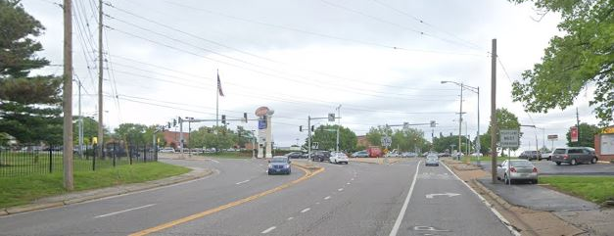
What is the purpose of this project?

Slide 3
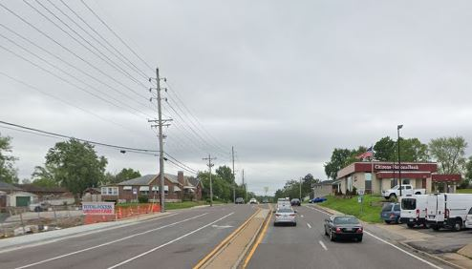
Main Goal: Enhance safety
The purpose of this project is to improve safety on Route P from Gravois to Watson by converting the raised shoulders into sidewalks to meet Americans with Disabilities Act requirements, updating signals and pedestrian crossings and replacing the driving surface.

Slide 4
Route P roadway improvements Gravois to Watson
If you have questions, please share them in Q&A

Slide 5
Route P roadway improvements Gravois to Watson

Slide 6
If you have questions, please share them in Q&A

Slide 7
If you have questions, please share them in Q&A

Slide 8
If you have questions, please share them in Q&A

Slide 9
If you have questions, please share them in Q&A

Slide 10
If you have questions, please share them in Q&A

Slide 11
If you have questions, please share them in Q&A

Slide 12
What are the anticipated impacts?
Construction details have not been finalized at this time. We have confirmed a timeline of construction beginning in spring 2022. A completion date is estimated to be in late fall 2022. MoDOT will work with business owners and residents to ensure that access is available during construction.

Slide 13
What is the anticipated timeline?
What is the anticipated timeline?
Event | Time
Preliminary plans | Completed
Public Hearing | December 15, 2020
Right of Way process starts | Spring 2021
Project awarded | Spring 2022
Construction begins | Late spring 2022
Construction complete | Late fall 2023

Slide 14
How can I Submit my comment? Contacts?
Please submit all comments by January 5, 2021 at 4 p.m.
Share your thoughts on the project here: https://www.surveymonkey.com/r/rtePvph
Contact the project manager by e-mail
Stuart.McNeill@modot.mo.gov or by phone:
314-453-5042.

Slide 15
THANK YOU FOR ATTENDING

