Slide 1

Route 109 at Route CC intersection improvements
December 3, 2020

Slide 2
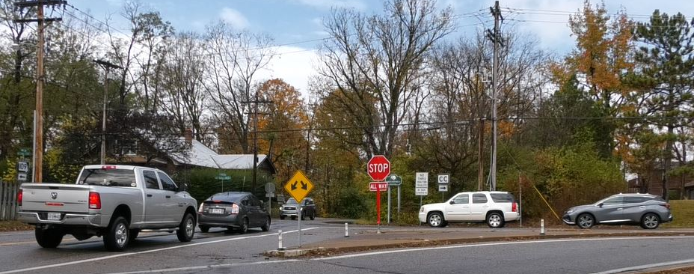
What is the purpose of this project?

Slide 3
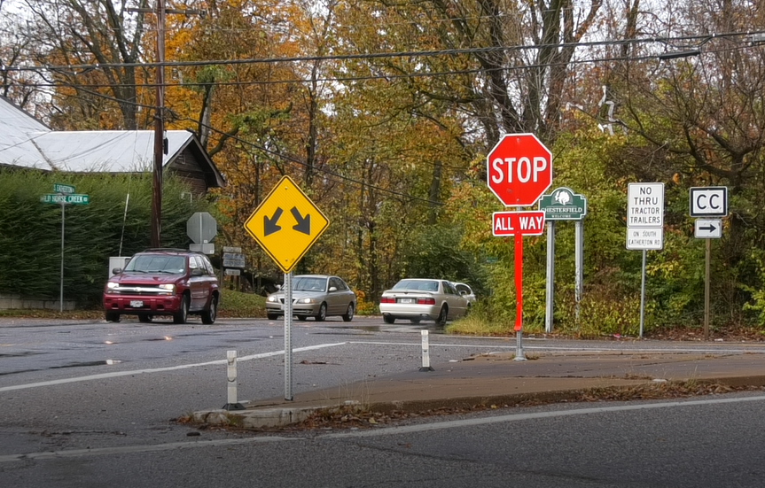
Main Goal: Reduce Congestion
This roadway is congested and that congestion is expected to increase in the future. After studying the area, the department determined that the best solution would be a two-lane roundabout. Would reduce backups and improve traffic movement in the area.

Slide 4
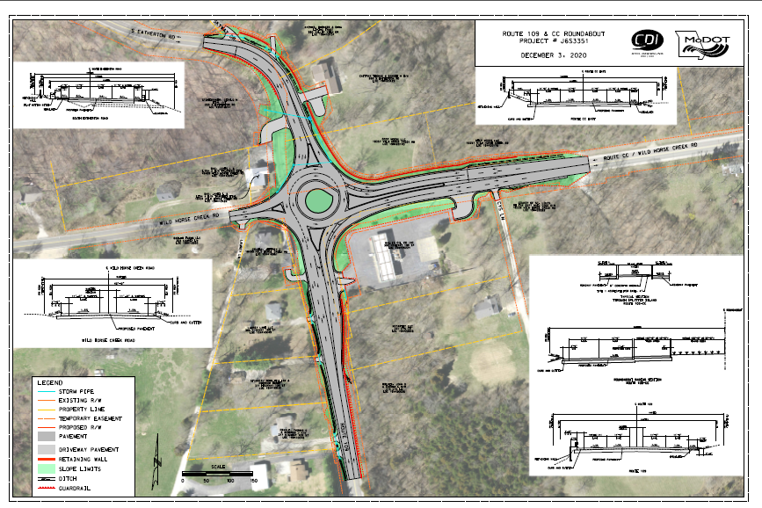

Slide 5

If you have questions, please share them in Q&A

Slide 6
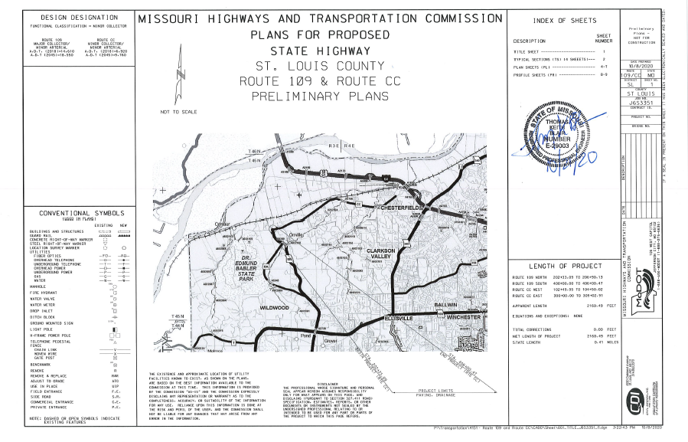
If you have questions, please share them in Q&A
.

Slide 7
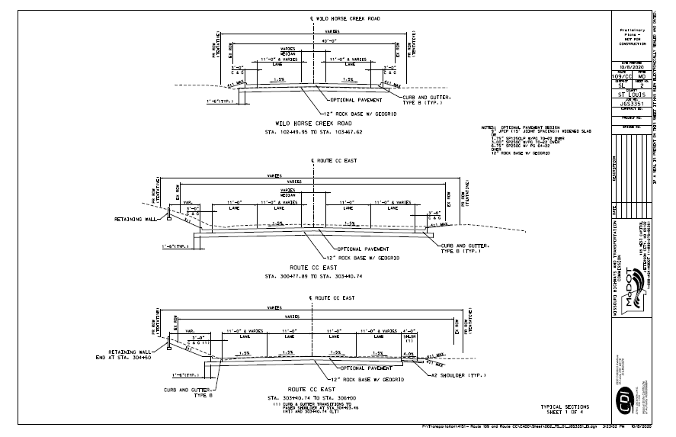
If you have questions, please share them in Q&A
.

Slide 8
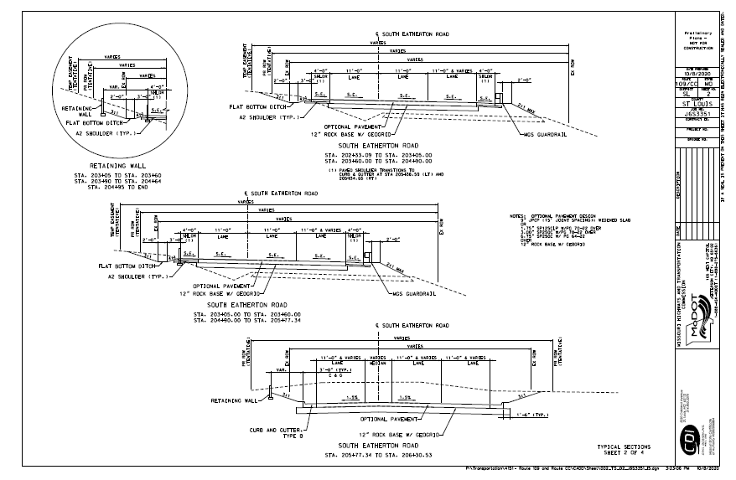
If you have questions, please share them in Q&A
.

Slide 9
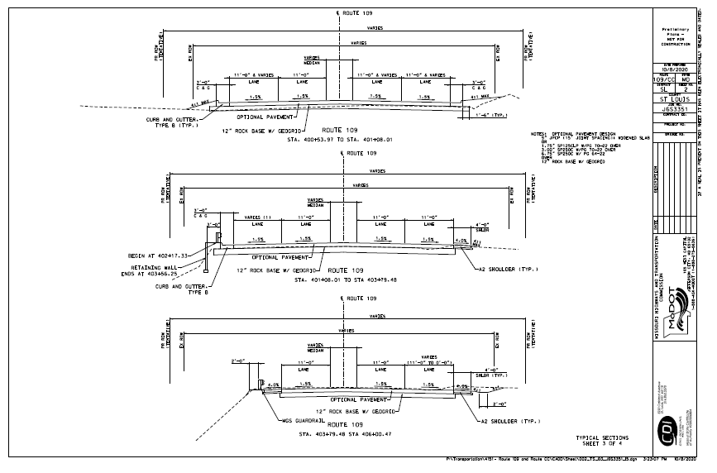
If you have questions, please share them in Q&A
.

Slide 10
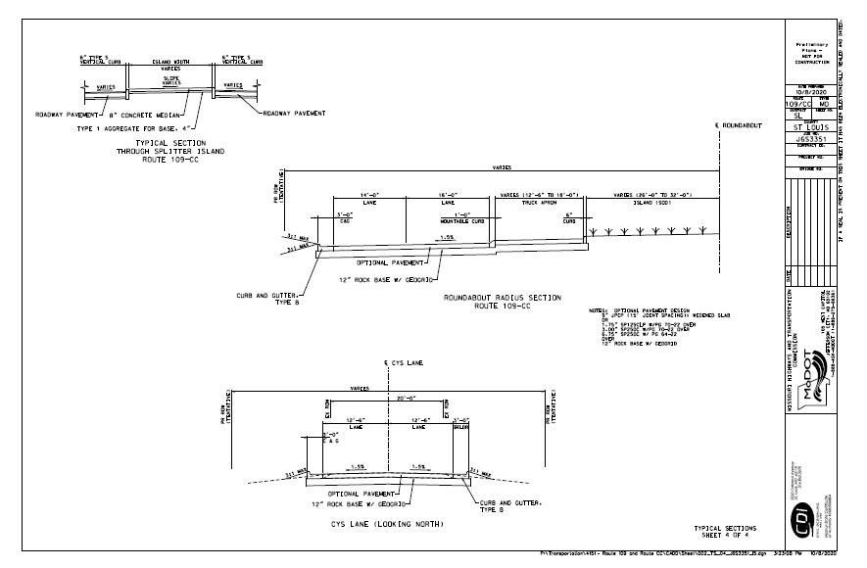
If you have questions, please share them in Q&A
.

Slide 11
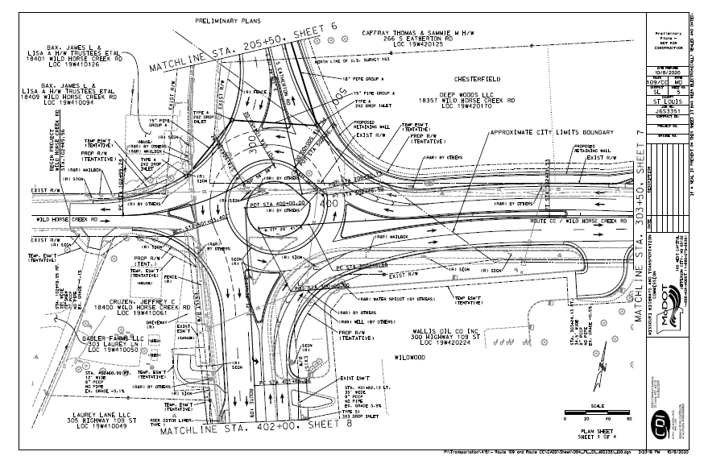
If you have questions, please share them in Q&A
.

Slide 12
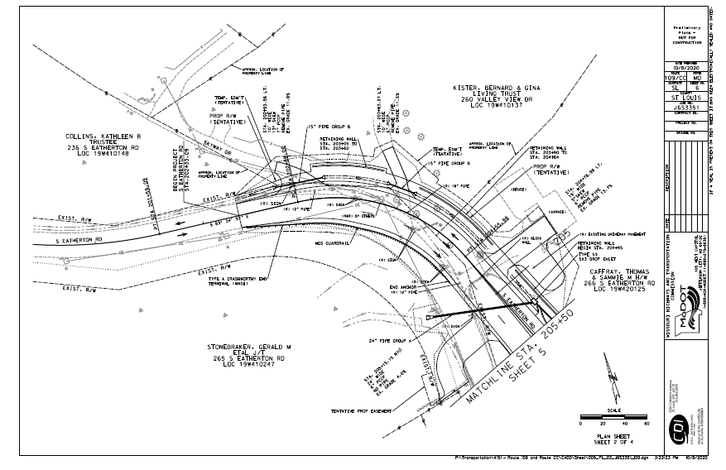
If you have questions, please share them in Q&A
.

Slide 13
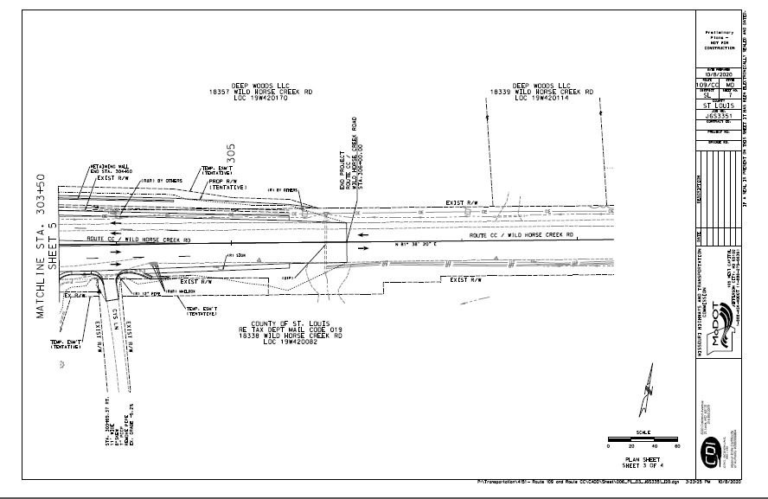
If you have questions, please share them in Q&A
.

Slide 14
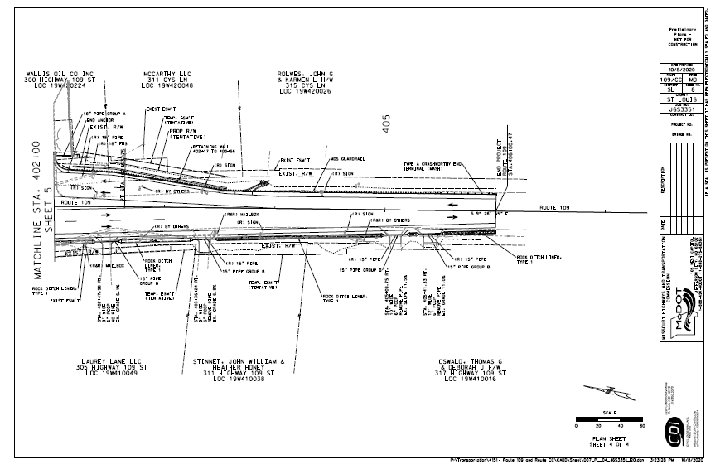
If you have questions, please share them in Q&A

Slide 15
What are the anticipated impacts?
Although construction details have not been finalized at this shifted traffic during construction as they build the roundabout. At this time, we anticipate beginning construction in fall 2022, with it completing sometime in the summer of 2023.
MoDOT will work with business owners and residents to ensure that access is available during construction.

Slide 16
What is the anticipated timeline?
Task | Completion
Conceptual plan | Completed
Evaluation and preliminary design | Completed
Public hearing | December 3, 2020
Right of way negotiations | Summer 2021
Construction begins | Fall 2022

Slide 17

How can I submit my comment? Contacts?
Please submit all comments before:
December 17 at 4 p.m.
You can fill out a comment form here:
https://www.surveymonkey.com/r/Route109CC
Contact the design lead via email:
Thomas.Montes-De-Oca@modot.mo.gov
Or by phone: 314-453-5031

Slide 18

THANK YOU FOR ATTENDING

