Slide 1

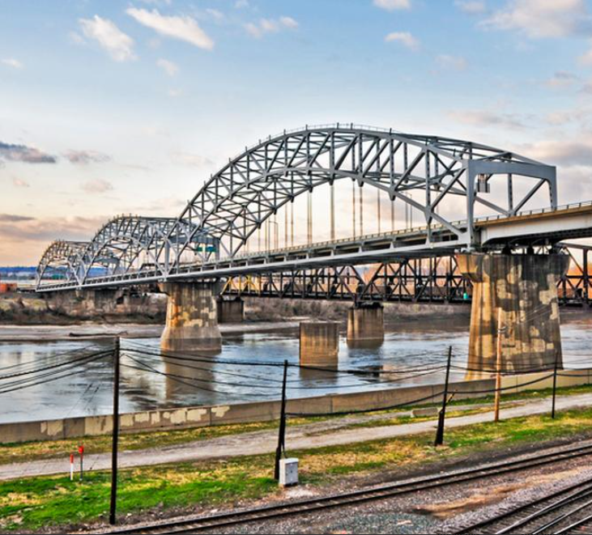

Buck O’Neil Bridge Design-Build Project
Industry Meeting
7/21/2020

Slide 2

MoDOT Design-Build Team
Mary Miller
Project Director
Matthew Daulton
Deputy Project Director
Karlee Bauknecht
Project Team Coordinator
Jordan Swing
Project Team Coordinator

Slide 3
Today’s Agenda
Project Overview
Project Goals
Procurement Schedule
Project Budget
Request for Qualifications
Early Release Information
Risk Allocation
DBE and Workforce goals
Draft ITP
Draft Configuration Requirements
TRANSMISSION
OUTAGES

Slide 4
Project Overview
Partnership between MoDOT and KCMO
Project Corridor
  Cleared footprint
EA/FONSI approved 5/15/20
Conceptual AJR approved 6/16/20
TRANSMISSION
OUTAGES

Slide 5
Project Overview
Purpose:
To facilitate the safe movement of people and goods along US-169 while improving mobility, connectivity, and accessibility across the Missouri River.
Needs:
Maintain infrastructure – address the physical condition of the historic Buck O’Neil Bridge
Maintain a reliable regional transportation linkage across the Missouri River that services local and regional traffic and minimizes local traffic conflicts
Improve the operational and safety performance of the Missouri River crossing for all transportation
TRANSMISSION
OUTAGES

Slide 6
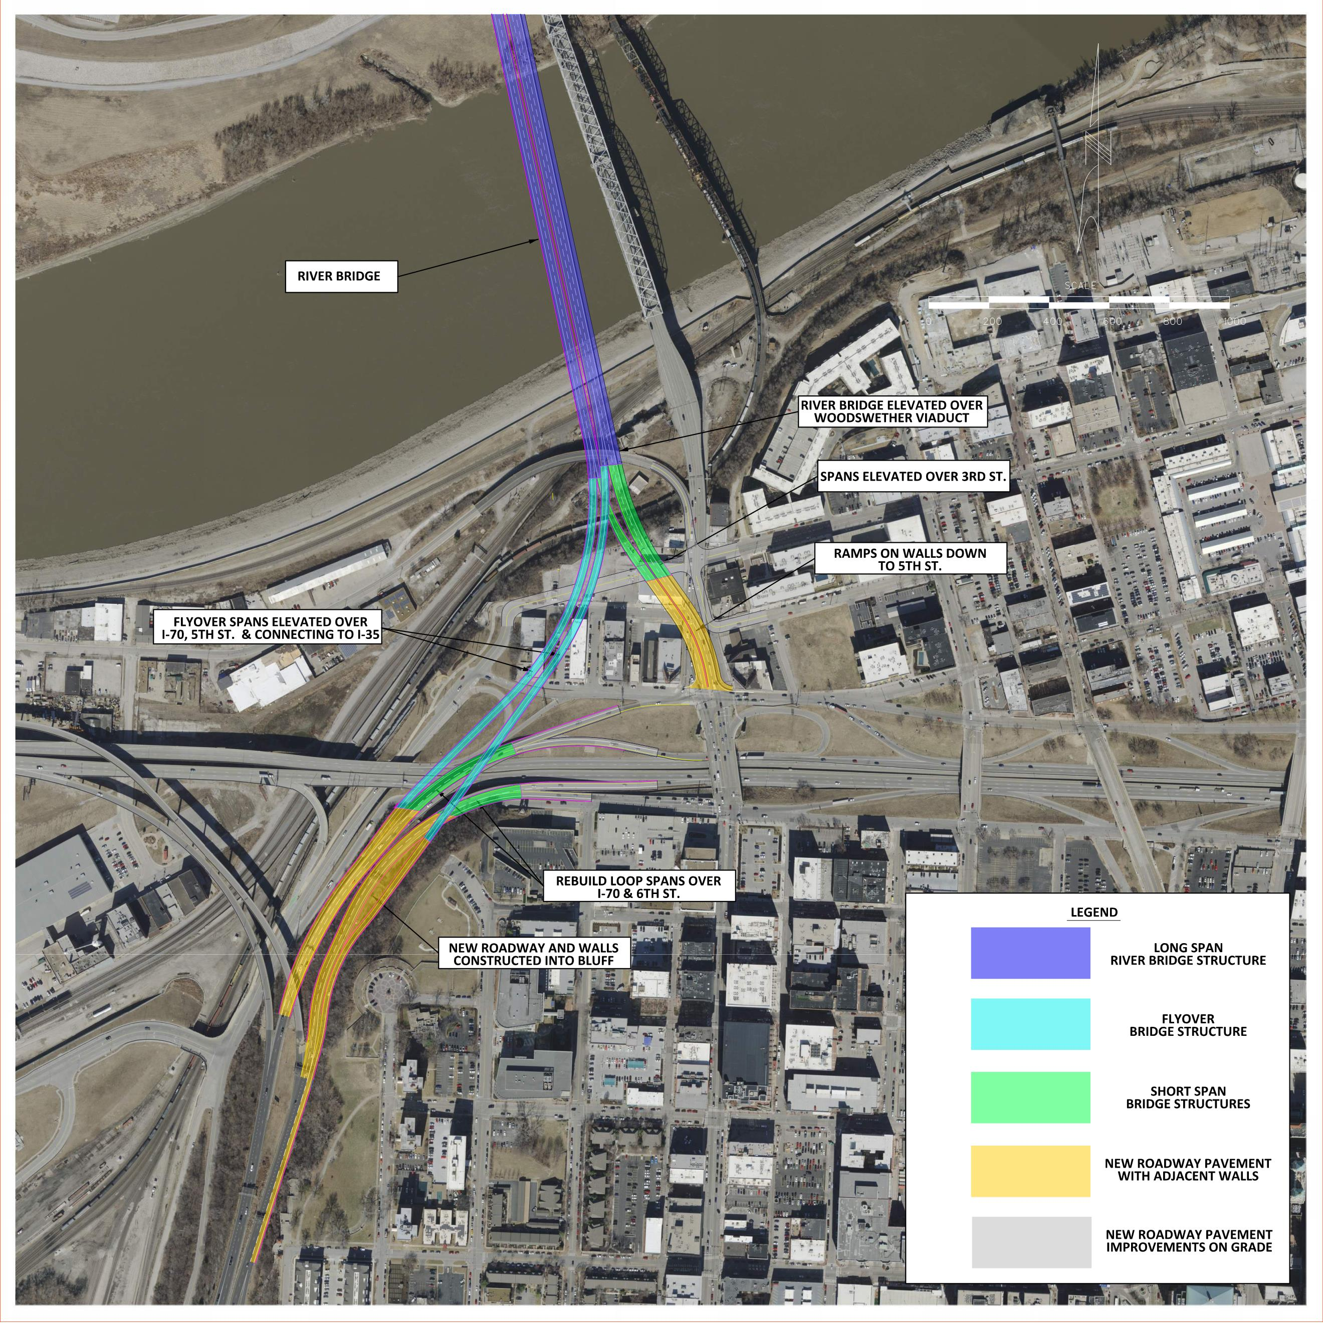
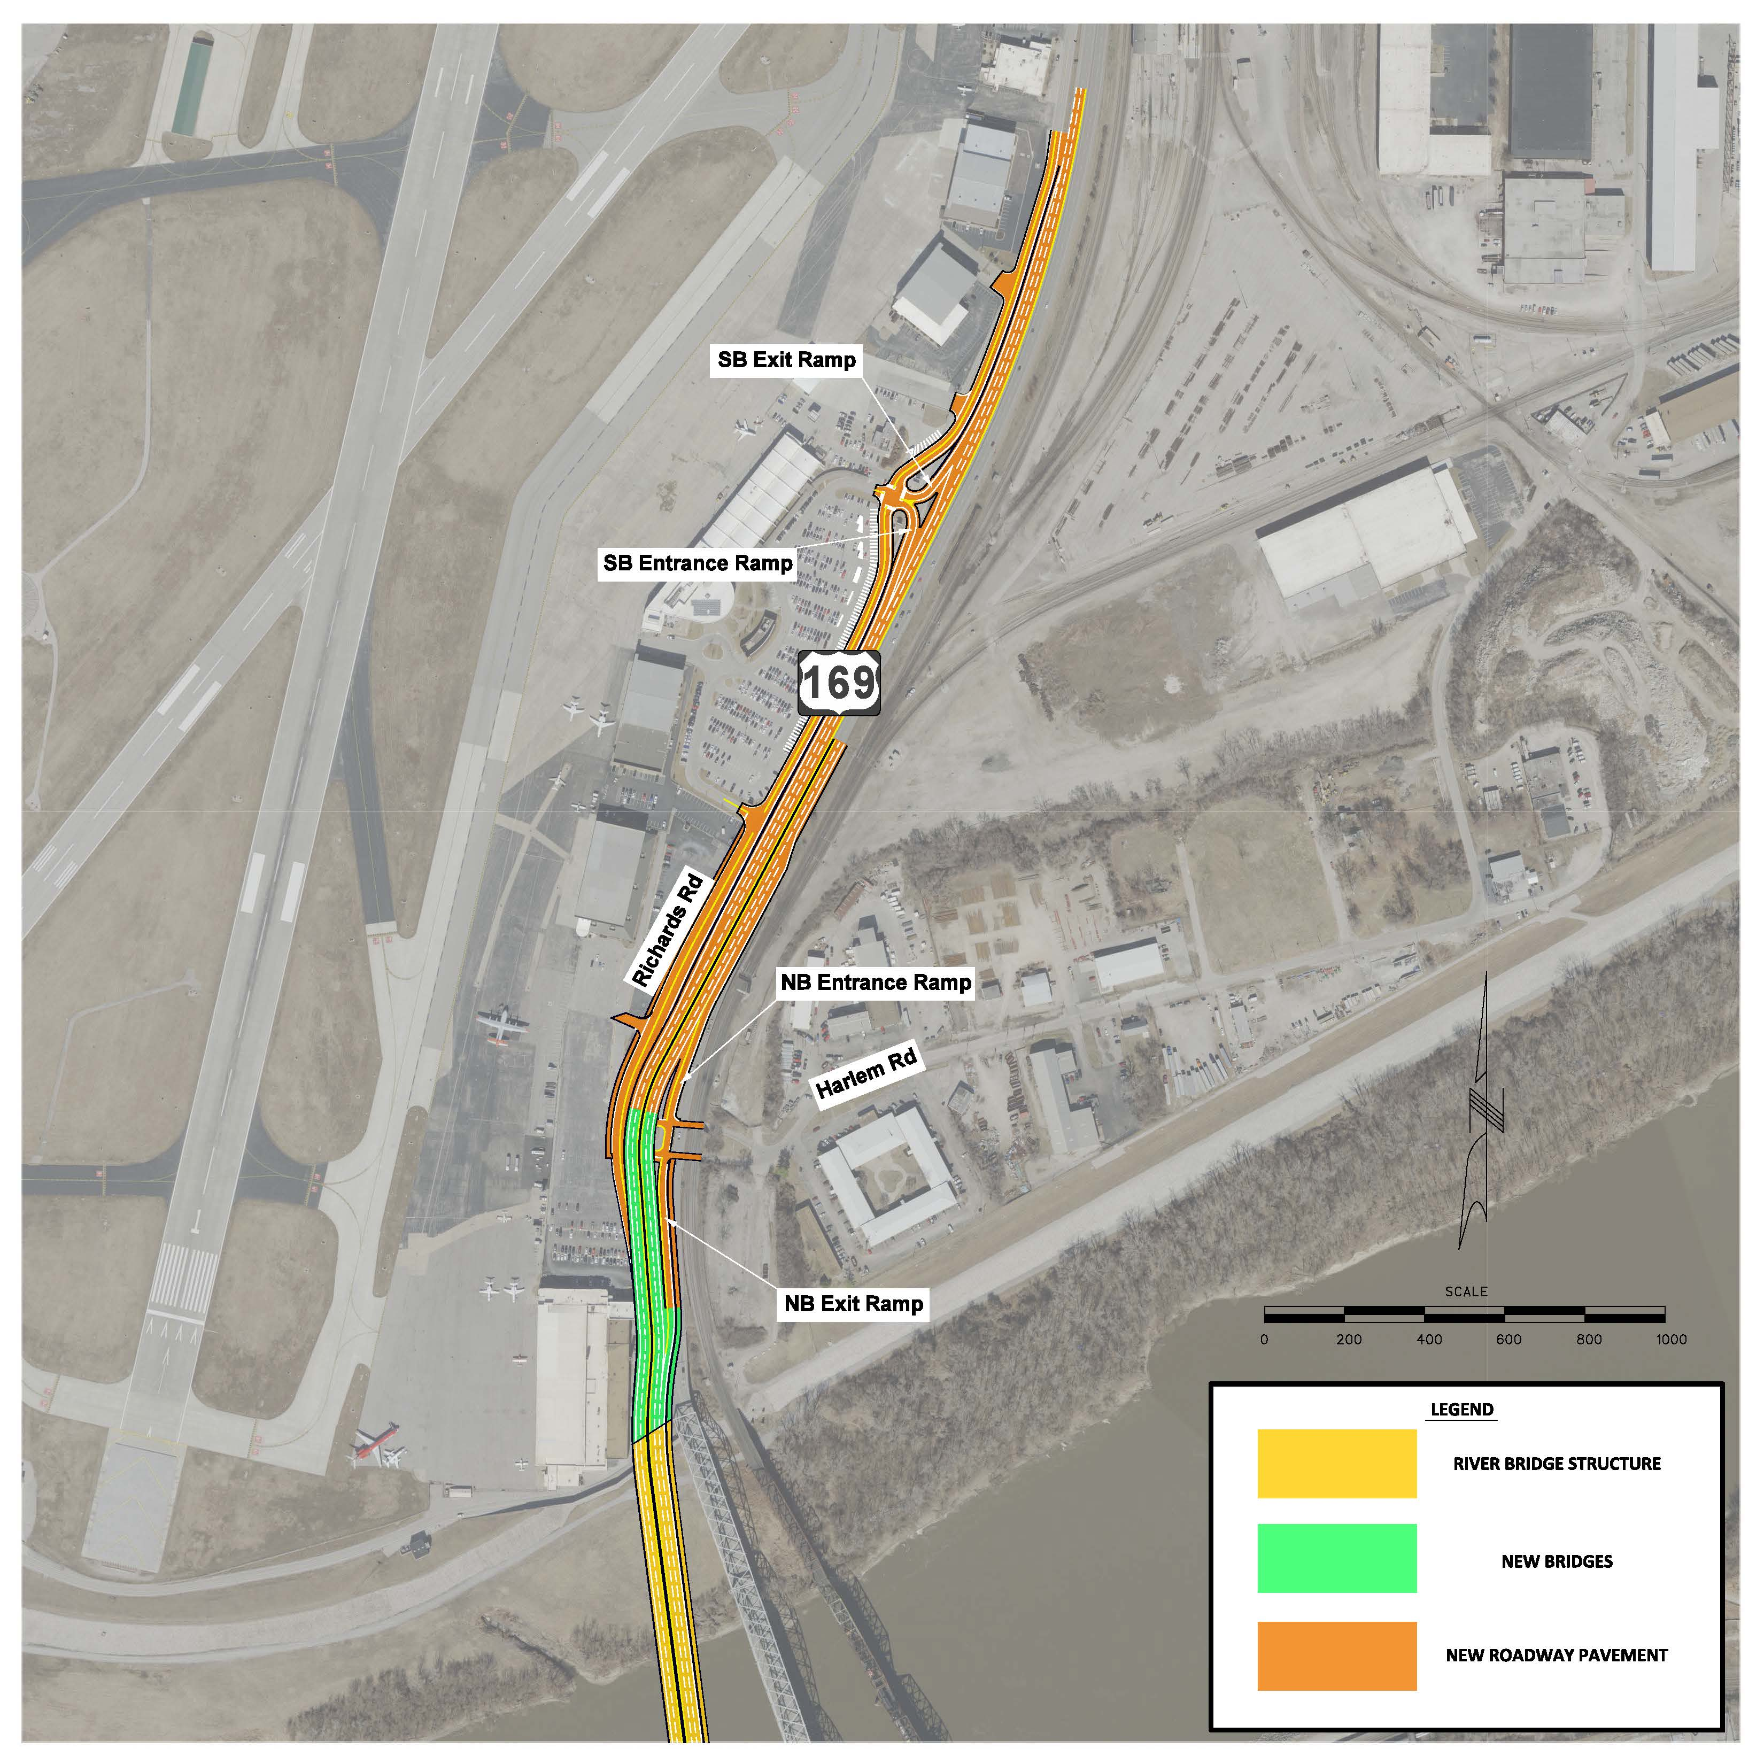
Project
Overview
TRANSMISSION
OUTAGES

Slide 7
Project Goals
Construct an innovative, low-maintenance Missouri River Bridge that will provide a century of service within the program budget of $247.5 million.
Provide a safe, connective and accessible transportation facility that improves regional and local system performance.
Manage the impact to the traveling public during construction.
Complete the project by December 1, 2024, utilizing a diverse workforce.
TRANSMISSION
OUTAGES

Slide 8
Anticipated Project Schedule
Milestone | Date
Issue RFQ/Industry Meeting | July 21,2020
Deadline for submitting RFQ questions | July 30, 2020
Final response to questions posted & Final RFQ addendum issued | July 31, 2020
SOQ Due | August 4, 2020
Oral Presentations | August 10-11, 2020
MoDOT notifies shortlisted submitters | August 17, 2020
Issue RFP | August 31, 2020
Final proposal and Price Allocation due | December 14, 2020
Selection of Apparent Best Value | February 2021
TRANSMISSION
OUTAGES

Slide 9
Project Budget
Project costs shared 50/50 between MoDOT and KCMO
Project was awarded a $25 million BUILD Grant
Total Program Budget is $247.5 million
Anticipated Design-Build Budget is $220 million
  Estimated cost for R/W, Utilities, Stipends and Incidentals is $25 to $30 million
TRANSMISSION
OUTAGES

Slide 10
RFQ – Statement of Qualifications
Submitter Experience (100 points)
  Relevant Recent Experience
  Quality and Safety
  DBE and Workforce
Key Personnel (100 points)
  Project Manager
  Quality Manager
  Design Manager
  Construction Manager
Oral Presentations (50 points)
TRANSMISSION
OUTAGES

Slide 11
RFQ – Oral Presentations
August 10th and 11th (Virtual)
Only Key Personnel allowed to participate
Maximum 75 minutes in length
Virtual interviews will be scheduled upon submittal of SOQ’s
Meeting invitations will be sent to Key Personnel via provided email address
Interview questions will be provided to Project Manager
TRANSMISSION
OUTAGES

Slide 12



RFQ – Ineligible Firms
The following firms are serving as MoDOT’s owner representatives and are ineligible to compete.
  Burns & McDonnell (Owner-Engineer)
  TREKK Design Group, LLC
  Geotechnology, Inc.
TRANSMISSION
OUTAGES

Slide 13
Early Release Information
Early release:
  As-Built plans
  Geotechnical data
  CADD files
  Environmental Commitments
  AJR
  Vissim files
  Hydraulics
For access, send a e-mail to: BuckONeilBridge@modot.mo.gov
TRANSMISSION
OUTAGES

Slide 14
Risk Allocation
MoDOT is proactively working on these risk areas:
Regulatory Permitting
  Corps of Engineers
  Coast Guard
Railroads
  BNSF, UP, KC southern, KC terminal
Utilities
FAA
ROW
TRANSMISSION
OUTAGES

Slide 15
DBE and Workforce Goals
DBE Goals
  14% for Construction Activities
  18% for Professional/Design Activities
Federal workforce goals apply to project
  12.7% minority
  6.9% female
  Goals apply per craft
  6 Construction Trainees and 1 Design Trainee at 1000 hours each - On-The-Job training Requirement
DBE firms must be certified with the Missouri Regional Certification Committee (MRCC) modot.mo.gov/business/contractor resources/External Civil Rights/DBE program.htm
TRANSMISSION
OUTAGES

Slide 16
Draft ITP
Scoring Categories (subject to change)
Project Definition (65 Points)
  Missouri River Bridge(s)
  System Performance
  Other Structures
  Urban Design
Safety (20 points)
  Geometrics
  Construction
  Pedestrians
Maintenance of Traffic and Schedule (15 points)
TRANSMISSION
OUTAGES

Slide 17
Draft Configuration Requirements
The Project configuration requirements are as follows:
Remove and replace the US 169 Buck O’Neil Bridge with a new wider four (4) lane bridge.
Provide a direct connection from US 169 to I-35 and approaching roadway(s) for local connectivity.
Maintain or improve existing access to the Interstate System.
The Contractor shall provide separate bike/pedestrian facilities on the new Missouri River Bridge to connect Richards Road to the local system and the Riverfront Heritage Trail.
Through the duration of the project and through all phases, access to all occupied properties must be maintained at all times.
The Contractor must perform bridge rehabilitation on Bridge A1128 according to the Bridge Rehabilitation Checklist in Book 4.
All Work is to be constructed within the Right of Way shown in Book 4, except for additional Right of Way or Permanent Easements as allowed in Book 2 Section 8.
TRANSMISSION
OUTAGES

Slide 18
TRANSMISSION
Mary Miller, P.E.
Buck O’Neil Bridge Project Director
(816) 607-2030
Missouri Department of Transportation
600 NE Colbern Rd.
Lee’s Summit, MO 64086
BuckONeilBridge@modot.mo.gov
ES

Slide 19
Buck O’Neil Bridge Design-Build Project
Industry Meeting
7/21/2020

